Slide 1


PROJECTS PERFORMANCE ANALYSIS OVERVIEW REPORT
PREPARED FOR
ALCHEMY GLOBAL SOLUTIONS
PREPARED BY
OMAR ABOULWAFA

Slide 2
EXECUTIVE SUMMARY
INTRODUCTION AND METHODOLOGY
This report analyzes the current set of ‘capital projects’ and ‘Operational projects’ focusing on schedule and budget performance. The primary objective is to Define a set of KPIs to measure the success of each project set.
METHODOLOGY
According to the Project Management Institute (PMI) methodology, numerous Key Performance Indicators (KPIs) can be employed to evaluate the success of a project. These KPIs span various aspects of project management, including scope, quality, risk, stakeholder satisfaction, and more. However, for our current evaluation of capital projects, we will focus primarily on two critical KPIs: Schedule Variance, Budget Variance, and Progress Tracking depending on data availability.

Slide 3
TERMINOLOGY
PROJECT_STATUS - Based on PSVI: Description of the project status.
PROJECT_STAGE: Current stage of the project.
Schedule_Variance: Difference between planned and actual schedule.
Original_Project_Duration: Planned duration of the project.
PSVI: Performance Schedule Variance Index.
APPROVED_BUDGET: Approved budget for the project.
PROJECT_TOTAL_ACTUAL: Total actual expenditure on the project.
NEXT_CUM_PLAN_PROGRESS: Cumulative planned progress.
ACTUAL_COST_MONTH: Actual cost for the current month.
POTENTIAL_CUM_VOS_COST: Potential cumulative variance of scope cost.

Slide 4
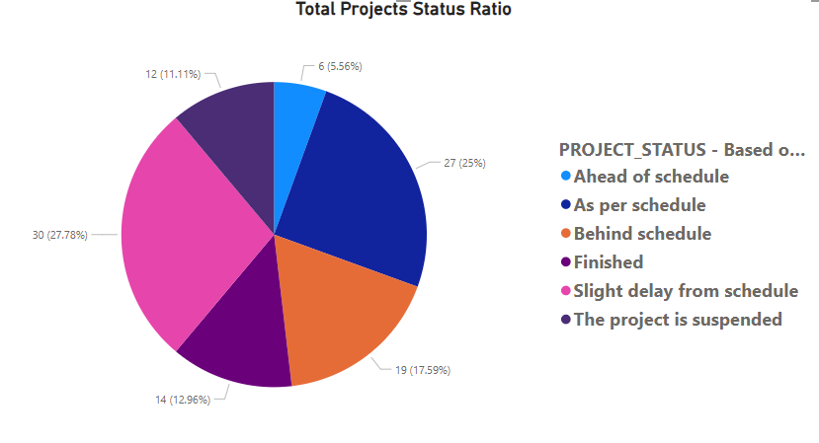
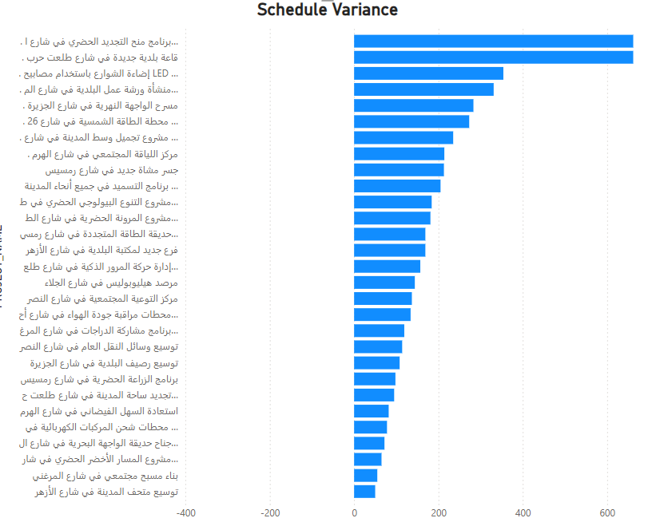
Capital Projects
The pie chart illustrates the distribution of projects based on their current status in relation to the schedule. Here’s a breakdown of each status category and its significance:
Ahead of Schedule (5.56% - 6 Projects)
As Per Schedule (25% - 27 Projects)
Behind Schedule (17.59% - 19 Projects)
Finished (11.11% - 12 Projects)
Slight Delay from Schedule (27.78% - 30 Projects)
The Project is Suspended (12.96% - 14 Projects)
This analysis of the project status ratio highlights key areas for attention and improvement. While a good number of projects are on track or ahead of schedule, the presence of delays and suspended projects necessitates focused management efforts to ensure successful project delivery.

Slide 5
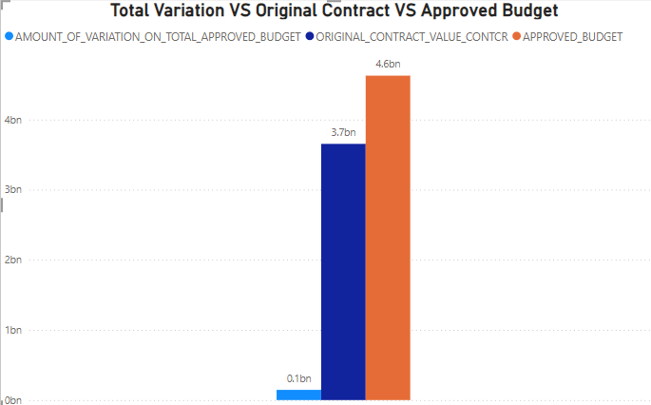
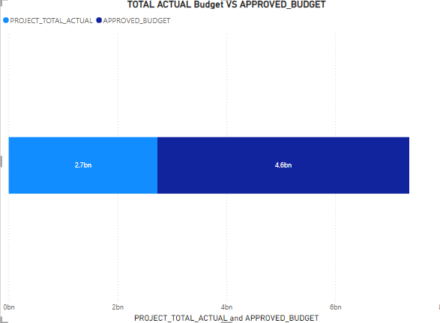
The original contract value is set at 3.7 billion, which serves as the baseline for financial commitments associated with the projects.
The approved budget is higher than the original contract value, totaling 4.6 billion. This indicates that adjustments have been made, perhaps to accommodate scope changes, unforeseen costs, or additional resource requirements.
The amount of variation from the total approved budget is relatively small, at 0.1 billion. This shows a minimal variance between the planned and actual budgetary allocations.
The small variation from the approved budget suggests that projects are generally being managed within their financial constraints. This is a positive indicator of fiscal discipline and effective cost control.

Slide 6
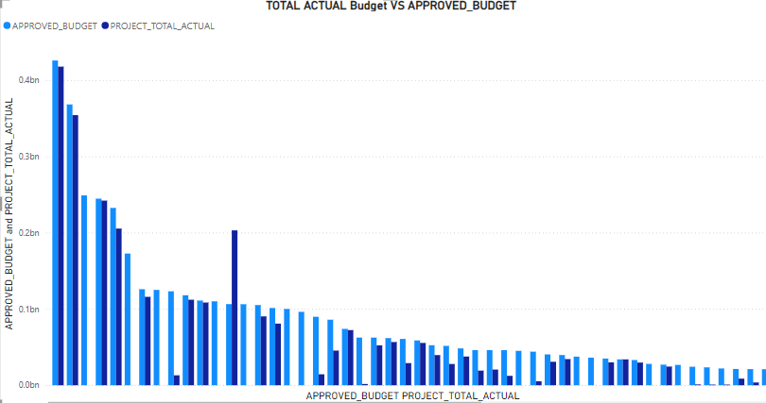
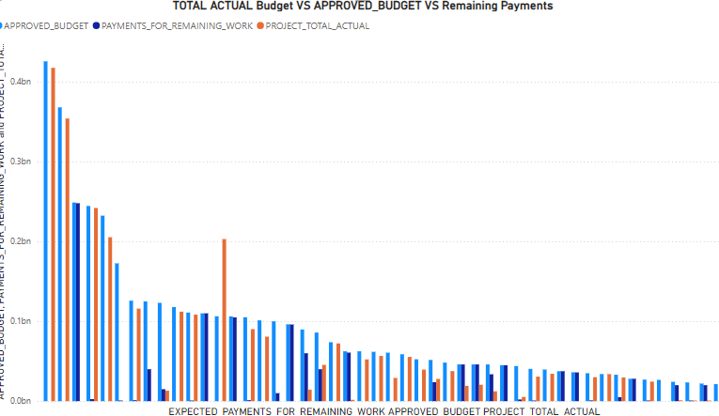
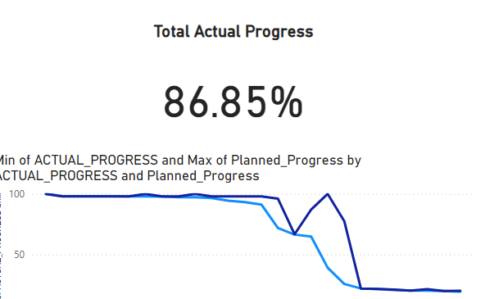
Projects with issues
Totally one project over budget by(190.8893%)
8 projects expect to break their approved budget by (110%)

Slide 7
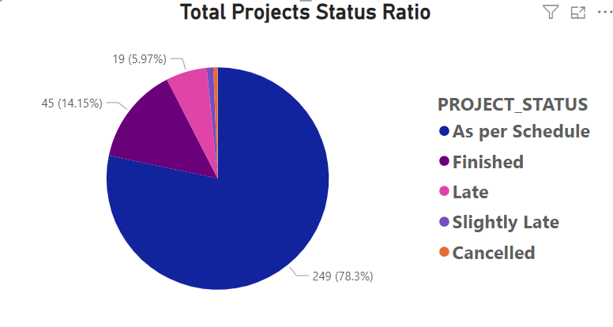
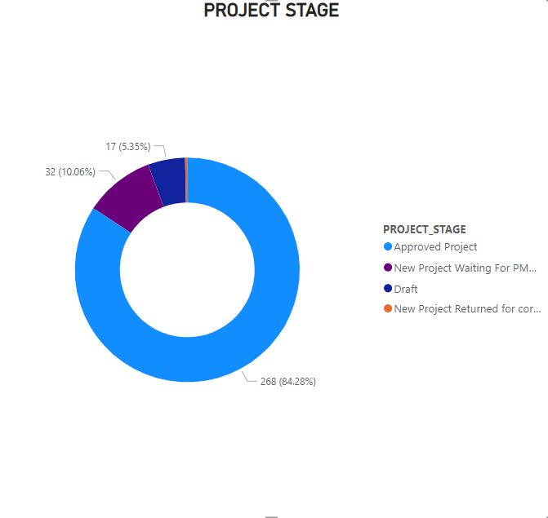
Operational Projects
The pie chart illustrates the distribution of projects based on their current status in relation to the schedule. Here’s a breakdown of each status category and its significance:
As Per Schedule (78.3% - 249 Projects)
Late (5.97% - 19 Projects)
Finished (14.15% - 45 Projects)
Slight Late from Schedule (0.94% - 3 Projects)
The Project is Canceled (0.63% - 2 Projects)
The majority of projects (84.28%) are in the "Approved Project" stage
New Project Waiting (10.06%)
Draft Stage( 5.35% )
Returned Projects (0.31%)
The absence of data for "New Project Returned for correction" might indicate a low occurrence or a decision to exclude it from the analysis.
The high percentage of "Approved Projects" suggests efficient project initiation and approval processes.
Analyzing the reasons for projects in the "New Project Waiting For PM..." and "Draft" stages could identify potential bottlenecks or areas for improvement.

Slide 8
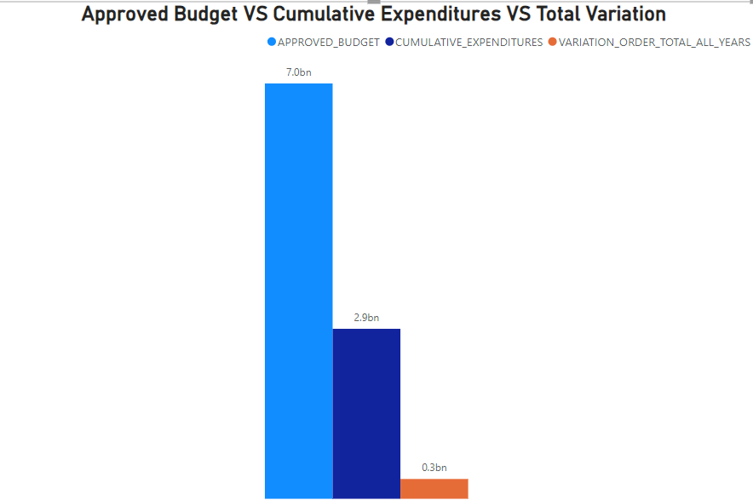
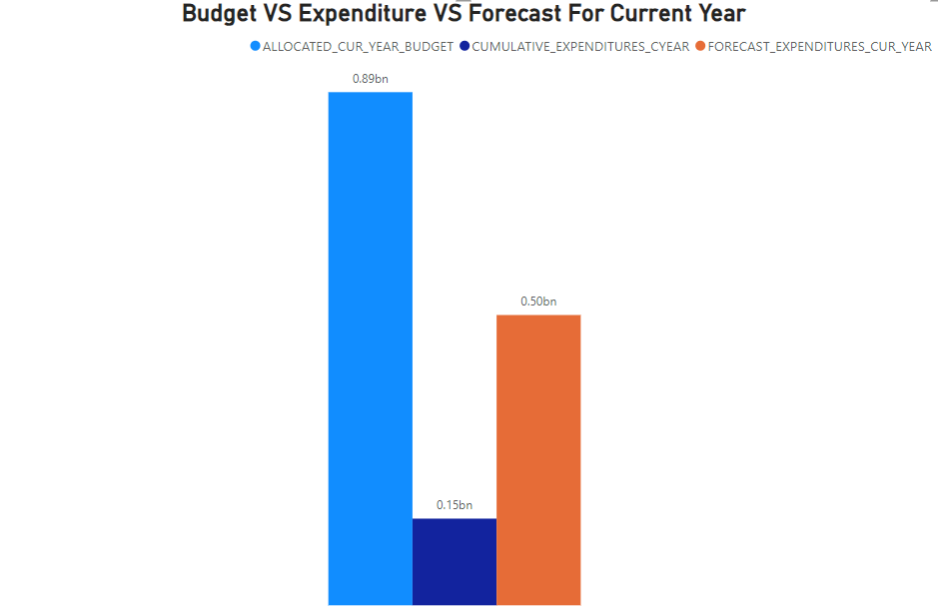
The bar chart compares the approved budget, cumulative expenditures, and total variation for a specific project or initiative.
The substantial difference between the approved budget and cumulative expenditures indicates a significant budget surplus.
The relatively small total variation compared to the approved budget might suggest potential underperformance or underspending.
Further Investigation Needed:
To understand the reasons behind the budget surplus and potential underperformance, additional information is required, such as:
Project scope and objectives
Factors affecting expenditures

