Slide 1

Sentiment Analysis Model For Multilingual Texts
Retaj Melhem
Laith Al-Daoud
Ghaith Aldiabat
Omar Al-Najjar

Slide 2

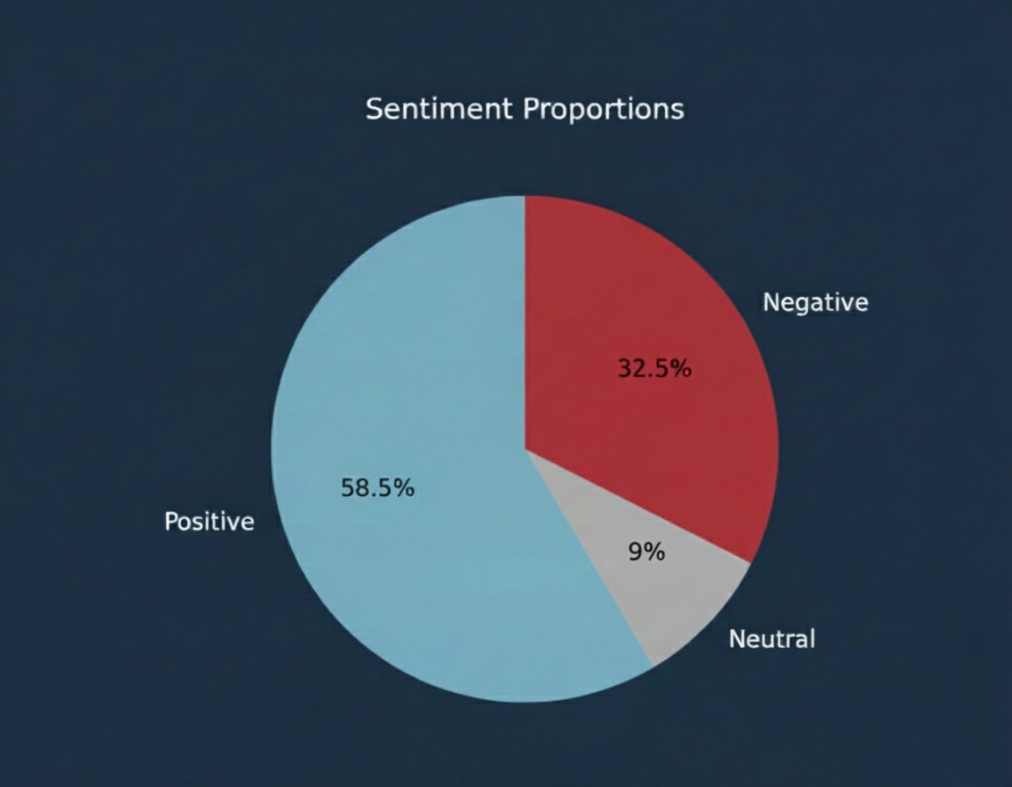
Dataset Overview & Visualization
4 datasets were chosen and integrated:
Class distribution visualization:
330k Arabic Sentiment Reviews
Source: Kaggle
Language: Arabic
Size: 330k reviews
Arabic Company Reviews
Source: Kaggle
Language: Arabic
Size: 40k reviews
Arabic 100k Reviews
Source: Kaggle
Language: Arabic
Size: 100k reviews
Yelp Reviews Dataset
Source: Kaggle
Language: English
Size: ~7 million reviews

Slide 3
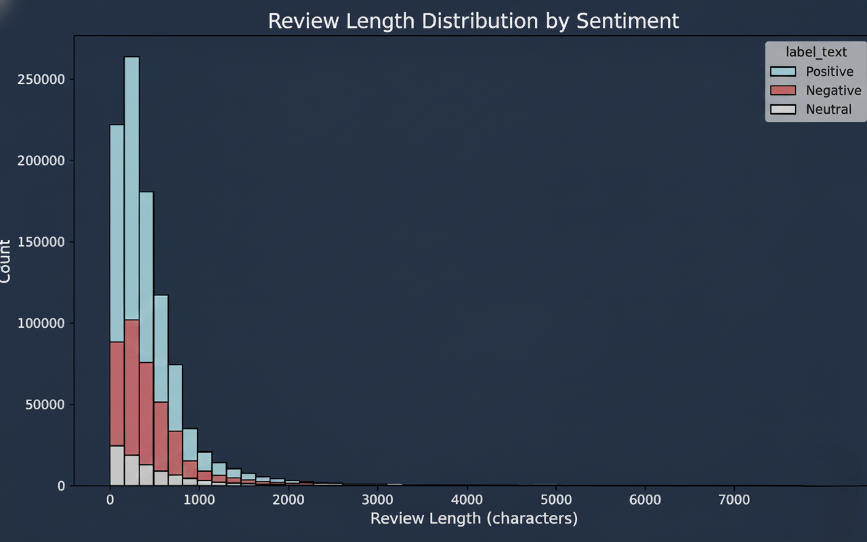
EDA
Main Insights from EDA:
Class imbalance is observed among positive, negative, and neutral reviews.
Positive class dominates the dataset.
Class distribution:
  Positive: 58.5%
  Negative: 32.5%
  Neutral: 9%
English texts dominates on Arabic texts.

Slide 4



Methodology
Cleaning:
Sampling:
Models:
Lowercasing
Punctuation removal
Extra spaces removal
Stop words removal
Stemming
Lemmatization
25k samples of each label for each language was used, 50k positive, 50k neutral, 50k negative, for a total of 150k samples.
GigaBERT
Multilingual BERT (mBERT)
XLM-RoBERTa (XLM-R)
MARBERT
Data from various sources(four) were collected and integrated into a single dataset.
Then a sampling process was applied across the three classes in both languages(Arabic and English) with general dialects. Finally data cleaning was performed on the resulting dataset.

Slide 5
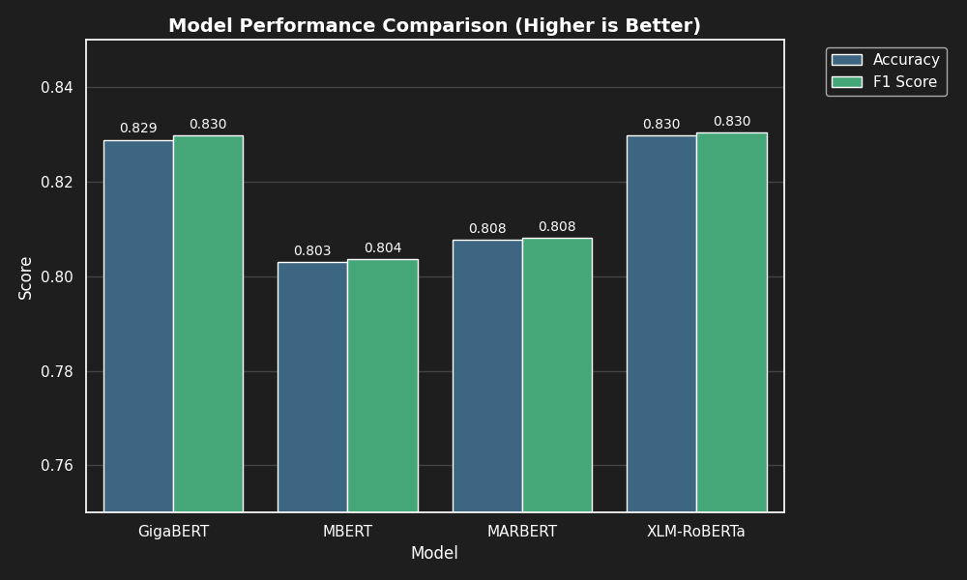
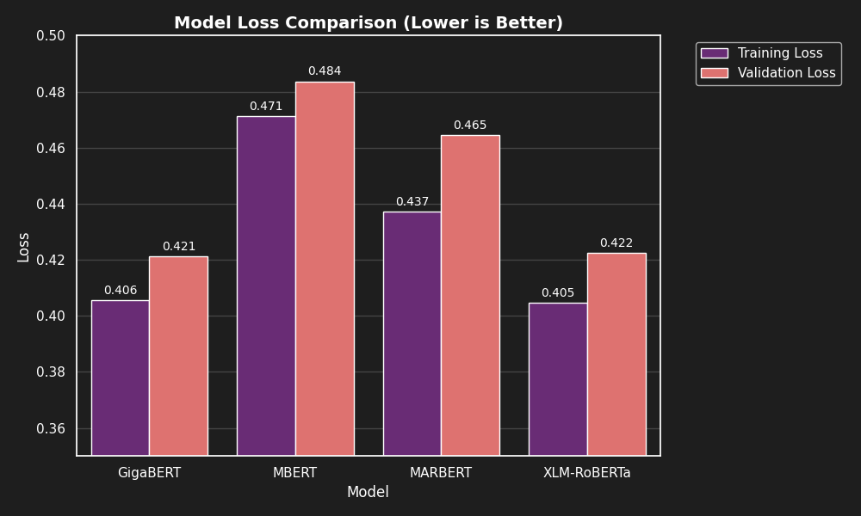
Experiments & Results

Slide 6
Conclusions
Final Findings:
Among all the evaluated models, XLM-Roberta achieved the best performance.
It outperformed the other models by obtaining the highest accuracy on the sentiment analysis task.
This indicates that XLM-Roberta is more effective at capturing sentiment meaning in multilingual data, especially when working with both Arabic and English.
The balanced sampling strategy contributed to fair and reliable model comparison.
Short Conclusion:
XLM-Roberta proved to be the most suitable model for multilingual sentiment analysis, delivering superior accuracy and more robust performance compared to the other tested models.
Reflection: Challenges, Scalability, and Future Work
Challenges: Linguistic diversity and Arabic–English code-switching increased preprocessing complexity, while dataset heterogeneity required careful label standardization.
Scalability: The modular pipeline and LoRA-based fine-tuning support efficient scaling to larger datasets and multilingual settings.
Future Work: Expanding dialect coverage, incorporating aspect-based sentiment analysis, and evaluating real-time deployment.

