Slide 1
News Category Classification
27-class classification with classical ML, fine-tuned RoBERTa, and LLM-generated explanations
Level 4 Data Science • 7-person student team • May 2026

Slide 2
The Problem
What category does this news article belong to?
Multi-class text classification across 27 consolidated categories.
Inputs: short headline + a paragraph-long description.
Output: one category label, with a confidence score and a short human-readable rationale.
Built as the deliverable for an academic Data Science course.
27
categories
consolidated from 42
(see ADR-010)

Slide 3
The Dataset
News Category Dataset v3 on Kaggle (publicly licensed, English news, 2012-2022)
209,527
27
29
35x
articles
categories (after merge)
avg words / article
imbalance ratio
Largest classes: POLITICS_WORLD (41,421) • ENTERTAINMENT (24,841) • HEALTH (13,762) • FAMILY (10,775)
Smallest classes: LATINO VOICES (1,127) • FIFTY (1,401) • GOOD NEWS (1,398)
Mitigation: class_weight='balanced' on every classifier that supports it (ADR-002).

Slide 4
Methodology — End-to-End Pipeline
Six pipeline stages, all reproducible from a single Colab notebook.
1
2
3
4
5
6
Load
Clean
Consolidate
Featurise
Train
Serve
Kaggle
209K rows
lowercase
tokenise
lemmatise
42 to 27
classes
TF-IDF +
RoBERTa
embeddings
6 classical
+ RoBERTa
(fine-tuned)
Gradio +
LLM
explanations

Slide 5
Preprocessing — Five Cleaning Stages
Single source of truth: src/preprocessing.py — same function used at training and inference.
1
Lowercase
All text uniformly cased so TF-IDF treats 'Apple' = 'apple'.
2
Remove noise
Strip URLs, HTML tags, punctuation, digits.
3
Tokenise
NLTK word tokeniser splits text into words.
4
Drop stopwords
NLTK English stopword list removed.
5
Lemmatise
WordNet lemmatiser: noun-form first, then verb-form.
Plus three numeric features per article: word count • character count • punctuation count

Slide 6
Category Consolidation: 42 → 27
Several raw labels are near-duplicates that confuse every classifier. Merging them lifts accuracy by ~10 points.
Before — 42 classes
After — 27 classes
STYLE • STYLE & BEAUTY
ARTS • ARTS & CULTURE • CULTURE & ARTS
WORLDPOST • THE WORLDPOST • POLITICS
WELLNESS • HEALTHY LIVING
TECH • SCIENCE
PARENTS • PARENTING • WOMEN
MONEY • BUSINESS
STYLE
ARTS
POLITICS_WORLD
HEALTH
SCI_TECH
FAMILY
BUSINESS
Result on classical models: accuracy 0.55 → 0.69 | RoBERTa: 0.65 → 0.75 (ADR-010)

Slide 7
Six Classical Models
Each trained with hyper-parameter tuning on the 27-class data. Class weights = 'balanced' where supported.
Logistic Regression
Linear SVM
KNN
GridSearchCV over C ∈ {0.1, 1, 10}
GridSearchCV over C, calibrated probabilities
RandomizedSearchCV over n_neighbors, weights
saga solver, max_iter=300
CalibratedClassifierCV(cv=3)
cosine metric
Decision Tree
Random Forest
AdaBoost
GridSearchCV over max_depth, min_samples_leaf
Tuned on 30K subsample, refit best on full train
GridSearchCV over n_estimators, learning_rate
single estimator
balanced class weights
SAMME algorithm

Slide 8
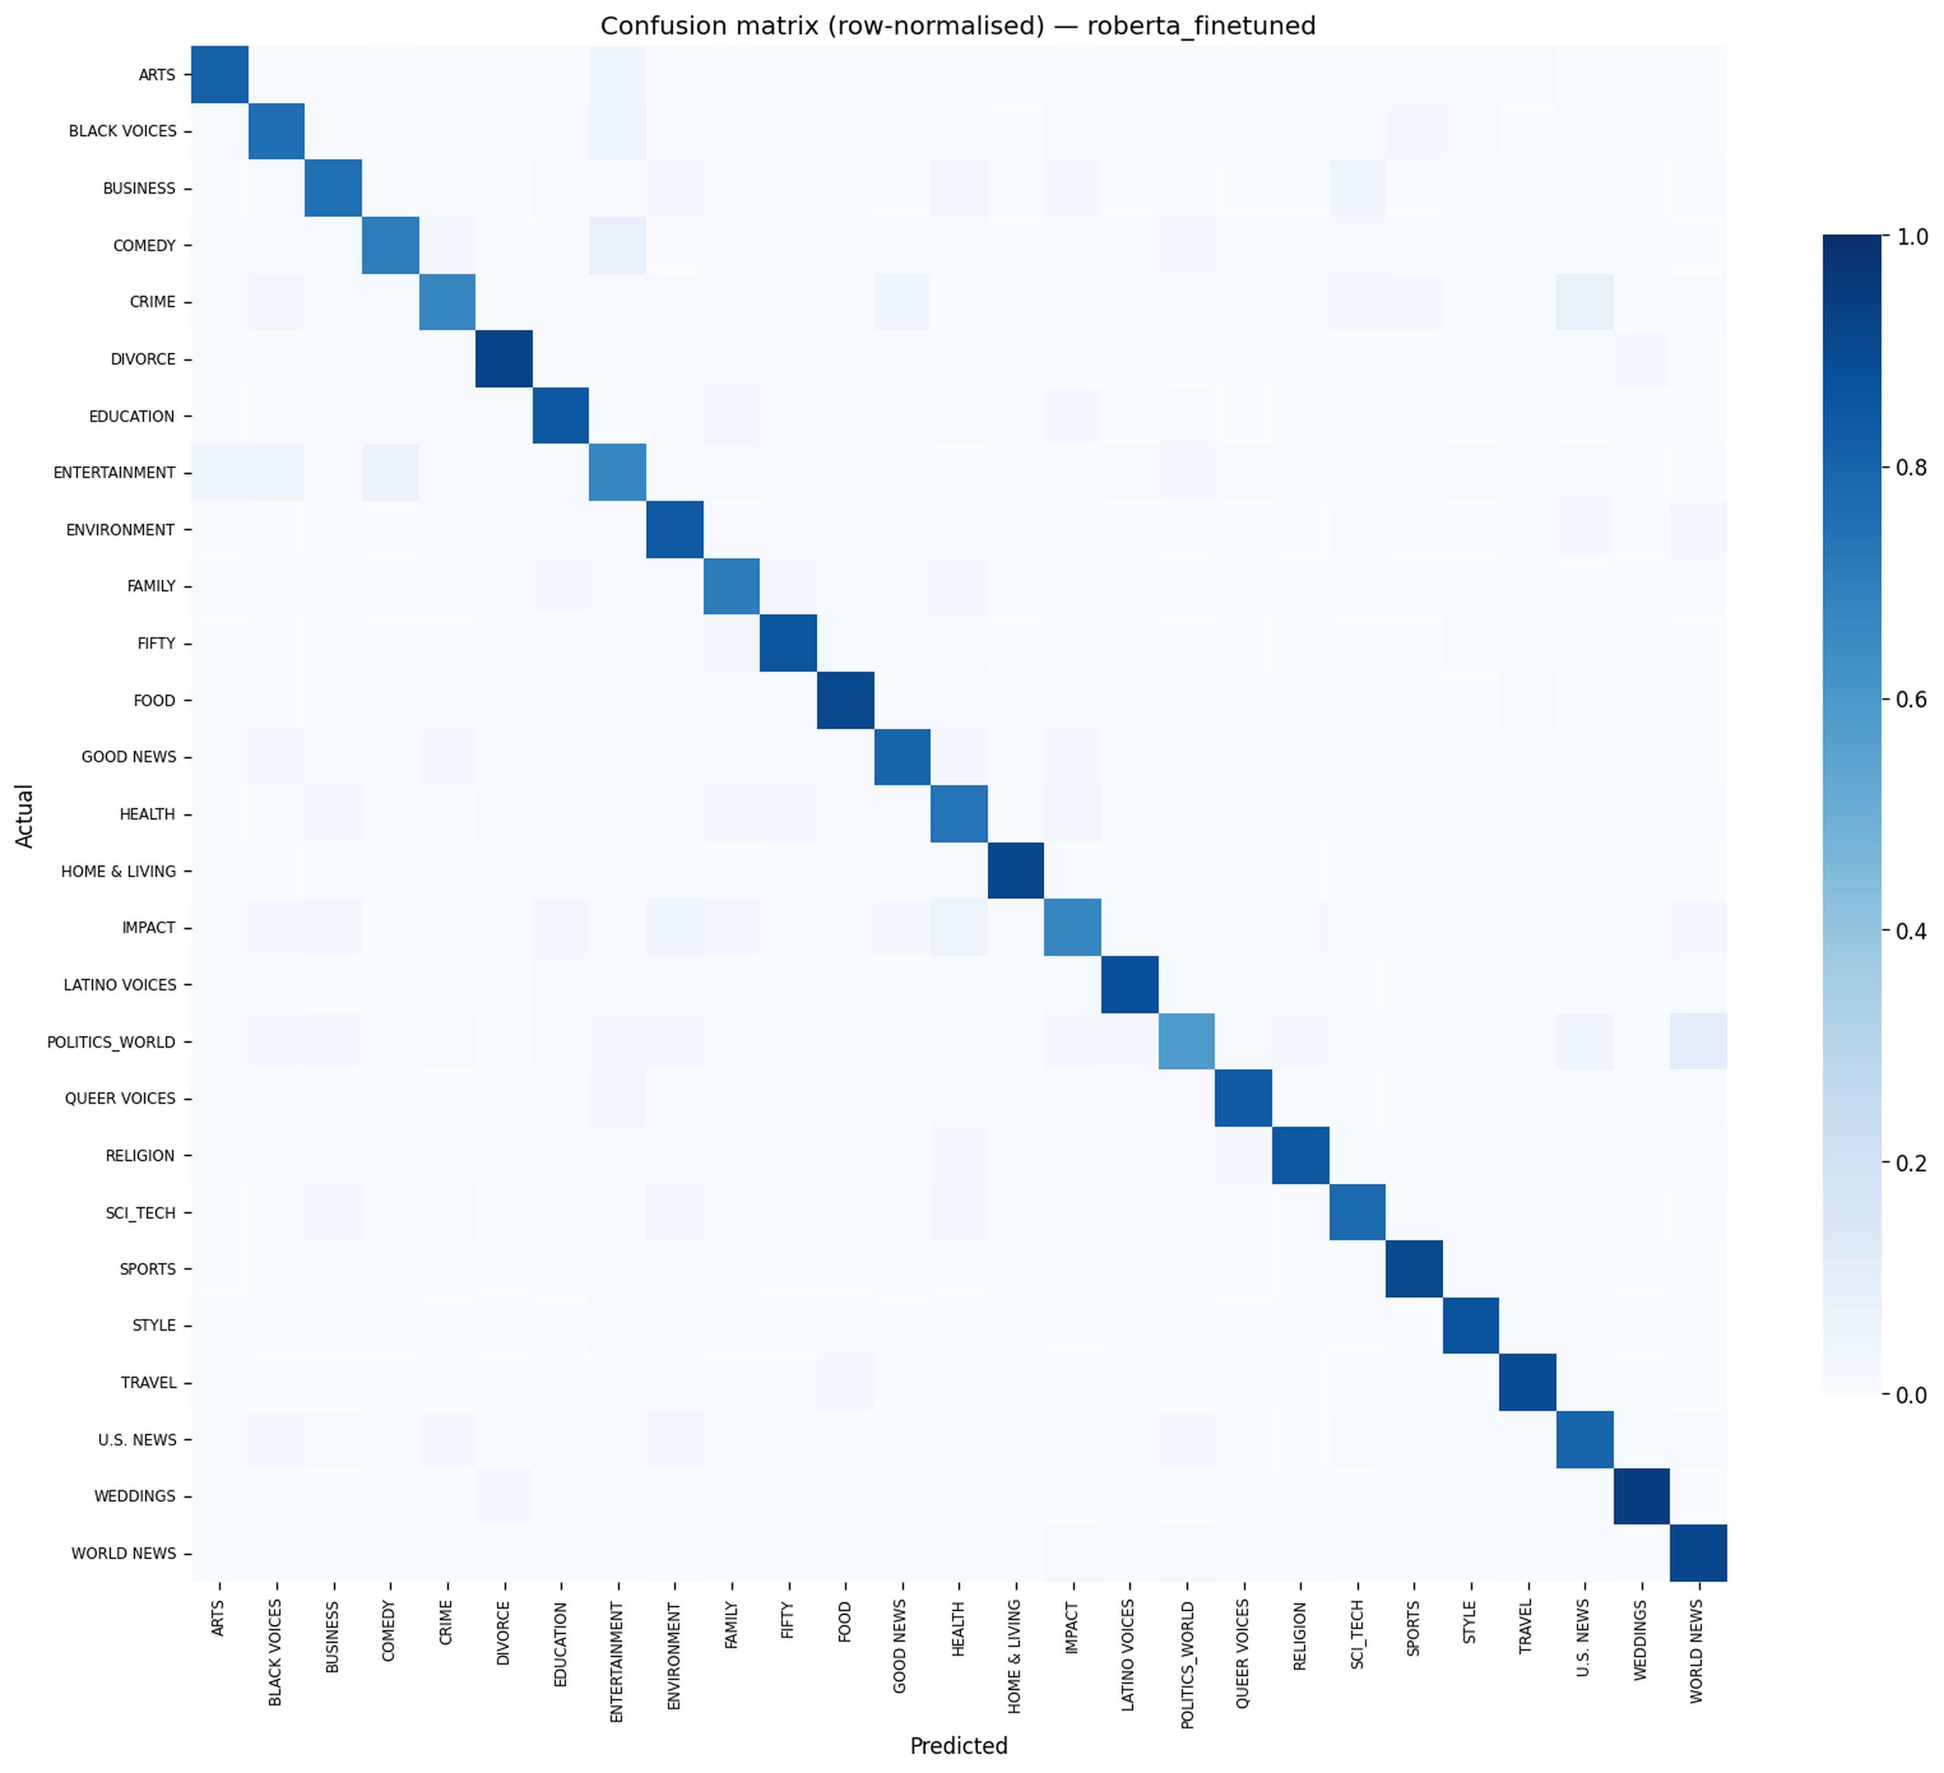
Fine-tuned RoBERTa — Confusion Matrix
RobertaForSequenceClassification, 27-way head, fine-tuned on the consolidated dataset. Hosted on Google Drive (470 MB), downloaded once via gdown, cached locally.
Headline numbers — held-out test set:
accuracy 0.7477 macro-F1 0.7102
weighted-F1 0.7562 ROC-AUC 0.9854
Most-confused class pairs (visible on the matrix):
• POLITICS_WORLD ↔ U.S. NEWS — both label US political news; the original tagging is inconsistent.
• ENTERTAINMENT ↔ COMEDY — celebrity-comedy and late-night content straddle the boundary.
• HEALTH ↔ FAMILY — wellness and parenting overlap on child-health pieces.
Attribution: weights from the team coordinator's prior individual work on the same dataset (ADR-011).
Row-normalised confusion matrix — fine-tuned RoBERTa on 27-class held-out test set

Slide 9
Model Comparison
All seven models on the same 80/20 stratified test split (random_state = 42). Sorted by macro-F1.
#
Model
Accuracy
Macro-F1
Weighted-F1
ROC-AUC
1
RoBERTa (fine-tuned)
0.7477
0.7102
0.7562
0.9854
2
Linear SVM
0.6865
0.5704
0.6755
0.9561
3
Logistic Regression
0.6279
0.5582
0.6432
0.9500
4
Random Forest
0.4413
0.4055
0.4702
0.8848
5
Decision Tree
0.4252
0.3593
0.4271
0.6701
6
KNN
0.3991
0.2904
0.3825
0.7078
7
AdaBoost
0.2266
0.0446
0.1043
0.7105
AdaBoost collapsed to predicting only the majority class on the 27-class problem (macro-F1 = 0.045).
PRD §2 acceptance bars: classical accuracy ≥ 0.65 ✓ macro-F1 ≥ 0.55 ✓ RoBERTa accuracy ≥ 0.70 ✓ macro-F1 ≥ 0.65 ✓

Slide 10
EDA Highlights
From notebooks/01_eda.ipynb (Parts 1 + 2).
Severe imbalance
Token length
Vocabulary
35×
29
50K
max-to-min class ratio
average words per article
unique TF-IDF tokens (cap)
Top words
Top bigrams
Top trigrams
covid · trump · american · woman · gop
donald trump · prime minister · white house
new york city · per cent of · centers for disease

Slide 11
Demo — The Gradio App
Public share link from Colab. Two text inputs, four outputs, end-to-end inference under 5 s on a warm GPU.
Inputs
Outputs
Headline
Predicted category
SCI_TECH
Short description
Confidence
98%
LLM explanation
Two-to-three-sentence rationale generated by Groq Llama-3.3-70B.
Predict
Top-3 similar articles
Cosine over fine-tuned RoBERTa embeddings.

Slide 12
LLM Explanation Layer
Why an LLM here?
The classifier emits a label and a probability. Neither is a justification. The LLM turns 'SCI_TECH, 98%' into a short paragraph the demo audience can sanity-check.
Provider: Groq Cloud / llama-3.3-70b-versatile (free tier, ADR-001)
Prompt: fixed template — Article + Category + Confidence → 2-3 sentence rationale
Cache: lru_cache(1024) keyed on (sha1(text)[:16], label) — repeated demo queries hit cache
Failure: rate-limit / network errors return a polite placeholder — UI never crashes
model size
70 B
warm latency
<1 s
cache size
1024

Slide 13
Lessons Learned
Cleaning is model-specific
1
TF-IDF wants stems and lowercase. The fine-tuned RoBERTa wants near-original text. Feeding it the wrong column dropped accuracy from 0.75 to 0.58 — caught only by reading the prior project's inference code. Now stored as two columns: text (heavy) and raw_text (light).
Free-tier infrastructure has soft limits
2
Colab free-tier disconnected on 3-hour streaks during integration testing. Unblocked by switching accounts via Incognito and shorter session-per-run discipline. Time budgeted explicitly for this in sprint 2.
Notebook-first, with a sliver of Python
3
Seven contributors editing one notebook works when section ownership is clear and 'Restart & Clear All Outputs' is a pre-merge rule. Only the unit-tested clean_text() lives outside the notebook (ADR-009).

Slide 14
Future Work
Out of scope for the M2 deliverable, but cleanly extensible from the current pipeline.
UX
Top-3 prediction display in Gradio (PRD F13)
Calibration
Calibrate every probabilistic model — confidence histograms (PRD F12)
Modelling
Fine-tune RoBERTa from scratch and compare against the reused weights
Modelling
Compare prompt-only LLM classification vs the trained classifier
Deployment
Permanent hosting on Hugging Face Spaces (replace ephemeral Colab share link)
Coverage
Multilingual support — current pipeline is English-only

Slide 15
Thank you
Questions are welcome.
github.com/Omar-Anwar-Dev/news-category-classification
Level 4 Data Science • 7-person student team • May 2026

