Slide 1
Smart Pothole Detection System
Graduation Project Committee Presentation
Computer Engineering - Yarmouk University
Team Members: Omar Awawdeh, Hamza Al-Safi
Academic Year: 2025-2026
Committee Presentation

Slide 2
Problem Statement
Why a smart pothole monitoring workflow is needed
Manual road inspection is slow, costly, and difficult to keep up-to-date across large areas.
Potholes create safety risks, vehicle damage, and higher maintenance costs when they are reported late.
Citizens may report issues, but reports are often inconsistent, duplicated, or missing precise location data.
Road authorities need timely, GPS-tagged evidence to prioritize maintenance more effectively.
Core Idea
Use a smartphone camera and on-device AI to detect potholes in real time, attach GPS coordinates,
and send structured reports to a central dashboard for verification and tracking.
Why On Device?
Lower latency
Works with limited connectivity
Lower bandwidth and cloud cost
Better privacy than streaming video to the cloud

Slide 3
Objectives
Target outcomes for the complete system
Detect
Locate
Report
Visualize
Deploy
Identify potholes from live camera frames in real time on Android.
Capture GPS coordinates for each valid detection.
Upload structured reports with images and metadata to the backend.
Provide a dashboard with map, records, and status management.
Run the full system on a VPS with a production-style architecture.
This project is designed as an end-to-end workflow, not only an isolated AI model.

Slide 4
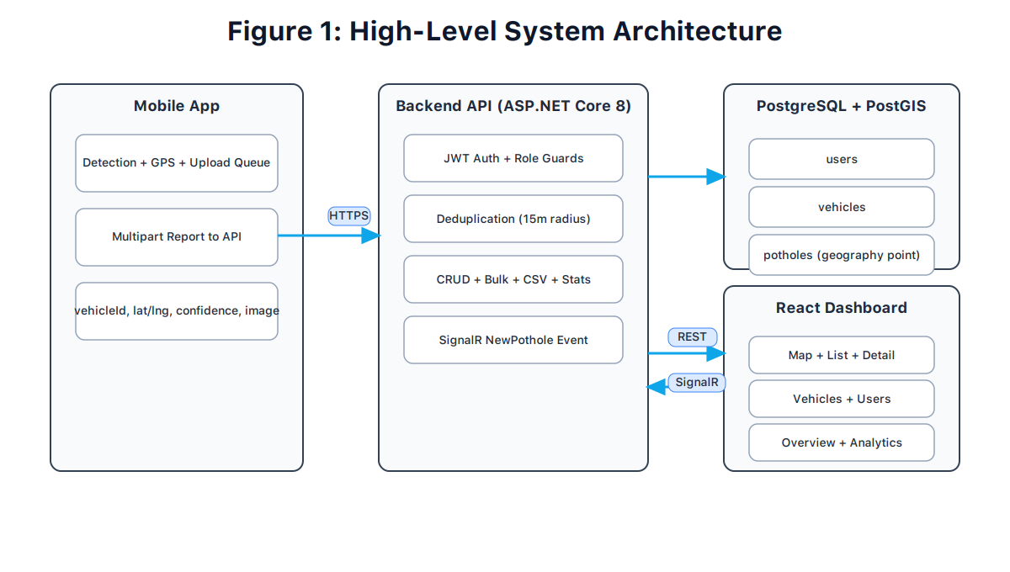
Proposed Solution
End-to-end workflow from detection to maintenance visibility
Android app captures live frames and runs YOLOv8n through TensorFlow Lite.
Valid detections are filtered, geotagged, deduplicated locally, and queued for upload.
Backend stores pothole records in PostgreSQL/PostGIS and manages report lifecycle.
Dashboard allows authorities to review locations, images, and repair status.

Slide 5
System Architecture
Current implementation stack in the repository
Mobile Layer
AI Layer
Backend Layer
Data Layer
Dashboard + Ops
Kotlin
Jetpack Compose
CameraX
TensorFlow Lite
GPS + WorkManager
YOLOv8n object detector
Float16 TFLite export
Recall-tuned thresholds
ASP.NET Core 8 Web API
Entity Framework Core
REST endpoints
PostgreSQL 16
PostGIS spatial support
Cloudflare R2 image storage
React + Vite + Tailwind
React Leaflet map
Docker Compose + NGINX on VPS

Slide 6
AI Model and Dataset
Why YOLOv8n is suitable for mobile pothole detection
Model: YOLOv8n (nano), selected for a strong speed/accuracy trade-off on mobile devices.
Dataset: 2,642 images and 9,077 labeled potholes collected from public datasets.
Data split: 80.5% train, 14.5% validation, 5.0% test.
Deployment format: float16 TFLite model, about 6 MB, suitable for Android packaging.
2,642
9,077
Images
Annotations
~6 MB
25-30 FPS
TFLite Size
Expected Mobile Speed

Slide 7
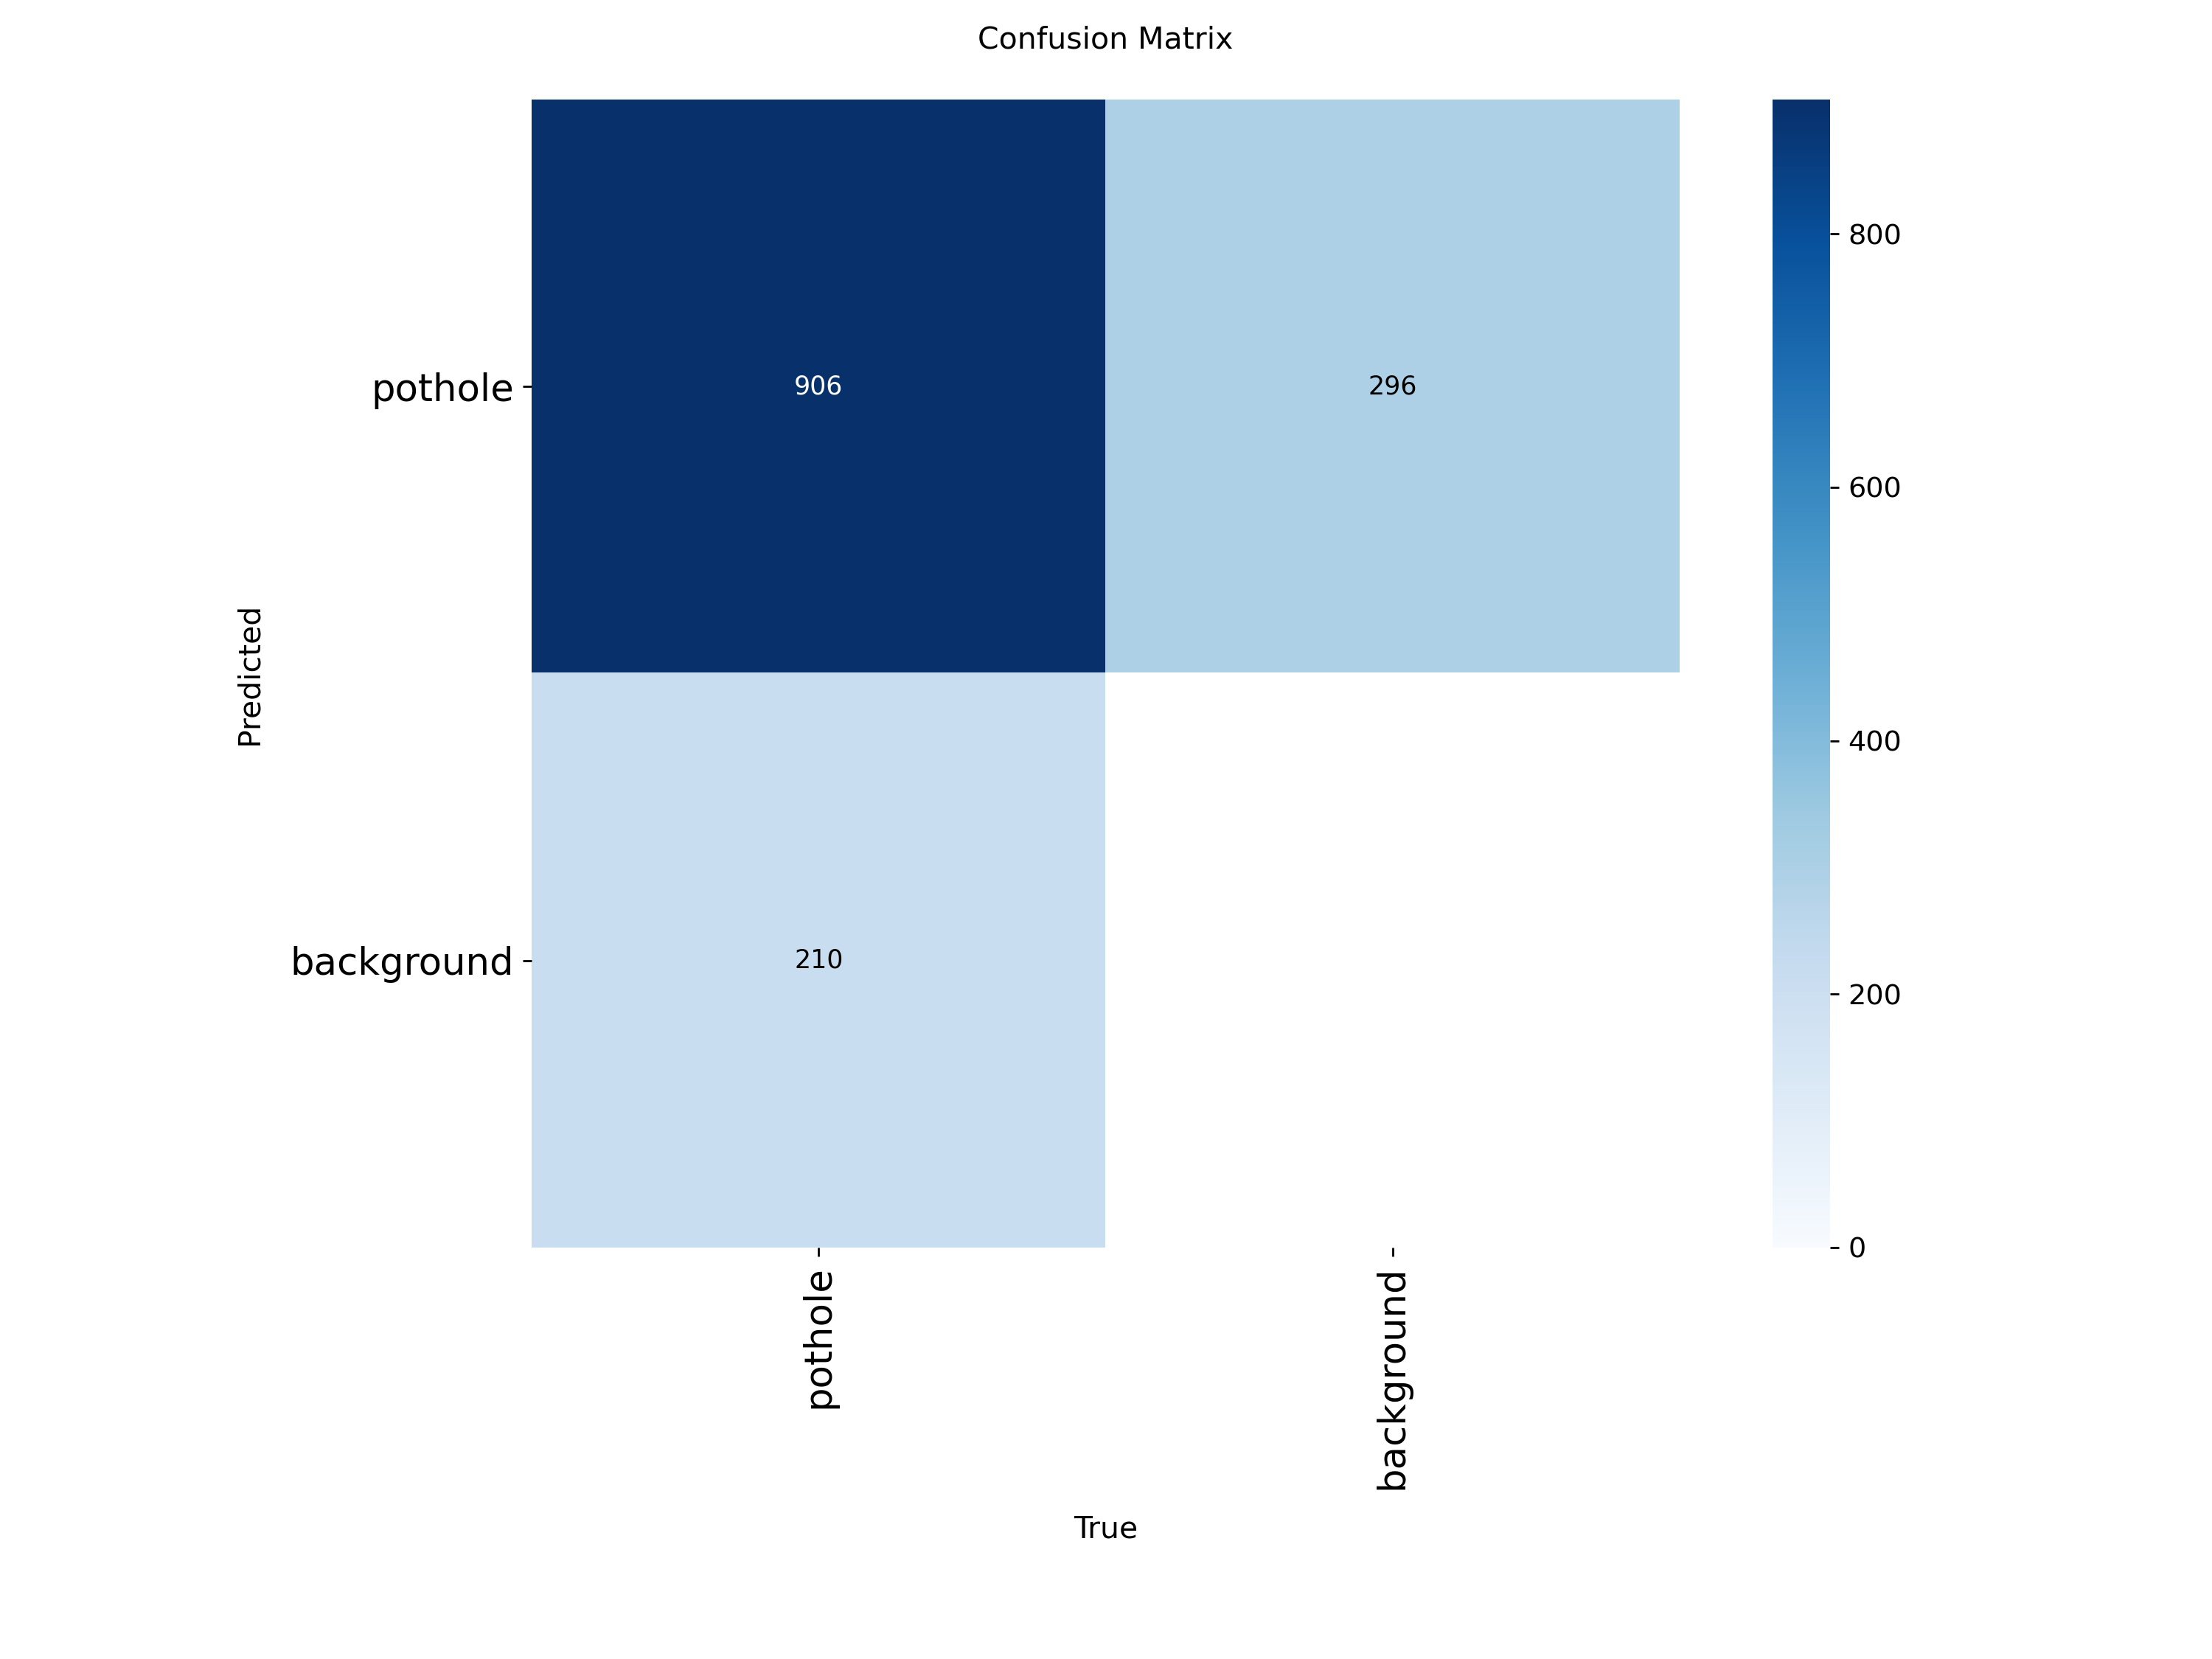
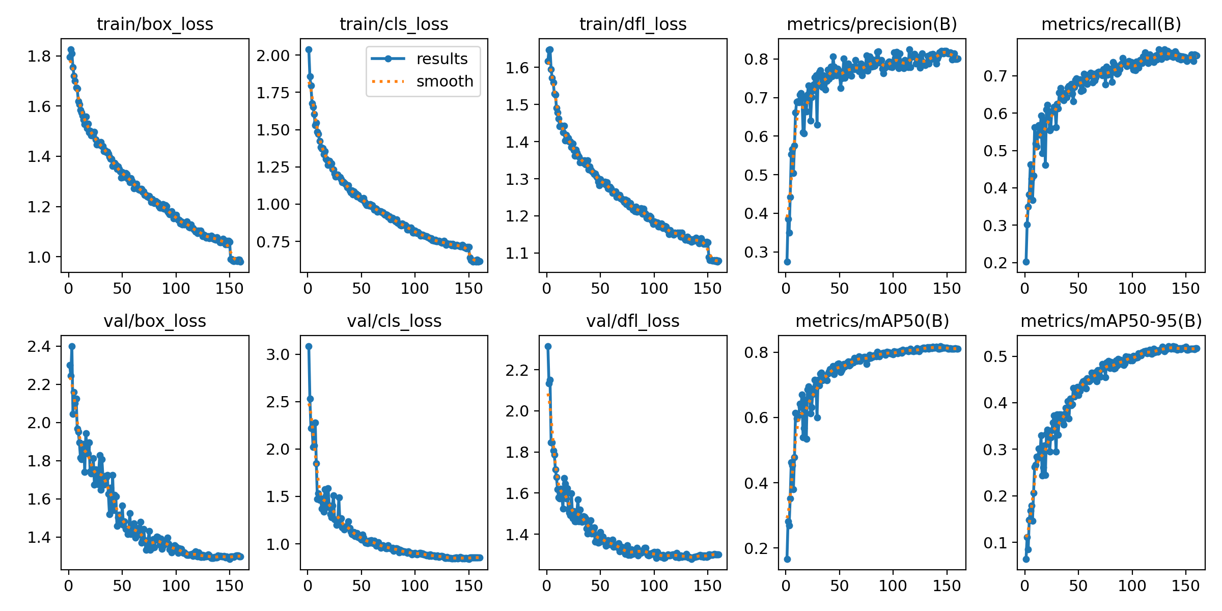
AI Results Charts
Visual evidence from model evaluation and training history
Confusion Matrix
Training Curves
Shows how well the model separates pothole detection from background and errors.
Shows loss reduction and metric improvement during training, supporting model convergence.

Slide 8
AI Results
Best validation metrics and deployment operating point
81.45%
52.13%
79.98%
75.90%
mAP@50
mAP@50-95
Precision
Recall
Interpretation
The tuned model keeps precision near 80% while reducing missed potholes.
This trade-off is suitable for a field reporting system where missing defects is costly.

Slide 9
Android Application
Main features implemented in the mobile app
Live camera preview with real-time pothole detection overlay.
On-device inference using TensorFlow Lite for low-latency performance.
GPS integration to tag each valid detection with location metadata.
History and settings screens for review and configuration.
Background upload queue for reliable synchronization when connectivity changes.
Engineering Focus
Low latency
Offline-friendly flow
Mobile-first UX
Reliable upload behavior
Representative Screens
Detection
History
Settings
Debug / verification support

Slide 10
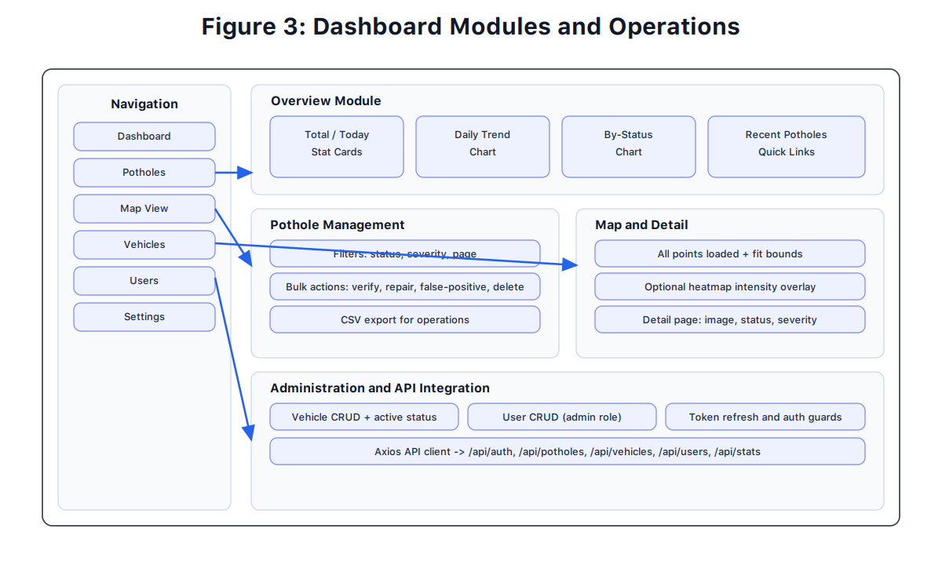
Backend and Dashboard
How reports are stored, reviewed, and managed
Backend uses ASP.NET Core 8 with PostgreSQL/PostGIS for API and spatial data handling.
Dashboard uses React, Vite, Tailwind, and React Leaflet for map-based monitoring.
Authorities can browse pothole records, inspect images, and update status such as verified or repaired.
Map view loads all pothole points and auto-fits bounds for easier monitoring.

Slide 11
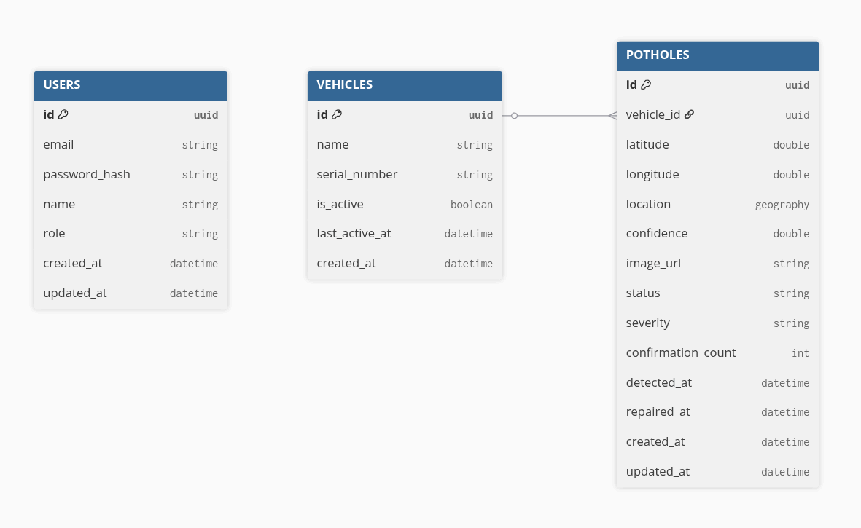
Database Design

Slide 12
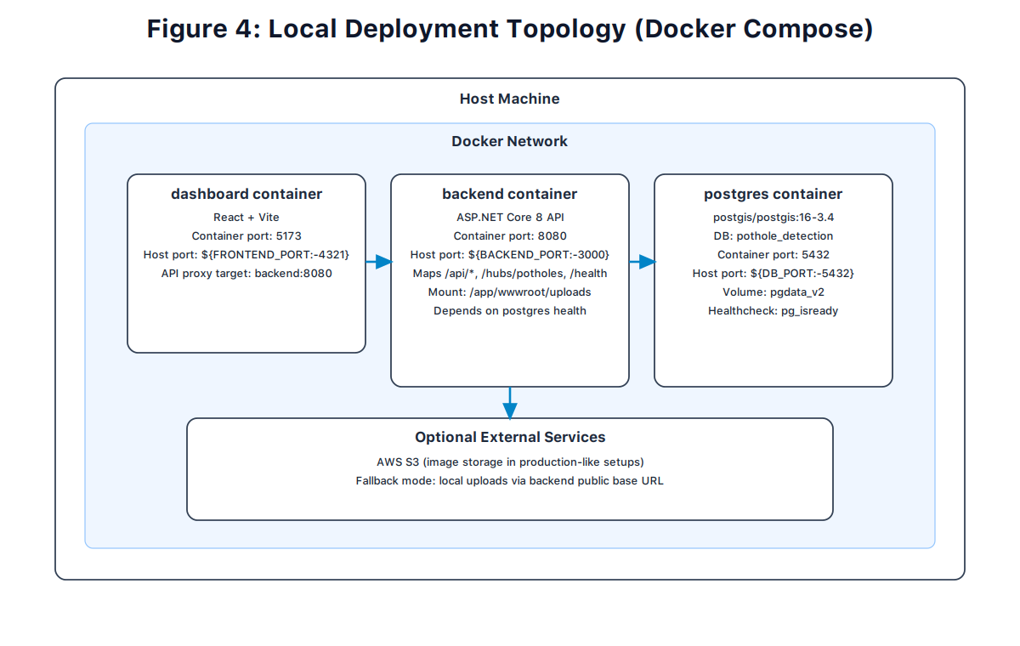
Deployment and Demo Readiness
Production-style setup used for the integrated system
System is deployed on a Linux VPS using Docker Compose and NGINX.
Dashboard domain: potholesystem.tech; API domain: api.potholesystem.tech.
PostgreSQL + PostGIS provides persistent geospatial storage.
Uploaded images can be served from Cloudflare R2 through a public image domain.

Slide 13
Limitations and Future Work
What can be improved after the current prototype
Current Limitations
Future Work
Recall is improved but some potholes are still missed.
Training data is mostly public and may not fully match local Jordan roads.
Performance can vary with lighting, glare, weather, and motion blur.
Current model detects potholes only, without severity grading.
Collect local road data and fine-tune on regional conditions.
Add severity classification and other road-hazard classes.
Validate the tuned TFLite export more extensively on target devices.
Expand robustness for night-time and adverse weather conditions.

Slide 14
Conclusion
An end-to-end AI-assisted road monitoring solution
The project delivers a complete workflow: detection, geotagging, reporting, storage, and dashboard monitoring.
The mobile AI model achieves acceptable results while remaining deployable on Android devices.
The integrated architecture demonstrates practical value for municipalities and road maintenance teams.
This work can be extended into a larger smart-city road condition monitoring platform.
Thank You
Questions and Discussion

