Slide 1


Lomuto Partitioning Algorithm
Omar Ahmed Essameldin 222481

Slide 2
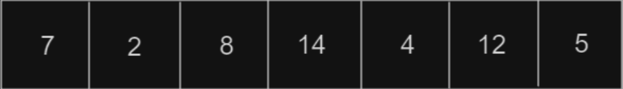
Problem Definition
We have an unsorted array and we want to sort it by following the Decrease and conquer strategy

Slide 3
Decrease and conquer
Involves breaking the problem into smaller subproblems, solving each subproblem independently, and then combining the solutions to obtain the final solution.

Slide 4
Lomuto Partitioning Algorithm
Lomuto Partitioning Algorithm
Selection of Pivot Element
Recursive Process
The algorithm recursively applies this process to the subarrays until the entire array is sorted.
The Lomuto Partitioning Algorithm is a popular method for partitioning an array during the quicksort algorithm.
It selects a pivot element and partitions the array into two subarrays - one with elements smaller than the pivot and one with elements greater than or equal to the pivot.

Slide 5
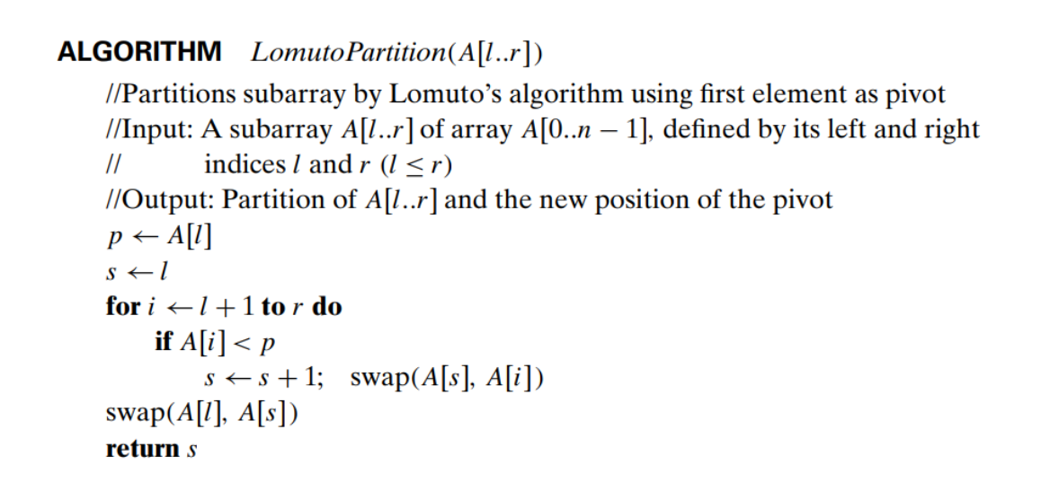
Lomuto Partitioning
Pseudocode Implementation

Slide 6
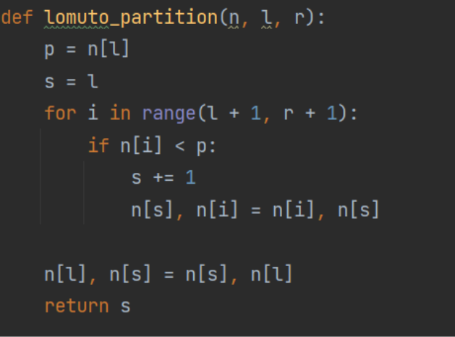
Lomuto Python Implementation

Slide 7
Thank You For Watching

