Slide 1

DESIGN & VERIFICATION OF A
32-Bit Direct-Mapped Cache Controller
L1 Subsystem Implementation with Write-Back Policy & MATLAB Golden Reference Validation
Omar Fawzy Mahmoud | Hatem Mustafa
September 2026

Slide 2



Introduction & Motivation
The Memory Wall Problem
Solution — Cache Memory
Processor speeds scale much faster than DRAM access speeds, causing CPU pipeline stalls during memory fetches.
A small, ultra-fast SRAM buffer located close to the core, operating at CPU speed.
Core Principles — Locality of Reference
Temporal Locality
Spatial Locality
Data accessed recently is likely to be accessed again soon.
Data adjacent to recently accessed addresses is likely to be accessed soon.
Objective: Reduce Average Memory Access Time (AMAT) and system power consumption.
32-Bit Direct-Mapped Cache Controller
2

Slide 3
System Specifications & Memory Organization
Architecture: 32-bit CPU interface, 128-bit (16-byte) backing main memory line. Write Policy: Write-Back with Write-Allocate on Write Misses.
32-Bit Address Partitioning
Tag
Index
Word Off.
Byte Off.
[31:10]
[9:4]
[3:2]
[1:0]
22 bits — identifies unique block in memory
6 bits — maps to 2^6 = 64 cache lines
2 bits — selects W0–W3
2 bits — always 2'b00
SRAM Storage Sizing
1 KB
1408 b
128 b
1.216 KB
Data Array
64 × 128 bits = 1024 Bytes
Tag Array
64 × 22 bits
Status Flags
64 Valid + 64 Dirty bits
Total Size
9728 bits
32-Bit Direct-Mapped Cache Controller
3

Slide 4



Subsystem Architecture
Five cooperating Verilog modules form the L1 cache subsystem.
cache_controller.v
cache_storage.v
main_memory.v
Central FSM managing request latching, line fills, and writebacks.
Houses SRAM arrays (Data, Tag, Valid, Dirty) and hit look-up logic.
Simulates 1024 × 128-bit backing store with single-cycle ready acknowledgment.
perf_counters.v
trace_generator.v
Tracks total accesses, hits, and misses.
Issues automated, repeatable test patterns.
32-Bit Direct-Mapped Cache Controller
4

Slide 5
Finite State Machine (FSM) Design
3'b000
IDLE
3'b001
COMPARE
3'b010
HIT
Latches incoming cpu_addr, cpu_wr_data, and flags.
Evaluates tag match and valid bit to route hit vs. miss.
Asserts cpu_ready=1, merges 32-bit word on write, returns to IDLE.
3'b011
MISS_WRITEBACK
3'b100
MISS_WAIT
3'b101
FILL
Flushes modified line: mem_addr = {tag_out, index, 4'b0000}.
Issues read request to main memory and waits for mem_ready.
Writes fetched 128-bit block to SRAM, sets valid=1, dirty=0.
Flow: IDLE → COMPARE → (Hit) HIT | (Miss & Dirty) MISS_WRITEBACK → MISS_WAIT → FILL | (Miss & Clean) MISS_WAIT → FILL
32-Bit Direct-Mapped Cache Controller
5

Slide 6
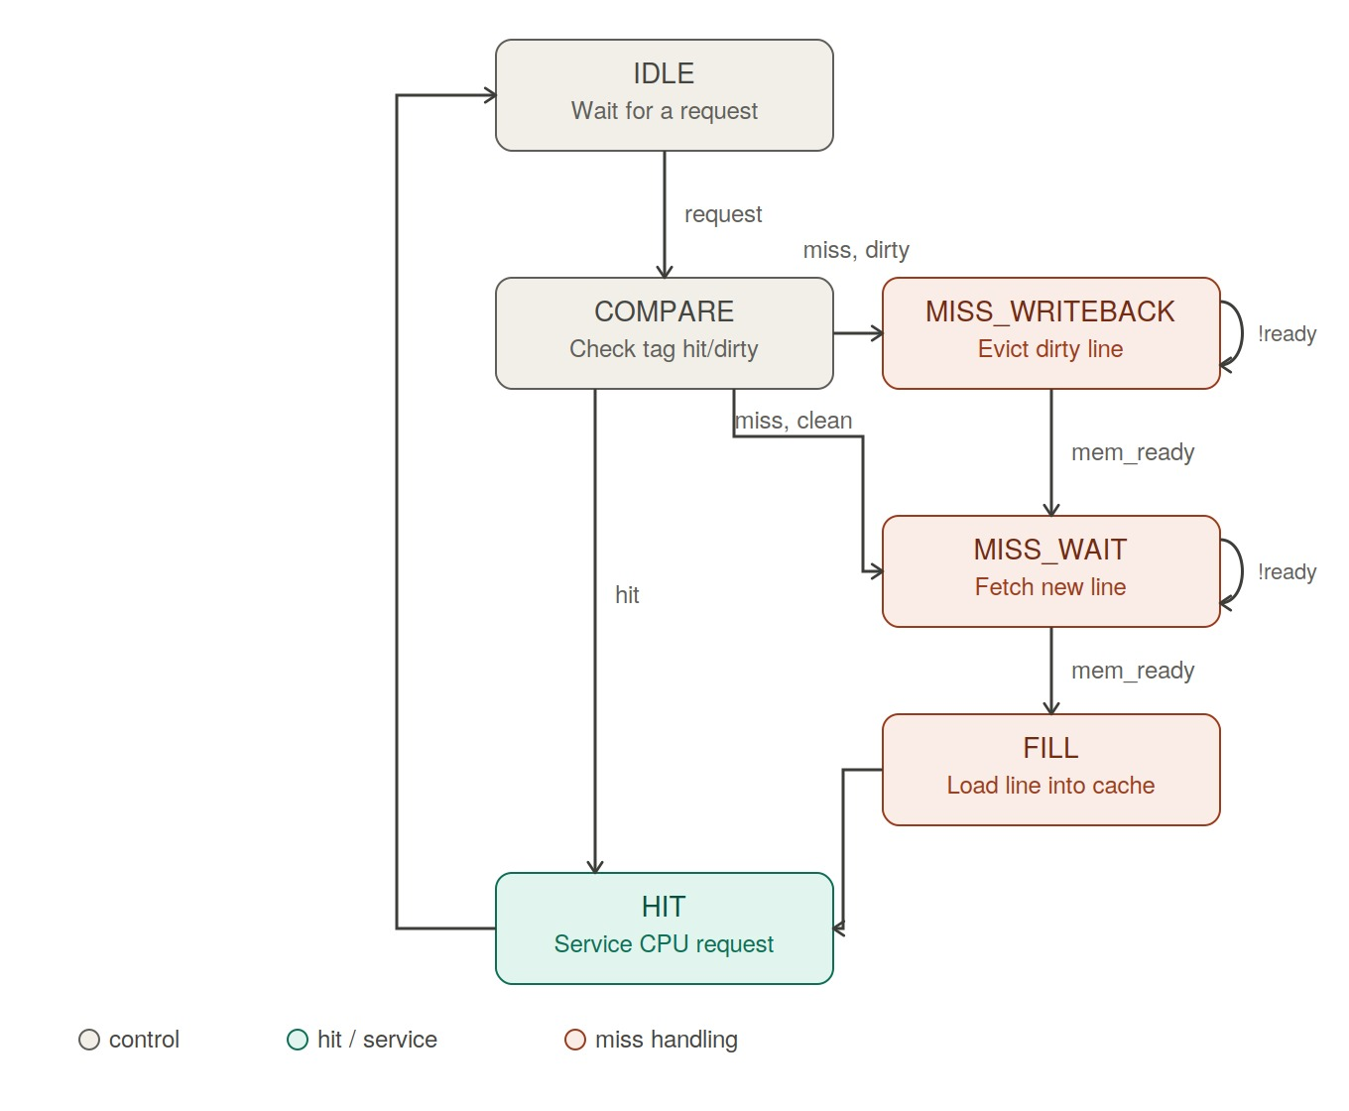
FSM State Diagram
Full transition diagram for the six-state cache controller.
32-Bit Direct-Mapped Cache Controller
6

Slide 7

Hardware Debugging & Key Fixes
Bug #1 — Tag Bit-Slice Regression
Bug #2 — Late Hit Sampling Synchronization
SYMPTOM
SYMPTOM
Eviction for 0x00000100 wrote back to incorrect memory address 0x00040100.
Performance counters recorded false hits during line refills.
ROOT CAUSE
ROOT CAUSE
Address generator sliced lower address bits [21:0] instead of upper bits [31:10].
Hit status was sampled in HIT state after FILL had already written valid data.
FIX
FIX
Updated all state logic in cache_controller.v to slice upper tag bits addr_reg[31:10].
Latched was_hit inside the testbench during the COMPARE state.
32-Bit Direct-Mapped Cache Controller
7

Slide 8
Verification Results: MATLAB vs. Verilog
Metric | MATLAB Golden Model | Verilog Simulation | Alignment
Total Memory Accesses | 38 | 38 | 100% Match
Total Cache Hits | 19 | 19 | 100% Match
Total Cache Misses | 19 | 19 | 100% Match
Dirty Line Evictions | 7 | 7 | 100% Match
Overall Hit Rate | 50.0% | 50.0% | Perfect Alignment
100%
Correlation across every transaction
7 / 7
Dirty evictions to correct block addresses
Verification Insights
100% Correlation — every memory transaction exhibited identical outcomes across both models.
Correct Address Reconstruction — all 7 dirty evictions targeted calculated block addresses accurately.
Data Integrity — word-merging on write hits modified only the targeted 32-bit word, leaving adjacent words intact.
32-Bit Direct-Mapped Cache Controller
8

Slide 9
Conclusion & Future Work
Summary of Achievements
Future Work
Successfully designed, implemented, and verified a 32-bit direct-mapped cache subsystem.
Extend design to Set-Associative Cache structures (2-way / 4-way).
6-state FSM controller fully integrated with SRAM and real-time performance tracking.
Implement configurable line-replacement algorithms (e.g., LRU / Pseudo-LRU).
100% architectural correlation verified against MATLAB golden reference.
Thank you
32-Bit Direct-Mapped Cache Controller
9

