Slide 1
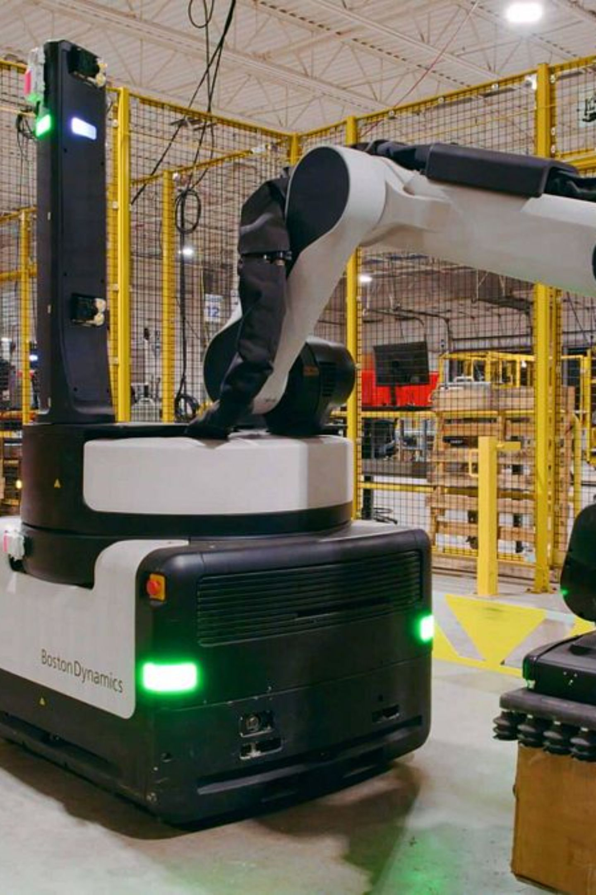
AI-Controlled Mobile Robot
Graduation Project · Mechatronics Engineering
Team Members · Department of Mechatronics Engineering · Faculty of Engineering
COMPUTER VISION
NATURAL LANGUAGE PROCESSING
ROBOTICS SIMULATION

Slide 2
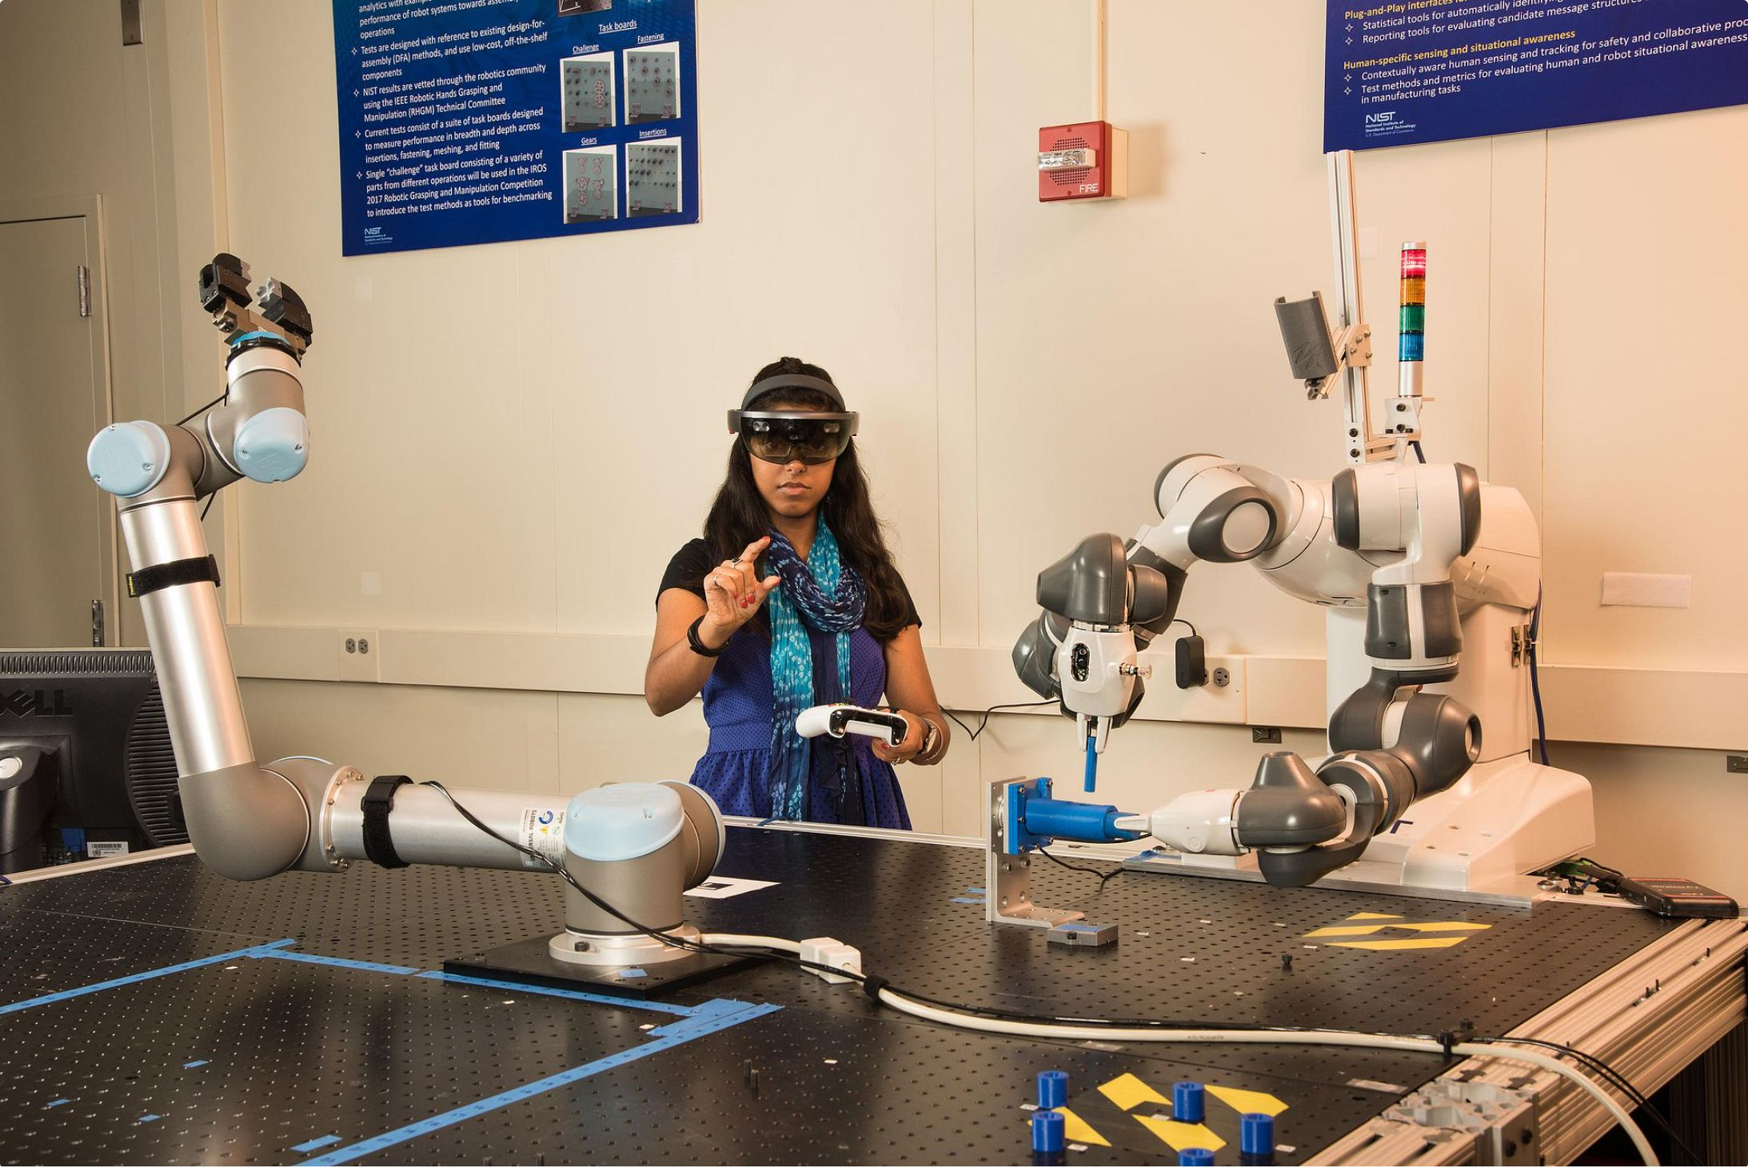
MOTIVATION
Why Intuitive Human–Robot Interaction?
The Problem
Traditional control: joysticks, teach pendants, fixed scripts
High expertise barrier — non-specialists cannot interact naturally
Slow response in dynamic or collaborative environments
Our Objective
Control a mobile robot via hand gestures or natural language text — no specialized hardware required.

Slide 3
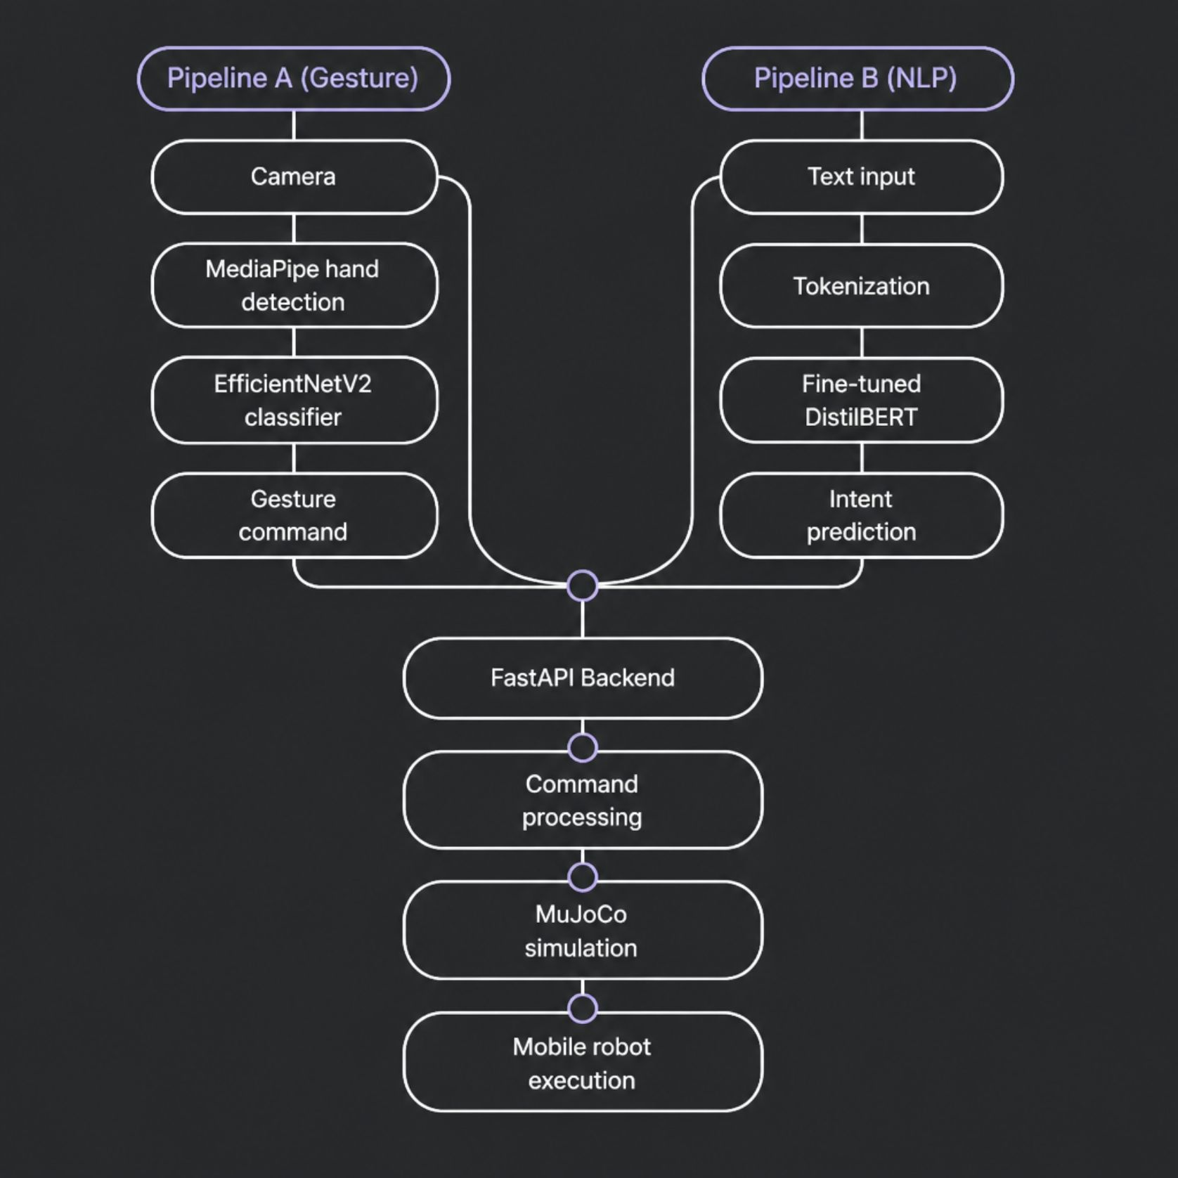
SYSTEM DESIGN
End-to-End System Architecture
Two Input Pipelines
Gesture: Camera → MediaPipe → EfficientNetV2 → Command
NLP: Text → DistilBERT → Intent → Command
Unified Backend
FastAPI merges both outputs, dispatches commands to MuJoCo for real-time physics-based execution.

Slide 4
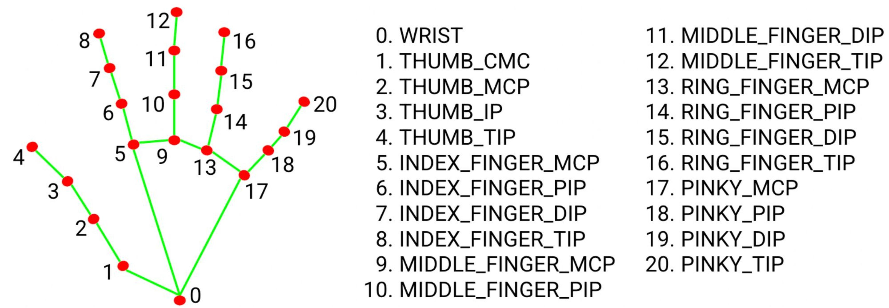
COMPUTER VISION
Gesture Recognition Pipeline
01
02
Detection
Preprocessing
MediaPipe extracts 21 hand landmarks in real time
Normalize and resize landmark coordinates
03
04
Classification
Execution
EfficientNetV2 maps gesture to robot command
Command dispatched to MuJoCo simulator

Slide 5
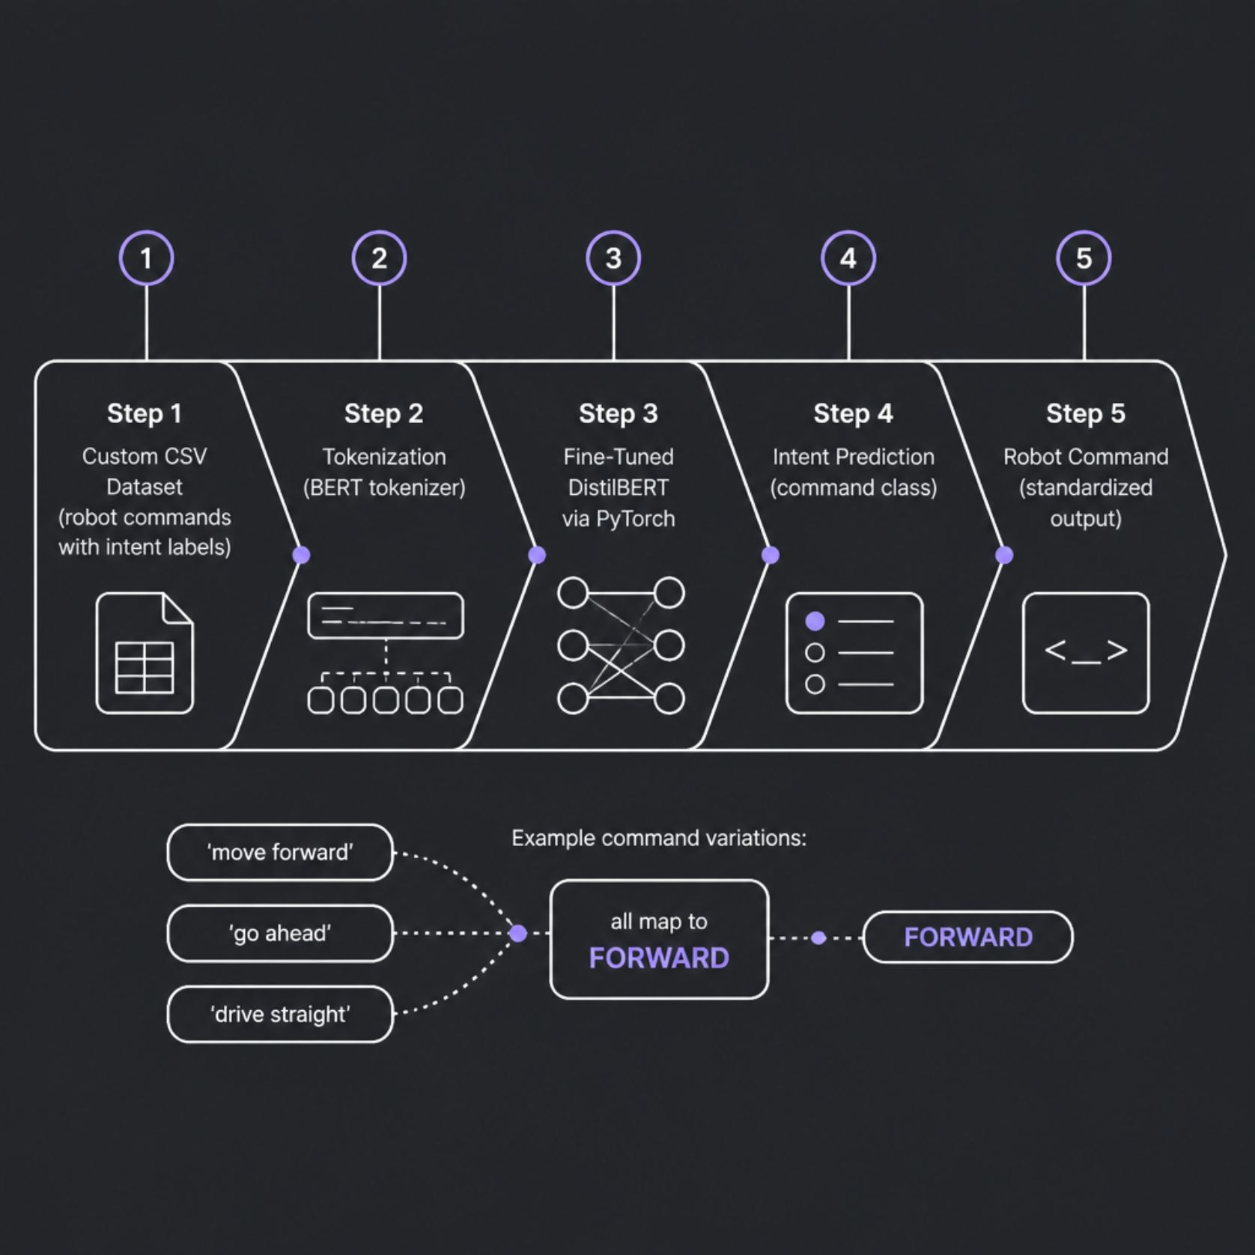
NATURAL LANGUAGE PROCESSING
Fine-Tuning DistilBERT for Command Classification
Training Approach
Custom CSV dataset: command sentences + intent labels
DistilBERT fine-tuned via PyTorch
Learns semantic variations of the same command
Example Mappings
"Move forward" / "Go ahead" → FORWARD
"Turn left" / "Rotate right" → TURN
"Open gripper" / "Close gripper" → GRIPPER

Slide 6

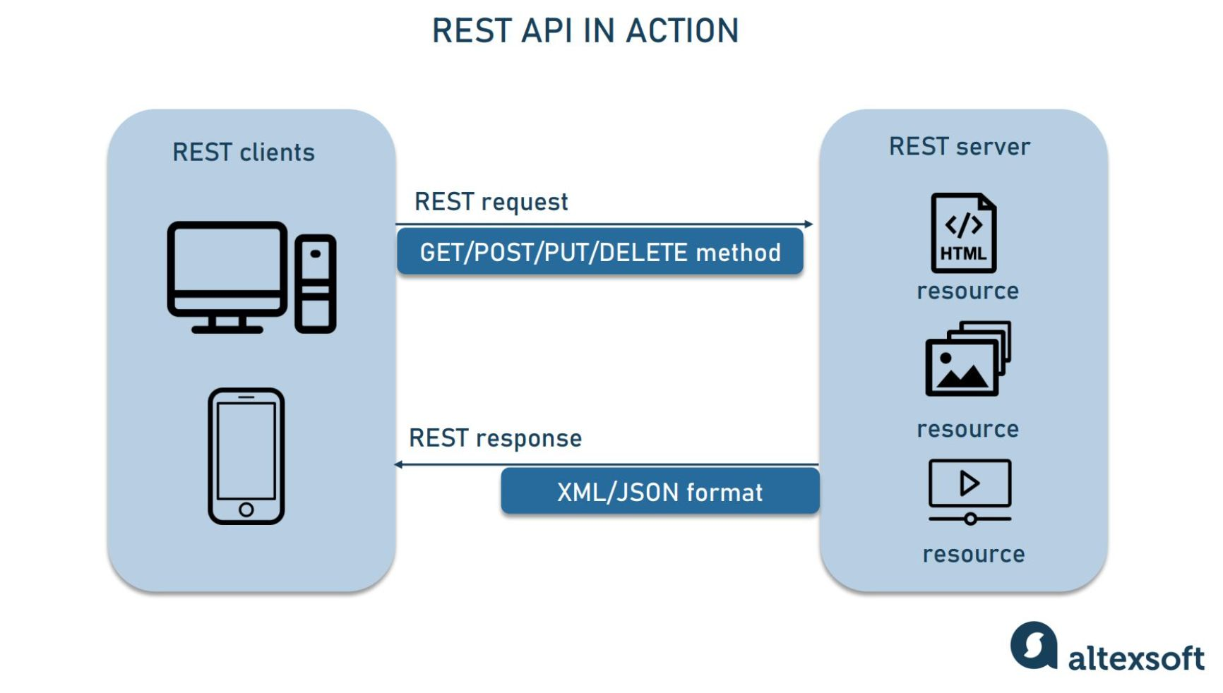
INTEGRATION
FastAPI Backend & Communication Layer
Core Responsibilities
Unified Interface
Command Normalization
Simulator Dispatch
Modularity
Receives predictions from both AI models
Converts outputs to a standardized command format
Sends commands to MuJoCo in real time
Loose coupling enables independent component testing

Slide 7
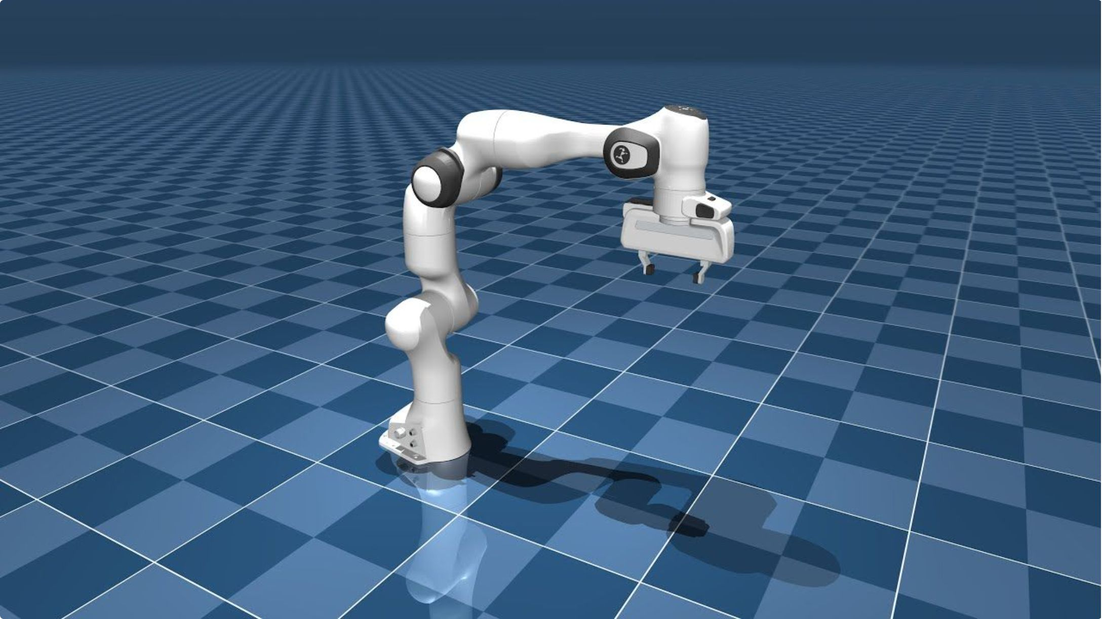
SIMULATION
MuJoCo Physics Simulation
Simulation Capabilities
Accurate rigid-body dynamics and contact physics
Mobile robot model: differential-drive wheels + 2-DOF arm
Real-time execution of AI-generated wheel and joint commands
Visual feedback for debugging and demonstration

Slide 8









TECH STACK
Technologies Used
Python
OpenCV
MediaPipe
Core language for all modules
Image capture and preprocessing
Real-time hand landmark extraction
PyTorch
EfficientNetV2
DistilBERT
Deep learning framework for training
Gesture classification model
Fine-tuned intent classifier
FastAPI
MuJoCo
Git & GitHub
Backend API and integration layer
Physics-based robot simulation
Version control and collaboration

Slide 9

OUTCOMES
Challenges, Results & Future Work
Challenges
Future Work
Custom NLP dataset creation
Reliable gesture recognition under lighting variation
Multi-component AI integration
Voice command support (ASR)
Expanded gesture vocabulary
Results
Gesture and NLP intent classification operational
Real-time control in MuJoCo simulation
Modular, extensible architecture
ROS 2 integration
Deployment on physical hardware
Object detection and autonomous navigation

Slide 10
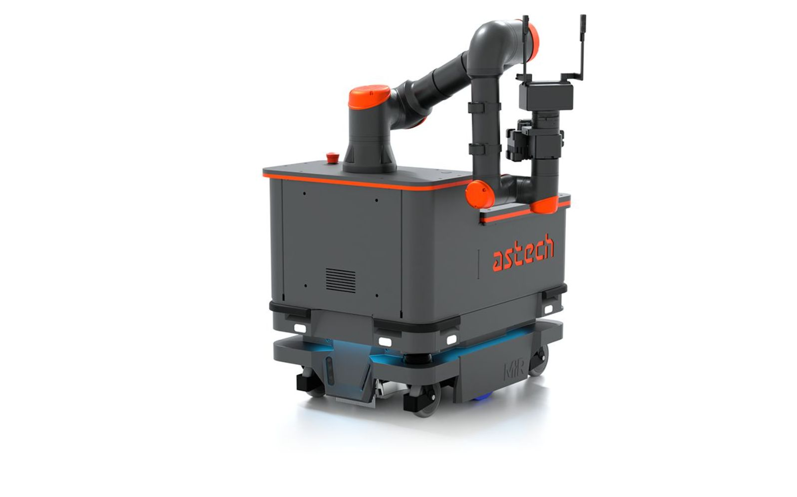
Conclusion
Computer Vision
Natural Language
MediaPipe + EfficientNetV2 for real-time gesture recognition
Fine-tuned DistilBERT for intent classification
Integration
Simulation
FastAPI unifies both pipelines into one control interface
MuJoCo validates robot behavior in a physics-accurate environment
Thank You — Questions?

