Slide 1



Lightning talk on “ Generalized linear models ’’ By : omar alshamrani

Slide 2
Overview
Motivation
Theory & Concepts
Algorithms
Benefits & Limitations
Examples

Slide 3
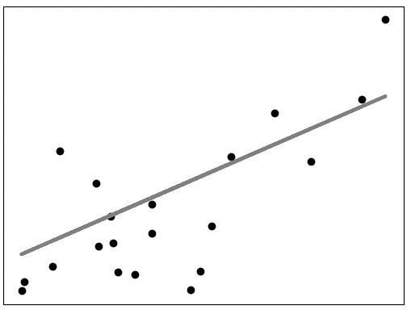

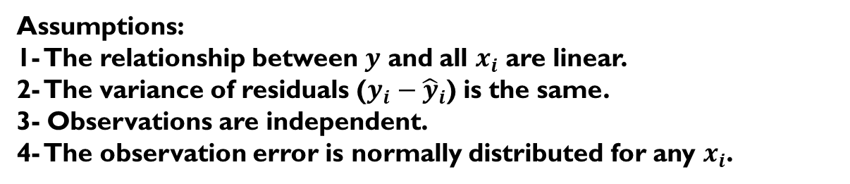
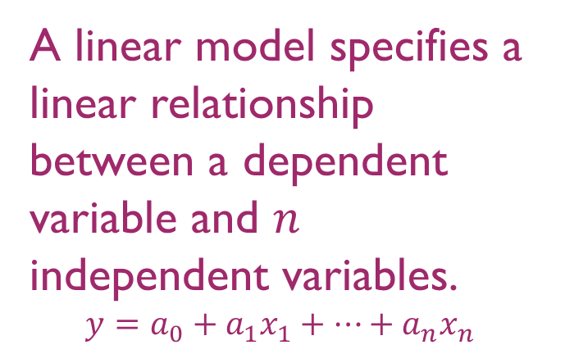
Motivation
A linear model specifies a linear relationship between a dependent variable and $n$ independent variables.
$$y=a_{0}+a_{1}x_{1}+…+a_{n}x_{n}$$
A linear model
Assumptions:
1- The relationship between $y$ and all $x_{i}$ are linear.
2- The variance of residuals ($y_{i}−{\hat{y}}_{i}$) is the same.
3- Observations are independent.
4- The observation error is normally distributed for any $x_{i}$.

Slide 4
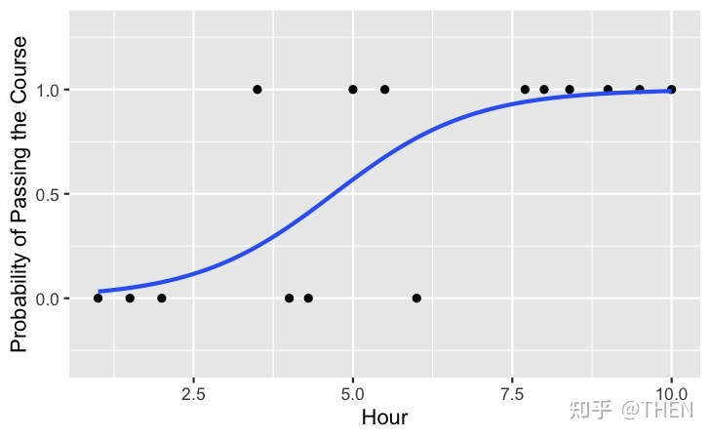
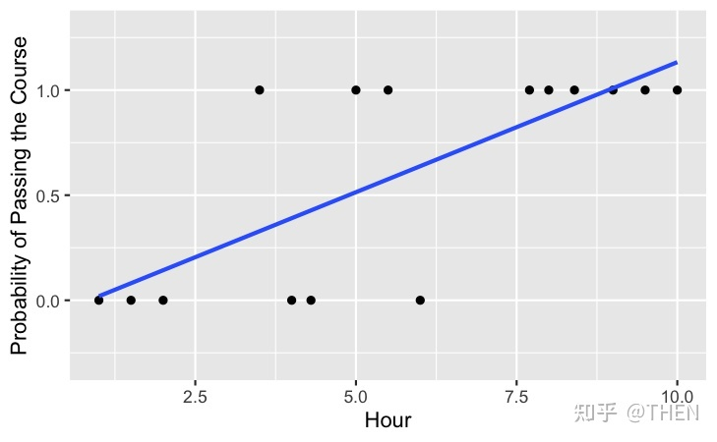
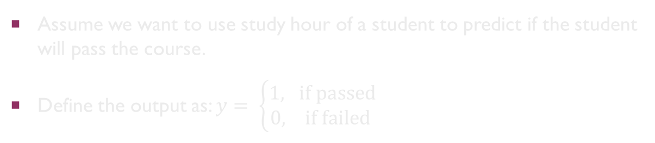
Motivation
Generalized Linear Model
Linear Model
Hour
Hour
Assume we want to use study hour of a student to predict if the student will pass the course.
Define the output as: $y= \left\{\begin{aligned}1, \text{if} \text{passed} \\ 0, \text{if} \text{failed} \end{aligned}\right.$

Slide 5
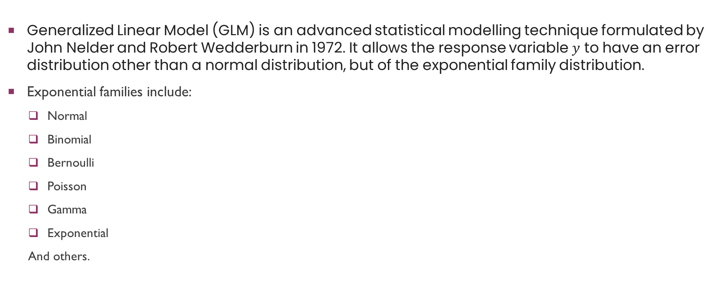
Theory & concepts
Generalized Linear Model (GLM) is an advanced statistical modelling technique formulated by John Nelder and Robert Wedderburn in 1972. It allows the response variable $y$ to have an error distribution other than a normal distribution, but of the exponential family distribution.
Exponential families include:
Normal
Binomial
Bernoulli
Poisson
Gamma
Exponential
And others.

Slide 6
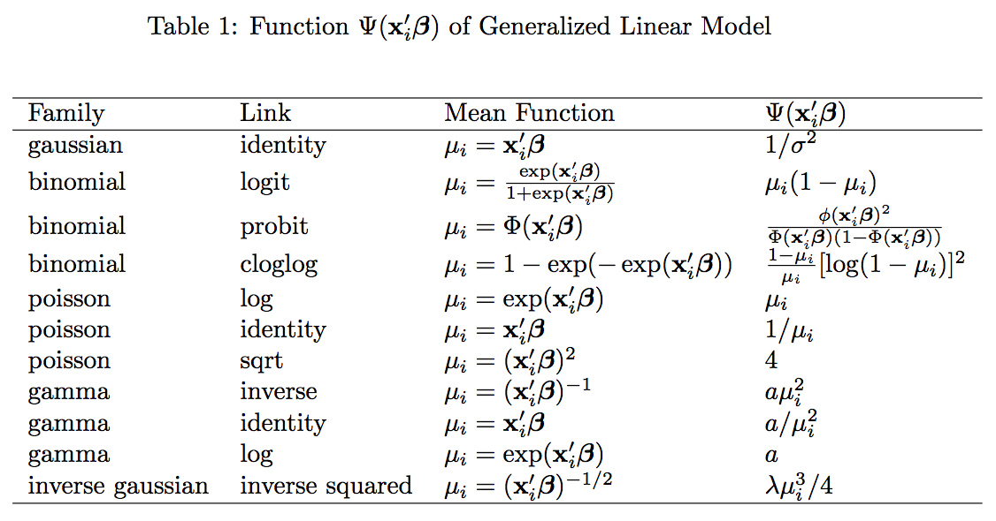

Theory & concepts
Components of a GLM:
Systematic Component:
$$a_{0}+a_{1}x_{1}+…+a_{n}x_{n}$$
Link Function : It maps a non-linear relationship to a linear one, which means you can fit a linear model to the data.
Random Component : It refers to the probability distribution, from the family of distributions, of the response variable.
6

Slide 7
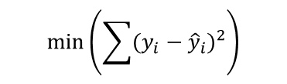
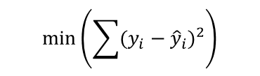


Algorithms
Linear model
Least Squares
Maximum Likelihood
Generalized Linear model
Least Squares
Maximum Likelihood
$$\text{min}\left(\sum{{(y_{i}−{\hat{y}}_{i})}^{2}}\right)$$
$$\text{max}\left(\prod{P(y_{i}\left|a)\right.}\right)$$
$$\text{min}\left(\sum{{(y_{i}−{\hat{y}}_{i})}^{2}}\right)$$
$$\text{max}\left(\prod{P(y_{i}\left|a)\right.}\right)$$

Slide 8
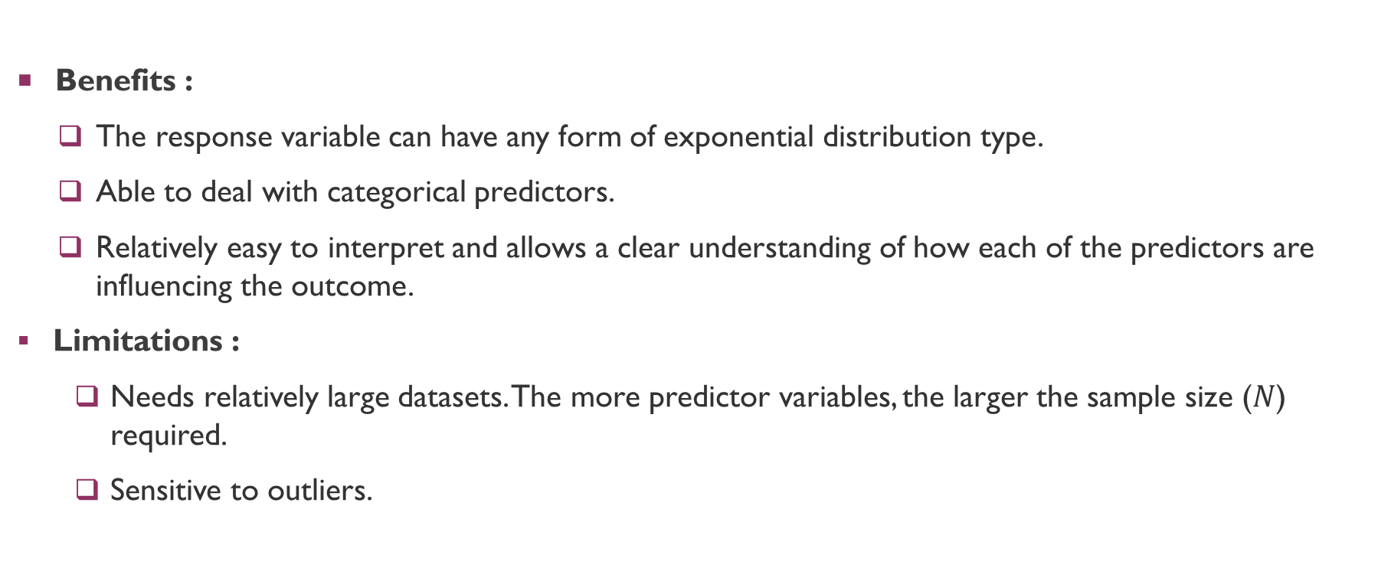
Benefits & limitations
Benefits :
The response variable can have any form of exponential distribution type.
Able to deal with categorical predictors.
Relatively easy to interpret and allows a clear understanding of how each of the predictors are influencing the outcome.
Limitations :
Needs relatively large datasets. The more predictor variables, the larger the sample size ($N$) required.
Sensitive to outliers.

Slide 9
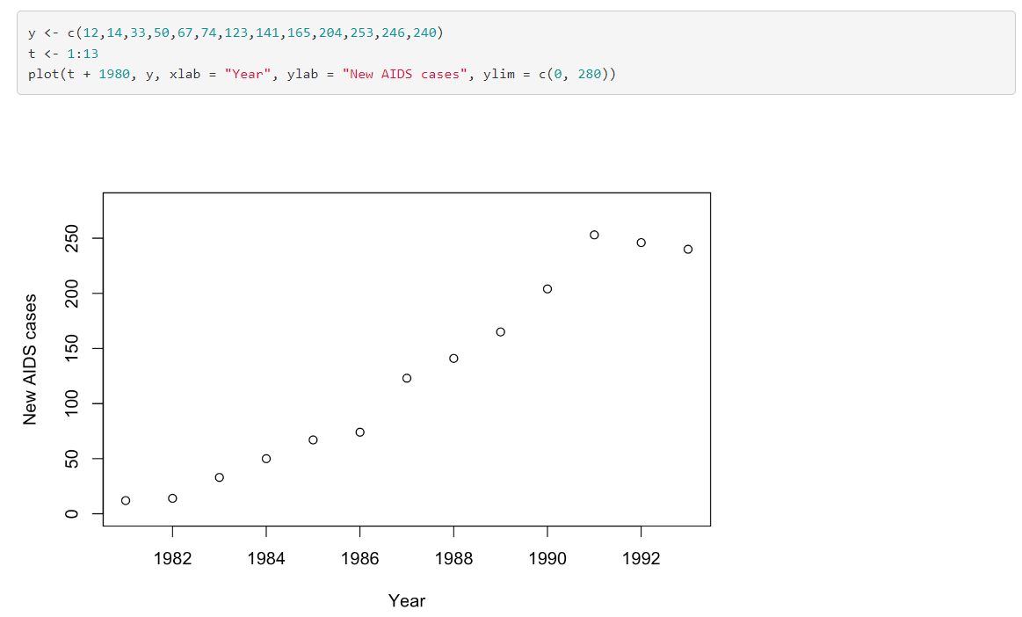
Examples
Poisson Regression
The dataset is from Venables and Ripley (2002), which provides the number of new AIDS cases each year in Belgium from 1981 to 1993.

Slide 10
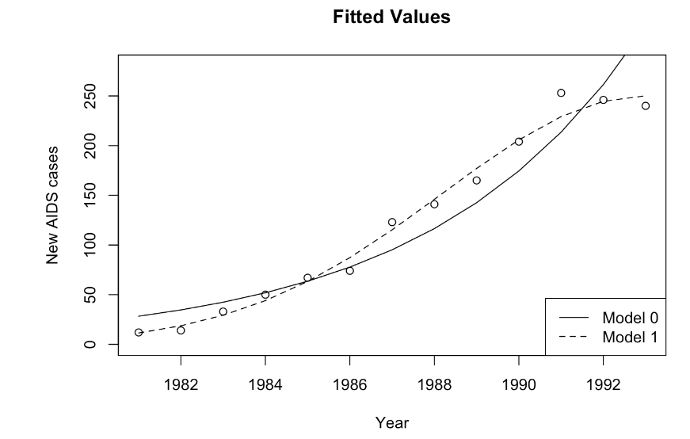
Examples
Poisson Regression

Slide 11
References
https://bookdown.org/marklhc/notes_bookdown/generalized-linear-models.html
Generalized linear models with examples in R, Peter K. Dunn, Gordon K. Smyth, Springer, 2018

