Slide 1

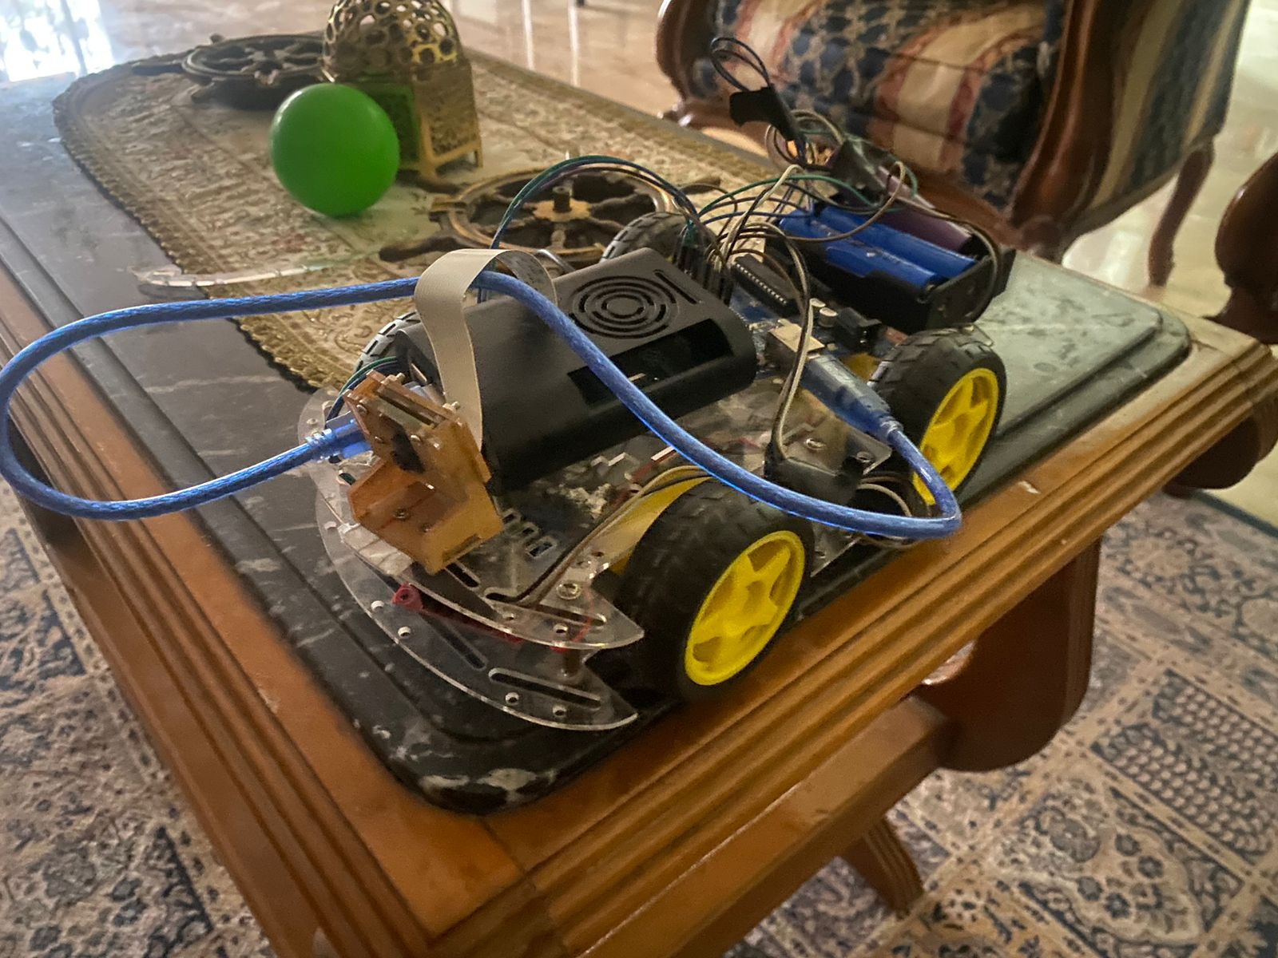
Abstract
Image Processing
This project showcases a real-time ball tracking system using Raspberry Pi and OpenCV. A camera detects a colored ball through image processing techniques like HSV segmentation and contour detection. A PID controller then adjusts the robot’s movement based on the ball’s position and size, enabling accurate tracking and alignment.
The input image is first processed through flipping and geometric resizing to match the camera’s orientation. CLAHE is applied to enhance contrast without altering color. Gaussian blur is used to reduce image noise. HSV color segmentation isolates the desired ball color. Morphological operations refine the detection mask by removing noise and closing gaps. Contour detection identifies the largest object, and centroid estimation determines the ball’s center of mass for accurate tracking.
Methodology
A Raspberry Pi 4 with a Pi Camera captures real-time video of the environment. The frames undergo preprocessing steps including flipping, resizing, CLAHE, and Gaussian blur. HSV color segmentation isolates the target ball, followed by morphological operations and contour detection to locate its centroid. A PID controller uses the ball’s position and size to generate movement commands for tracking.
Control
The system uses a PID controller to minimize the horizontal offset between the ball’s centroid and the frame center. Based on this error, it sends directional commands to align the robot left or right. For distance regulation, a fixed PWM drives the robot forward until the ball's detected area exceeds a predefined threshold—indicating close proximity—at which point movement halts. This ensures smooth and responsive tracking.
Results
The input image is first processed through flipping and geometric resizing to match the camera’s orientation. CLAHE is applied to enhance contrast without altering color. Gaussian blur is used to reduce image noise. HSV color segmentation isolates the desired ball color. Morphological operations refine the detection mask by removing noise and closing gaps. Contour detection identifies the largest object, and centroid estimation determines the ball’s center of mass for accurate tracking.

