Slide 1
Spoken Language Identification Using GMMs

Slide 2
Team Members
12
Zakaria Sobhy Abd-ElSalam Soliman Madkour
19P2676
Omar Mohamed Ibrahim Alsayed
19p7813

Slide 3
Table of contents
Language Identification
01
Dataset
02
Approaches
03
Results
04

Slide 4
Language Identification
01

Slide 5

What is the language identification problem?
The language identification challenge in Natural Language Processing (NLP) entails determining the language in which a particular piece of text was produced.
It is an essential preprocessing step for several NLP applications, including machine translation, text categorization, and information retrieval.

Slide 6

What is the language identification problem?
This project is about spoken language identification where we are given an audio file with one speaker speaking in one of the designated language and the system will classify the language spoken in this recording.
Hello
مرحبا
नमस्ते
Hallo

Slide 7
Dataset
02

Slide 8
Dataset
The data we are using is the Fleurs dataset. We only took three languages namely English, Arabic, and German. This dataset is already split into train, test, and validation sets.
 | Duration
count | 7693.000000
mean | 10.548216
std | 3.532879
min | 0.319063
25% | 8.100000
50% | 10.080000
75% | 12.480000
max | 42.360000

Slide 9
Dataset
Remark:
- most of the data in the training set is concentrated at recordings in the range 6-14 seconds recording size
- the same could be said for testing except that of german language it is spread more towards longer recordings
- the validation is centralized in the range 6-12
- from the above description of the training dataset the mean duration is 10.5 and the std is 3.5 so if we take our range [6-14] we will have covered nearly 68% of the population with maintaining a reasonable recording size range
Conclusion:
- we will filter the dataset and take only recordings of durations in range 6-14 seconds
 | Duration
count | 7693.000000
mean | 10.548216
std | 3.532879
min | 0.319063
25% | 8.100000
50% | 10.080000
75% | 12.480000
max | 42.360000

Slide 10
Preprocessing
We needed to unify the length of audio files input to the classifier. The solution was to pad small audio files to match large ones. But this introduced a problem to the models as the amount of padding was significantly large which caused the models to be biased towards the zeros of padding.

Slide 11
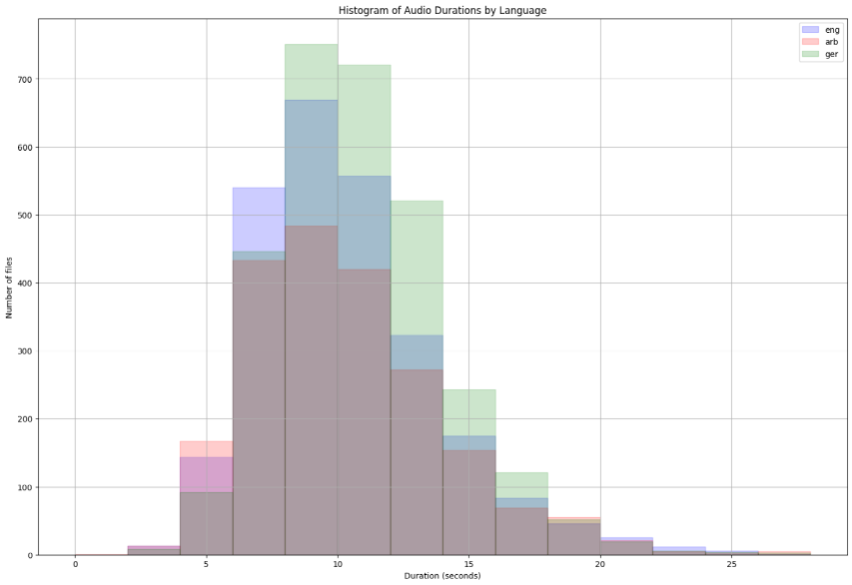
Preprocessing
We filtered the audios by taking only files with durations ranging between 6-14 seconds which from the following histogram resembles nearly 70% of the dataset. This way when we pad 6s. audio files to match with 14s. the model behavior won’t deteriorate very much.

Slide 12
Approaches
03

Slide 13
Hidden Markov Model HMM
We trained three Gaussian MMs one per each language and then for the classification we would run the audio file by the three models and the model with the highest probability would be the classification of this audio file. Each model had 10 hidden states and was trained on 50 iterations. The GMMs were created from the hmmlearn library
models ={}
for language, mfccs_list in mfccs.items():
# Train a model per language
model = hmm.GMMHMM(n_components=num_states, n_iter=num_iterations, verbose=True)
model.fit(mfccs[language])
# Add the model to the dictionary
models[language] = model

Slide 14
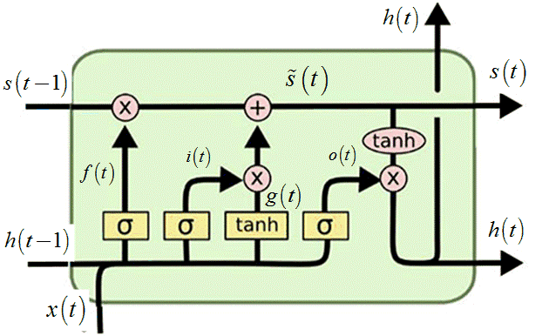
Long Short Term Memory LSTM
We trained a recurrent neural network with the LSTM acting as our temporal capturing mechanism. Then the hidden state of the last time step was feed to a fully-connected layer that outputs the class probability. The LSTM had 5 layers, dropout of 0.5 and hidden state vector of size equals 512.

Slide 15
Long Short Term Memory LSTM
class LSTM(nn.Module):
def __init__(self,input_size, hidden_size ,number_layers, drop_out, bidirectional, number_classes):
super(LSTM, self).__init__()
self.input_size = input_size
self.hidden_size = hidden_size
self.number_layers = number_layers
self.drop_out = drop_out
self.bidirectional = bidirectional
self.number_classes = number_classes
self.lstm = nn.LSTM(input_size=input_size, hidden_size=hidden_size, num_layers=number_layers, bidirectional=bidirectional, batch_first=True, dropout=drop_out)
# x.shape -> (batch_size, sequence_length, input_size)
self.fc = nn.Linear(hidden_size*(2 if self.bidirectional else 1), number_classes)

Slide 16
Results
04

Slide 17
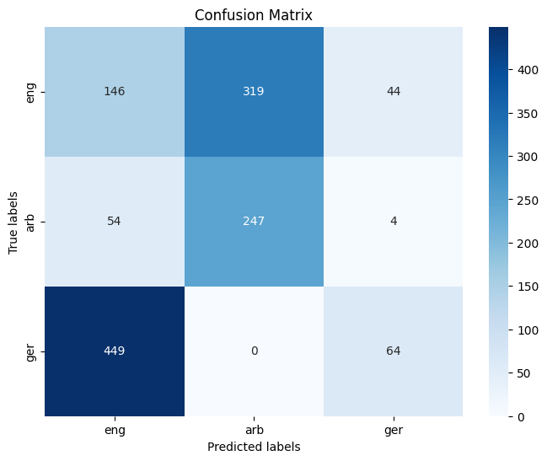
Hidden Markov Model HMM
Test accuracy of 34.44%

Slide 18

Long Short Term Memory LSTM
Test accuracy of 71.29%

Slide 19
Comments
The results show that the Long-Short Term Memory (LSTM) network outperforms the Hidden Markov Model (HMM) in terms of spoken language classification. The HMM's test accuracy of 34.44% indicates that it struggled to detect temporal connections and complicated patterns in the audio data.
This is most likely owing to its simplified structure and dependence on Markovian assumptions, which may not accurately simulate the complex fluctuations in speech. In contrast, the LSTM, with its capacity to grasp long-term dependencies and manage sequential data, produced a substantially better accuracy of 71.29%.

Slide 20
Thanks!

