Slide 1
Operating Systems’25
Project Description MS2
Memory Manager: More Features

Slide 2
Agenda
Logistics
Project Quick Guide
What’s New?
[Kernel] Project Features
Page fault handler during execution using BUFFERING
MODIFIED CLOCK replacement algorithm
[User] Project Features
User Heap
[Common]
Env free

Slide 3
Project quick guide

Slide 4
ALL Required Functions
Final Delivery
Page Fault Handler [2 cases]
User Heap [4 functions]
Env Free
Date: Saturday 10 MAY @10:00 PM)

Slide 5
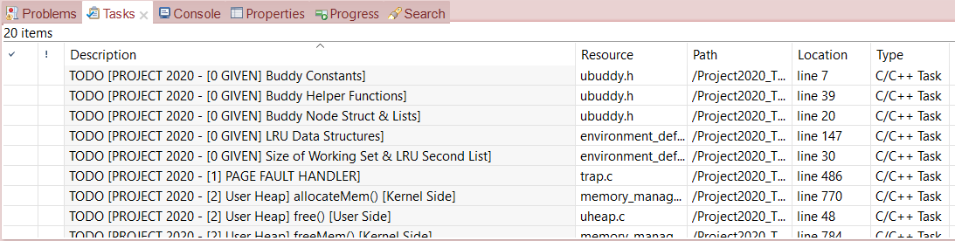
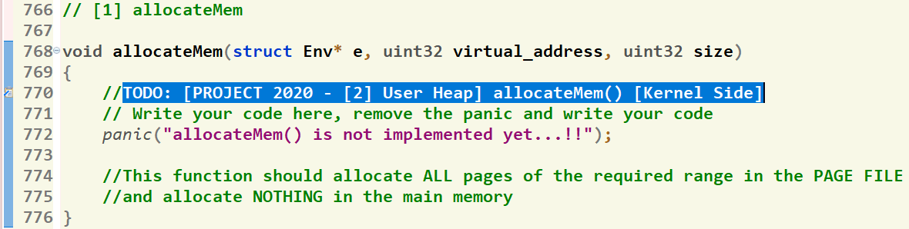
Where should I write the Code?
There’re shortcut links that direct you to the function definition
[1] Click on “Tasks” Tab
[2] Double Click on the required function
GIVEN
REQUIRED
[3] Function body, at which you should write the code

Slide 6

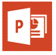
What about the steps?
Refer to project doc & ppt

Slide 7
How to Test Your Code? (Tests DON’T guarantee full correct logic, You should implement the correct logic as explained)
There’re test programs that test
Each function separately
Entire project
Just run the test program & it tell you if it succeed or not.

Slide 8
Helper Functions
Set of ready-made functions are available to help you when writing your solution.
Detailed description can be found in document.

Slide 9
Delivery
Dropbox-based… Fully automated
Test cases will be used to evaluate your solution
Each case is binary: success (1) or not (0)
Make sure they are run correctly before you deliver isA
Delivery Dates:
Final Delivery: Saturday (10 MAY @10:00 PM)
ONE MILESTONE IS FINAL delivery
MUST deliver the required tasks and ENSURE they’re worked correctly
Notes:
Need to be updated

Slide 10
ADVICES
#1: Work as a Team
Task division guide may help
#2: Start Immediately
To get benefit of the support
#3: Read docs & ppt
Detailed steps & helper functions
#4: Read and Adhere to Instructions
To successfully deliver your project

Slide 11
What’s New?
OLD
NEW
NEW Concepts
env_create( )
env_create( )
BIN
BIN
All
Set of pages
Working Set
Required Tables
If no enough memory, then don’t load it
All Pages
Page File
Refer to the
Project Documentation

Slide 12
Project Features
[KERNEL]
Load and run multiple user programs (DONE)
Page fault handler during execution with buffering
MODIFIED CLOCK replacement algorithm
[USER]
User Heap: dynamic allocation and free (The required strategy of each team will be sent to each team to the registered email.)
BEST FIT strategy
FIRST FIT strategy
NEXT FIT strategy
WORST FIT strategy
[COMMON]
Env Free

Slide 13
Page Fault Handler
Refer to the
Project Documentation

Slide 14
Project Features
[KERNEL]
Load and run multiple user programs (DONE)
Page fault handler during execution with buffering
MODIFIED CLOCK replacement algorithm
[USER]
User Heap: dynamic allocation and free
BEST FIT strategy
FIRST FIT strategy
NEXT FIT strategy
WORST FIT strategy
[COMMON]
Env Free

Slide 15
[USER] Project Features
Before we start!
Program runs in user mode (less privileges)
It requires functions from the kernel
So, need to switch to kernel mode, call the function, then return to user mode
SYSTEM CALLS (S/W interrupts) do this job!

Slide 16
Dynamic allocation/Deallocation [malloc() / free()]
What?
Why?
Program need dynamic allocations for its normal work
De-allocations are necessary after finished using allocated memory:
virtual address space fragmentation happens
Minimize virtual addresses fragmentation as possible

Slide 17
Dynamic allocation/Deallocation [malloc() / free()]
Allocation:
Example 1 (C++ and C):
C++: int * ptr_value = new int;
C: int * ptr_value = malloc(sizeof(int));
allocate 1 int (4 bytes) in virtual memory and return the allocated virtual address to “ptr_value”
Example 2 (C++ and C):
C++: float* arr = new float[200];
C: float* arr = malloc(sizeof(float) * 200);
allocate 200 floats (800 bytes) in memory and return the allocated address to “arr”

Slide 18
Dynamic allocation/Deallocation [malloc() / free()]
De-allocation (free)
Example 1 (C++ and C):
C++: delete ptr_value;
C: free(ptr_value);
deallocate (free) 1 int (4 bytes) from virtual memory at address “ptr_value”
Example 2 (C++ and C):
C++: delete[] arr;
C: free(arr);
de-allocate (free) 200 floats (800 bytes) from virtual memory at address “arr”

Slide 19
Dynamic allocation/Deallocation [malloc() / free()]
User Dynamic malloc/free *
malloc( ) (Next Fit, Best Fit, . . . )
free( )
Working Sets Pages + Empty Tables in Given Range
ALL Pages in Given Range
Nothing Created in Memory
ALL Pages Added to Page File

Slide 20
Dynamic allocation/Deallocation [malloc() / free()]
Allocate pages on 4KB granularity
.
.
.
ptr3 = malloc (3 KB)
ptr3
3 KB
ptr2 = malloc (1 KB)
ptr2
1 KB
2 KB
4 KB
ptr1 = malloc (6 KB)
ptr1
USER_HEAP_START
.
.
.

Slide 21
Dynamic allocation/Deallocation [malloc() / free()]
BEST FIT Strategy
4 GB
4 KB
USER_HEAP_MAX
.
.
.
1 MB
ptr3 = malloc (1 MB)
ptr3
1 MB
3 MB
4 MB
ptr2 = malloc (3 MB)
ptr2
2 MB
ptr4 = malloc (2 MB)
2 MB
ptr4
3 MB
ptr1 = malloc (1 MB)
ptr1
1 MB
2 MB
2 MB
.
.
.
USER_HEAP_START

Slide 22
Dynamic allocation/Deallocation [malloc() / free()]
NEXT FIT Strategy
.
.
.
USER_HEAP_MAX
2 MB
.
.
.
ptr4 = malloc (2 MB)
2 MB
ptr4
1 MB
ptr3 = malloc (1 MB)
ptr3
1 MB
3 MB
4 MB
ptr2 = malloc (3 MB)
ptr2
2 MB
3 MB
ptr1 = malloc (1 MB)
ptr1
1 MB
4 MB
Last Allocated
Space
USER_HEAP_START
.
.
.
22

Slide 23
Dynamic allocation/Deallocation [malloc() / free()]
FIRST FIT Strategy
.
.
.
USER_HEAP_MAX
2 MB
.
.
.
ptr4 = malloc (2 MB)
2 MB
ptr4
1 MB
3 MB
4 MB
ptr2 = malloc (3 MB)
ptr2
2 MB
ptr3 = malloc (1 MB)
ptr3
1 MB
3 MB
ptr1 = malloc (1 MB)
ptr1
1 MB
4 MB
USER_HEAP_START
.
.
.

Slide 24
Dynamic allocation/Deallocation [malloc() / free()]
WORST FIT Strategy
.
.
.
USER _HEAP_MAX
.
.
.
1 MB
3 MB
4 MB
ptr2 = malloc (3 MB)
ptr2
2 MB
ptr3 = malloc (1 MB)
ptr3
1 MB
3 MB
ptr1 = malloc (1 MB)
ptr1
1 MB
2 MB
2 MB
.
.
.
USER _HEAP_START

Slide 25
Dynamic allocation/Deallocation [malloc() / free()]
WORST FIT Strategy
.
.
.
USER _HEAP_MAX
.
.
.
1 MB
4 MB
ptr2 = malloc (2 MB)
ptr2
2 MB
2 MB
ptr3 = malloc (1 MB)
ptr3
1 MB
3 MB
ptr1 = malloc (1 MB)
ptr1
1 MB
2 MB
2 MB
.
.
.
USER _HEAP_START

Slide 26
Dynamic allocation/Deallocation [malloc() / free()]
Required Functions
[USER SIDE] Lib/uheap.c [KERNEL SIDE] kern/memory_manager.c
void* malloc(uint32 size)
Implement the required strategy (sent to registered email) to search the heap for suitable space to the required allocation size (space should be on 4 KB BOUNDARY)
if no suitable space found, return NULL, else,
Call sys_allocateMem to invoke the Kernel for allocation
Return pointer containing the virtual address of allocated space
void allocateMem(struct Env* e,uint32 virtual_address, uint32 size)
allocate ALL pages of the required size in the Page File (Don’t allocate any frame in the RAM)

Slide 27
Dynamic allocation/Deallocation [malloc() / free()]
.
.
.
USER_HEAP_MAX
2 MB
.
.
.
2 MB
ptr4
1 MB
3 MB
ptr2
2 MB
1 MB
free(ptr3)
ptr3
3 MB
3 MB
1 MB
1 MB
1 MB
free(ptr1)
ptr1
1 MB
4 MB
USER_HEAP_START
.
.
.

Slide 28
Dynamic allocation/Deallocation [malloc() / free()]
Required Functions
[USER SIDE] Lib/uheap.c [KERNEL SIDE] kern/memory_manager.c
void free(void* virtual_address)
Find the allocated size of the given virtual_address
Frees this allocation from the user Heap
Call “sys_freeMem” to free the allocation from the memory & page file
void __freeMem_with_buffering(struct Env* e, uint32 virtual_address, uint32 size)
Free ALL pages of the given range from the Page File
Free ONLY pages that are resident in the working set from the memory.
Free any BUFFERED pages in the given range.
Removes ONLY the empty page tables (i.e. not used) (no pages are mapped in the table)

Slide 29
Project Features
[KERNEL]
Load and run multiple user programs (DONE)
Page fault handler during execution with buffering
MODIFIED CLOCK replacement algorithm
[USER]
User Heap: dynamic allocation and free
BEST FIT strategy
FIRST FIT strategy
NEXT FIT strategy
WORST FIT strategy
[COMMON]
Env Free

Slide 30
Env Free
Free the entire environment (exit)
All pages in the page working set
The working set itself
All page tables in the entire user virtual memory
Directory table
All pages from page file, this code is already written for you ☺
30

Slide 31
Bonuses
Refer to the
Project Documentation

Slide 32
Thank you for your care…
Enjoy making your own FOS ☺

