Slide 1
Fashion MNIST
Final project

Slide 2
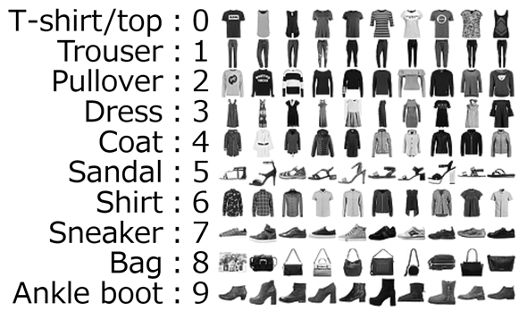
Introduction
Motivation:
“MNIST is too easy.”
“MNIST is overused.”
“MNIST cannot represent modern CV tasks.”
Dataset description:
28x28x1 images
60,000 training examples
10,000 test examples
Notes:
https://atmarkit.itmedia.co.jp/ait/articles/2005/28/news016.html

Slide 3
Methodology

Slide 4
Methodology: Model Ensemble
Predictions
CNN
Best CNN
T-shirt: 20%
…
Boot: 2%
Hyperband tuner
Final prediction
Training data
ResNet50
Best ResNet50
T-shirt: 15%
…
Boot: 4%
T-shirt: 17.6%
…
Boot: 8.6%
Hyperband tuner
Weighted average
ConvNet
Best ConvNet
T-shirt: 18%
…
Boot: 20%
Hyperband tuner
Test data

Slide 5
Hyperband tuner
Basics:
Hyperparameter tuning posed as a pure-exploration multi-armed bandit problem.
Characteristics:
Allocates resources (epochs) to the most promising configurations, discards the rest.
Successive halving
Could we be discarding good candidates too early?
Notes:
https://www.automl.org/blog_bohb/

Slide 6
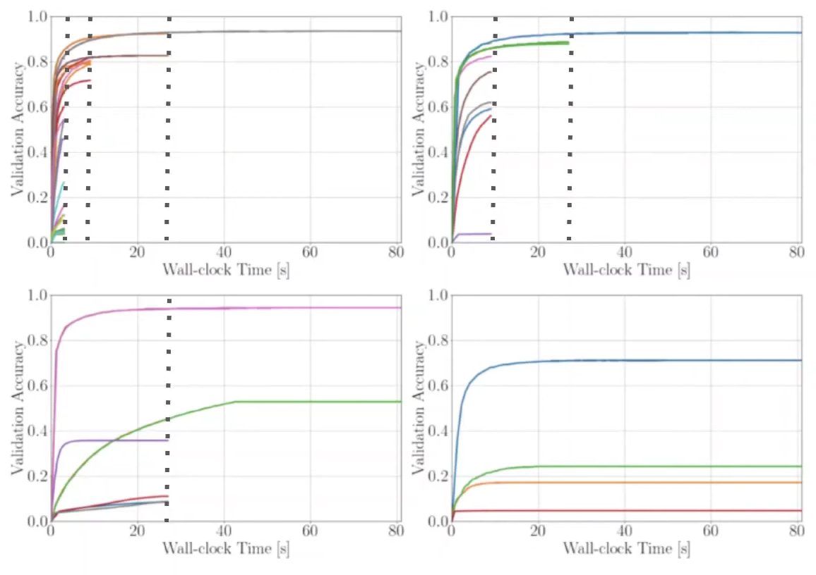
Hyperband tuner
Basics:
Hyperparameter tuning posed as a pure-exploration multi-armed bandit problem.
Characteristics:
Allocates resources (epochs) to the most promising configurations, discards the rest.
Takes into account that good candidates might be discarded early so it uses different “brackets”.
Hyperband brackets
Notes:
https://www.youtube.com/watch?v=JUrU92fTxpo

Slide 7
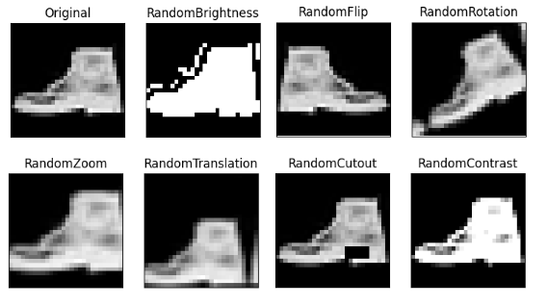
Data Augmentation
RandomBrightness
RandomFlip
RandomRotation
RandomZoom
RandomTranslation
RandomCutout
RandomContrast
Synthethic image generation (GAN)*

Slide 8
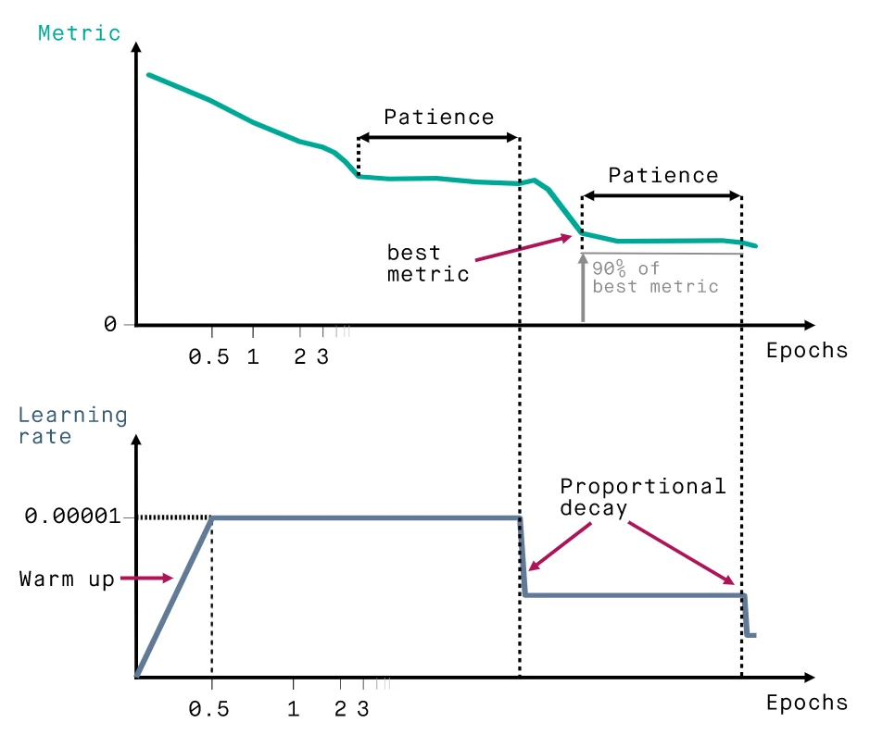
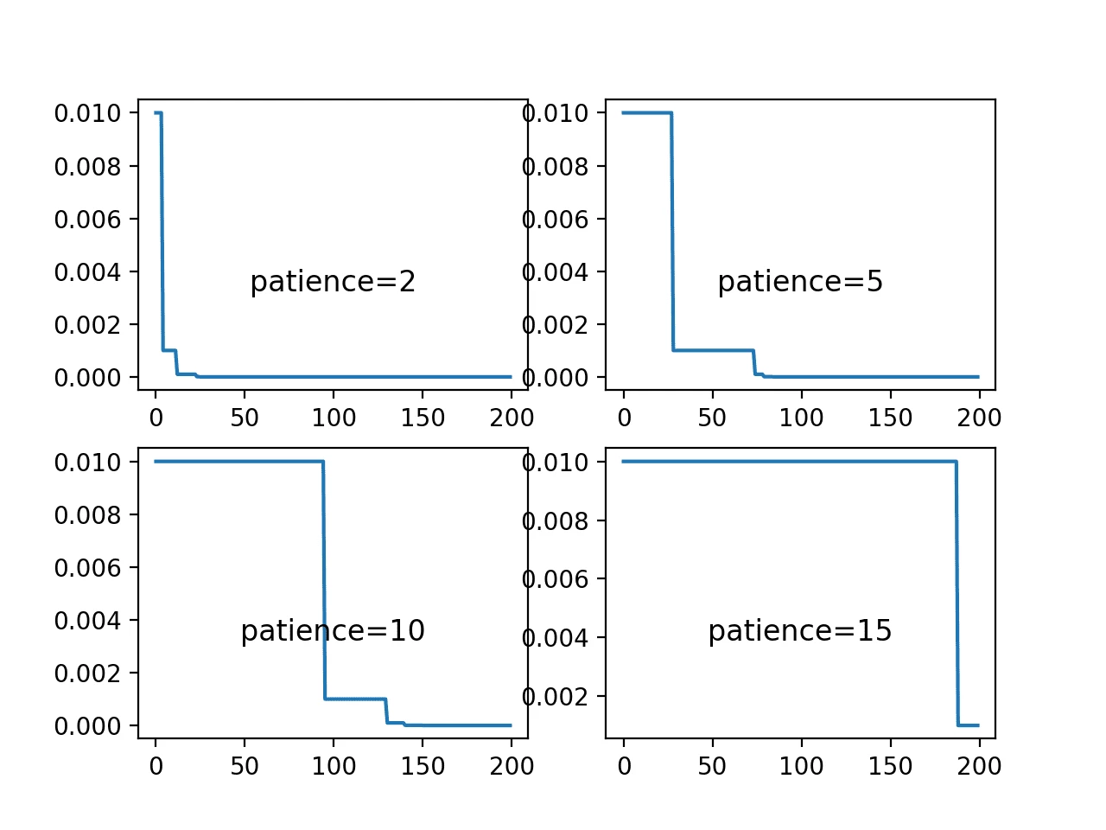
Reduce learning rate on Plateau
We selected patience = 1
Notes:
https://hasty.ai/docs/mp-wiki/scheduler/reducelronplateau

Slide 9
Model training

Slide 10
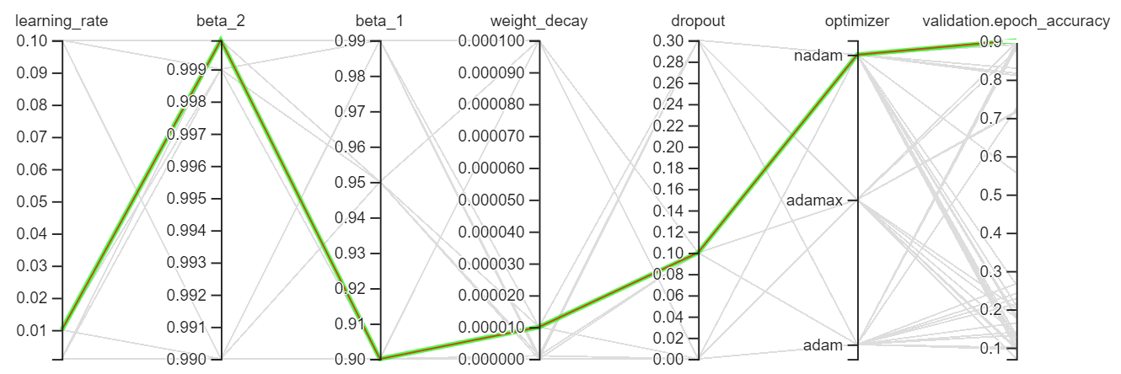
ResNet50 parameter search
90 random configurations tested.
Max budget of 50 epochs w/early stopping.
'optimizer': 'nadam', 'learning_rate': 0.01,
'beta_1': 0.9,
'beta_2': 0.9999,
'weight_decay': 1e-05,
'dropout': 0.1,
Optimal parameters:

Slide 11
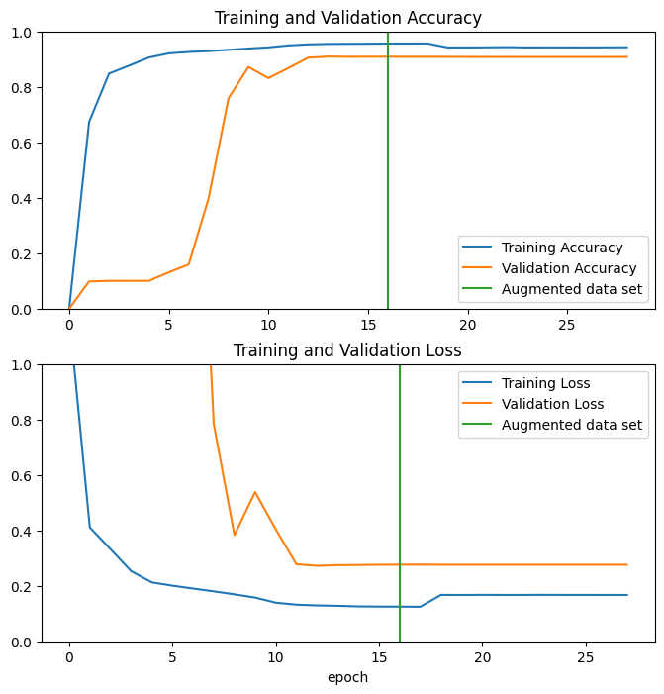
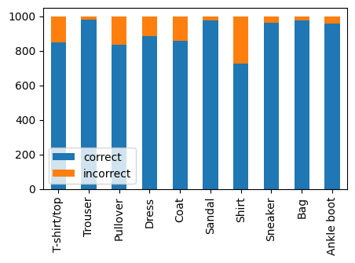
ResNet50 performance
Training accuracy | Validation accuracy | Testing accuracy
0.9622 | 0.9104 | 0.9006
Testing set

Slide 12
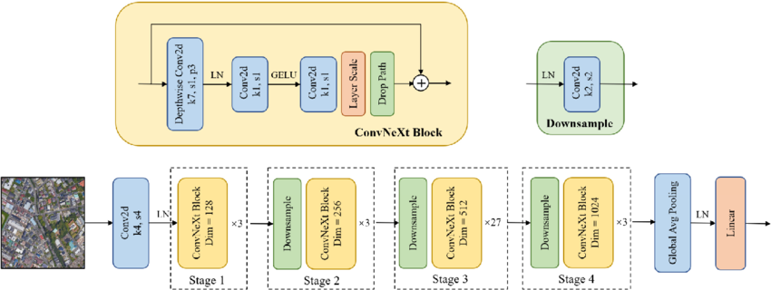
ConvNext
'optimizer': 'nadam', 'learning_rate': 0.001,
'fine_tune_at': 143,
'weight_decay': 1e-04,
‘lr_schedule’: 94_step_0_9
'dropout': 0.1,
Optimal parameters:

Slide 13
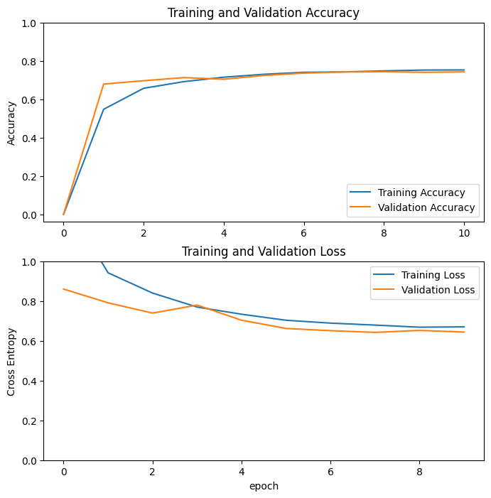
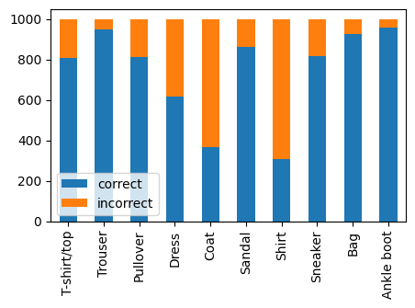
ConvNet performance
Training accuracy | Validation accuracy | Testing accuracy
0.7459 | 0.7425 | 0.7423

Slide 14
Simple CNN
Dense
=2048
Output
=10
64
128
Input
28x28
Conv1
kernel=(3,3)
Max
Pooling
=(2,2)
Conv1
kernel=(3,3)
Max
Pooling
=(2,2)
Flatten
All: activation='relu'

Slide 15
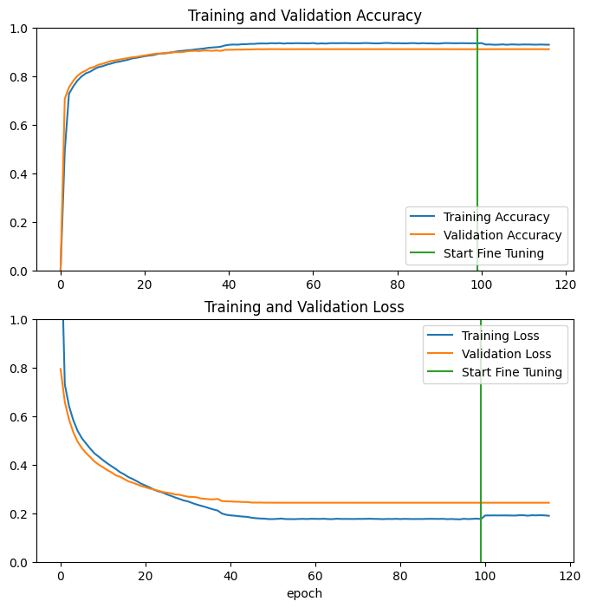

Simple CNN performance
'optimizer': 'nadam', 'learning_rate': 0.001, 'beta_1': 0.9,
'beta_2': 0.99, 'weight_decay': 0.0, 'dropout': 0.1
Training accuracy | Validation accuracy | Testing accuracy
0.9358 | 0.9107 | 0.9016

Slide 16
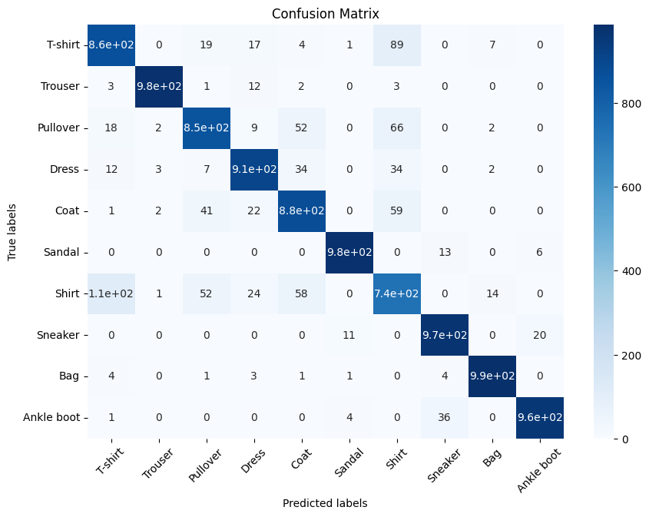
Ensemble performance on testing set
Model | Testing set | Weight
CNN | 0.9016 | 0.45
ResNet50 | 0.9007 | 0.45
ConvNet | 0.7423 | 0.10
Ensemble | 0.911
Our model confuses T-shirts with Shirts the most

Slide 17
Demo EnsembleDemo.ipynb

