Slide 1

Machine Learning Model
Healthcare - Persistency of a drug
Team: DG_team_project_PL-RO-KSA-EGY
Date: May 10, 2021

Slide 2
Executive Summary
This report highlights the machine learning building phase and selection.
ML models experimented:
Support Vector Machine
Logistic Regression
KNN
Random Forest
The highest model accuracy and precision were attained using the logistic regression statistical model.

Slide 3
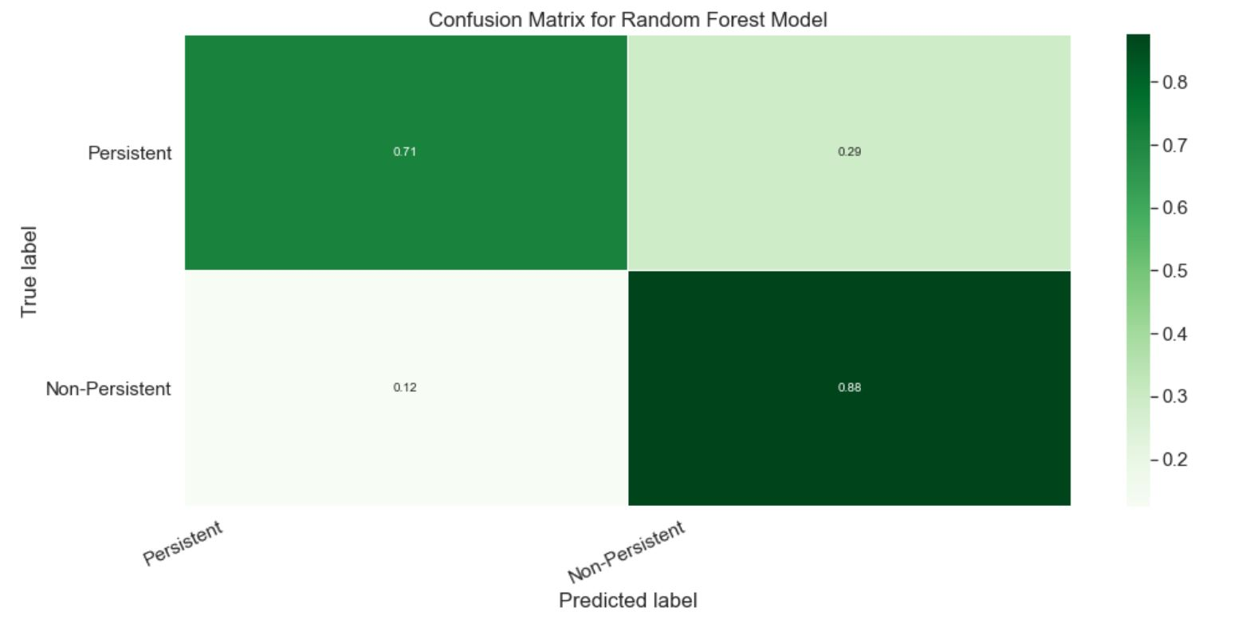
Random Forest Model
Model Trade-offs:
Advantages:
Insensitive to Outliers.
Insensitive to Null values.
Less Prone to overfitting.
Disadvantages:
Losing Interpretability.
Difficult to diagnose and improve.
Summary of results:
Model accuracy: 81% .
F1 Score: 82%
Model was able to predict “Non-Persistent” flags with a 84% precision.
“Persistent” flags lagged with a 76% precision.

Slide 4

Thank You

