Slide 1

Exploratory Data Analysis
Healthcare - Persistency of a drug
Team: DG_team_project_PL-RO-KSA-EGY
Date: May 3, 2021

Slide 2

Agenda
Executive Summary
Problem Statement
Approach
EDA
EDA Summary
Recommendations

Slide 3
Executive Summary
Descriptive, correlation and contextual analysis were made to help the Pharmaceutical company to improve patient adherence to their drug through data-driven insights.
Prior to EDA data set was cleansed of missing values and outliers.
8 hypothesis were constructed to gain knowledge on the subject and formulate final recommendation on features and model selection. Main topics included:
Importance of CT scan
Risks impact
Demographics
Effect of provider attributes
Effect of glucose
Side effects
Most frequent risks
Comorbidities and persistence

Slide 4
Problem Statement
One of the challenge for all Pharmaceutical companies is to understand the persistency of drug as per the physician prescription. To solve this problem ABC pharma company approached an analytics company to automate this process of identification.
Objective:
With an objective to gather insights on the factors that are impacting the persistency, build a classification for the given dataset.

Slide 5
Approach
Verification of data set provided by the Pharmaceutical company, data cleansing (NaN & outliers) and transformation into final data set for EDA and modeling.
Formulation of hypothesis.
Performing EDA over formulated hypothesis (correlation and contextual analysis).
Concluding EDA and writing recommendation for features and model selection.

Slide 6
EDA – data set
„cleaned_data.csv”:
67 features
3425 data entries
Cleaned of missing values
Cleaned of outliers

Slide 7
EDA – hypothsis
Hypothesis no. 1: Since pulmonary NTM disease diagnosis requires a high-resolution CT scan of the lungs, features related to dexa scan (i.e. Dexa_Freq_During_Rx, Dexa_During_Rx) should contribute to drug persistency classification?
Hypothesis no. 2: Features associated with “Risk” in data set are very important classifier of drug persistency?
Hypothesis no. 3: Effects of Demographics on persistency of drugs?
Hypothesis no. 4: Effects of provider attributes on the persistency?
Hypothesis no. 5: Effects of Glucose record During Rx?
Hypothesis no. 6: Side effect analysis based on patients condition since taking the drugs?
Hypothesis no. 7: Most frequent risks?
Hypothesis no. 8: Effect of comorbidities on persistence?
Hypothesis no. 9: Effect of Adherence on persistence?

Slide 8
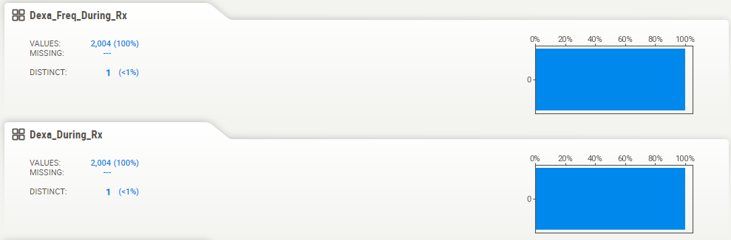
EDA - Hypothesis no. 1 „dexa scan”
Unfortunately, after removing outliers remaining data related to dexa scan is useless for modelling. Both features Dexa_Freq_During_Rx and Dexa_During_Rx give 100% negative. These features should not contribute to modeling.

Slide 9
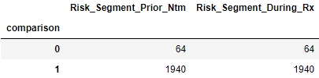
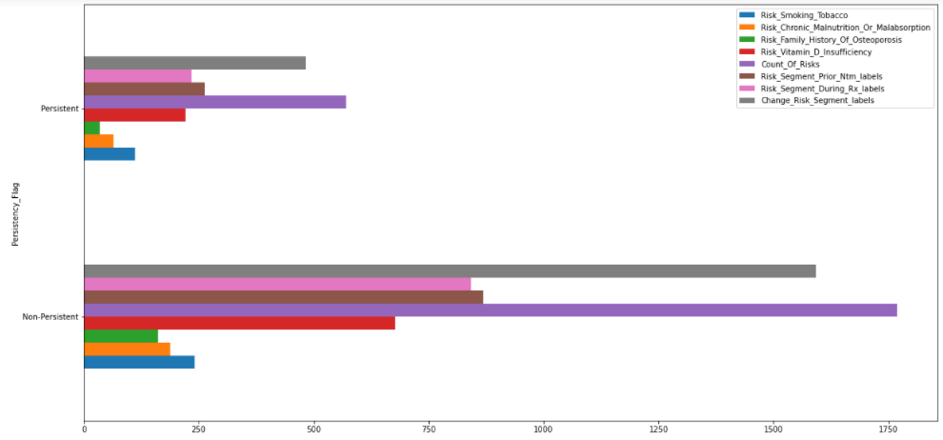
EDA - Hypothesis no. 2
„RISK features as important classifier of drug persistency”
Features: "Risk_Segment_Prior_Ntm" and "Risk_Segment_During_Rx" have nearly same values. Difference between this 2 features is around 3%. Therefore suggestion is to take only one of this features for modeling.
For modeling should be taken all of the features from df_risks apart “Risk_Segment_During_Rx_labels”.

Slide 10
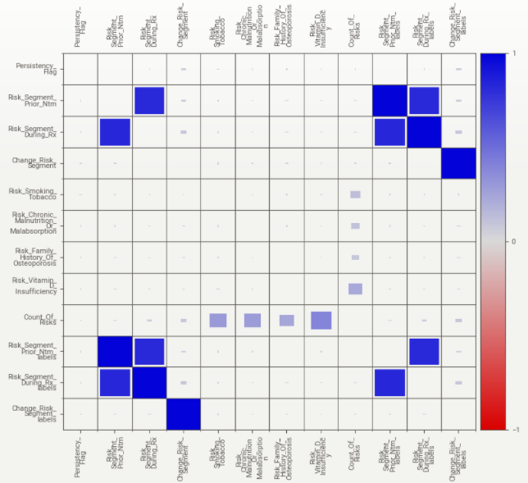
EDA - Hypothesis no. 2
„RISK features as important classifier of drug persistency”

Slide 11
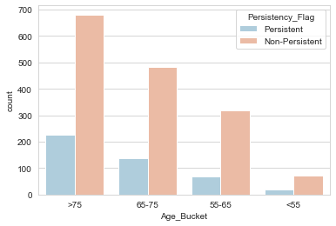
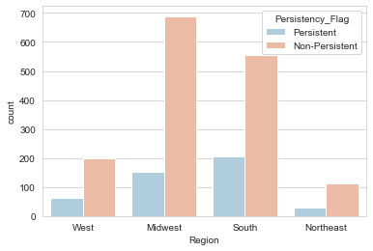
EDA - Hypothesis no. 3
„Effects of Demographics on persistency of drugs?”
Older patients are more persistent.
People from south is more Persistent followed by midwest.

Slide 12
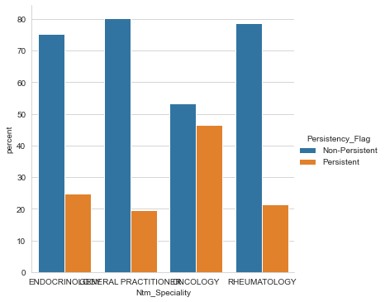
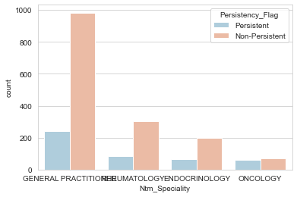
EDA - Hypothesis no. 4
„Effects of provider attributes on the persistency?”
Oncology followed by Endocrinology drugs are more persistent.
In general terms, cancer patients are more persistent in taking medicines followed by diabetes and thyroid patient.

Slide 13
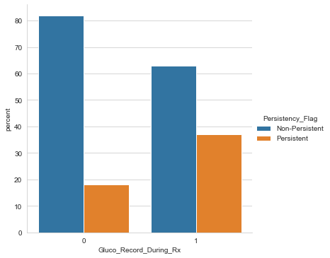
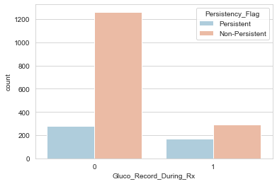
EDA - Hypothesis no. 5
„Effects of Glucose record During Rx?”
When glucose record is considered during RX persistency increases from 18 to 38 %.

Slide 14
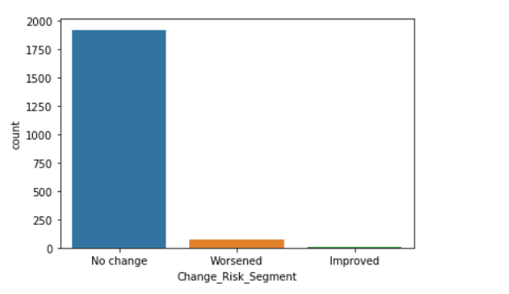
EDA - Hypothesis no. 6
„Side effect analysis based on patients condition since taking the drugs”
After dealing with the Nan values, the graph consulted shows that most of the patients had no side effects, but they neither improved their condition.
This is an example where the dominant category will definitely influence learning only one category and will be of no use when training, and no influence over declaring the persistency of a drug.
For this reason along with consideration of the very small appearance number of the two categories in the dataset, the two categories “Worsened” and “Improved” can be considered outliers. Therefore, after outliers removal, this column will not even exist.

Slide 15
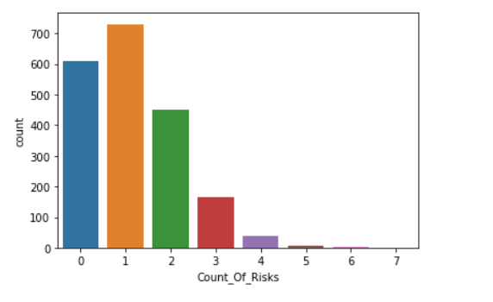
EDA - Hypothesis no. 7
„Most frequent risks”
As a general analysis, there are usually met at most 4 type of risk for each patient. In most cases, for each patient, there is just one risk met.

Slide 16
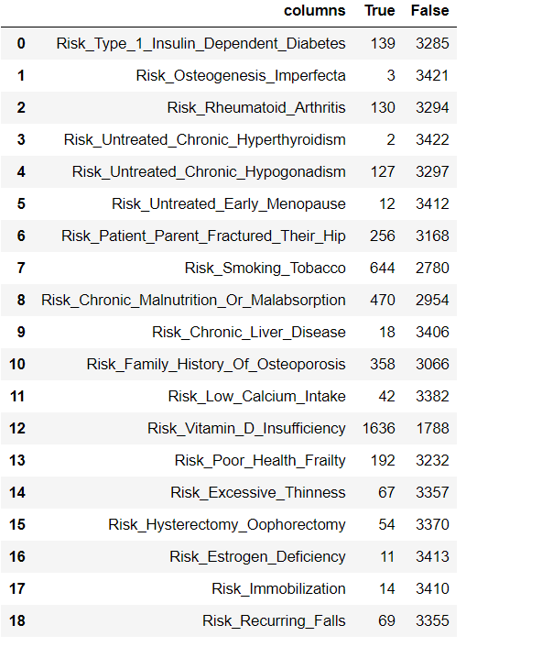
EDA - Hypothesis no. 7
„Most frequent risks”
This graph is made after dealing with NaN values and before dealing with outliers in order to have a clear understanding over overall risks.
This graph shows for how many patients each kind of risk is met. It can be concluded that risk of Vitamin D insufficiency, along with risk of smoking tobacco and risk of chronic malnutrition or malabsorption are the among the most frequent risks.
The rest column risks include outliers and being only 2 categories, those risk columns will be of no use for model training.

Slide 17
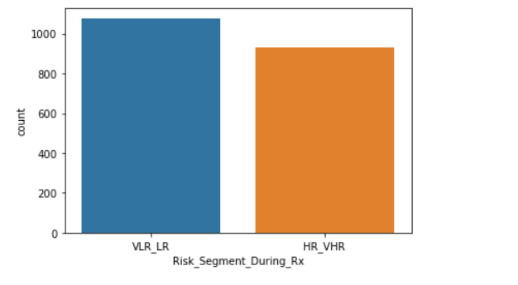
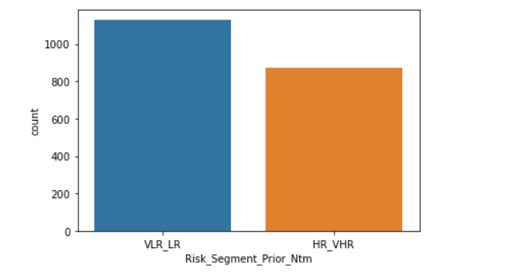
EDA - Hypothesis no. 7
„Most frequent risks”
There are also 2 types of risks: during Rx and before mycobacteria (NTM) treatment, that have other categorical values and are among the most frequent risks.
These graphs are made on he cleaned dataset and are valuable to model training.

Slide 18
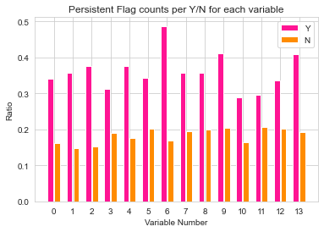
EDA - Hypothesis no. 8
„Effect of comorbidities on persistence”
The plots shows that Persistent_Flag variable is highly dependent on Comorbidities variables; numbered from 0 to 13.
This was validated using a Chi-Square test of Independence.
“Y” flags refer to entries with values “Yes”, similarly “N” refer to “No” values.

Slide 19
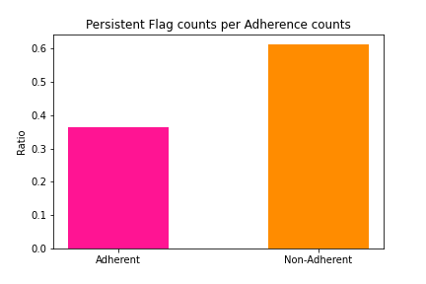
EDA - Hypothesis no. 9
„Effect of Adherence on persistence”
The plots shows that Persistent_Flag variable is also dependent on Adherence Flag.
This was validated using a Chi-Square test of Independence, emphasizing its use in later modeling stages.

Slide 20
EDA Summary
CT scan prior and during therapy has similar values. Therefore, only one of these features should be taken into modeling.
All risk related features should be taken into modeling.
Most of the patients had no side effects, but they neither improved their condition.
The most frequent risks are usually among: Vitamin D insufficiency, risk of smoking tobacco, risk of chronic malnutrition or malabsorption, risks during Rx and before mycobacteria (NTM) treatment.
Variables related to comorbidities and adherence contribute to the likelihood of patients behind persistent with the medication.

Slide 21
Technical aspects – recommended models
Following modeling techniques should be consider for this assignment:
Decision Trees
K-Nearest Neighbors
Logistic Regression
SVM (Support Vector Machines)
Following evaluation metrics will be followed in this assignment:
Accuracy
Precision and Recall
F1/F2 Score
Lift and Gain
KS statistics
AUC-ROC

Slide 22
Thank You

