Slide 1

Final Report
Healthcare - Persistency of a drug
Team: DG_team_project_PL-RO-KSA-EGY
Date: May 15, 2021

Slide 2

Agenda
Project GitHub repository
Project team and schedule
Problem statement
Business understanding and scope identification
Data understanding
EDA and feature engineering
Model building and model selection
Model evaluation
Model deployment
Model governance (food-for-thoughts)

Slide 3
Project GitHub repository
https://github.com/Omar-Safwat/HealthCare_project
|| („Findings” folders – work of team members, „Week” folders – combined works)
|-- Afshan-Findings
|-- Larisa-Findings
|-- Omar-Findings
|-- Roger-Findings
|-- Week_7
|-- Week_8
|-- Week_9
|-- Week_10-11
|-- Week_12
|-- Week_13

Slide 4
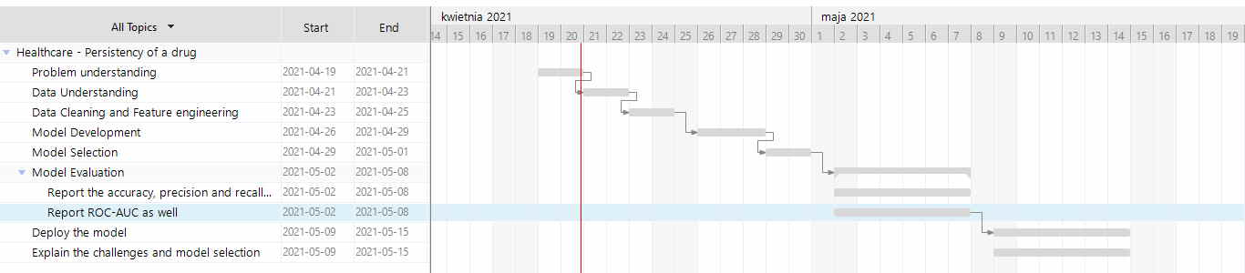
Project team and schedule

Slide 5
Problem Statement
One of the challenge for all Pharmaceutical companies is to understand the persistency of drug as per the physician prescription. To solve this problem ABC pharma company approached an analytics company to automate this process of identification.
Objective:
With an objective to gather insights on the factors that are impacting the persistency, build a classification for the given dataset.

Slide 6
Business understanding and scope identification (Week_7)
Patients around the world are suffering from mycobacteria (NTM). The most common clinical manifestation of NTM disease is lung disease.
Pulmonary NTM disease diagnosis requires both identification of the mycobacterium in the patient's lungs, as well as a high-resolution CT scan of the lungs.
Failure to adhere to prescribed-medication regimens is one of the principal reasons patients don’t achieve the expected outcomes from their treatment. Solving this challenge has been a major goal for pharmaceutical and healthcare organizations for decades.
An estimated 125,000 lives are lost annually in the United States and additional healthcare expenditures of 290 billion USD are driven bynonadherence.

Slide 7
Data understanding (Week_8)
The Pharmaceutical company provided dataset called in xlsx format.
69 features were discovered, among them 1 label required for classifier to rely on (Persistancy_Flag).
3424 data entries were discovered.
99% features were provided as categorical data and needed to be turned into numerical for ML model.
Missing values were present within 7 features.
Outliers were present within 23 features.
Skewed data was not present.

Slide 8
Data cleansing and transformation (Week_9)
1. Missing data in total: 7278 values which means 3%.
Approaches used:
prediction using regression technique
imputation using KNN technique
2. Outliers in total: in 23 of 69 features which means 33%.
Approaches used:
deletion of feature
deletion of row containing outlier
3. Outcome:
EDA dataset: cleaned_data.csv with categorical values
Training dataset: data_training.csv with numerical values

Slide 9
EDA and feature engineering (Week_10-11)
8 hypothesis were constructed to gain knowledge on the subject and formulate final recommendation on features and model selection. Main topics included:
Importance of CT scan
Risks impact
Demographics
Effect of provider attributes
Effect of glucose
Side effects
Most frequent risks
Comorbidities and persistence

Slide 10
Model building and model selection (Week_12)
1. Following models were developed by team members:
Decision Trees
K-Nearest Neighbors (KNN)
Logistic Regression
Support Vector Machines (SVM)
2. Following evaluation metrics were used to assess models:
Accuracy
Precision and Recall
F1/F2 Score
Lift and Gain
KS statistics
AUC-ROC

Slide 11
Model evaluation (Week_13)
 |  | Decision Trees | KNN | Logistic Regression | SVM
Accuracy (highest) |  | 82% | 79% | 84% | 84%
Precision | O (False) | 0.76 | 0.53 | 0.86 | 0.85
 | 1 (True) | 0.84 |  | 0.80 | 0.77
F1-score | O (False) | 0.74 | 0.61 | 0.87 | 0.90
 | 1 (True) | 0.86 |  | 0.78 | 0.53
ROC AUC score |  | - | - | 0.90 | 0.83

Slide 12
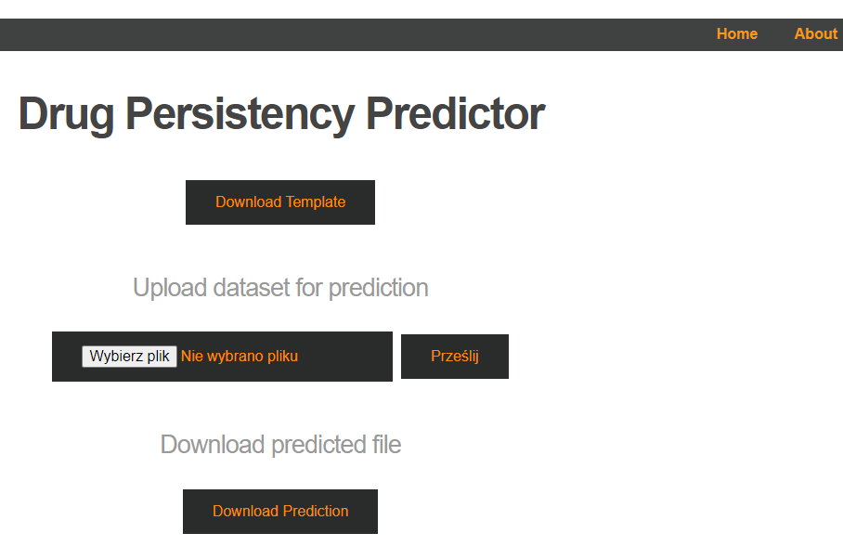
Model deployment (Week_13)
Following cloud solution was implemented on Heroku
As data needs to be in specific format user can download template.
User provides filled template to predictor.
After ML computation user can download file with prediction.
https://healthcare-project-plroksaegy.herokuapp.com/

Slide 13
Model governance (food-for-thoughts)
Training should be provided to the organization on how to use the ML model.
Each submittal of data on webapp should contribute to expansion of data set.
Quarterly new model will be trained based on expanded dataset.

Slide 14
Thank You

