Slide 1

Machine Learning Model
Healthcare - Persistency of a drug
Team: DG_team_project_PL-RO-KSA-EGY
Date: May 10, 2021

Slide 2
Executive Summary
This report highlights the machine learning building phase and selection.
ML models experimented:
Support Vector Machine
Logistic Regression
KNN
Random Forest
The highest model accuracy and precision were attained using the logistic regression statistical model.

Slide 3
Random Forest Model
Model Trade-offs:
Advantages:
Insensitive to Outliers.
Insensitive to Null values.
Less Prone to overfitting.
Disadvantages:
Losing Interpretability.
Difficult to diagnose and improve.
Results obtained:
Accuracy: 79 – 81 %

Slide 4
Support Vector Machine Model
Model Trade-offs:
Advantages:
Can successfully handle high dimensional data
Can successfully handle imbalanced classes
Disadvantages:
Difficult to diagnose and improve
Quite sensitive to outliers – training on dataset with outliers decreased model accuracy
Not suitable for large datasets since the training time will be higher
Results obtained:
Accuracy: 84 %
Techniques applied for improving worsened the model performance:
Upsampling
Downsampling
PCA dimension reduction

Slide 5

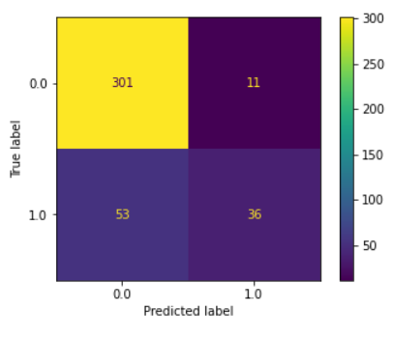
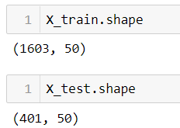
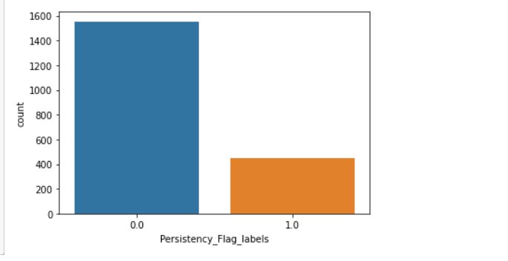
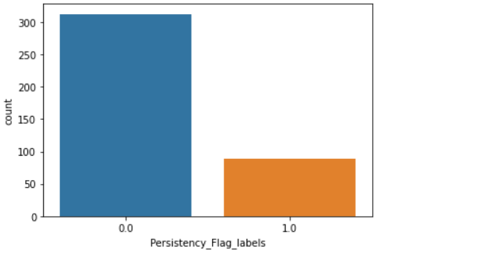
Support Vector Machine Model Results
Test predictions

Slide 6
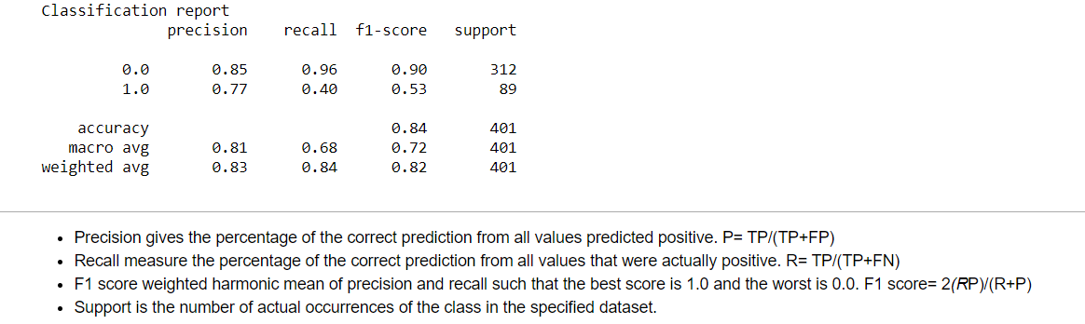

Support Vector Machine Model Results

Slide 7
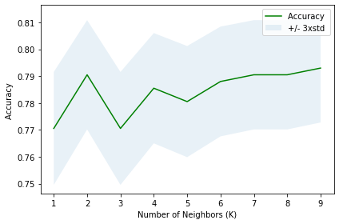
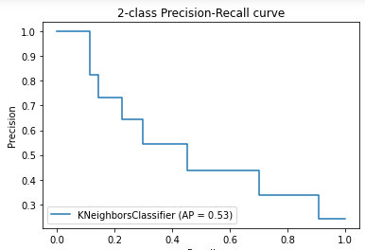

KNN Model Results
Best
0.7930

Slide 8
KNN Model Results
Advantages of KNN Algorithm:
It is simple to implement.
It is robust to the noisy training data
It can be more effective if the training data is large.
Disadvantages of KNN Algorithm:
Always needs to determine the value of K which may be complex some time.
The computation cost is high because of calculating the distance between the data points for all the training samples.

Slide 9
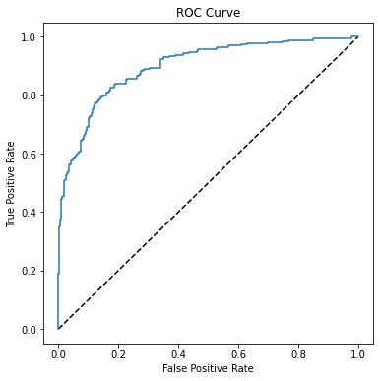
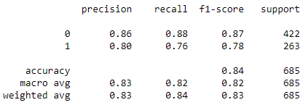

Logistic Regression Model Results

Slide 10

Thank You

