Slide 1

Machine Learning Model
Healthcare - Persistency of a drug
Team: DG_team_project_PL-RO-KSA-EGY
Date: May 10, 2021

Slide 2
Executive Summary
This report highlights the machine learning building phase and selection.
ML models experimented:
Support Vector Machine
Logistic Regression
KNN
Random Forest
The highest model accuracy and precision were attained using the logistic regression statistical model.

Slide 3
Random Forest Model
Model Trade-offs:
Advantages:
Insensitive to Outliers.
Insensitive to Null values.
Less Prone to overfitting.
Disadvantages:
Losing Interpretability.
Difficult to diagnose and improve.
Results obtained:
Accuracy: 79 – 81 %

Slide 4
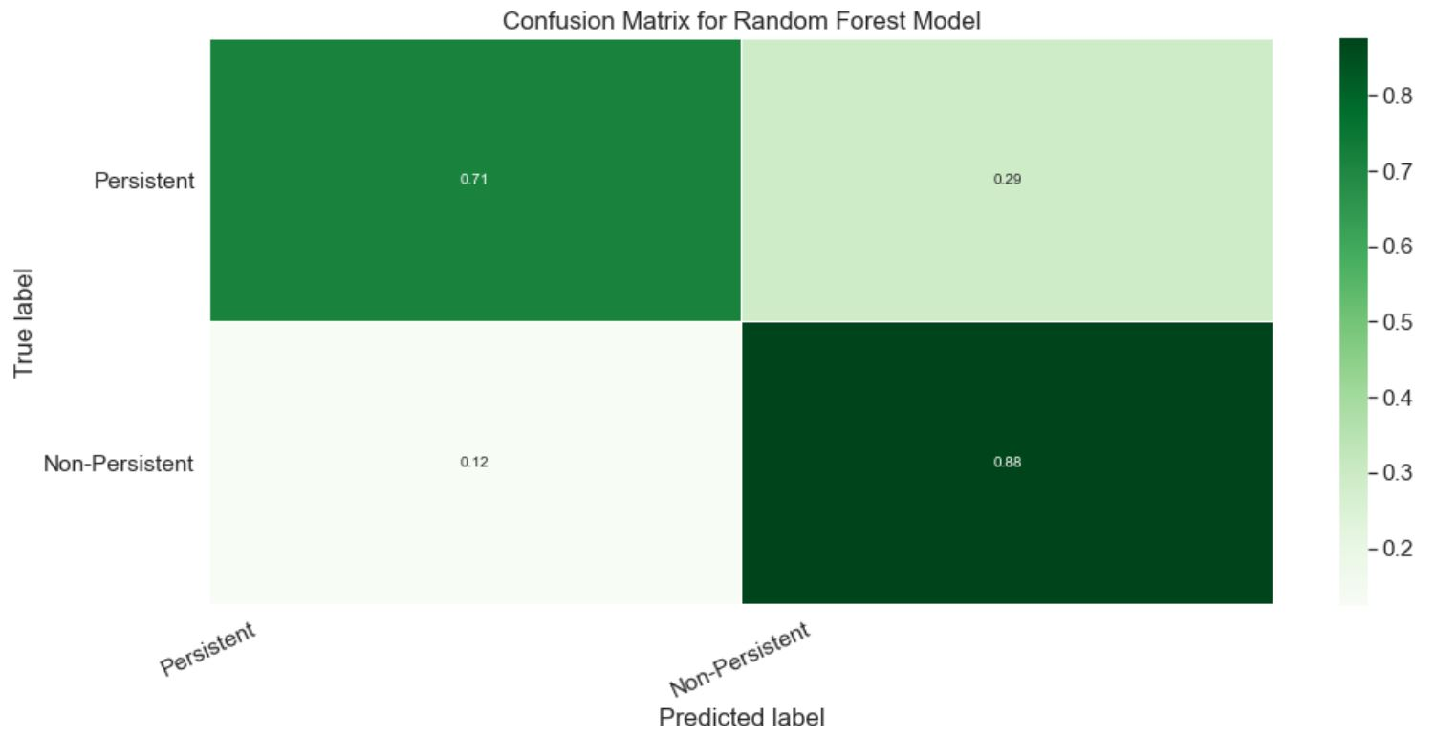
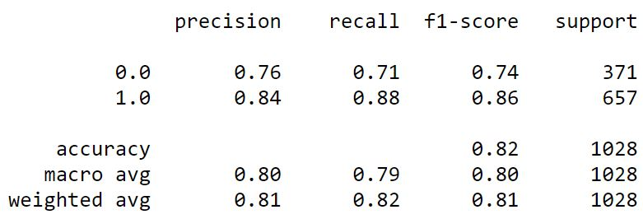
Random Forest Model
0.0 correlates to “Persistent” flag.
1.0 correlates to “Non-Persistent” flag.

Slide 5
Support Vector Machine Model
Model Trade-offs:
Advantages:
Can successfully handle high dimensional data
Can successfully handle imbalanced classes
Disadvantages:
Difficult to diagnose and improve
Quite sensitive to outliers – training on dataset with outliers decreased model accuracy
Not suitable for large datasets since the training time will be higher
Results obtained:
Accuracy: 84 %
Techniques applied for improving worsened the model performance:
Upsampling
Downsampling
PCA dimension reduction

Slide 6

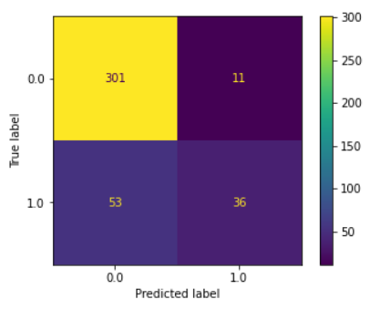
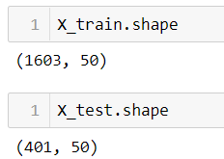
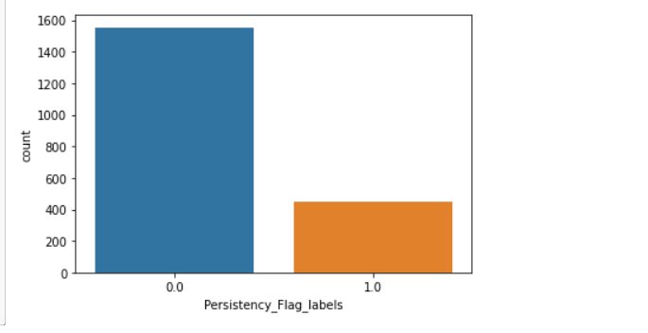
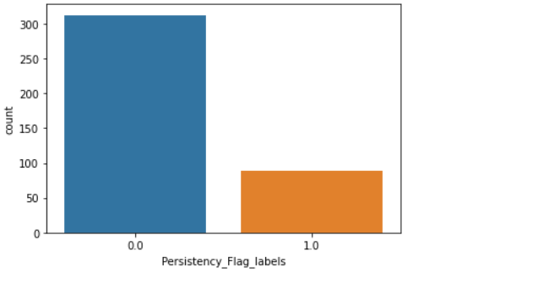
Support Vector Machine Model Results
Test predictions

Slide 7
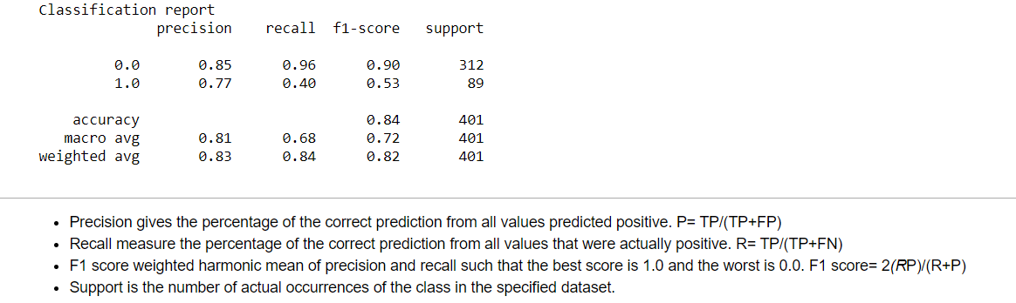

Support Vector Machine Model Results

Slide 8
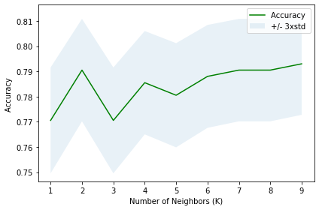
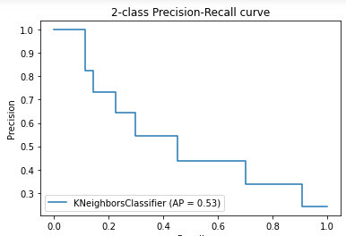

KNN Model Results
Best
0.7930

Slide 9
KNN Model Results
Advantages of KNN Algorithm:
It is simple to implement.
It is robust to the noisy training data
It can be more effective if the training data is large.
Disadvantages of KNN Algorithm:
Always needs to determine the value of K which may be complex some time.
The computation cost is high because of calculating the distance between the data points for all the training samples.

Slide 10

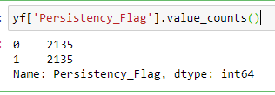
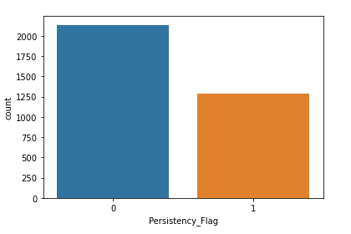
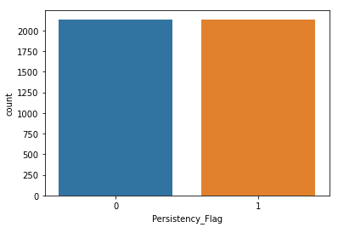
Imbalanced class were balanced using SMOTE

Slide 11
SMOTE-Synthetic minority oversampling Technique
Increases the number of low incidence examples in a dataset using synthetic minority oversampling.
SMOTE takes the entire dataset as an input, but it increases the percentage of only the minority cases.
SMOTE reduces the bias towards the classification ..

Slide 12
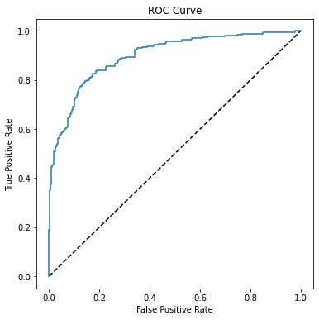
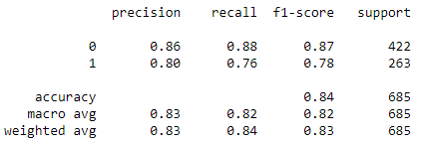

Logistic Regression Model Results

Slide 13

Thank You

