Slide 1

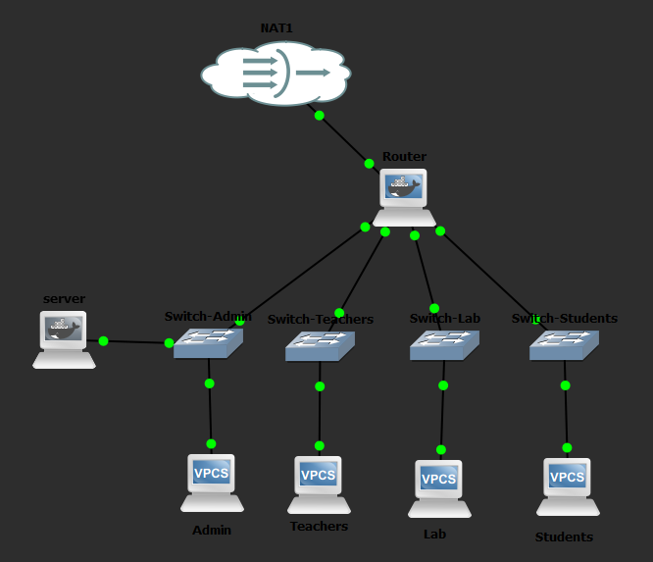
SECURE LOCAL SCHOOL
NETWORK SYSTEM
Project Report
Project Team
Supervisor:
Jehad Hamamreh
Students:
Omar Salous (12427830)
Ferial Kalboneh (12428346)
GNS3 topology with segmented departments and protected internal services

Slide 2
About the Project
Purpose and overall design
Overview
Key Outcomes
Design a secure local school network using GNS3.
Connect Administration, Teachers, Lab, and Students through one router.
Allow controlled communication between departments while protecting sensitive resources.
Provide internal services through a dedicated server: DHCP, Web Server, and File Sharing.
Four subnets with clear gateways.
Firewall policy blocks Students from the Admin network.
NAT enables Internet access through the external interface.
Testing confirms service availability and enforced security rules.

Slide 3
Objectives
What the implementation aimed to achieve
Project Objectives
Connect different school departments
Separate networks using subnets
Improve network security
Provide internal services
Enable routing between allowed networks
Verify operation with practical ping tests
Internal services include DHCP, Web Server, and Samba File Sharing.

Slide 4
Network Topology
Main components and departmental layout
Components
1 Router
4 Switches
4 PCs
1 Server
1 NAT connection

Slide 5
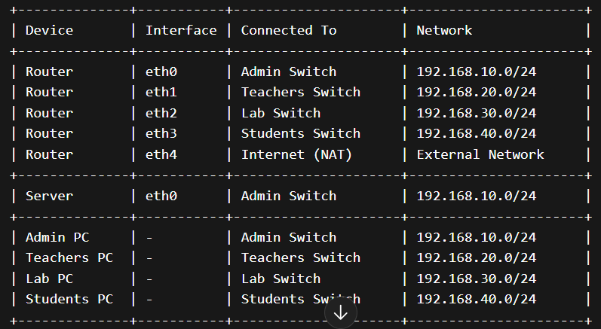
IP Addressing and Device Connections
Subnet plan and key interfaces
Connection Map
Addressing Summary
Admin → 192.168.10.0/24 | gateway 192.168.10.1
Teachers → 192.168.20.0/24 | gateway 192.168.20.1
Lab → 192.168.30.0/24 | gateway 192.168.30.1
Students → 192.168.40.0/24 | gateway 192.168.40.1
Server → 192.168.10.100 in the Admin subnet
Router eth4 obtains Internet access from NAT

Slide 6
PC Configuration
Static addressing for departmental PCs
Admin
Teachers
ip 192.168.10.10 255.255.255.0 192.168.10.1
ip 192.168.20.10 255.255.255.0 192.168.20.1
Lab
Students
ip 192.168.30.10 255.255.255.0 192.168.30.1
ip 192.168.40.10 255.255.255.0 192.168.40.1
VPCS devices can save the configuration using the save command.

Slide 7
Routing and Security Design
How the router controls communication
Routing
Security
Router Services
The router connects all four internal networks.
Each subnet uses its local router interface as the default gateway.
IP forwarding is enabled to allow inter-network routing.
NAT on eth4 provides outbound Internet access.
Students are blocked from reaching the Admin network.
Teachers and Lab remain reachable where allowed.
The rule is implemented using iptables FORWARD filtering.
eth0 → Admin / Server
eth1 → Teachers
eth2 → Lab
eth3 → Students
eth4 → NAT / Internet

Slide 8
Internal Server Services
Central services hosted in the Admin subnet
Server
Services
Testing Focus
Static IP: 192.168.10.100
Connected to the Admin switch
Acts as the internal service platform
Apache Web Server
dnsmasq for DHCP
Samba for File Sharing
Ping verification between networks
Web page reachable locally
Shared folder visible on the server
Security rule successfully enforced

Slide 9
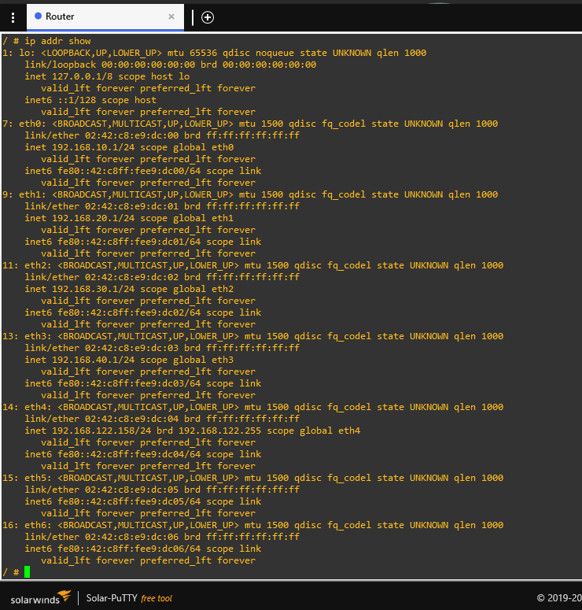
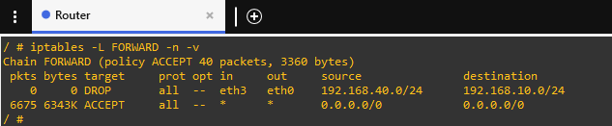
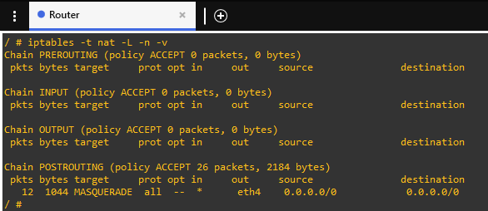
Router Verification
Addressing, firewall, and NAT evidence
Router Interfaces and IP Addressing
Firewall Rules on the Router
What the Screens Show
All internal interfaces are configured with the correct gateways.
FORWARD chain includes a DROP rule from Students to Admin.
POSTROUTING uses MASQUERADE on eth4 for Internet access.
NAT Configuration for Internet Access

Slide 10
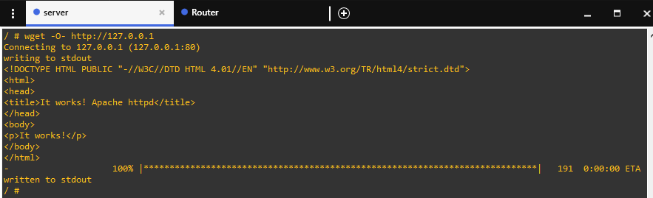
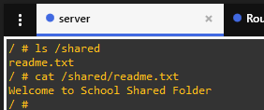
Service Verification
Evidence that Web and File Sharing are running
Local Web Server Test
Interpretation
The Apache test confirms the internal school page is served correctly.
The shared folder contains the expected readme file.
Together they prove the server is actively delivering internal services.
Shared Folder Verification

Slide 11
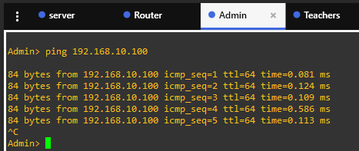
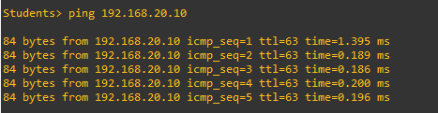
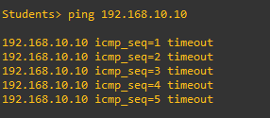
Testing and Verification
Connectivity success and policy enforcement
Admin to Server Connectivity Test
Students Can Access Allowed Networks
Students Blocked from Accessing Admin Network
Verification Summary
Admin can reach the internal server successfully.
The Students-to-Admin ping fails as intended.
Students can still reach a permitted subnet, confirming selective filtering.

Slide 12
Conclusion
Project outcome
Final Remarks
A secure and organized school network was designed and implemented in GNS3.
Departments were separated into subnets and connected through one central router.
Internal services were successfully deployed through the server.
Security rules protected the Admin network while keeping allowed communication available.
Thank You

