Slide 1
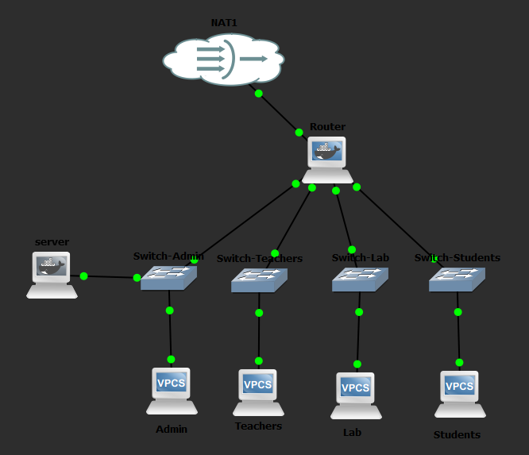
Secure Local School
Network System
Project Report
Supervisor: Jehad Hamamreh Omar Salous (12427830) Ferial Kalboneh (12428346)
Simulated in GNS3 · Segmented Departments · Protected Internal Services

Slide 2
OVERVIEW
About the Project
Purpose
Key Outcomes
Design a secure local school network using GNS3.
Connect Administration, Teachers, Lab, and Students through one router.
Allow controlled communication between departments while protecting sensitive resources.
Provide internal services via a dedicated server: DHCP, Web Server, and File Sharing.
Four subnets with clear gateways.
Firewall policy blocks Students from the Admin network.
NAT enables Internet access through the external interface.
Testing confirms service availability and enforced security rules.
2 / 12

Slide 3
OBJECTIVES
Project Objectives
01
02
03
Departmental
Connectivity
Network
Segmentation
Security
Enforcement
Connect all school departments through a single central router.
Separate each department into distinct subnets.
Block unauthorized access using iptables firewall rules.
04
05
06
Internal
Services
Inter-Network
Routing
Practical
Verification
Deploy DHCP, Web Server, and Samba File Sharing.
Enable routing between permitted networks via IP forwarding.
Verify operation using ping tests across all departments.
3 / 12

Slide 4
TOPOLOGY
Network Topology
Components
1
Router
4
Switches
4
PCs (1 per dept.)
1
Server (Admin)
1
NAT connection
4 / 12

Slide 5
ADDRESSING
IP Addressing & Subnets
Each department occupies a /24 subnet → 2³² ⁻ ²⁴ − 2 = 254 usable host addresses
Department
Network / Address
Gateway
Subnet Mask
Notes
Administration
192.168.10.0/24
192.168.10.1
255.255.255.0
Hosts Server
Teachers
192.168.20.0/24
192.168.20.1
255.255.255.0
Lab
192.168.30.0/24
192.168.30.1
255.255.255.0
Students
192.168.40.0/24
192.168.40.1
255.255.255.0
Restricted
Server
192.168.10.100
192.168.10.1
255.255.255.0
Static IP
5 / 12

Slide 6
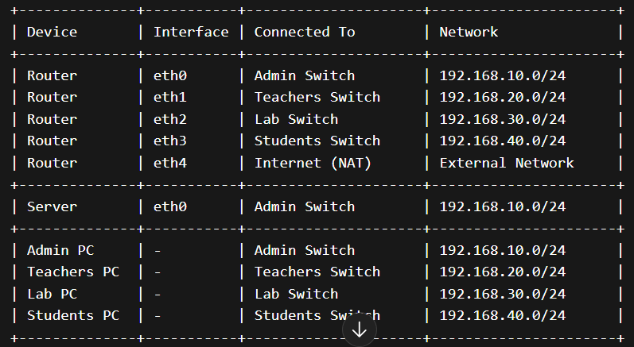
CONNECTIONS
Device Connection Map
Each router interface connects to a dedicated switch serving its department subnet.
6 / 12

Slide 7
CONFIGURATION
PC Static Configuration
Each VPCS device is assigned a static address in the format: ip <address> <mask> <gateway>
Administration
ip 192.168.10.10 255.255.255.0 192.168.10.1
Teachers
ip 192.168.20.10 255.255.255.0 192.168.20.1
Lab
ip 192.168.30.10 255.255.255.0 192.168.30.1
Students
ip 192.168.40.10 255.255.255.0 192.168.40.1
Configuration is saved with the save command in VPCS.
7 / 12

Slide 8
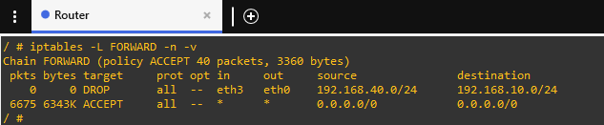
SECURITY
Routing & Security Design
Routing
Security
All four subnets connect through a single router.
Each subnet uses its local router interface as the default gateway.
IP forwarding is enabled for inter-network routing.
NAT on eth4 provides outbound Internet access.
Students are blocked from reaching the Admin network.
Teachers and Lab remain reachable where allowed.
Rules implemented using iptables FORWARD chain filtering.
Live Firewall Output — iptables -L FORWARD
8 / 12

Slide 9
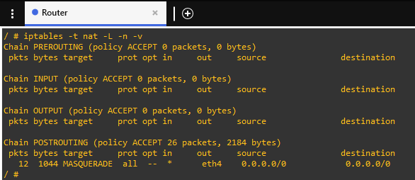
SECURITY
Routing & Security Design
NAT Configuration — iptables -t nat -L
8 / 12

Slide 10
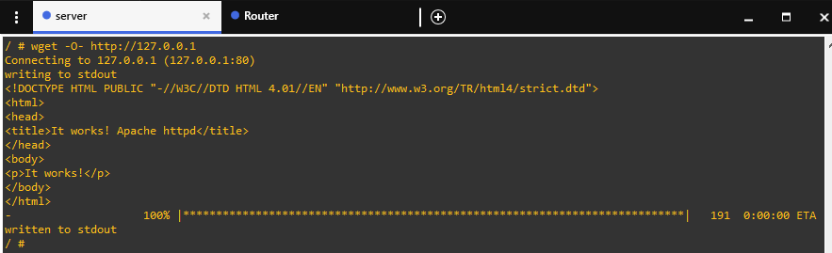
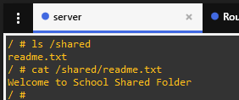
SERVICES
Internal Server Services
Server
Apache Web Server
Serves the internal school web page on HTTP.
Static IP: 192.168.10.100 Location: Admin switch Role: Central internal service platform
Samba File Share
Shared folder accessible over the internal network.
dnsmasq (DHCP)
Distributes IP addresses dynamically within subnets.
9 / 12

Slide 11
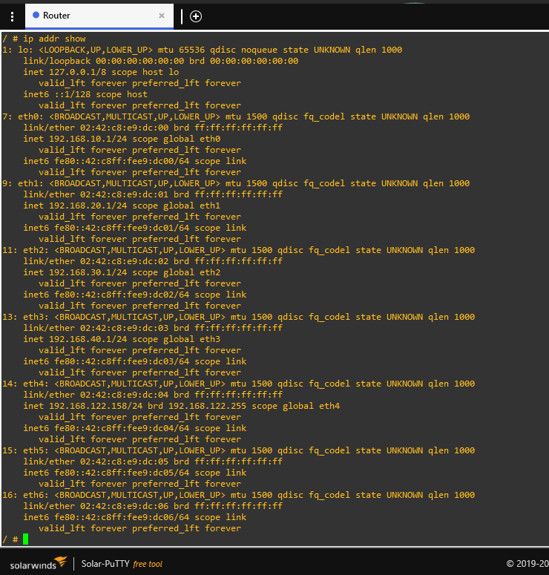
VERIFICATION
Router Verification
1. Interface Addressing — ip addr show
2. Firewall FORWARD Chain — iptables -L
3. NAT POSTROUTING — iptables -t nat -L
All interfaces configured correctly. DROP rule from Students→Admin confirmed. MASQUERADE on eth4 for Internet access.
10 / 12

Slide 12
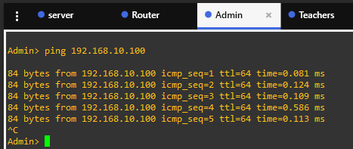
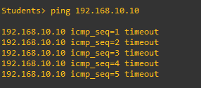
TESTING
Testing & Verification
PASS
Admin → Server
192.168.10.10 pings 192.168.10.100 successfully.
BLOCKED
Students → Admin
FORWARD DROP rule blocks all packets — timeout shown.
11 / 12

Slide 13
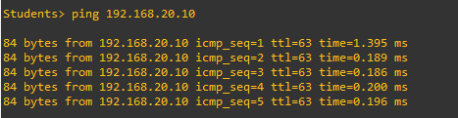
TESTING
Testing & Verification
PASS
Students → Teachers
Students can reach permitted subnets — selective filter.
11 / 12
PASS
Web Server & Samba
Apache page served. Samba readme.txt visible.

Slide 14
Conclusion
01 A secure, organized school network was designed and fully simulated in GNS3.
02 Departments were isolated into four /24 subnets, each with its own gateway.
03 Internal services — DHCP, Web Server, and File Sharing — were successfully deployed.
04 Firewall rules protected the Admin network while keeping permitted communication available.
Thank You

