Slide 1


Arab Academy for Science, Technology and Maritime Transport
College of Computing and Information Technology – Cairo
Course Name: Introduction to Software Engineering
Course Code:CSE2001
12th Week Project Documentation
Project Name: Nutrition Tracker
Nutrition Tracker is a digital platform that connects users with professional nutritionists. Users register, set up their profile, choose a subscription plan, and receive a personalized meal plan. The system handles payments, discount codes, and progress tracking, all in one place.
Presented By:
Name 1 :Seif Yasser
Name 2 :Omar Akram
Reg # 2 :241004666
Reg # 1 : 241004681
Presented To:
Dr.Eman ElSayed Mahmoud
Eng.Anas Ahmad Ibraheem

Slide 2
nutrition tracker
the best choice to manage your food

Slide 3

Table of contents
Introduction
Problem Statement
Project Goals
Project Objectives
Functional Requiemenets
Non Functional Requirments
UML Design
Usecase Diagram
Activity Diagram
Sequence Diagram
Misuse case Diagram
Class Diagram
Implementation
Conclusion and Summary
End Your Presentation

Slide 4


Introduction
Nutrition Tracker is a digital platform designed to bridge the gap between people seeking better health and the professional nutritionists who can guide them. Instead of searching for advice online or booking expensive in-person consultations, users get a structured, personalized experience, from setting their goals to receiving a custom meal plan, all in one place.

Slide 5
Problem Statement
Eating better sounds simple, but for most people it is not. Without professional guidance, many end up following generic diets that do not match their body, goals, or lifestyle. On the other side, nutritionists have no dedicated digital tool to manage their clients, track progress, or deliver meal plans efficiently. The gap between people who need nutrition help and professionals who can provide it remains wide — and no organized platform currently closes it. Nutrition Tracker was built to solve exactly that.

Slide 6
Project Goals
1- Connect users directly with qualified, real nutritionists — not generic advice.
2-Make the entire journey seamless, from registration to receiving a meal plan.
3-Give nutritionists a proper workspace to manage clients and track their progress.
4-Ensure every payment is secure, transparent, and confirmed instantly.
5-Put admins in full control of the platform without technical complexity.

Slide 7
Project Objectives
1-A new user can register, complete their full health profile, and
finish payment in under 5 minutes.
2-Every nutritionist is immediately notified
when a new client is assigned to them.
3-Users can view their personalized meal plan and
send progress updates at any time.
4-The system automatically confirms payments and
notifies both the user and their nutritionist.
5-Admins can manage every user, nutritionist, and
subscription from a single dashboard.

Slide 8
Functional Requiemenets
ID | Name | Describtion
FR1 | User Registration & Login | Users can create an account, log in, and reset their password
FR2 | Health Profile Setup | Users fill in age, weight, height, goals, and training schedule
FR3 | Choose Subscription Plan | Users view and select a plan, optionally apply a discount code
FR4 | Make Payment | Payment via gateway, system confirms and notifies user & nutritionist
FR5 | View Meal Plan | Users view their personalized meal plan from their dashboard
FR6 | Send Progress Updates | Users submit progress reports directly to their nutritionist
FR7 | Nutritionist View Clients | Notified when assigned a client, can view full profile and goals
FR8 | Create & Update Meal Plans | Nutritionists create plans and update them based on progress
FR9 | Admin Manage Users | Admin can add, edit, or remove user and nutritionist accounts
FR10 | Admin Manage Subscriptions | Admin creates and manages subscription plans and discount codes
FR11 | Auto Notifications | System sends notifications after payment, assignment, and progress updates

Slide 9
Non-Functional Requirements
1-Performance: Pages and dashboards must load within 3 seconds under normal usage. The payment process must complete without delays to ensure a smooth and frustration-free user experience.
2-Security: All user data and payment information must be fully encrypted during transfer and storage. Passwords are stored using secure hashing algorithms and are never saved in plain text. Each user can only access their own data based on their role in the system.
3-Usability: The platform must be simple and intuitive enough that a brand new user can register, fill in their full health profile, and complete their subscription payment in under 5 minutes — without needing any instructions or external help.
4-Availability: The system must remain available at least 99% of the time, meaning no more than roughly 4 hours of downtime per month. Both users and nutritionists must be able to access the platform at any time of the day without interruption.

Slide 10
Non-Functional Requirements-continued
5-Scalability: The system must be built to grow. As the number of users and nutritionists increases over time, the platform must continue to perform at the same speed and quality without crashing or slowing down.
6-Reliability: Payment processing must be fully accurate and dependable at all times. No payment should ever be lost, duplicated, or incorrectly charged. In the event of a system crash, no user data or transaction records should be lost.
7-Maintainability: The codebase must be clean, well-structured, and easy to understand. Any developer joining the project should be able to fix bugs or add new features without breaking existing functionality or needing to rewrite large parts of the system.
8-Compatibility: The platform must work correctly across all major browsers including Chrome, Firefox, Safari, and Edge. It must also display and function properly on both desktop and mobile screen sizes without any loss of feature.

Slide 11
UML Design
This section presents the visual models of the Nutrition Tracker system. Five UML diagrams were created to document the system from different perspectives, covering user behavior, system workflow, object structure, time-ordered interactions, and security threats. Together they provide a complete picture of how the system is designed and how its components relate to each other.

Slide 12
1-UseCase Diagram
This diagram shows who uses the system and what they can do. The User registers, logs in, fills their profile, chooses a subscription, pays, views their meal plan, and sends progress updates. The Nutritionist views client data, analyzes it, and creates or updates the meal plan. The Admin manages users, nutritionists, and subscriptions. The Payment Gateway processes and confirms the payment. Some actions are linked together — for example applying a discount extends the payment step, and confirming payment is included as part of processing it.

Slide 13
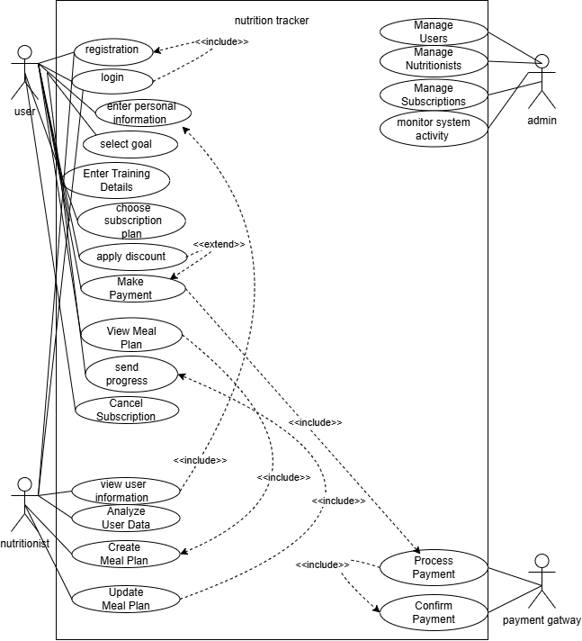

Slide 14
2-Activity Diagram
This diagram shows the flow of the system from start to finish. The user opens the app, registers if new or logs in if already registered. Then they fill in their personal info, select their goals, and enter their training details. After that they choose a subscription plan and make a payment, with an option to apply a discount first. Once payment is confirmed the nutritionist gets notified, views the user data, and creates the meal plan. The user then views their meal plan and sends progress updates to the nutritionist.

Slide 15
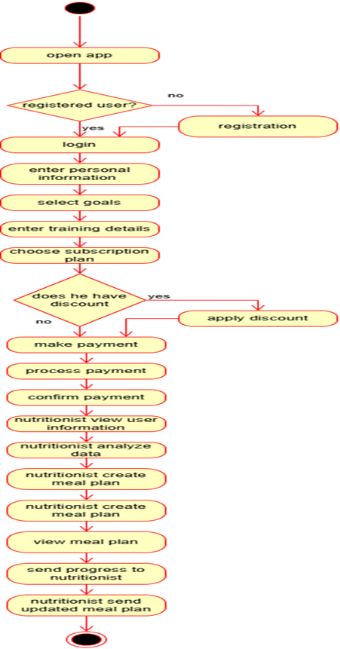

Slide 16
3-Sequence Diagram
This diagram shows the messages exchanged between the four participants — User, Nutritionist, Payment Gateway, and System — in time order. The user either registers or logs in depending on whether they have an account. Then they enter their personal info and select a subscription plan. If they have a discount they apply it, if not they go straight to payment. The payment gateway processes the transaction and confirms it back to the system, which then notifies the user. The nutritionist gets notified of the new client, views the user data, and uploads the meal plan. The system then notifies the user that their meal plan is ready.

Slide 17
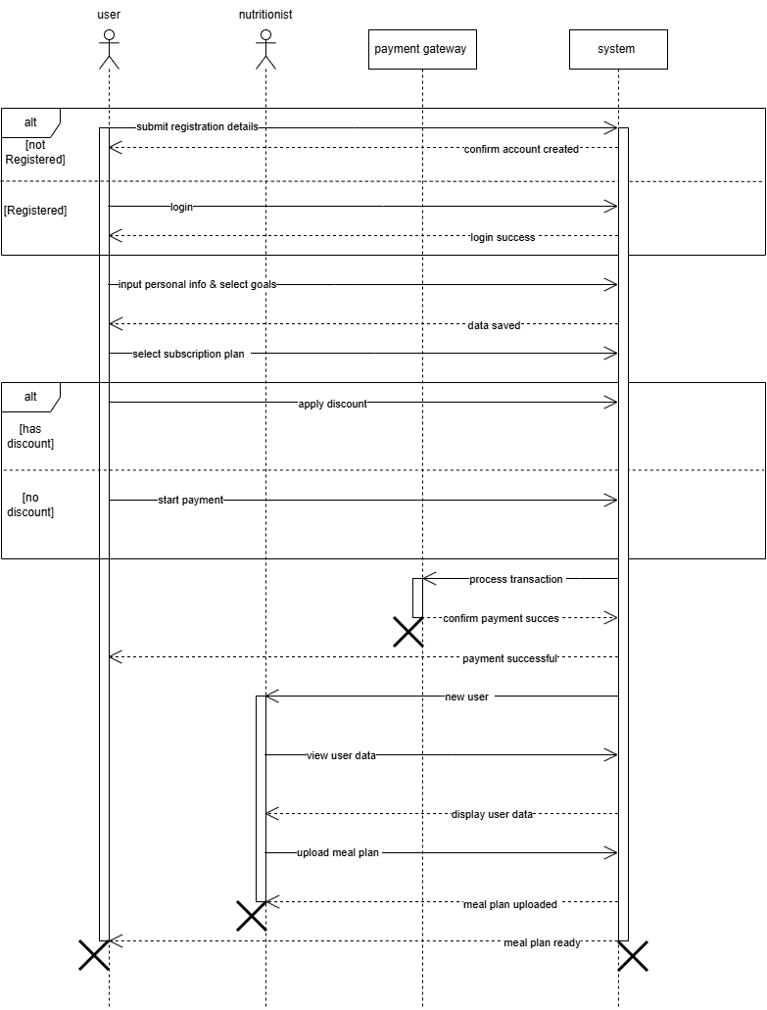

Slide 18
4-Misuse Case Diagram
This diagram extends the use case diagram to show potential security threats and how the system defends against them. An attacker tries to harm the system in five ways. First, creating fake accounts — blocked by email verification on signup. Second, brute force login attempts — blocked by locking the account after 5 failed tries. Third, SQL injection attacks on the inputs — blocked by validating and sanitizing all user inputs. Fourth, using fake or stolen discount codes — blocked by one-use limits and code validation. Fifth, man-in-the-middle attacks on payment — blocked by enforcing HTTPS and using a trusted payment gateway.

Slide 19
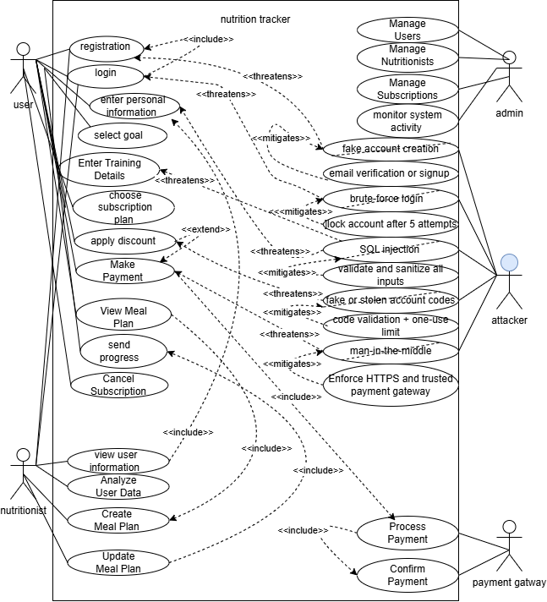

Slide 20
5-class Diagram
This diagram shows the structure of the system using classes. There is one parent class called SystemUser which holds the shared attributes — id, name, email, and password — and one shared method which is login. Three classes inherit from it. The User class adds personal information, goal, training routine, and subscription plan, with methods to register, make a payment, view the meal plan, send progress, and cancel the subscription. The Admin class has methods to manage users, manage nutritionists, and monitor activity. The Nutritionist class holds the meal plan attribute and has methods to view user info, analyze user data, and create a meal plan.

Slide 21
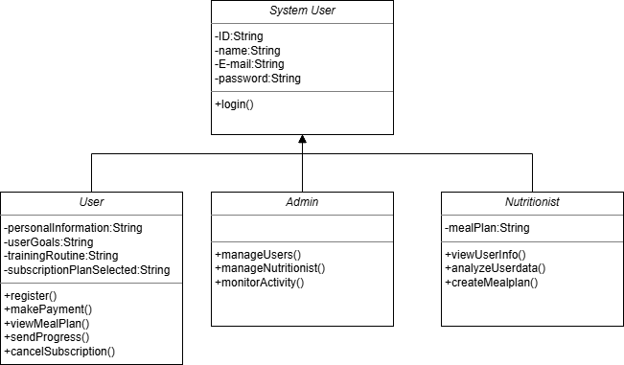

Slide 22
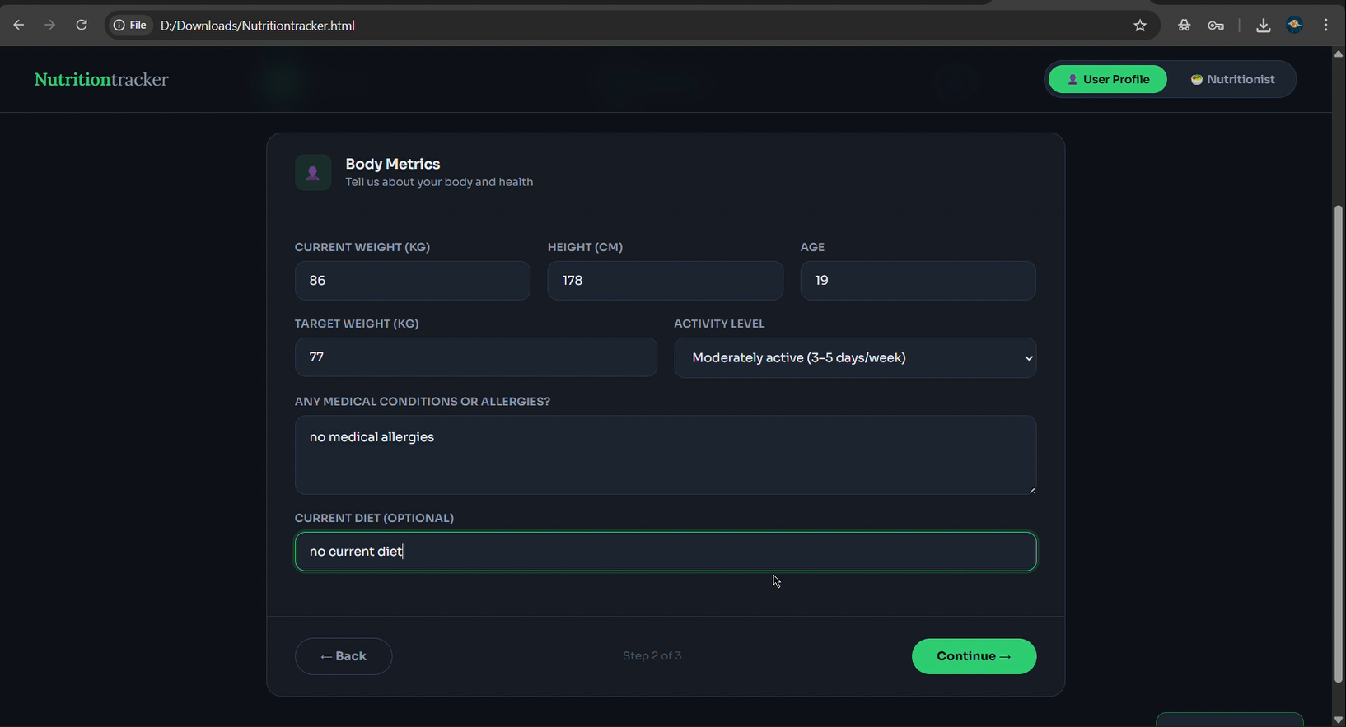
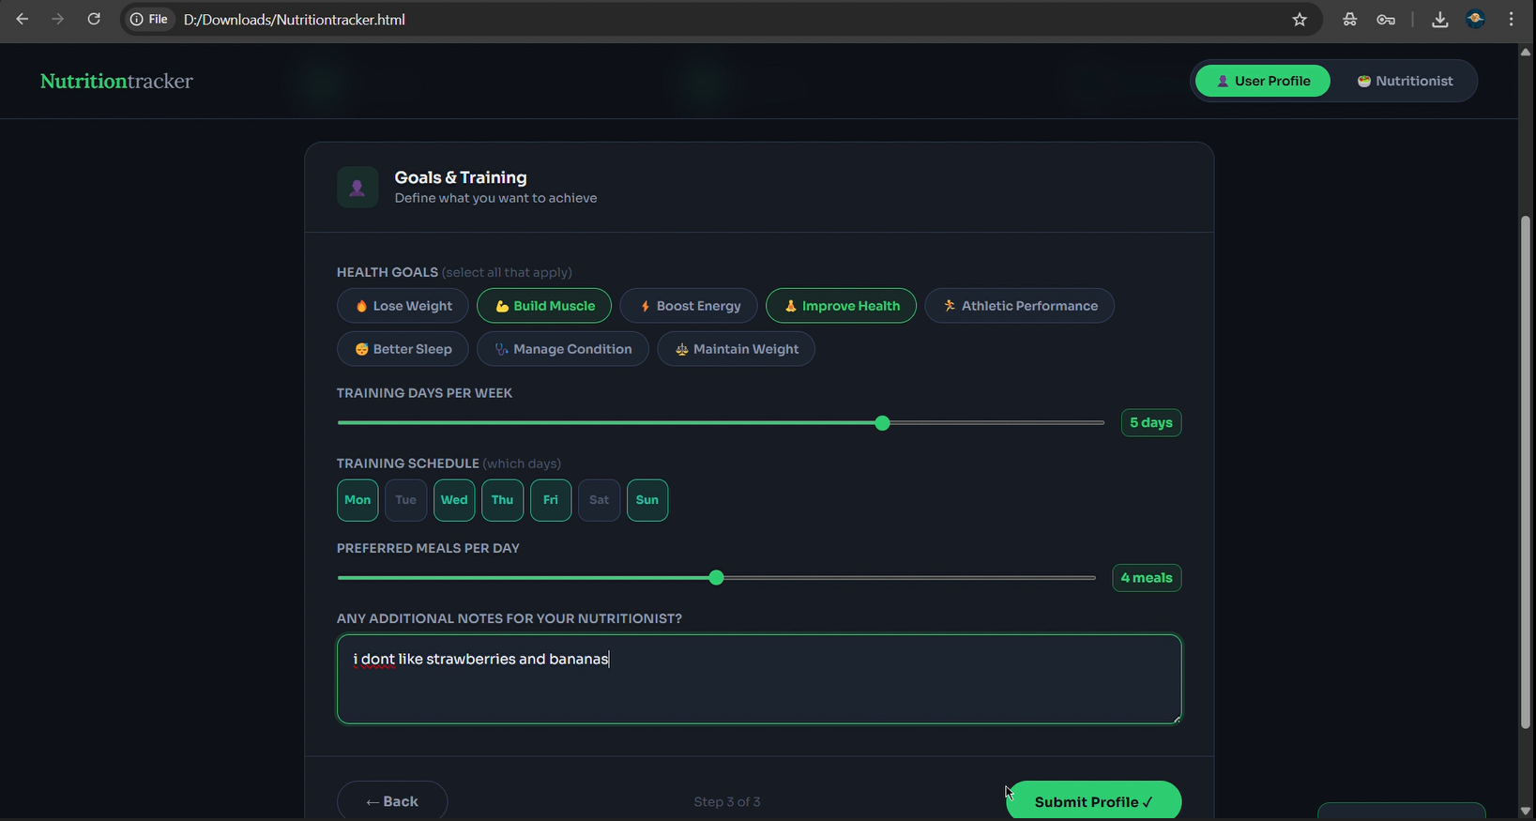
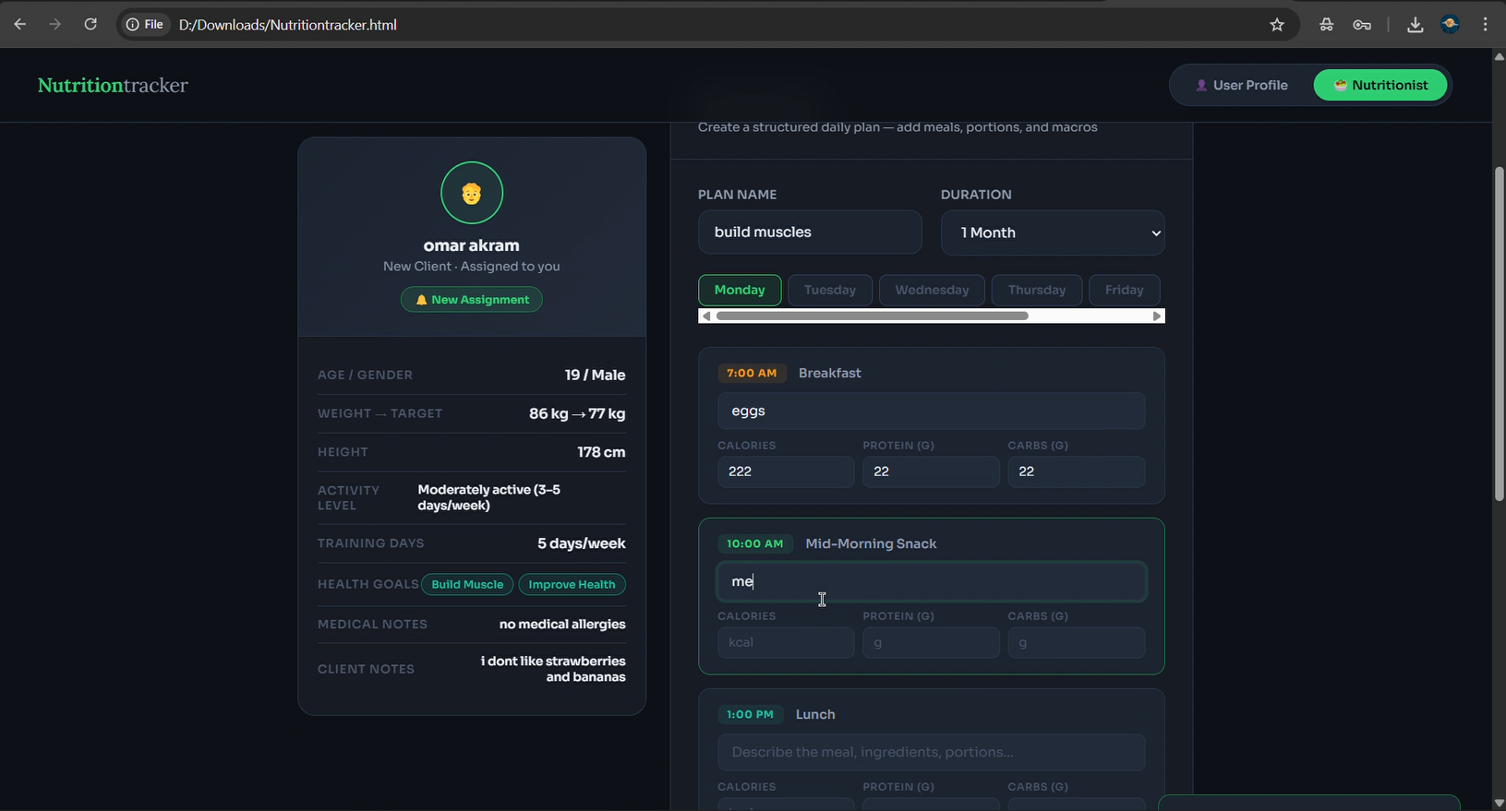
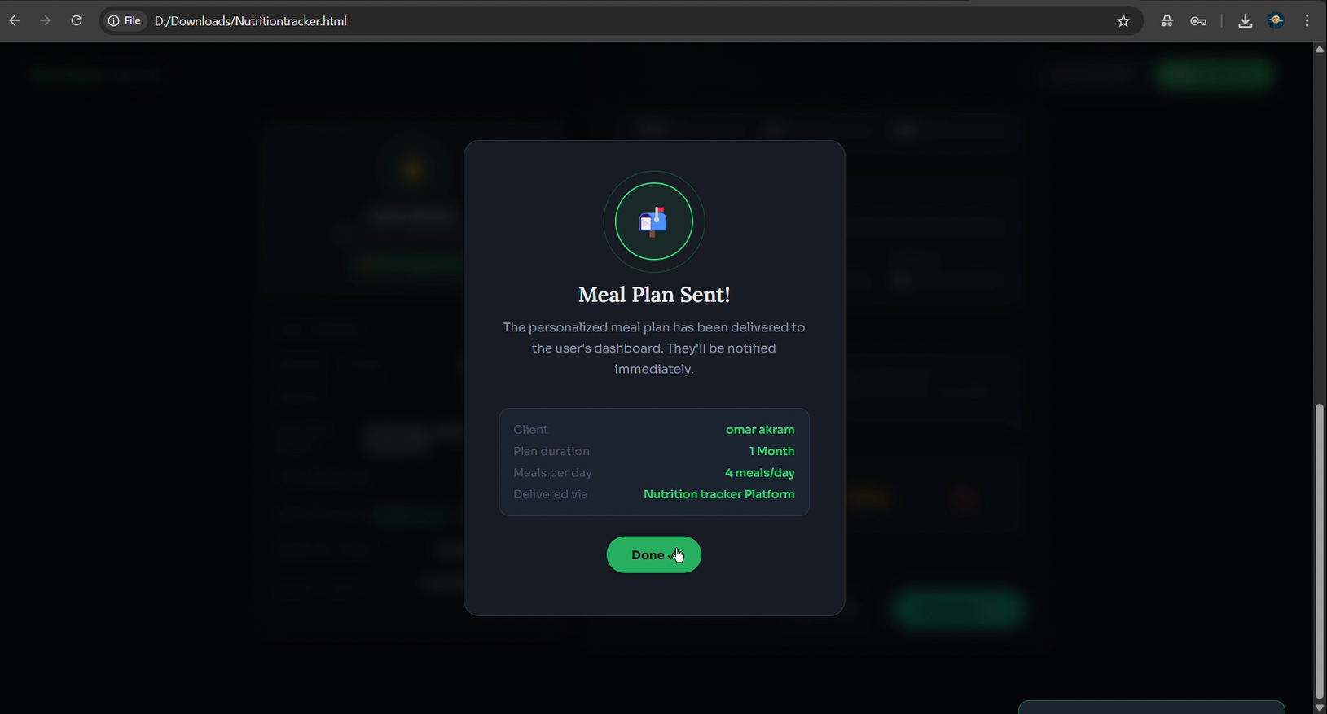
Implementation
This is a pictures for explain our idea as an website for our system

Slide 23
summary
Conclusion and Summary: The Nutrition Tracker is a complete digital platform that successfully bridges the gap between users and professional nutritionists. The system covers everything from registration and payment to personalized meal planning and progress tracking. It is built with 11 functional requirements covering all major workflows, 8 non-functional requirements ensuring quality, security, and performance, and 5 UML diagrams fully documenting the system design. The result is a secure, scalable, and user-friendly platform that makes professional nutrition guidance accessible to everyone.

Slide 24
your goals deserve a real plan
Thank you for your attention Questions are welcome.
This is the canva link of our original presentation that has the visuals and implementation video
https://canva.link/u9v5t1zfjs6896p

