Slide 1
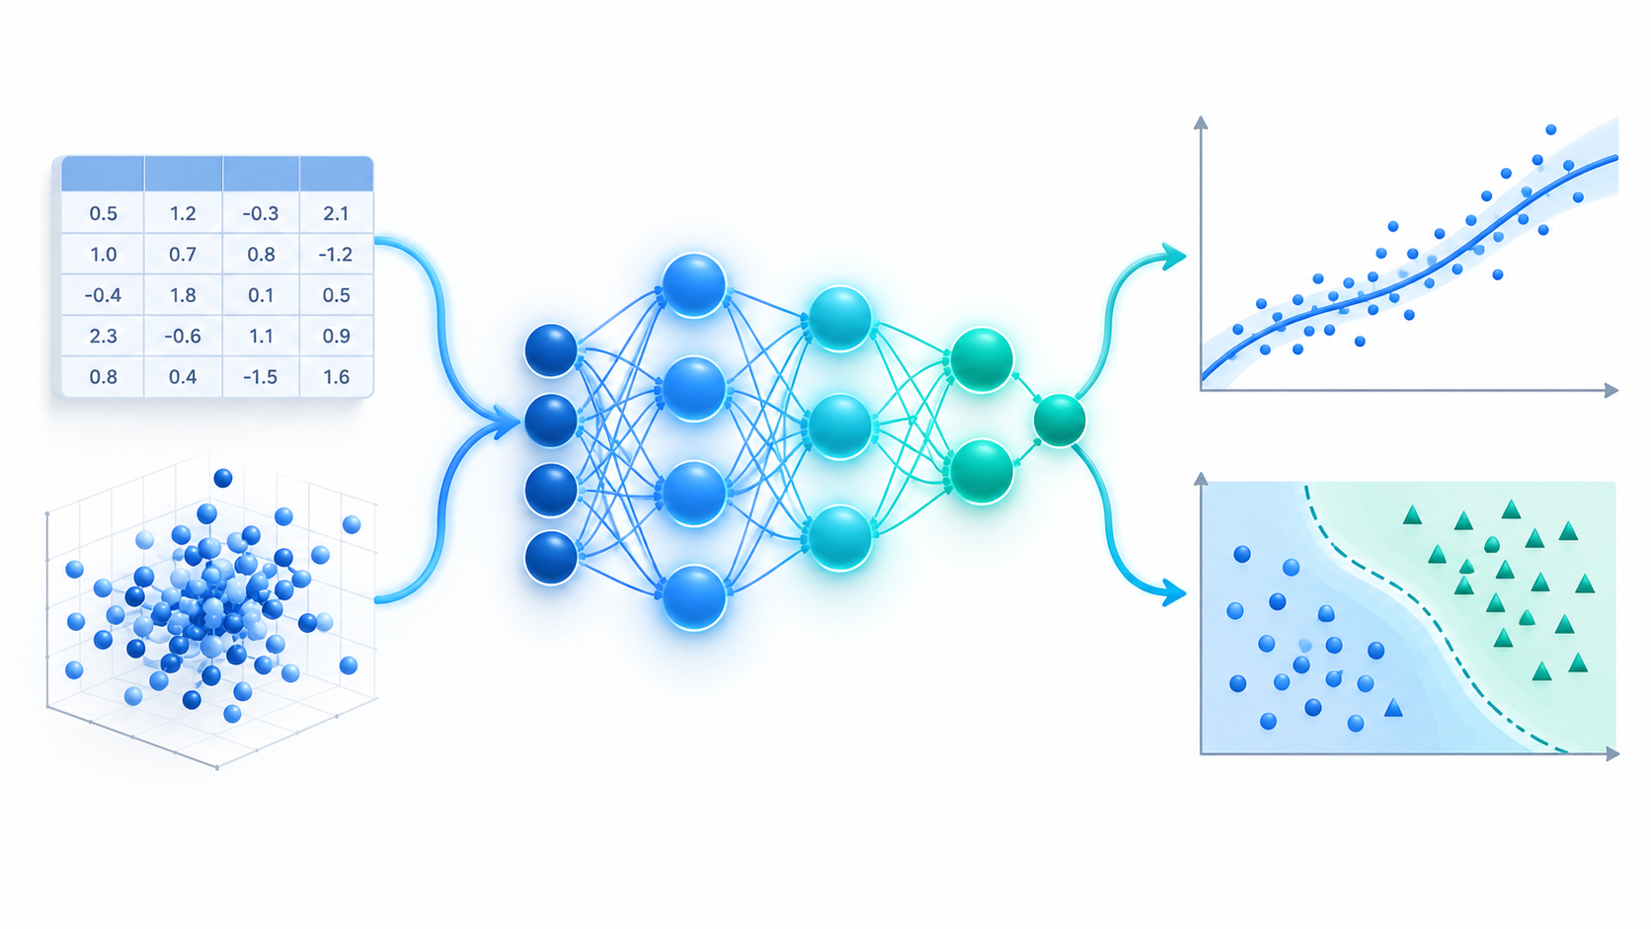
W01
Deep Learning Foundations
Neural networks for regression and classification
Regression
Classification
Professional notebook + visual lecture deck
From data to representation to prediction

Slide 2
W01 · Deep Learning Foundations
Deep Learning
Why neural networks are introduced
Classical ML can work extremely well when useful features are already prepared. Neural networks become valuable when the useful representation itself must be learned from data.
Classical machine learning workflow
Raw
data
Manual
features
Model
Prediction
Deep learning workflow
Raw
data
Learned
representation
Prediction
Representation learning is the key difference.

Slide 3
W01 · Deep Learning Foundations
Deep Learning
A neuron: the smallest building block
Inputs
x₁, x₂, …, xₙ
Weighted sum
z = wᵀx + b
Activation
a = g(z)
Output
a
Expanded equation
z = w₁x₁ + w₂x₂ + ⋯ + wₙxₙ + b
Weights and bias are learned from data. The activation allows non-linear behavior instead of only straight-line rules.
a = g(z)

Slide 4
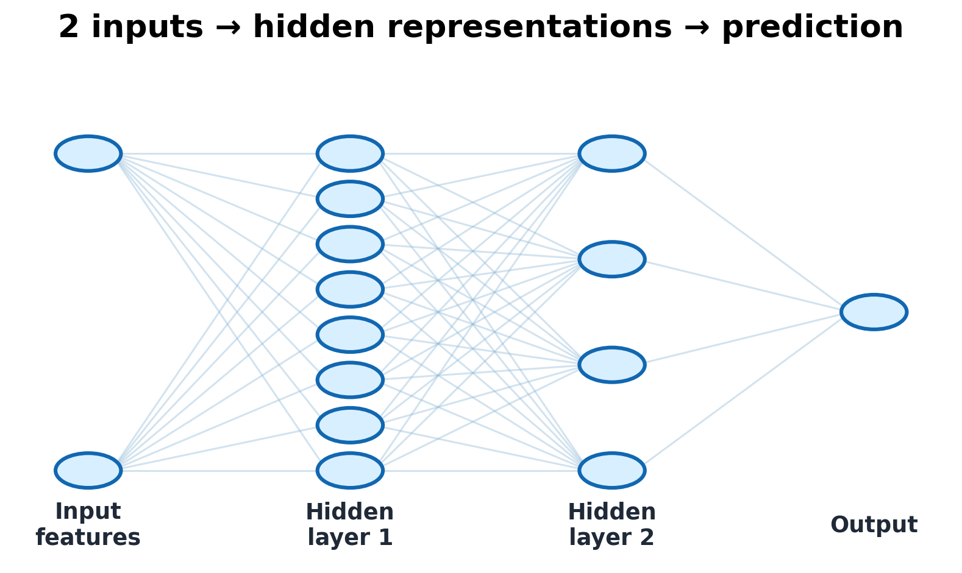
W01 · Deep Learning Foundations
Deep Learning
Architecture used in the notebook
Two input features are passed through hidden neurons. Each hidden layer transforms the data into a more useful representation before the final output is produced.
2 features
8 → 4 neurons
Input size
Hidden layers
1 value or probability
Output
The same architecture idea is used twice: once for a numeric prediction and once for a class decision.

Slide 5
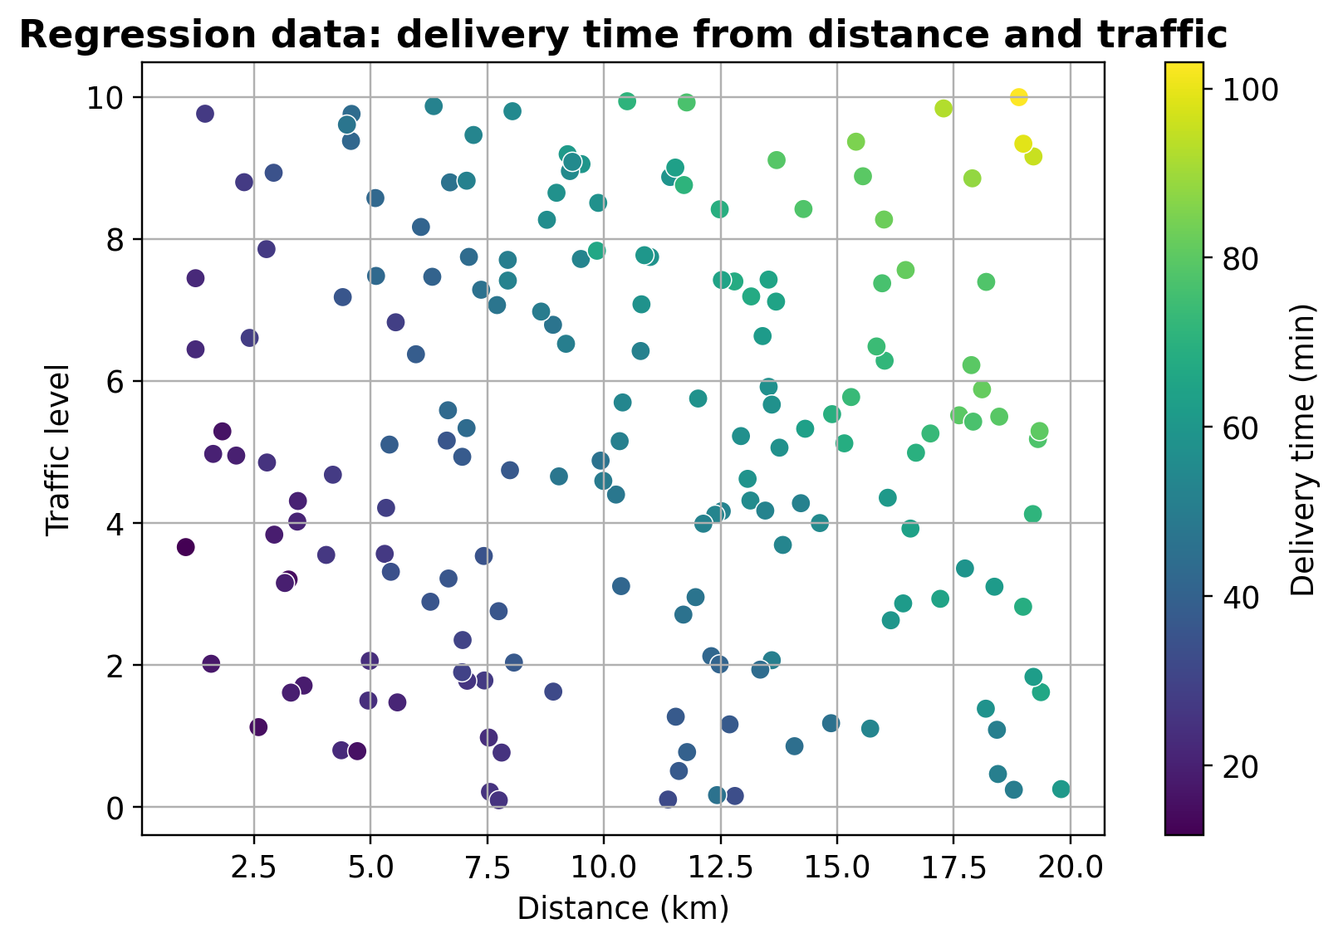
W01 · Deep Learning Foundations
Deep Learning
Regression problem: delivery-time prediction
Real-life question
How many minutes will a delivery take, given distance and traffic level?
distance, traffic
neural network
Output: delivery time in minutes
This is regression because the target is a continuous number.

Slide 6
W01 · Deep Learning Foundations
Deep Learning
Regression formulation and evaluation
Model output
ŷ = fθ(distance, traffic)
2.92 min
2.69 min
Linear regression MAE
Neural network MAE
Training loss
0.965
0.971
MSE = 1/N · Σ(yᵢ − ŷᵢ)²
Linear regression R²
Neural network R²
Interpretation
MAE is measured in minutes. R² close to 1 means that the model explains most of the variation in delivery time.

Slide 7
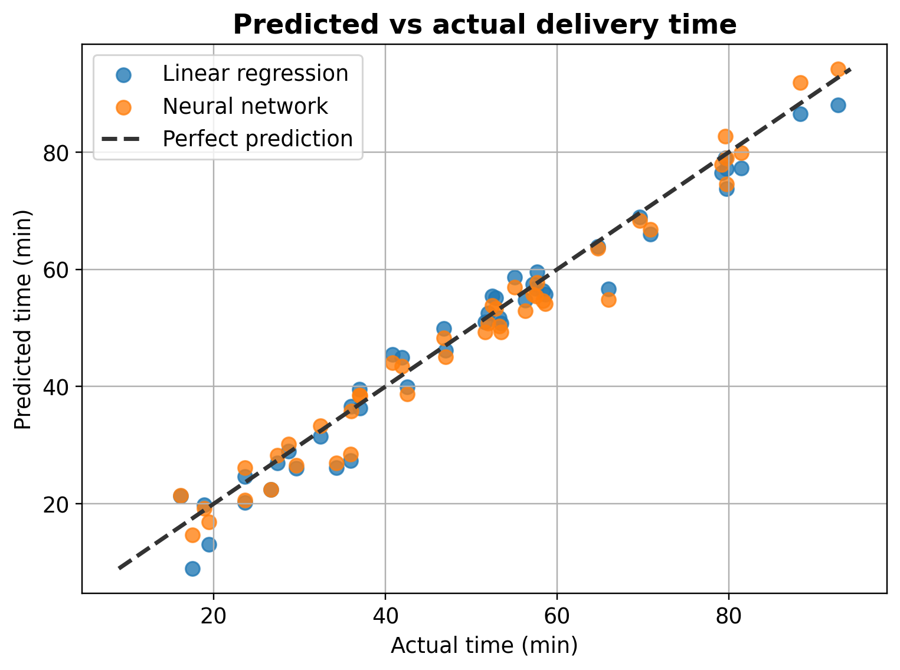
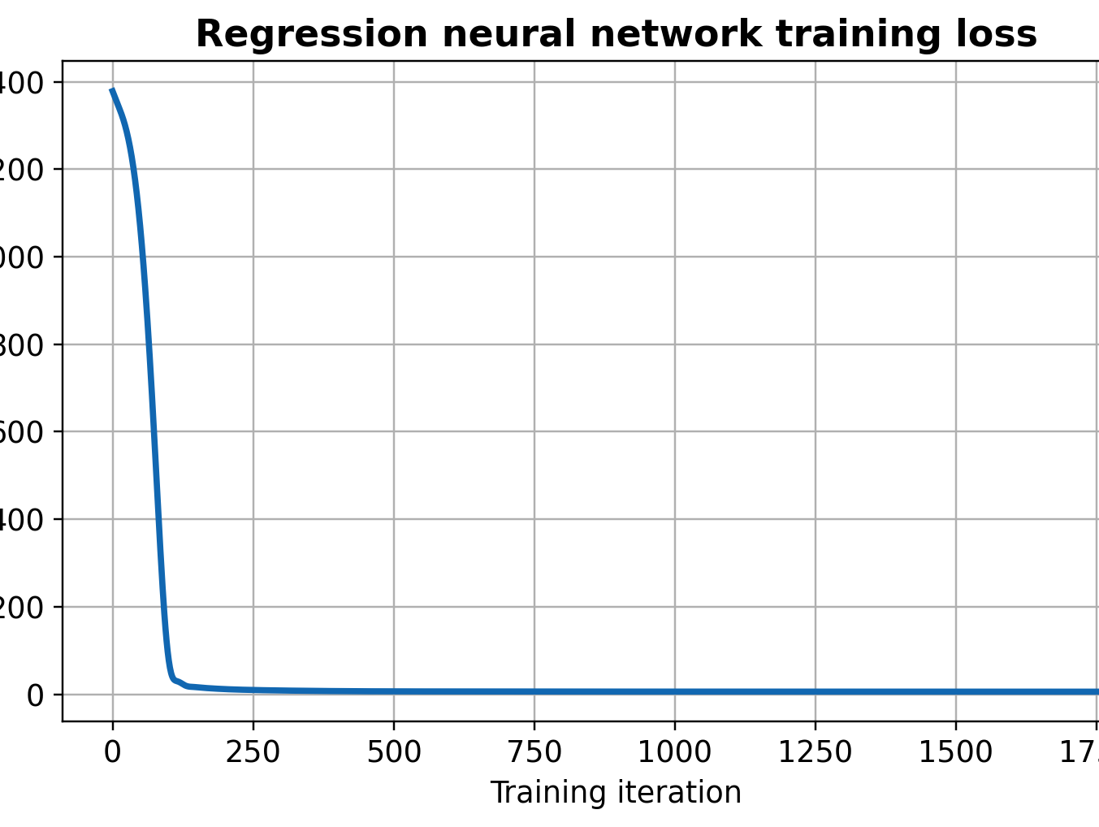
W01 · Deep Learning Foundations
Deep Learning
Regression results: predictions and learning curve
Points near the diagonal represent accurate numeric predictions.
A decreasing loss curve shows that training improved the network weights.

Slide 8
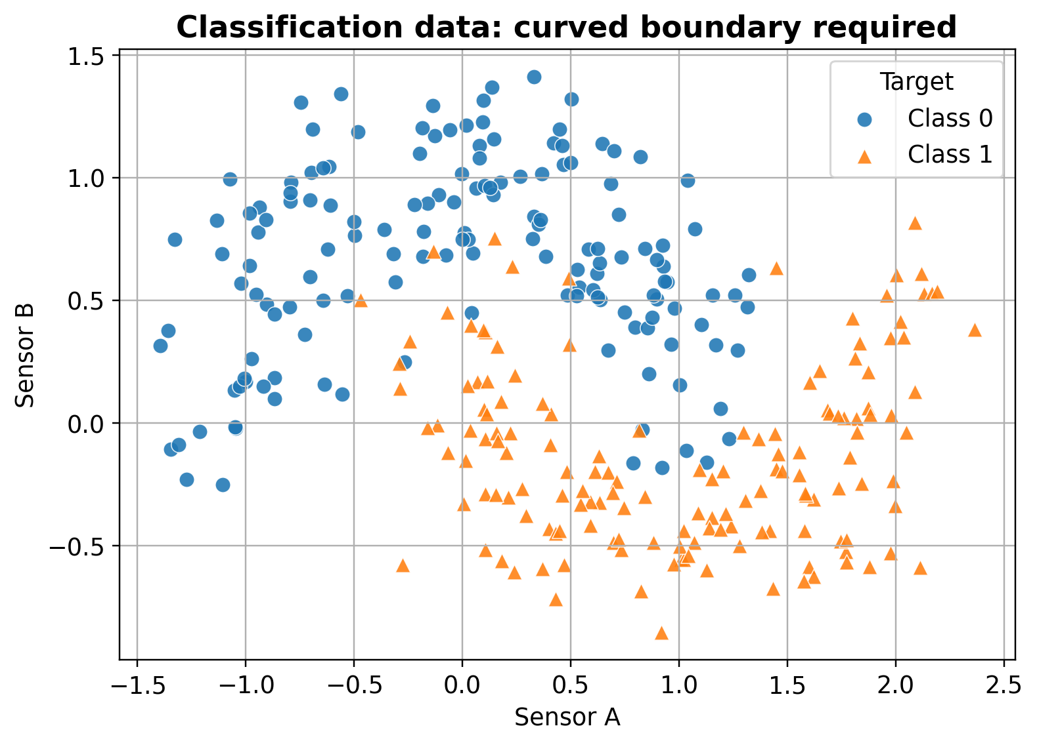
W01 · Deep Learning Foundations
Deep Learning
Classification problem: quality-inspection decision
Real-life question
Should the item be accepted as normal or sent for inspection?
sensor A, sensor B
neural network
Output: probability of “requires inspection”
This is classification because the output is a class label.

Slide 9
W01 · Deep Learning Foundations
Deep Learning
Classification formulation
Network probability output
p̂ = P(y = 1 | x₁, x₂)
0.947
Accuracy
Decision threshold
0.925
ŷ = 1 if p̂ ≥ 0.5, otherwise 0
Precision
Binary cross-entropy
0.974
Recall
BCE = −1/N · Σ[yᵢlog(p̂ᵢ) + (1−yᵢ)log(1−p̂ᵢ)]
The classifier must be judged by more than one metric because different errors can have different costs.

Slide 10
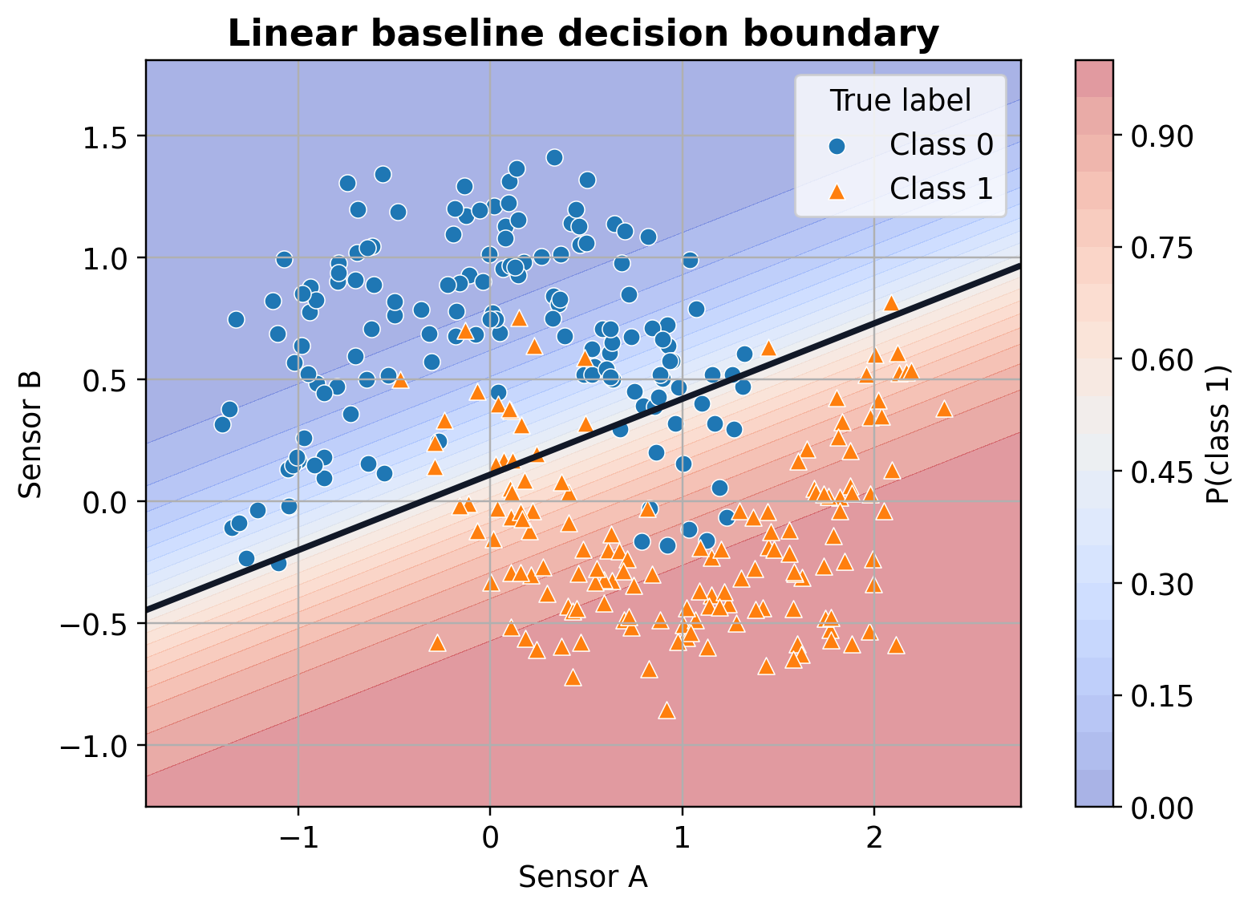
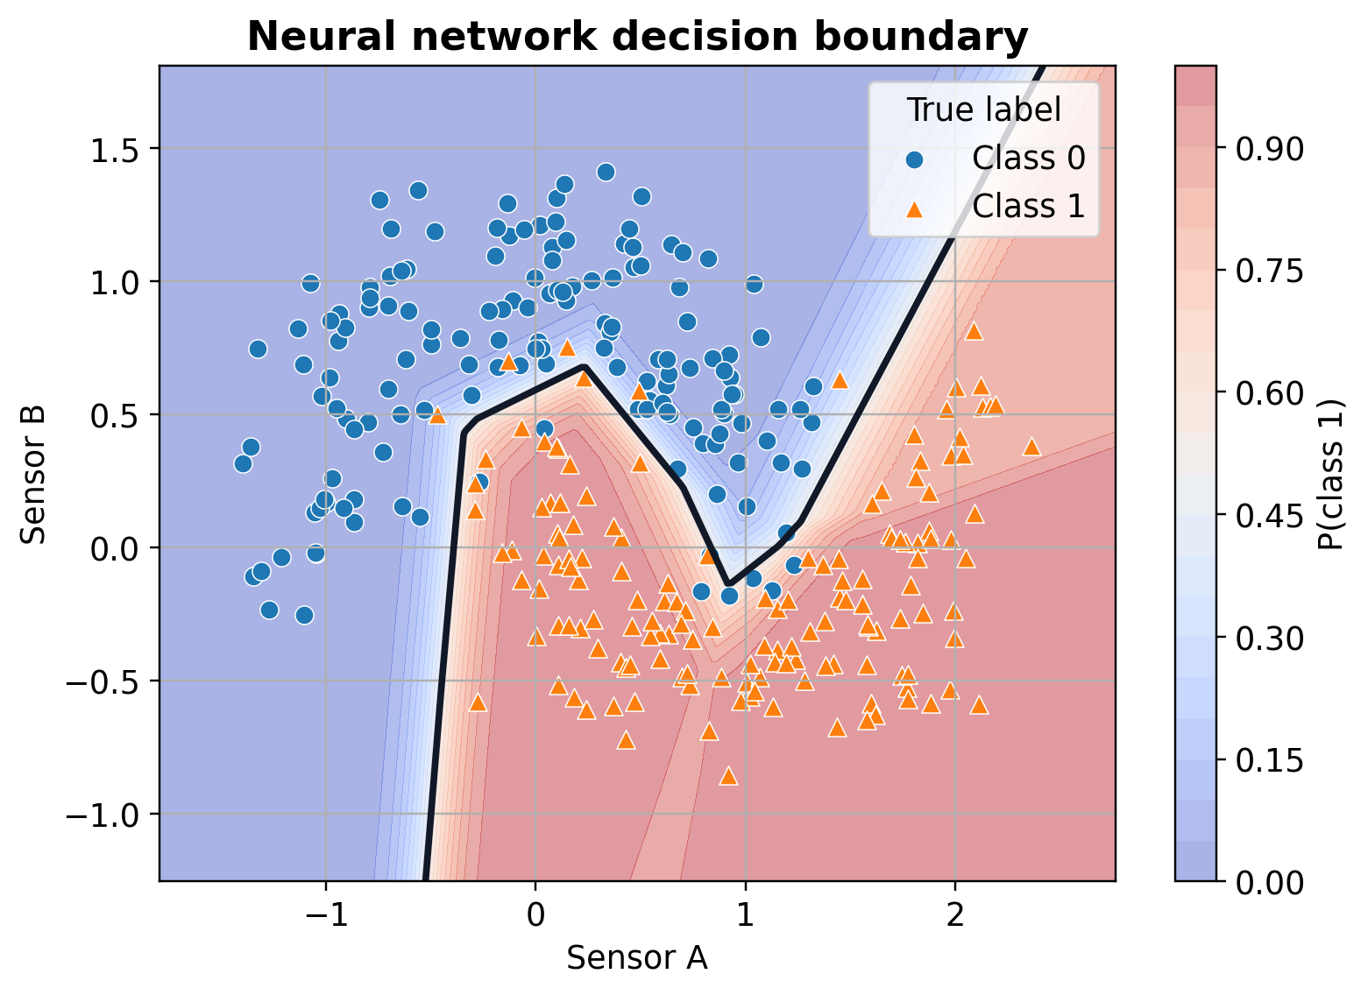
W01 · Deep Learning Foundations
Deep Learning
Decision boundaries: linear baseline vs neural network
A straight boundary is limited when the pattern is curved.
Hidden layers allow the boundary to bend around the data structure.

Slide 11
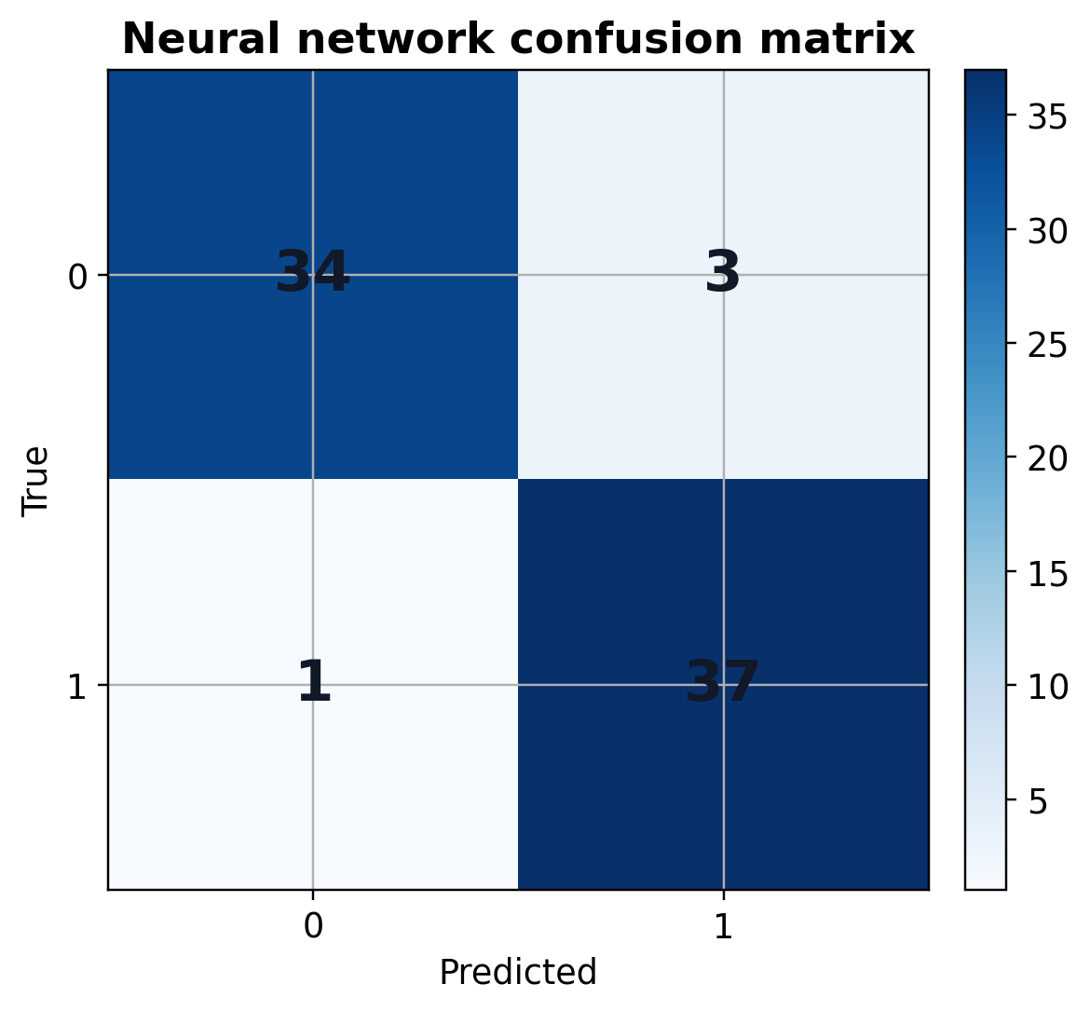
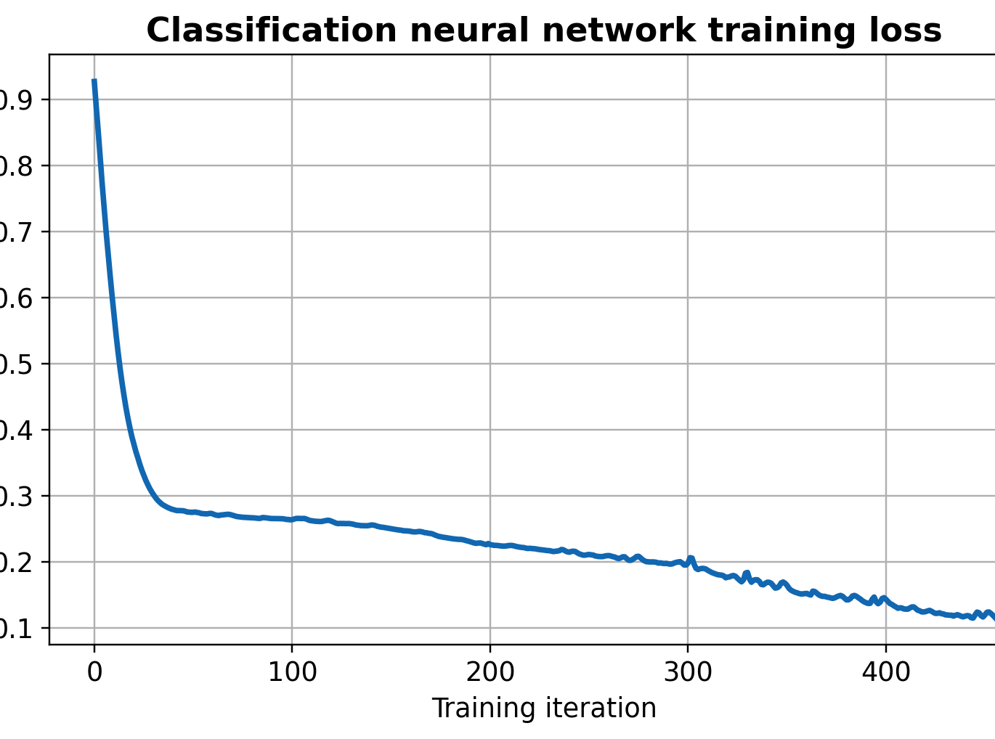
W01 · Deep Learning Foundations
Deep Learning
Classification results: confusion matrix and loss
The confusion matrix gives exact counts of correct and incorrect decisions.
Loss should generally decrease as the network improves its weights.

Slide 12
W01 · Deep Learning Foundations
Deep Learning
Concept checks
1
Why is delivery-time prediction a regression problem?
2
What does a decreasing loss curve indicate?
3
Why can hidden layers help with a curved boundary?
4
When should precision matter more than accuracy?
5
Why must test data be separated from training data?
6
When can a simpler model still be preferred?
Main takeaway
A neural network is not valuable because it is complicated. It is valuable when it learns useful representations and improves real decisions in a measurable way.

