Slide 1
UVM Project Si-vision Academy 2025
Omar Magdy

Slide 2
Agenda
ALU Design
Environment Architecture
Sequence Item
Sequence
Sequencer
Driver
Monitor
Agent
Scoreboard
Coverage Collector
Environment
Test
Top
Assertions
Simulation Results
Coverage Closure

Slide 3
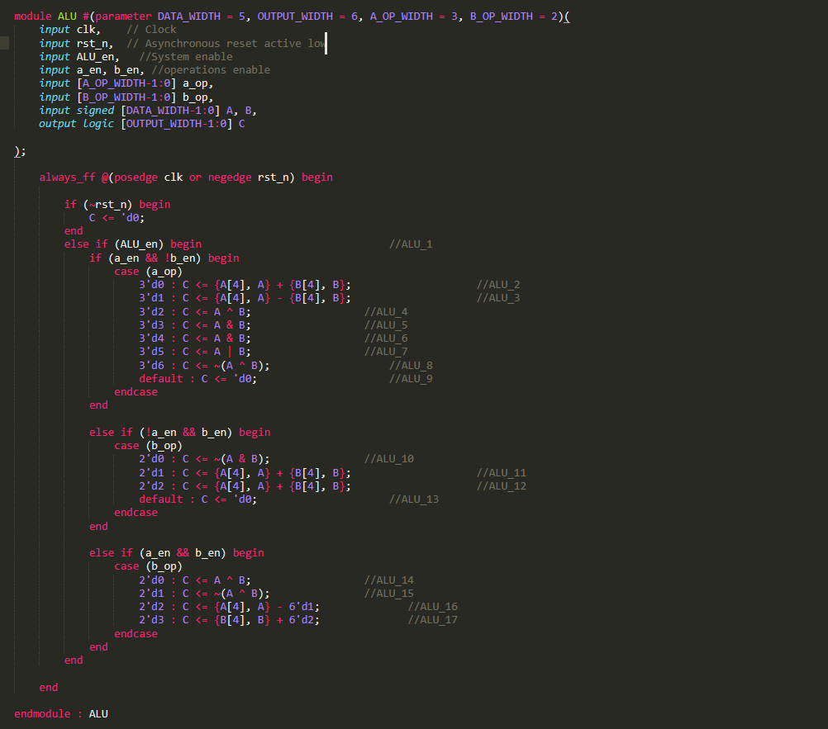
ALU
The verification environment is designed to fully verify ALU.
It has 10 ports, 9 input ports and 1 output port.
There are three operation sets, each of them are used depending on the different combinations of “a_en” and “b_en”.

Slide 4
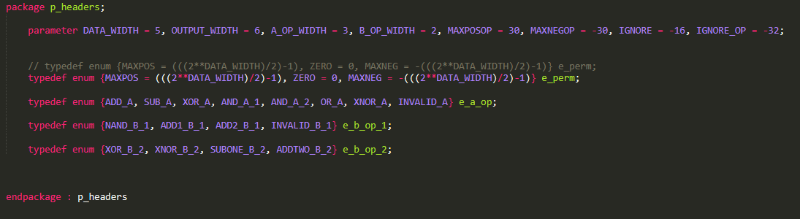
Package
Package file is created to group common parameters that are used in multiple classes like input bit width, maximum positive, and negative values.
Also, it contains defined enums to facilitate dealing with the operations.

Slide 5
Environment Architecture
The UVM environment consists of:
Sequence item: required to have the data to be randomized.
Sequence: responsible for defining the scenario in which the sequence item randomization depends on.
Sequencer: used to drive sequence item from sequence to driver.
Driver: receives data from sequencer and drives the interface signals.
Monitor: samples the DUT signals and convert them to transaction level.
Agent: encapsulates driver, monitor, and sequencer.
Scoreboard: checks the transaction coming from monitor.
Coverage Collector: samples the incoming transaction to calculate functional coverage.
Environment: encapsulates scoreboard, coverage collector.
Test: it determine which sequence will be run.
Top: it connects the DUT to the testbench.

Slide 6
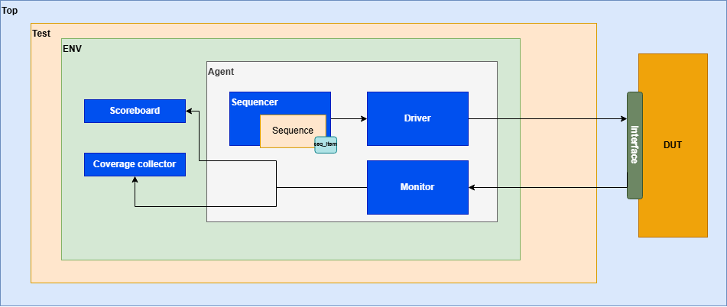

Slide 7
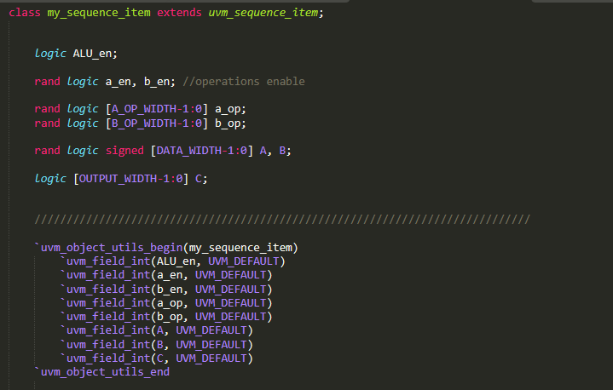
Sequence item
Sequence item contains the data that is going to be randomized.
Also, it has the constraints in which the randomization will use to achieve the highest functional coverage.
Field macro is used to determine which data is going to be printed.

Slide 8
sequence
The sequence determine the scenario for testing.
The sequence class has 4 scenarios:
One for a_op set.
One for the first b_op set.
One for the second b_op set.
One is a randomization sequence.
Final sequence is used to wrap and all sequences using uvm_do macro.

Slide 9
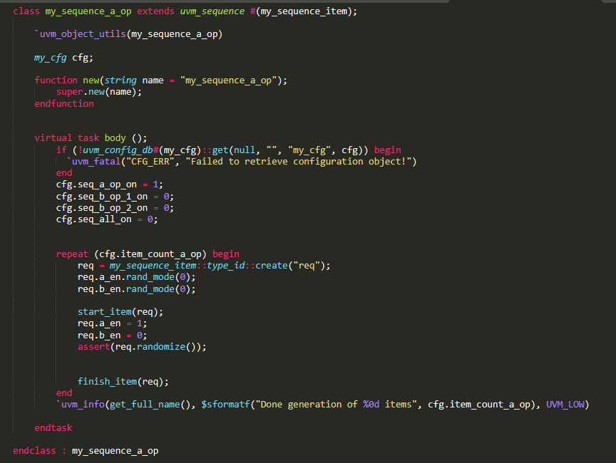
Sequence
Sequence a_op
The sequence turn off randomization for a_en and b_en and sets them to 1 and 0 respectively to enable the a_op set.
It get the item count from configuration object set in the test.

Slide 10
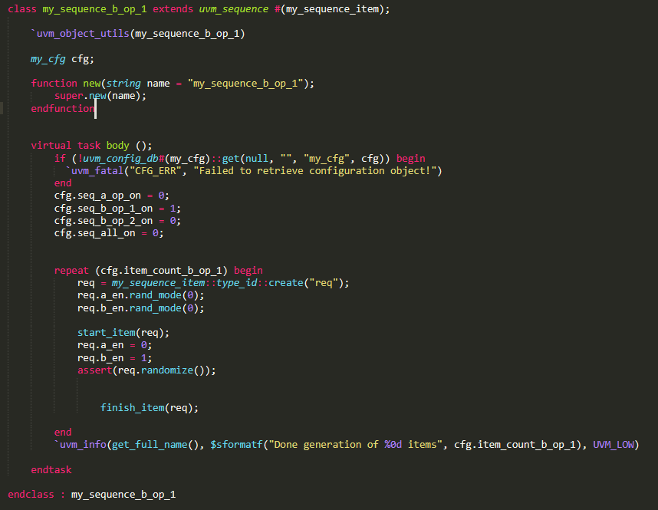
sequence
Sequence b_op
The sequence turn off randomization for a_en and b_en and sets them to 0 and 1 respectively to enable the b_op set.
It get the item count from configuration object set in the test.

Slide 11
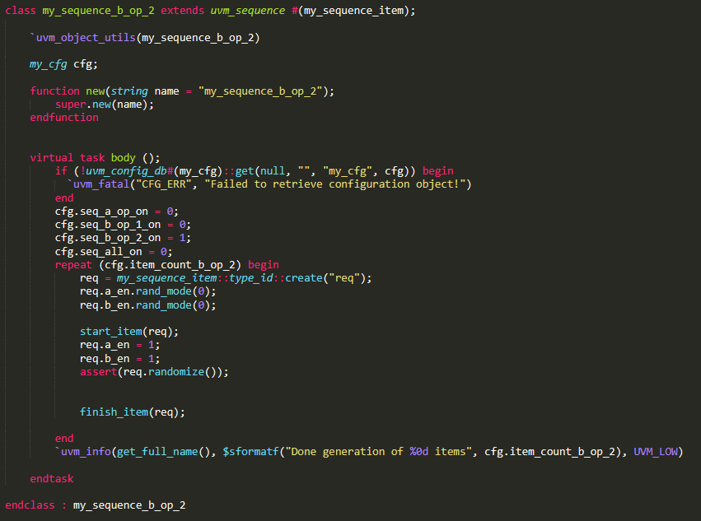
sequence
Sequence b_op
The sequence turn off randomization for a_en and b_en and sets them to 1 and 1 respectively to enable the b_op set.
It get the item count from configuration object set in the test.

Slide 12
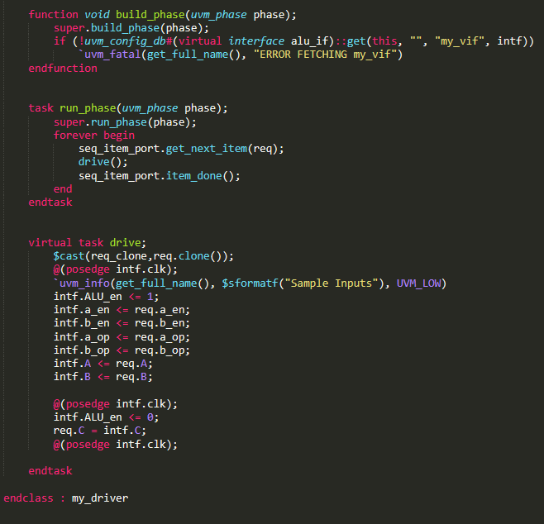
Driver
The driver transforms from transaction level to pin level.

Slide 13
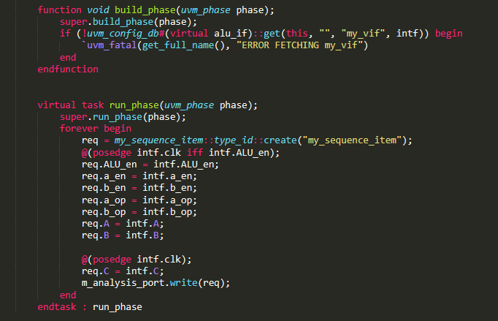
Monitor
The Monitor is responsible for sampling interface values and assigning them to sequence item which will be sent to Scoreboard and Coverage collector classes.

Slide 14
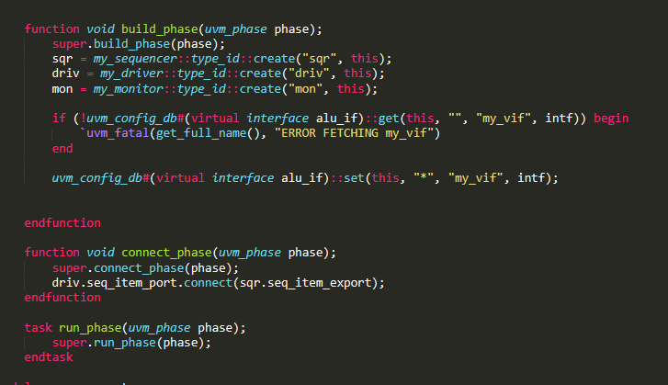
Agent
It encapsulates driver, monitor, and sequencer.

Slide 15
Scoreboard
Scoreboard receives the transactions from Monitor class.
It samples transaction values to evaluate the expected output and check the actual output value sampled from the same transaction.

Slide 16
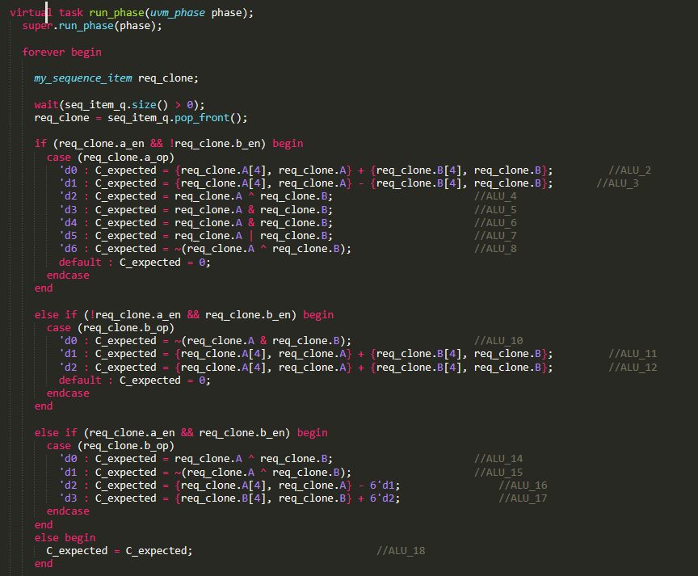
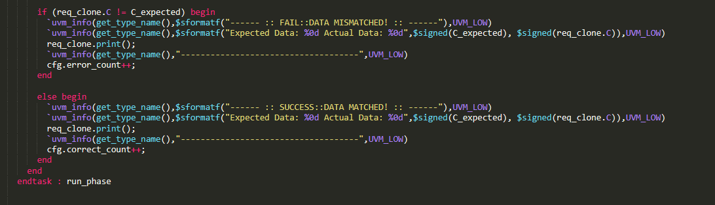
Scoreboard

Slide 17
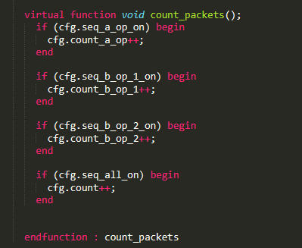
scoreboard
The scoreboard increments the number of incoming packets from each sequence to verify all packets are received by the scoreboard.

Slide 18
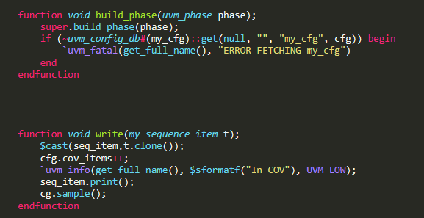
Coverage collector
The class is responsible for grouping the cover points and cross coverage for the transaction values.
This ensures ALU functionality is fully checked.
The cover group is sampled when collector class receives the transaction.

Slide 19
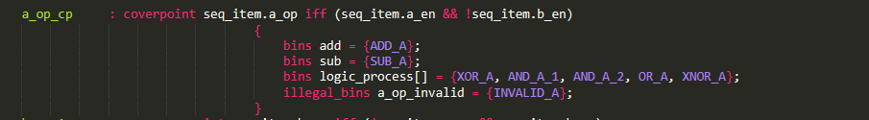
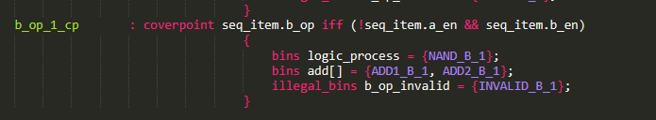
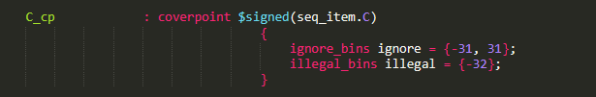
Coverage collector
Illegal bins are defined for the prohibited operations in set A and set B1.
Furthermore, illegal bins are defined for “-32” for “C” and “-16” for both “A” and “B”.
Ignore bins are defined for “-31,31” as they can not be achieved given the range of the inputs [-15, 15].

Slide 20
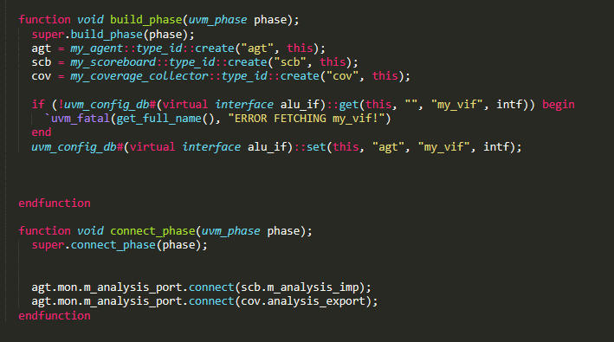
Environment
Environment class encapsulates Agent, Scoreboard, and Coverage Collector classes.

Slide 21
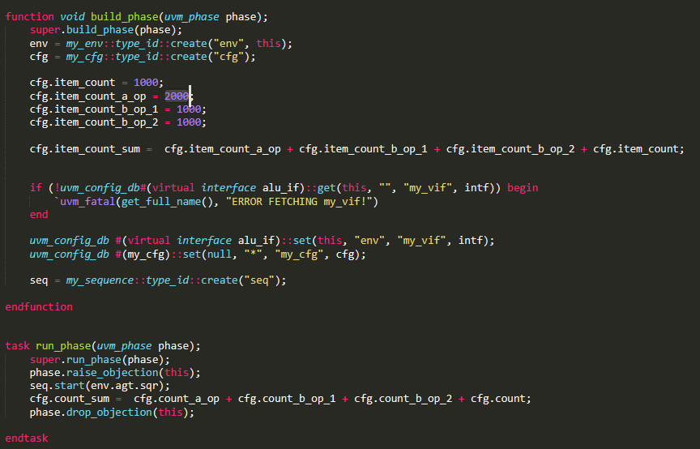
Test
Test program creates the Environment class and starts the intended sequence.
The number of packets in each sequence are determined in build phase.

Slide 22
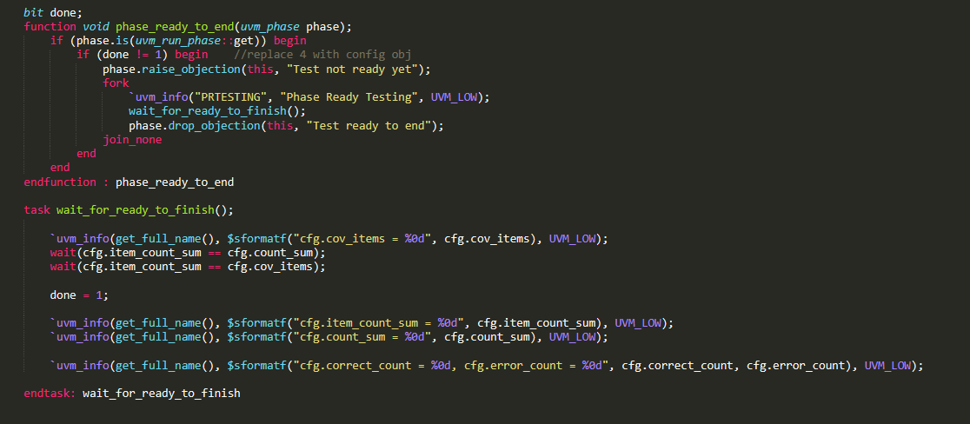
test
Phase ready to end function is used to ensure the test does not end before all packets are processed.

Slide 23
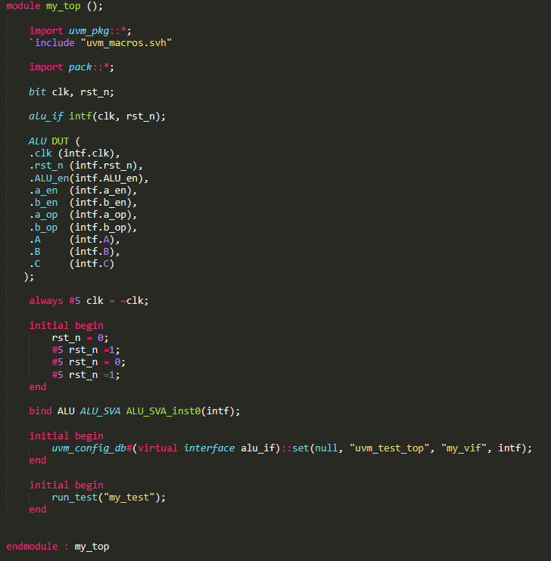
top
Top module initiates DUT, Test, and interface.
System clock is generated and passed to the interface as an input.
Bind is used to initiate ALU_SVA module in ALU module.

Slide 24
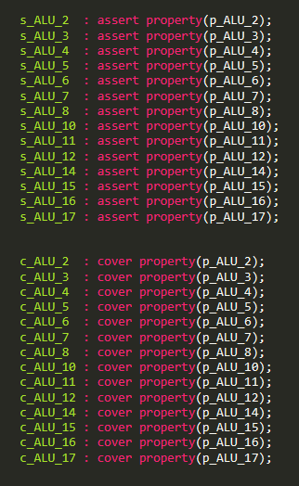
assertions
Assertions module is created to group multiple properties of the design to fully ensure the properties of the design are covered.

Slide 25
Simulation results

Slide 26
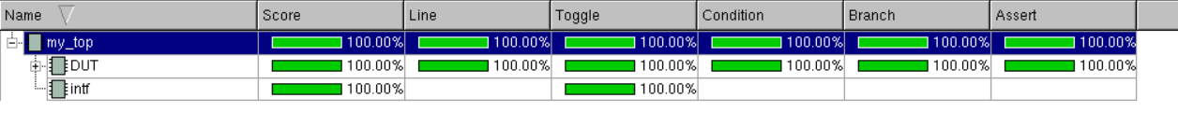
Assertions and coverage closure

