Slide 1


Nominal event synset identification and classification
Project Elective in AI
Cristiano Bellucci 1760390
Omar Bayoumi 1747042

Slide 2

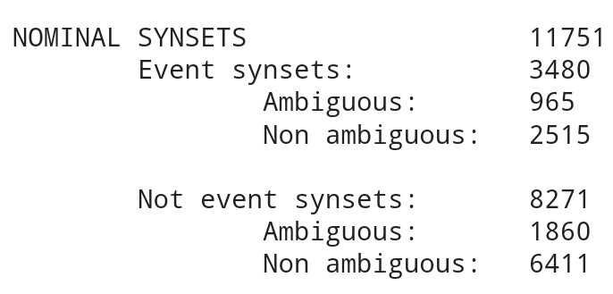
Results HW1b
Narrative Undestanding and Storytelling
Project Elective in AI
07/12/2022
Pagina <number>

Slide 3
Event identification
Adding new nominal event synsets by using neural networks
Narrative Undestanding and Storytelling
Project Elective in AI
07/12/2022
Pagina <number>

Slide 4
Dataset – Event identification
Label ‘‘event’’
Label ‘‘not event’’
All the synset in the hyponym tree of the synset event
All synsets in the hyponym tree of some key “not event” synset: e.g. “physical object”
The "not event" synsets found in the homework are already classified in this way
To balance the dataset prioritize the nominal “event” and “not event” sysents found in the Homework
Narrative Undestanding and Storytelling
Project Elective in AI
07/12/2022
Pagina <number>

Slide 5
Model input – Event identification
depriving one of self-esteem
[CLS], de, ##p, ##ri, ##ving, one, of, self, -, esteem, [SEP]
Transformer input
[101, 1260, 1643, 2047, 3970, 1141, 1104, 2191, 118, 22123, 102]
Input
Pos Embedding input
[0, 16, 0, 0, 0, 9, 2, 8, 13, 8, 0]
Narrative Undestanding and Storytelling
Project Elective in AI
07/12/2022
Pagina <number>

Slide 6
Model – Event identification
Transformer Input
POS Input
Transformer
POS Embedding
Concatenation
Binary Classifier
B-LSTM
Narrative Undestanding and Storytelling
Project Elective in AI
07/12/2022
Pagina <number>

Slide 7
Identification
Not event synset HW1b
Nominal synset from not event key synset hyponym
“not event” sample of the dataset
Model
[“event”, ”not event”]
Narrative Undestanding and Storytelling
Project Elective in AI
07/12/2022
Pagina <number>

Slide 8
Event classification
Disambiguate nominal event synsets by using neural networks
Narrative Undestanding and Storytelling
Project Elective in AI
07/12/2022
Pagina <number>

Slide 9
Dataset – Event classification
Train + Validation + Test
Disambiguation
Unambiguous nominal event synsets from:
Homework 1b
Event identification step
Ambiguous nominal event synsets from:
Homework 1b
Event identification step
Narrative Undestanding and Storytelling
Project Elective in AI
07/12/2022
Pagina <number>

Slide 10
Model input – Event classification
depriving one of self-esteem
[CLS], de, ##p, ##ri, ##ving, one, of, self, -, esteem, [SEP]
Transformer input
[101, 1260, 1643, 2047, 3970, 1141, 1104, 2191, 118, 22123, 102]
Pos Embedding input
Input
[0, 16, 0, 0, 0, 9, 2, 8, 13, 8, 0]
VerbAtlas predicates frame embedding input
[0, 191, 0, 0, 0, 0, 0, 0, 0, 0, 0]
Narrative Undestanding and Storytelling
Project Elective in AI
07/12/2022
Pagina <number>

Slide 11
Model – Event classification
VerbAtlas predicates frame Input
Transformer Input
POS Input
Transformer
VerbAtlas predicates frame Embedding
POS Embedding
Concatenation
Classifier
B-LSTM
Narrative Undestanding and Storytelling
Project Elective in AI
07/12/2022
Pagina <number>

Slide 12
Disambiguation
Ambiguous synset definition
Synset’s reference frames
a remote or indirect consequence of some action
AFFECT, INFLUENCE
Model
If frame > Threshhold
T
F
Max label between ambiguous ones
Maintain ambiguity
[ 0.01, …, 0.6, 0.3, …]
[EAT-BITE, …, AFFECT, INFLUENCE, …]
Narrative Undestanding and Storytelling
Project Elective in AI
07/12/2022
Pagina <number>

Slide 13
Evaluation – Identification & Classification
Model scores:
  Precision
  Recall
  F1
Identification and classification:
  Manual checking
Narrative Undestanding and Storytelling
Project Elective in AI
07/12/2022
Pagina <number>

Slide 14
Thanks for your attention!

