Slide 1
Named Entity Recognition
Omar Bayoumi 1747042

Slide 2
What is NER?
The Named Entity Recognition (NER) problem belongs to the category of tagging problems.
I used the IOB scheme for NER:
I: inside
O: outside
B: beginning

Slide 3
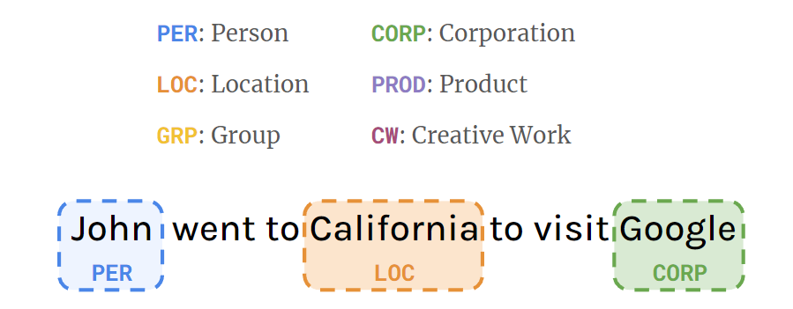
Categories
Person (PER),
Location (LOC),
Group (GRP),
Corporation (CORP),
Product (PROD),
Creative Work (CW)
Other (O)

Slide 4
Categories: IOB
My name is Robin Hood
O O O B-Per I-Per

Slide 5
Architectures

Slide 6
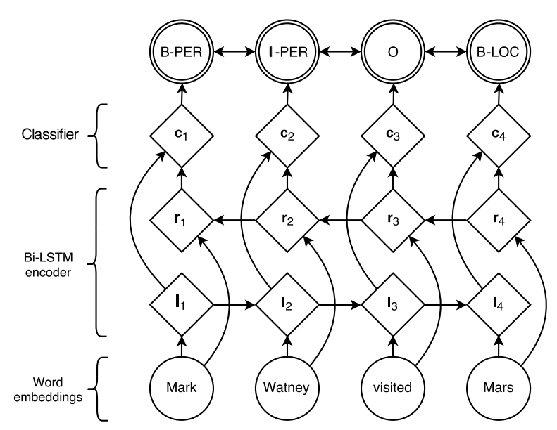
Model 1: Base

Slide 7
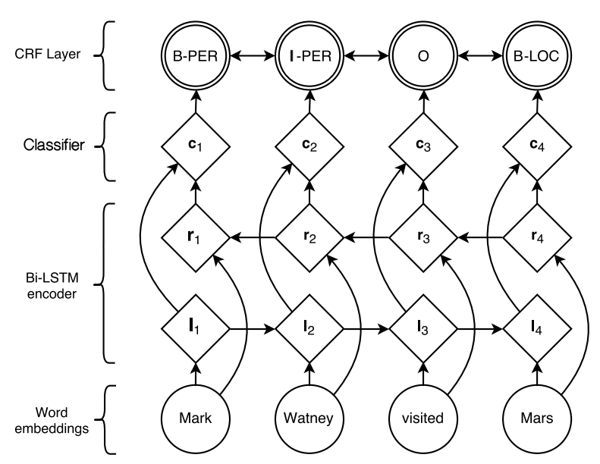
Model 2: Base + CRF

Slide 8
Conditional Random Field (CRF)
A CRF is an output layer that encourages the neural network to produce a valid sequence of output labels, through log-likelihood maximization of the correct label sequence

Slide 9
Preprocess

Slide 10
Dataset Augmentation
Spacy lemmatizer
Component for assigning base forms to words using rules based on part-of-speech tags, or lookup tables.
My name is Robin Hood
Lemmatization...
My name be Robin Hood

Slide 11
Dataset Augmentation
Spacy lemmatizer
[eaton’s]
Component for assigning base forms to words using rules based on part-of-speech tags, or lookup tables.
Some word is splitted
Lemmatization...
[eaton, ’s]

Slide 12
Dataset Augmentation
Spacy lemmatizer
[eaton’s]
Component for assigning base forms to words using rules based on part-of-speech tags, or lookup tables.
Some word is splitted
The label is B-CLASS for each split
Lemmatization...
[eaton, ’s]
Label
[B-CORP, B-CORP]

Slide 13
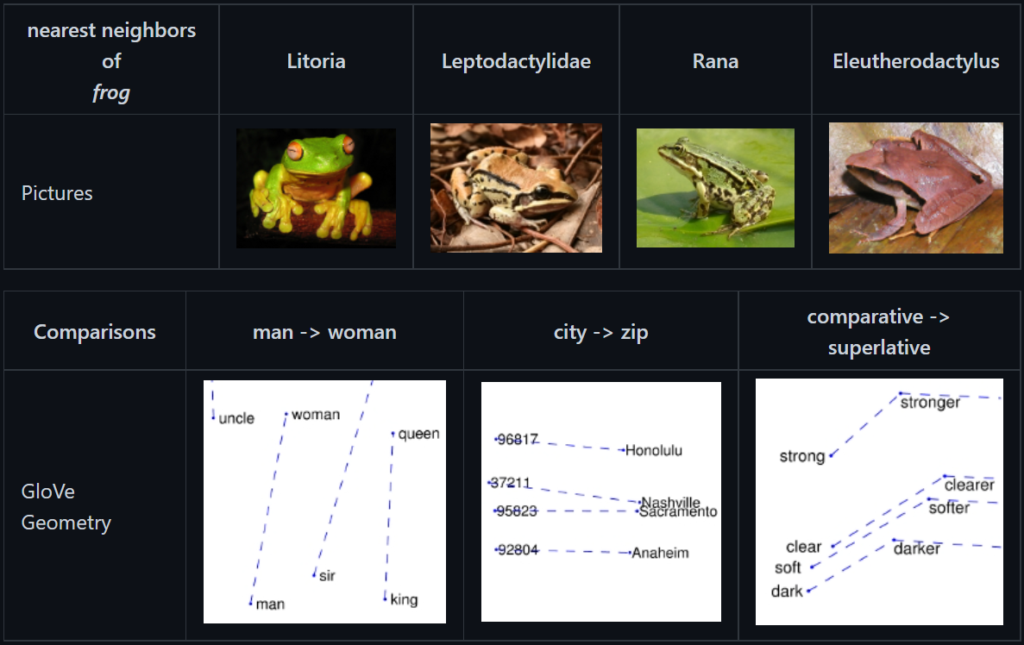
GloVe
Different implementations

Slide 14
GloVe
Different implementations
I used the one based on twitter

Slide 15
GloVe
Different implementations
I used the one based on twitter
Embedding size: 200

Slide 16
Vocabulary
I calculated the frequencies

Slide 17
Vocabulary
I calculated the frequencies
I assigned an id to each word

Slide 18
Vocabulary
I calculated the frequencies
I assigned an id to each word
If I use GloVe, in case the word doesn’t exist in the vocabulary I assign <unk> id.
If I don’t use GloVe, if the word appear less than a min frequency, I assign <unk> id

Slide 19
Input of the model
Windows
Finding the length of the input
Small number
Big number

Slide 20
Input of the model
Windows
Finding the length of the input
Small number
Big number
The fixed size window moves to the sentence and each frame is an input

Slide 21
Input of the model
Windows
Finding the length of the input
Small number
Big number
The fixed size window moves to the sentence and each frame is an input.
Padding is added at the end for small sentences

Slide 22
Training

Slide 23
Hyperparameters
Hyperparameter | Base model | Base model + CRF
Min frequency | 3 | 0
Glove Embedding | No | Yes
Window size/shift | 100 | 100
LSTM hidden dimention | 128 | 128
Dropout | 0.5 | 0.5
Learning rate | 0.001 | 0.001

Slide 24
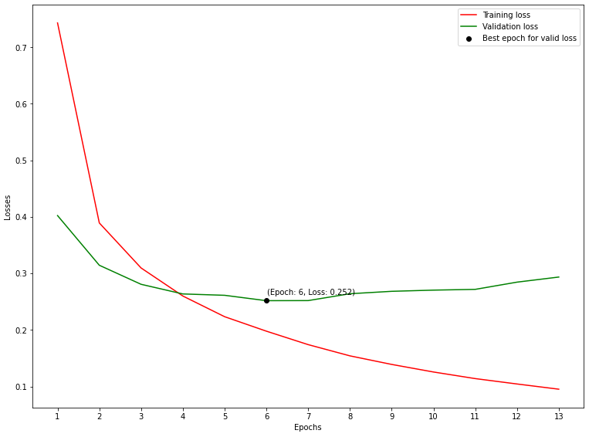
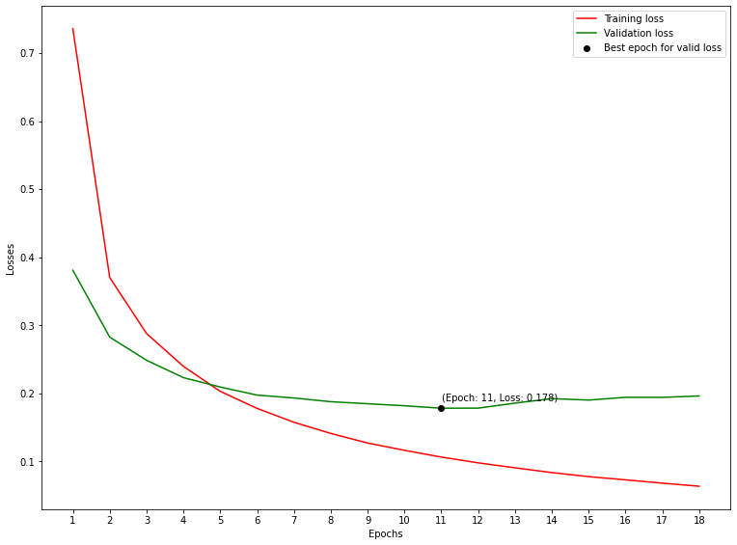
Loss function
Model 1: Cross Entropy loss Best = 0.252
Model 2: Negative Loglikelihood of the CRF layer Best = 0.178

Slide 25
Results

Slide 26
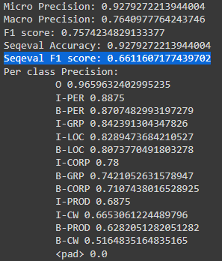
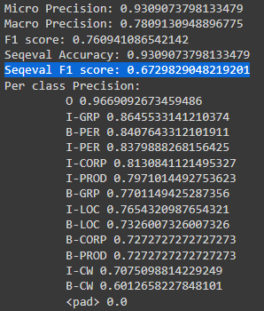
Scores
Model 1
Model 2

Slide 27
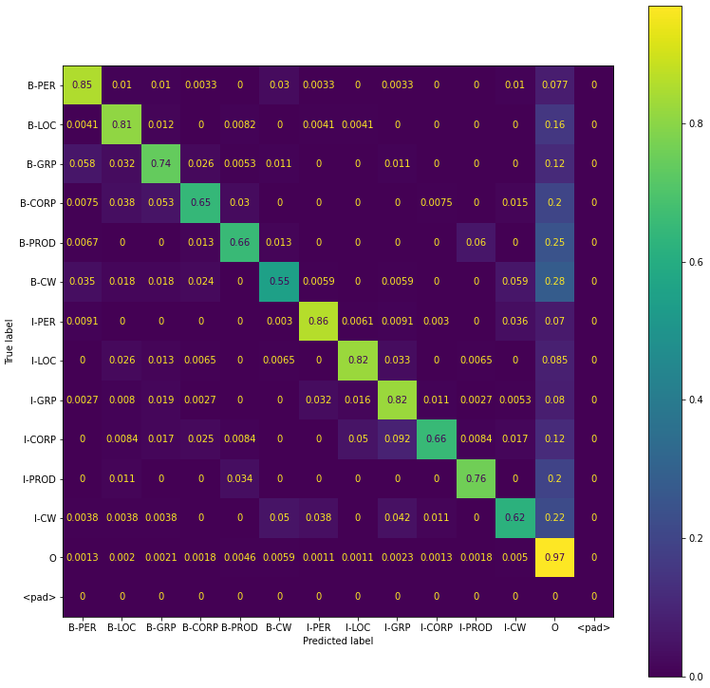
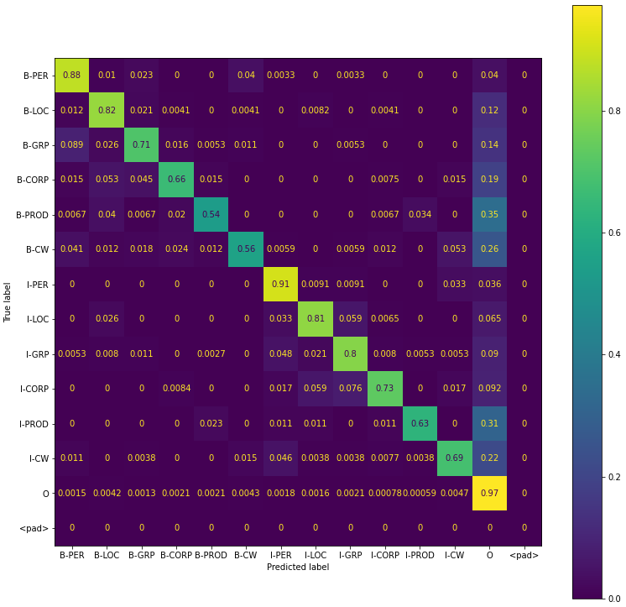
Confusion Matrices
Model 1
Model 2

Slide 28
Semantic Role Labeling
Omar Bayoumi 1747042

Slide 29
Who did What to Whom, how, Where and When?
"
"
The cat ate the fish
Who?
Did what?
To whom?

Slide 30
Algorithm
Step 1
Predicate Identification
Step 2
Step 3
Argument Identification
Step 4
Argument Classification
Predicate Disambiguation

Slide 31
Architectures

Slide 32
Step 3-4: Base model
Transformer input
Predicate input
Transformer
Predicate Embedding
Concatenation
Classifier
B-LSTM

Slide 33
Step 3-4: Base model + POS
Transformer input
Predicate input
POS input
Transformer
Predicate Embedding
POS Embedding
Concatenation
Classifier
B-LSTM

Slide 34
Step 1: Base model – Predicate Embedding
Transformer input
Transformer
Concatenation
Classifier
B-LSTM

Slide 35
Step 2: Base model
Transformer input
Predicate input
Transformer
Predicate Embedding
Concatenation
Classifier
B-LSTM

Slide 36
Preprocess

Slide 37
Preprocess: Base
“I used a Transformer”
[[CLS], I, used, a, Trans, ##former, [SEP]]
[101, 146, 1215, 170, 13809, 23763, 102]
Input
Transformer input
[0, 1, 2, 1, 1, 0, 0]
Predicate Embedding input

Slide 38
Preprocess: Base + POS
“I used a Transformer”
[[CLS], I, used, a, Trans, ##former, [SEP]]
[101, 146, 1215, 170, 13809, 23763, 102]
Transformer input
Input
[0, 1, 2, 1, 1, 0, 0]
Predicate Embedding input
[0, 11, 16, 6, 8, 0, 0]
POS Embedding input

Slide 39
Preprocess: Base + POS + VerbAtlas
VerbAtlas Manipulation
“I used a Transformer”
+
“[SEP] use agent patient”
[[CLS], I, used, a, Trans, ##former, [SEP]]
+
[use, agent, patient, [SEP]]
[101, 146, 1215, 170, 13809, 23763, 102]
+
[1329, 3677, 5351, 102]
Transformer input
Input
[0, 1, 2, 1, 1, 0, 0]
+
[0, 0, 0, 0]
Predicate Embedding input
[0, 11, 16, 6, 8, 0, 0]
+
[0, 0, 0, 0]
POS Embedding input

Slide 40
Training

Slide 41
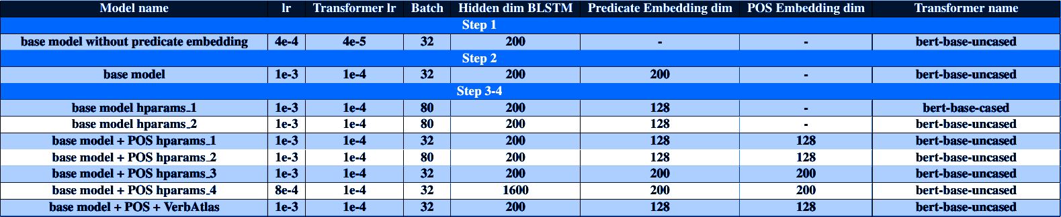
Hyperparameters

Slide 42
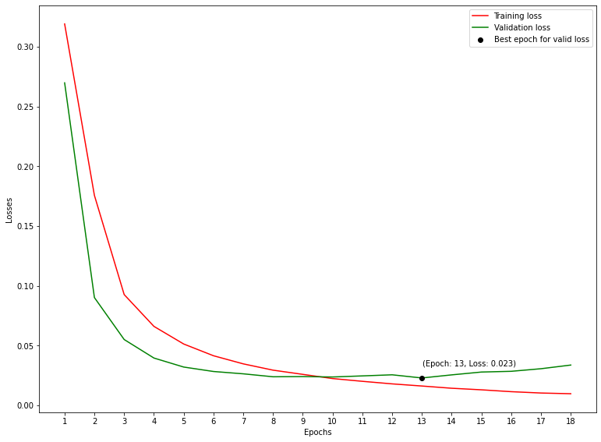
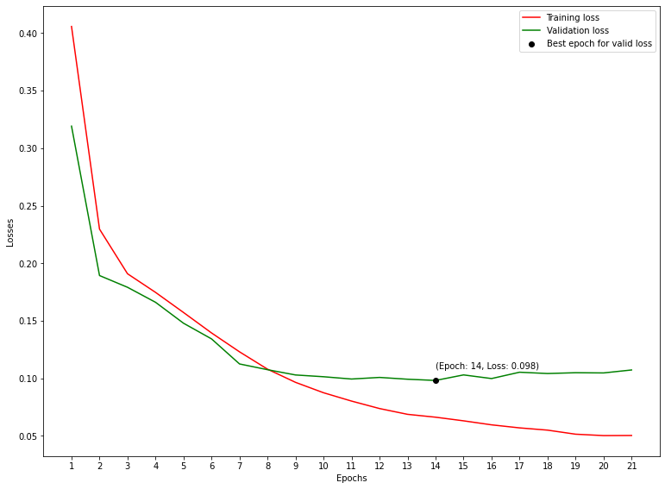
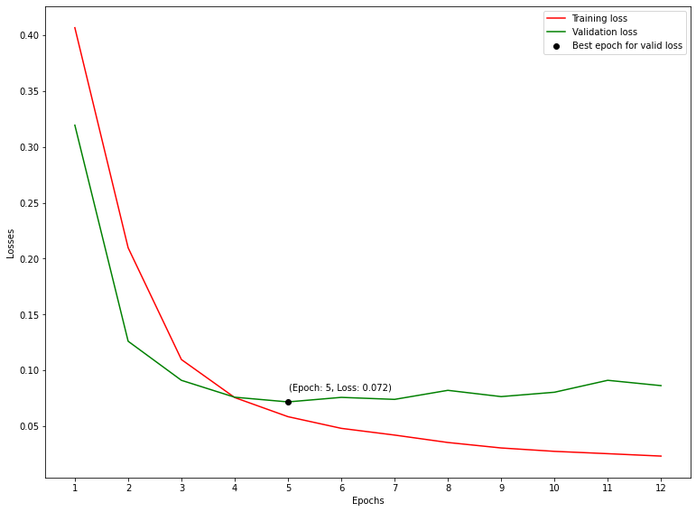
Loss Function
Step 1 Best = 0.023
Step 2 Best = 0.098
Step 3-4 Best = 0.072

Slide 43
Results

Slide 44
Scores
Name | F1 score Predicate Identification | F1 score Predicate Disambiguation | F1 score Argument Identification | F1 score Argument Classification
Results 1-2-3-4 | 0.9482 | 0.7943 | 0.8481 | 0.7808
Results 2-3-4 | - | 0.8309 | 0.8779 | 0.8072
Results 3-4 | - | - | 0.882 | 0.8468

Slide 45
Other Languages

Slide 46
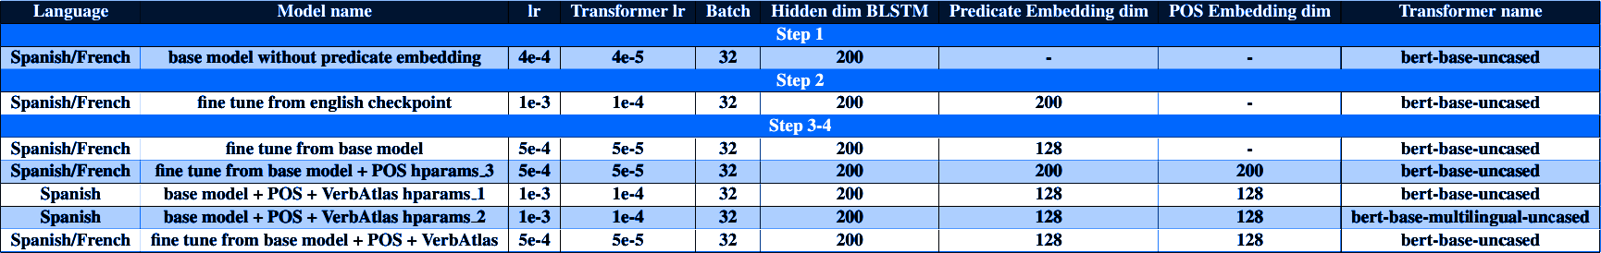
Hyperparameters

Slide 47
Hyperparameters

Slide 48
Scores
Name | F1 score Predicate Identification | F1 score Predicate Disambiguation | F1 score Argument Identification | F1 score Argument Classification
Spanish
Results 1-2-3-4 | 0.9176 | 0.4465 | 0.6773 | 0.5078
Results 2-3-4 | - | 0.4661 | 0.7256 | 0.5422
Results 3-4 | - | - | 0.7360 | 0.6600
French
Results 1-2-3-4 | 0.8821 | 0.4179 | 0.6586 | 0.4889
Results 2-3-4 | - | 0.4357 | 0.7099 | 0.5177
Results 3-4 | - | - | 0.7230 | 0.6455

Slide 49
Thanks 🤗

