Slide 1

Welcome to my presentation
Presented by
MD. OMAR FARUK

Slide 2
Tuor spot in Khulna district
In my presentation I'm highlighting the most popular tour sopts in Khulna district.

Slide 3
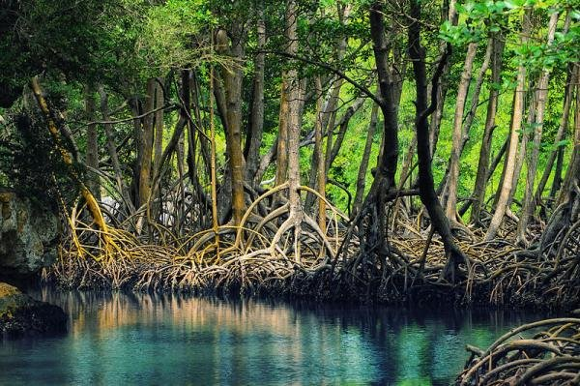
Mangrove Forest

Slide 4
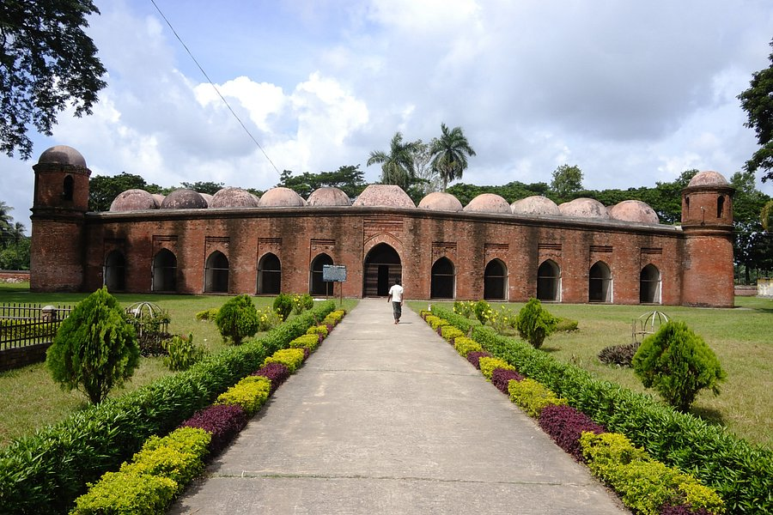
Shait-Gambuj Mosque
The Sixty Dome Mosque, is a mosque in Bagerhat, , Bangladesh. It is a part of the Mosque City of Bagerhat, a UNESCO World Heritage Site. It is the largest mosque in Bangladesh from the sultanate period (1352–1576). It was built during the Bengal Sultanate by Khan Jahan Ali, the governor of the Sundarbans.

Slide 5
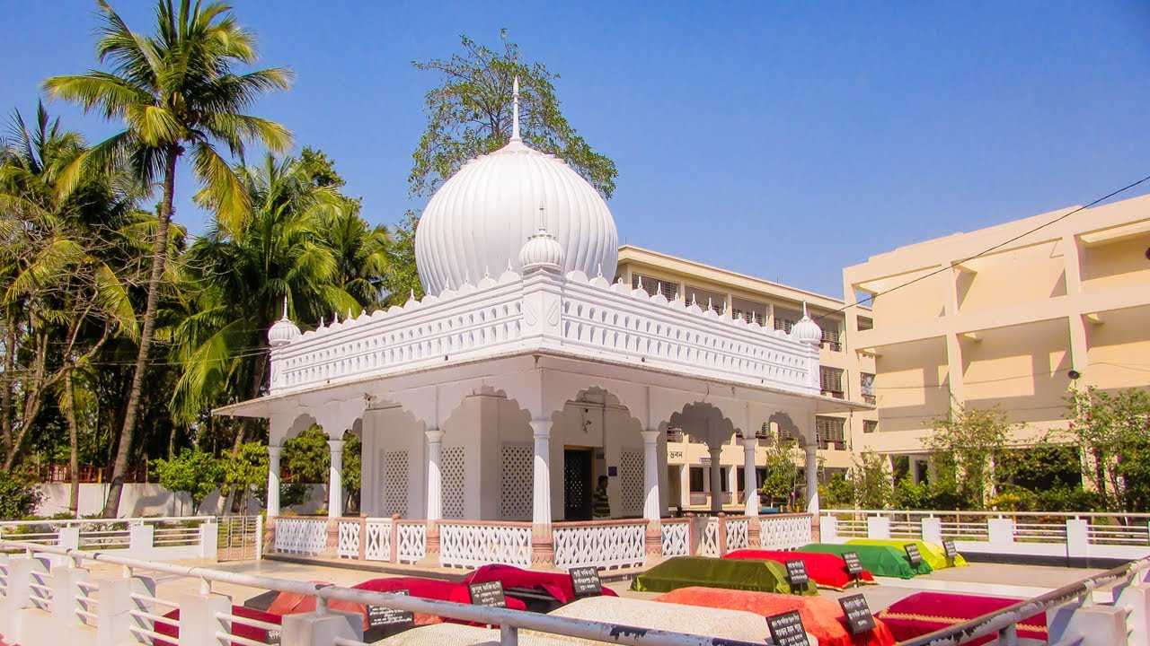
Mausoleum of Lalon Shah

Slide 6
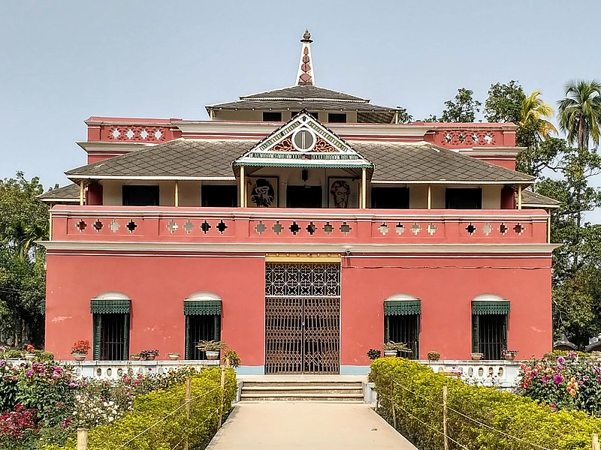
Shilaidaha Rabindra Kuthibari
Shilaidaha Kuthi Bari is a place in Kumarkhali Upazila of Kushtia District in Bangladesh.It is located in khulna division. The place is famous for Kuthi Bari; a country house. Rabindranath Tagore lived a part of life here and created some of his memorable poems while living here.

Slide 7
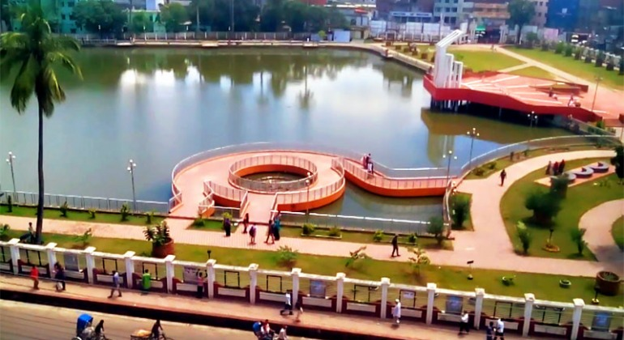
Shahid Hadis Park
Thetraditional Shahid Hadis Park in Khulna is a well-known place. It is situated in the center of Khulna city. Its location is on the western side of Bangladesh Bank Khulna branch.

Slide 8
The end

