Slide 1
Project Proposal: Age and Gender Prediction System
This presentation outlines a project proposal for the development of an advanced age and gender prediction system. We will utilize deep learning models and create a user-friendly web interface to provide a powerful and accessible tool for diverse applications.

Slide 2
Project Overview: A Robust and Accurate Prediction System
Project Scope
Target Applications
This project focuses on developing a system that can accurately predict the age category and gender of individuals from input images. The system will leverage advanced deep learning techniques to analyze facial features and patterns, providing a reliable and efficient solution for diverse applications.
The proposed system has a wide range of potential applications, including:
Demographic analysis
Personalized marketing
Security and surveillance
Healthcare and aging research

Slide 3
Team Structure and Task Distribution: Collaboration for Success
Team 1: Data Preparation
Team 2: Age Classification Model
Team 3: Gender Classification Model
This team will focus on collecting, preprocessing, and cleaning the image datasets used for model training. They will also be responsible for splitting the data into training, validation, and testing sets to ensure a robust and reliable training process.
This team will implement and refine the age classification model, focusing on maximizing accuracy and efficiency. They will train the model using the prepared dataset and perform rigorous testing and evaluation to ensure optimal performance.
This team will develop and optimize the gender classification model, focusing on achieving high accuracy and efficiency. They will also conduct thorough testing and evaluation to ensure that the model performs reliably.

Slide 4
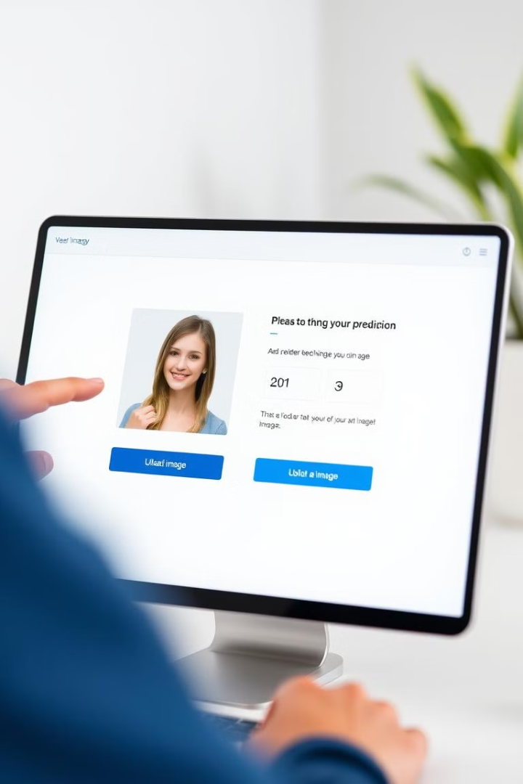
Team Structure and Task Distribution (Continued)
Team 4: Integration and Deployment
Team 5: Documentation and Presentation
This team will integrate the age and gender classification models into a unified framework. They will develop and deploy the system using Streamlit, ensuring smooth functionality across different platforms and user-friendly access.
This team will document the entire project, including methodology, results, challenges, and insights. They will also create a comprehensive and engaging presentation for stakeholders, highlighting key achievements and future directions.

Slide 5
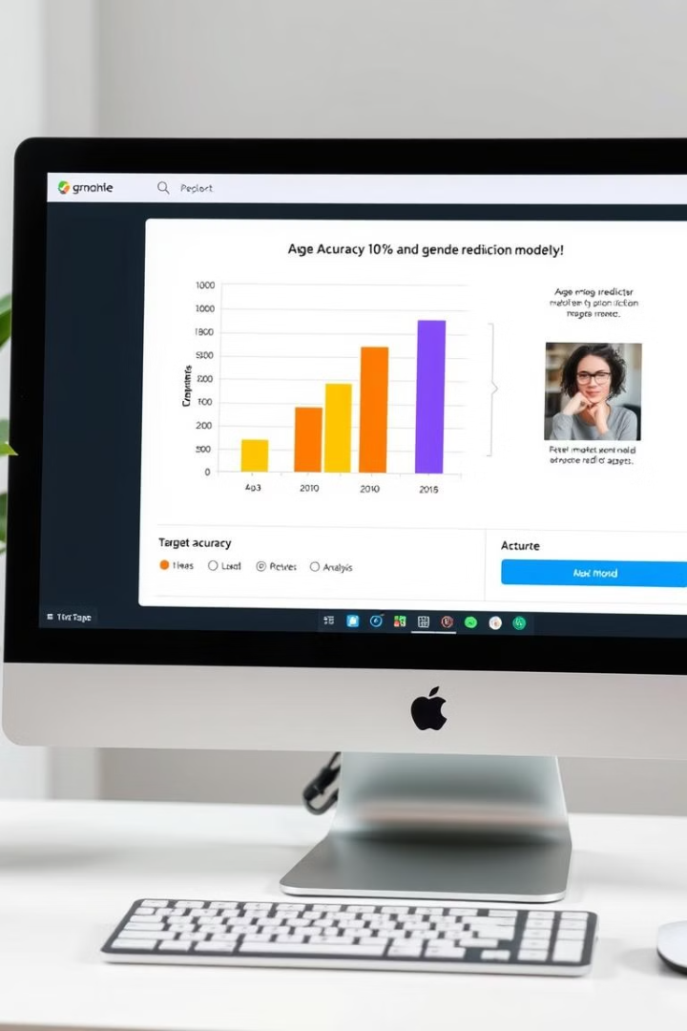
Key Project Objectives: Achieving High Accuracy and User-Friendly Deployment
1
Develop and Train Deep Learning Models
2
Deploy Models Using a User-Friendly Web Application
This objective focuses on developing and training advanced deep learning models capable of accurately predicting age and gender from input images.
This objective aims to create a seamless and user-friendly web application for deploying the developed models. This will ensure ease of use and accessibility for diverse users.
3
Achieve Minimum Accuracy of 70%
This objective sets a target accuracy of 70% for both age and gender prediction models. This high accuracy will ensure the reliability and effectiveness of the system.

Slide 6
Methodology: Leveraging Deep Learning and Streamlit
Deep Learning Techniques
Streamlit Deployment
The project will utilize various deep learning techniques for image classification. These techniques include convolutional neural networks (CNNs), which have demonstrated remarkable performance in image-related tasks.
Streamlit will be used for web application development and deployment. It is a Python framework that simplifies the process of building interactive web applications, allowing for easy integration of the developed models and user-friendly interfaces.

Slide 7



Expected Outcomes: A Powerful Tool for Various Applications
High Accuracy
1
The project aims to achieve high accuracy for both age and gender prediction models, exceeding 70%.
User-Friendly Interface
2
The deployed web application will provide a seamless and intuitive user experience, making it easy for users to upload images and receive accurate predictions.
Scalable and Adaptable
3
The developed system will be designed to be scalable and adaptable, allowing for future improvements and integration with other applications and services.

