Slide 1
Assistant-bot
Supervised by
Dr.Ayman El-klany
TA.Ahmed Ramzy
Implemented by
Nada Bassem Shouman | 20160328
Shimaa samir mohamed | 20160117
Aya Attia Ramdan | 20190321
Zaynab Muhammed Muhammed | 20160107
Omar Abdelfattah | 20160160

Slide 2
Project idea
We're using the messenger chat Bot tool to understand user natural language about specific services using NLU unit, for saving user time and money.

Slide 3
Problem Definition
Using different services like asking for weather, food recipe and football news user need to deal with many different sources
We also have a problem that the human language is not specific to a certain meaning so the chat bot would face some difficulties in communicating.

Slide 4
Suggestion solution
-Make a chat bot using the Facebook Messenger
chat
-The main idea is a conversation with the users which occurs through written messages between the messenger chat Bot and the user.
-That natural language unit tries to understand user's .message as much as possible

Slide 5

scenario
-If the user sent message like
“I want trend films“
“I want to know the daily weather“
“how much it will be if I want to convert
100 dollars to Egyptian pounds “

Slide 6
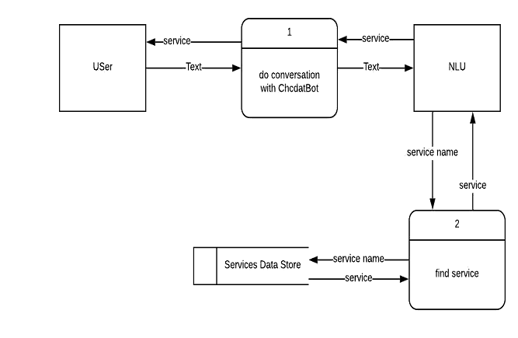
How scenario actually done?

Slide 7
System Architecture
At First the user send a message to the chat-bot.
Then the chat-bot send the message as a text to the NLU.
And then send the result to the chat-bot which replay to the user with the required service.

Slide 8
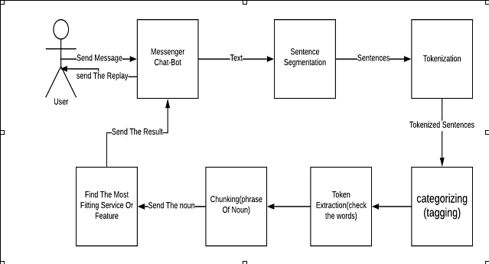
System Architecture diagram

Slide 9
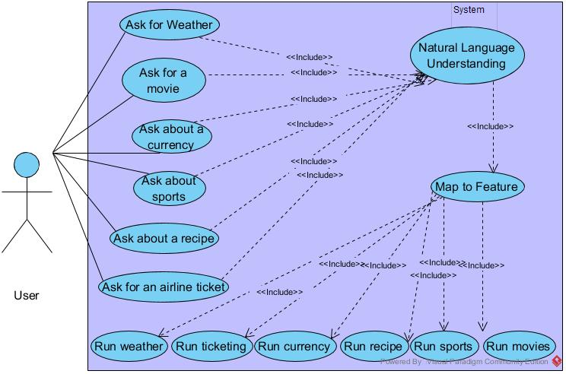
Use case

Slide 14
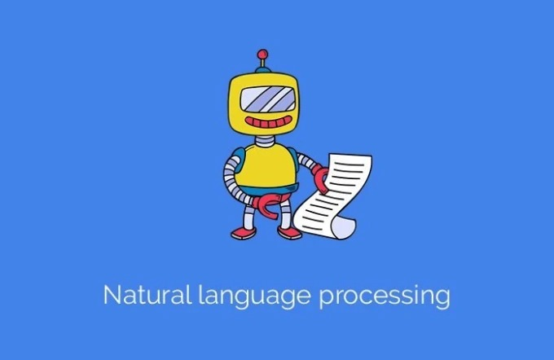
Natural language unit

Slide 15
NLP vs NLU
•NLP is short for:
-Natural Language Processing :The process of operating some functionalities to raw text.
•NLU
is short for:
-Natural language understanding and it’s Part of NLP.
-NLU: Structuring raw text to be understood by program.

Slide 16
NLP Levels
1-Morphological
2-Lexical
3-Syntactic(Parsing)
4-Semantic
5-Discourse
6-Pragmatic

Slide 17
Parsing
Parsing by Paragraph
Parsing by Sentence

Slide 18
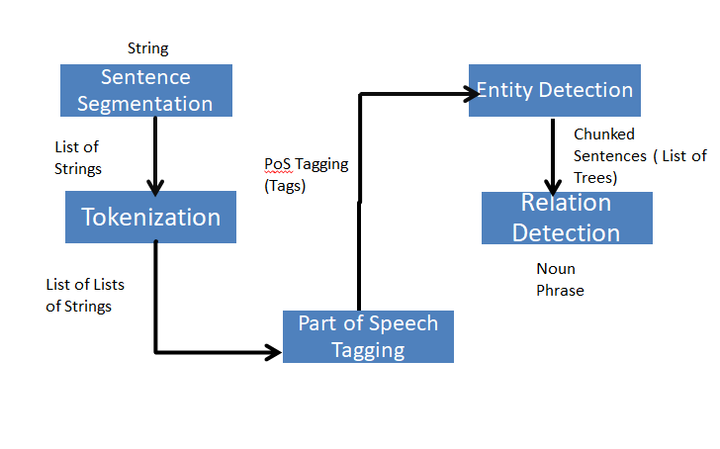
Information Extraction

Slide 19
Part of Speech Tagging
Part-of-speech tags are assigned to a single word according to its role in the sentence.
Traditional grammar classifies words based on eight parts of speech: the verb (VB), the noun (NN), the pronoun (PR+DT), the adjective (JJ), the adverb (RB),the preposition (IN), the conjunction (CC) and the interjection (UH).

Slide 20
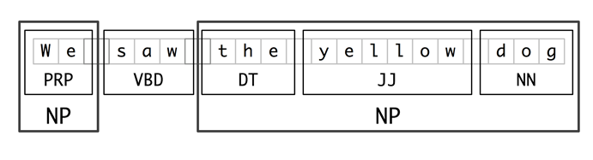
Chunking Entity Detection

Slide 21
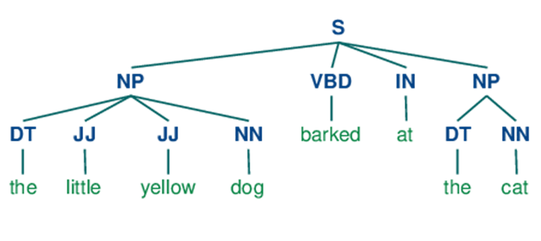
Ontology “We Saw The Yellow Dog”

Slide 22
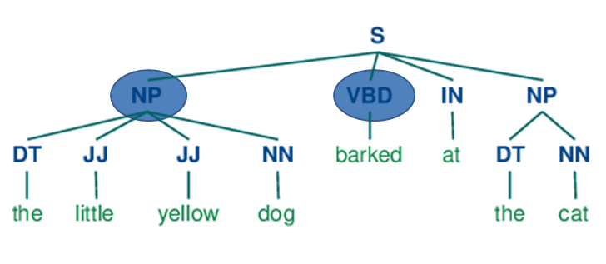
The Language Ontology “We Saw The Yellow Dog”

Slide 23
Function requirement
:Users can
-Ask about the weather.
-Asking for a name of movies or asks about a trend.
-Ask for currency convertibility.
-Asking about specific football name of team, asking
news of match".
-Asking for food Recipe or quick answer about foods.

Slide 24
Current progress
-Now the user can do all of this services and even he can do much more.
-We also created a chat Bot.
- Now we can categories any sentence words.

Slide 25
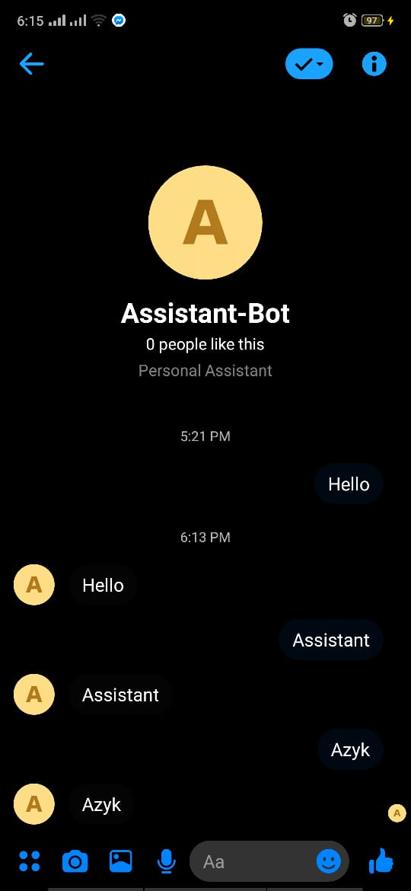

Slide 26
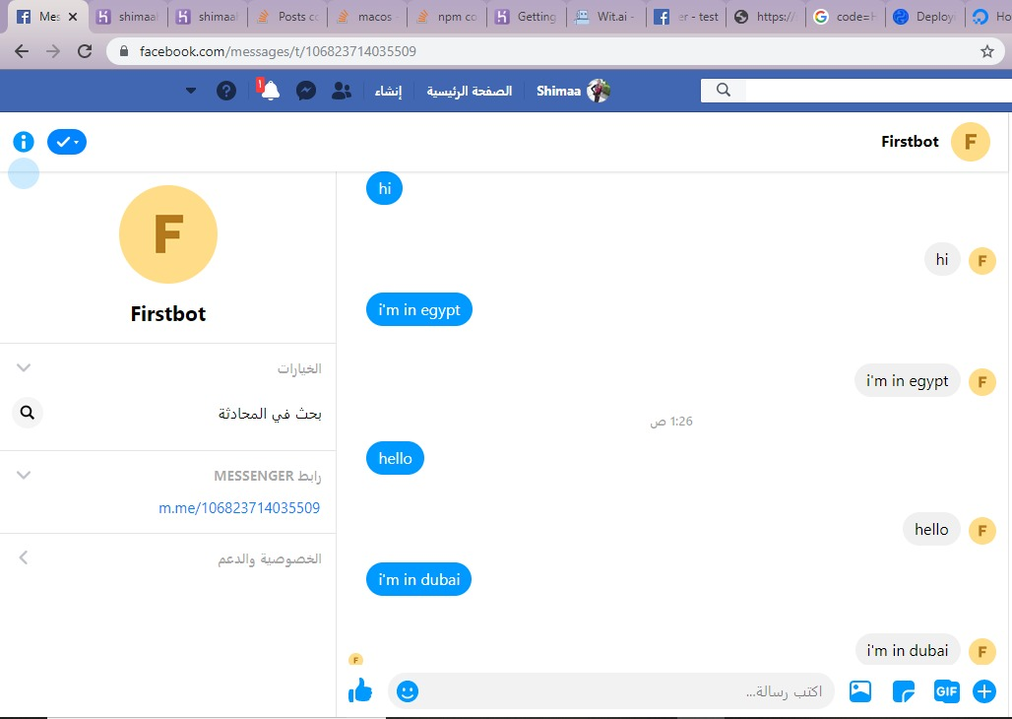

Slide 27
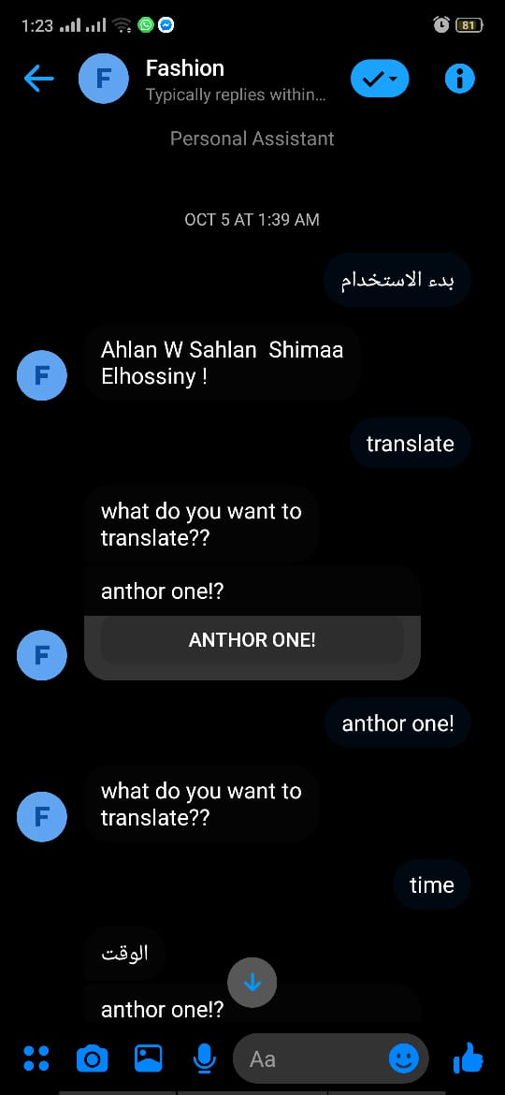

Slide 28
Any question?

Slide 29
Thanks !

