Slide 1


BILINGUAL VOICE ASSISTANT
Python Backend + Flutter GUI
AI & Robotics Summer Field Training Project
Arabic + English
Local LLM
Flutter GUI

Slide 2
01
Project Motivation
Why a small bilingual desktop assistant is useful
User challenge
Engineering challenge
Training value
Short voice commands are variable, bilingual, and often code-switched. A rigid command syntax makes a desktop assistant harder to use.
The system must combine probabilistic speech/language understanding with deterministic desktop actions and clear failure handling.
The project demonstrates an end-to-end AI software system: audio, STT, NLP, local inference, actions, TTS, GUI integration, testing, and CI.
Target interaction
1
Speak / type
2
Understand
3
Act
4
Respond
English, Arabic, or code-switched
STT + local intent parsing
Desktop utility action
Text + local TTS
Design principle: keep the intent/action vocabulary small and testable, while using the local LLM to make phrasing more flexible.

Slide 3
02
Scope and Supported Capabilities
What the implemented system actually covers
Operational intents
Included
get_time
Current time
Linux desktop operation
Local TTS with fallback chain
get_date
Current date
Arabic + English speech/text
Flutter Voice / Chat / Settings UI
Local Qwen intent parsing
Voice enrollment + mic diagnostics
get_sys_info
CPU / memory / disk
Regex + fuzzy fallback
Automated tests and CI
open_app
Launch desktop app
web_search
Browser search
Explicitly excluded / limited
No physical robot platform; no fully offline STT; no broad open-domain conversation; no multi-turn memory.

Slide 4
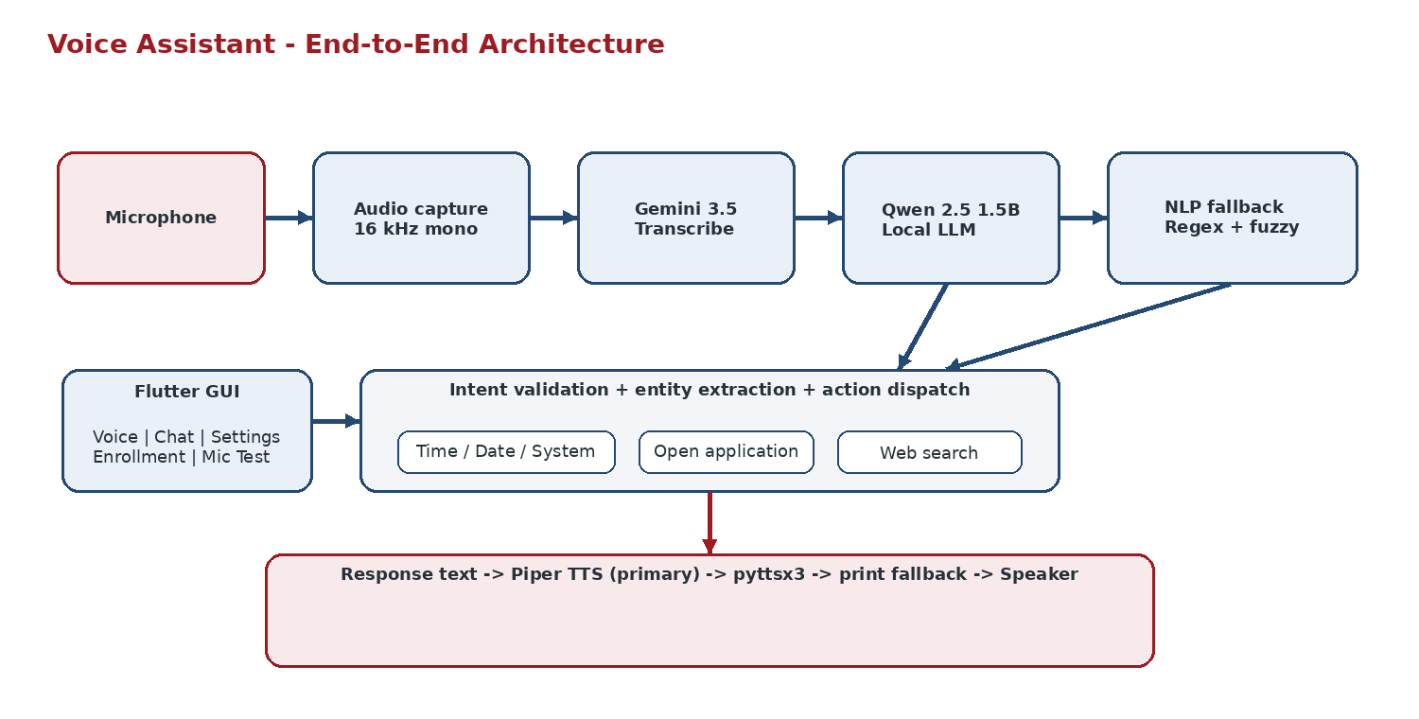
03
System Architecture
Python owns the AI/action pipeline; Flutter is the client UI
Figure: end-to-end architecture reconstructed from the repository modules and GUI protocol.

Slide 5
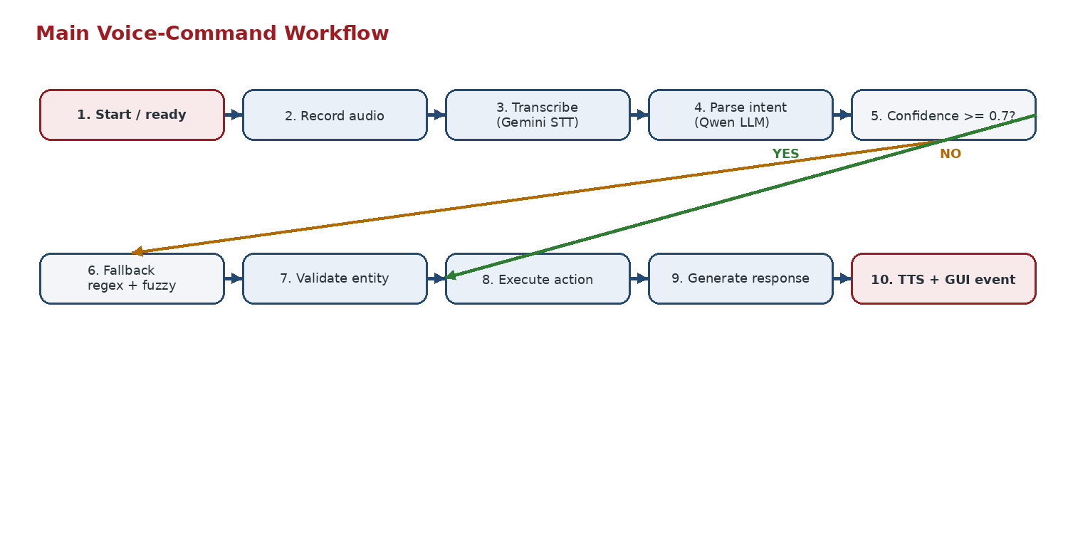
04
AI / NLP Pipeline
Hybrid intent understanding with a deterministic fallback
Primary semantic parser: local Qwen2.5-1.5B
Fallback: Arabic/English regex + fuzzy matching
Confidence threshold: 0.7 for the LLM path

Slide 6
05
Backend Implementation
Python modules and their responsibilities
STT
sounddevice
16 kHz mono capture; Gemini 3.5 Transcribe; ar-EG / en-US mapping; retry on rate limits.
LLM
llama-cpp-python + Qwen2.5-1.5B GGUF
Local semantic intent parsing; structured JSON; low-temperature inference.
Fallback NLP
regex + SequenceMatcher
config/intents.json; language-specific patterns; entity extraction; fuzzy matching.
Actions
psutil + subprocess + webbrowser
Time/date/system info; desktop app launch; browser search; install suggestions.
TTS
Piper -> pyttsx3 -> print
Local Arabic/English speech synthesis with fallback behavior.
Python >= 3.11
Click CLI
Pydantic config
Ruff + mypy + pytest + CI

Slide 7
06
Flutter GUI and Integration
The GUI reuses the Python backend rather than duplicating business logic
Flutter <-> Python GUI Protocol
One JSON object per line
Flutter GUI
stdin commands
stdout events
Python Backend
CliService
voice_command
status
GuiSession
Voice / Chat / Settings
Enrollment / Mic Test
text_command
transcription
STT / LLM / NLP / Actions / TTS
test_mic
response
settings
tts_playing
enroll_*
mic_test_result / enroll_state / error
stdin -> command | stdout -> event
process + state updates
Voice / Chat / Settings
Enrollment / Mic Test
JSON Lines over stdin/stdout
Logs -> stderr

Slide 8
07
User Experience
Implemented GUI features and state feedback
Voice
Chat
Settings
Large animated microphone button; Connected / Disconnected status; speaking and processing states.
Text entry, loading animation, assistant/user bubbles, Arabic RTL rendering, selectable responses.
Input gain 0.01-2.0; Auto Gain; language; theme; CLI path; Auto Start; reset to defaults.
Enrollment
Mic Test
Six phrases; one-at-a-time recording; silence retry; progress dots; saved enrollment state.
Duration, RMS, peak, clipping, language, transcription, assessment, and suggested gain.
State is driven by backend events: transcription, response, tts_playing, mic_test_result, enroll_state, status, and error.

Slide 9
08
Testing and Engineering Quality
What the repositories already test
Tested behaviors
End-to-end loop
GUI protocol
Mic -> STT -> NLP -> action -> TTS
JSONL commands, event order, malformed JSON
Error recovery
Runtime settings
Missing mic, model failure, action/TTS errors
Gain, Auto Gain, language mapping
Enrollment
Mic diagnostics
Start, record, silence, cancel, completion
Required result fields and values
CI quality gates
Ruff format/check
mypy
pytest
coverage >= 50%
package build
The repository defines these checks in GitHub Actions; this presentation does not claim an independent test run during report generation.

Slide 10
09
Performance
Repository-documented latency on the tested configuration
STT target
Local LLM
Piper TTS
End-to-end
< 1.5 s
~ 300 ms
~ 300 ms
~ 1.5-2.0 s
Network/API dependent
Qwen2.5-1.5B, int4 CUDA
Local synthesis
Speech end -> audio start
Important interpretation
These figures are repository-documented values for a specific environment (including an RTX 3050 Ti 4 GB test configuration). They are useful engineering targets, not universal benchmarks.
LLM
TTS
Other / I/O
Network is the variable
Illustrative component view of the documented ~1.5 s lower end; STT/network time varies.

Slide 11
10
Limitations and Next Fixes
Issues found by tracing both repositories
Cloud STT only
Gemini is the current STT provider; speech input is not fully offline.
Next: Add a local STT provider / fallback.
Dynamic fact correctness
The high-confidence LLM path can return model-generated text for time/date/system info instead of always using the deterministic action result.
Next: Route dynamic facts through local actions; use LLM for phrasing.
GUI mic-test contract
Flutter serializes test duration in the text field and does not serialize gain as explicit protocol fields expected by Python.
Next: Align the command model and protocol schema.
Auto Start behavior
The preference is persisted, but HomePage currently starts the CLI during initialization regardless of the stored value.
Next: Make startup honor the saved setting.
Install confirmation
Backend has a confirmation parameter/background install path, but the GUI protocol has no full confirmation dialog flow.
Next: Add explicit confirmation UX for side-effecting installs.

Slide 12
11
Conclusion and Demo Flow
A compact, integrated AI software system
Demo sequence
1
Launch GUI
2
Tap mic / type
3
Gemini STT
4
Qwen + fallback
5
Desktop action
6
Response + TTS
Technical outcome
Integration outcome
Learning outcome
The backend cleanly separates STT, semantic parsing, deterministic fallback, actions, and TTS.
Flutter consumes the same backend through a small JSON-lines process protocol and state/event streams.
Python architecture, local inference, bilingual NLP, process integration, Flutter state management, testing, and CI.
Core message: useful desktop voice interaction comes from integrating probabilistic understanding with deterministic execution and robust software interfaces.

Slide 13
12
References and Source Basis
Project repositories + related technical documentation
[1] Rasa, "Intents and Entities," Rasa Documentation. https://rasa.com/docs/reference/primitives/intents-and-entities/
[2] Rhasspy, "Intent Handling," project documentation. https://github.com/rhasspy/rhasspy/blob/master/docs/intent-handling.md
[3] OpenVoiceOS, project documentation. https://github.com/OpenVoiceOS/OpenVoiceOS
[4] Qwen Team, "Qwen2.5-1.5B-Instruct," Hugging Face model card, 2024. https://huggingface.co/Qwen/Qwen2.5-1.5B-Instruct
[5] Open Home Foundation, "Piper: Fast and local neural text-to-speech engine." https://github.com/OHF-Voice/piper1-gpl
[6] Flutter, "shared_preferences," package documentation. https://pub.dev/packages/shared_preferences
Access date for online sources: 28 August 2026.

