Slide 1
Employee Attrition Analysis
Omar Adel

Slide 2
Content
Data Modeling & Schema
Dashboard Overview
Key DAX Measures
Workforce Overview (KPIs)
Attrition by Job Role & Department
Attrition by Demographics
Satisfaction & Attrition
Insights: Key Outliers
Recommendations

Slide 3
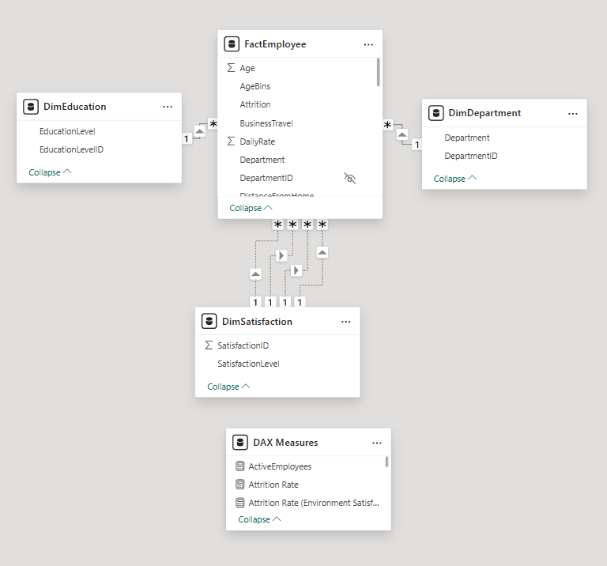
Data Modeling & Schema
Using Employee Attrition data in Power BI, data is loaded, cleaned & transformed in Power Query
Star Schema for analysis:
Fact table: FactEmployee
Dimensions: DimEducation, DimDepartment, DimSatisfaction

Slide 4
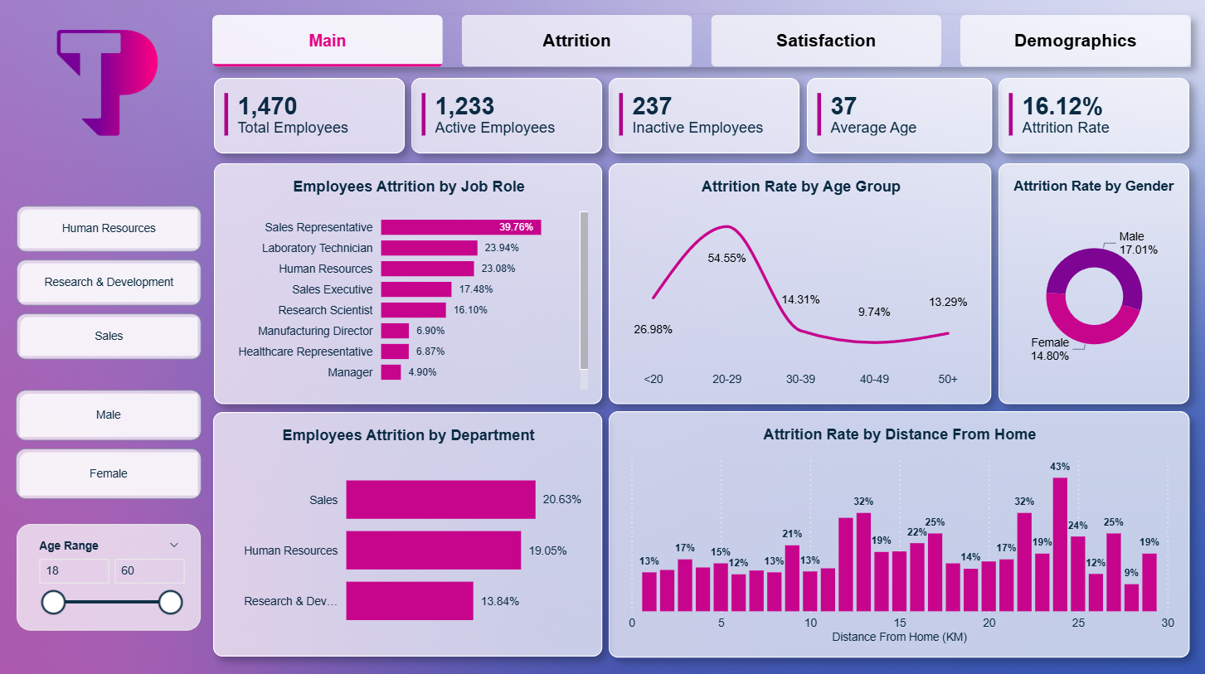
Interactive Dashboard in Power BI snapshot

Slide 5
Key DAX Measures
AttritionRate =
VAR YesAttrition = CALCULATE([TotalEmployees],FactEmployee[Attrition] = "Yes")
VAR Employees = DISTINCTCOUNT (FactEmployee[EmployeeNumber])
RETURN
DIVIDE(YesAttrition, Employees, 0)
TotalEmployees = DISTINCTCount(FactEmployee[EmployeeNumber])
ActiveEmployees = CALCULATE([TotalEmployees], FactEmployee[Attrition] = "No")
InactiveEmployees = CALCULATE([TotalEmployees], FactEmployee[Attrition] = "Yes") TargetAttritionRate = 0.10
Attrition Rate
Total Employees
Active Employees
Inactive Employees
Target Attrition Rate
Job, Environment, Relationship, Work life balance Satisfaction Attrition Rate
And many more!
Attrition Rate (Job Satisfaction) =
DIVIDE(
CALCULATE(
DISTINCTCOUNT(FactEmployee[EmployeeNumber]), FactEmployee[Attrition] = "Yes",
USERELATIONSHIP(FactEmployee[JobSatisfaction], DimSatisfaction[SatisfactionID])
),
CALCULATE(
DISTINCTCOUNT(FactEmployee[EmployeeNumber]),
USERELATIONSHIP(FactEmployee[JobSatisfaction], DimSatisfaction[SatisfactionID])
)
)

Slide 6
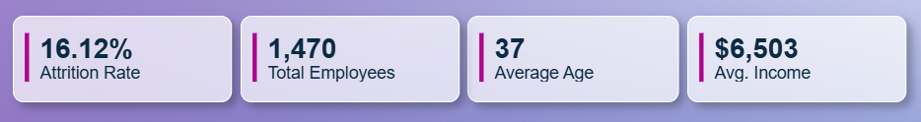

Workforce Overview
Attrition Rate = ~16.12% (237)
Total Employees = 1,470
Average Age = 37 yrs
Average Income = $6,503

Slide 7
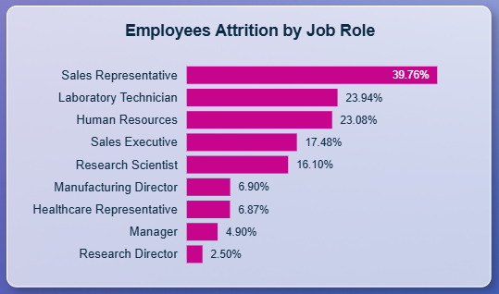

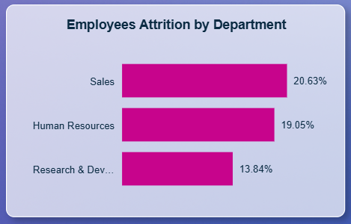
Attrition by Job role & Department
Job Role Sales Representatives: 39.76% attrition (highest).
Lab Technicians: 23.94%.
Human Resources: 23.08%.
Research Director: 2.50% (lowest attrition).
Departments
Sales: 20.63%.
Human Resources: 19.05%.
Research & Development: 13.84%.

Slide 8
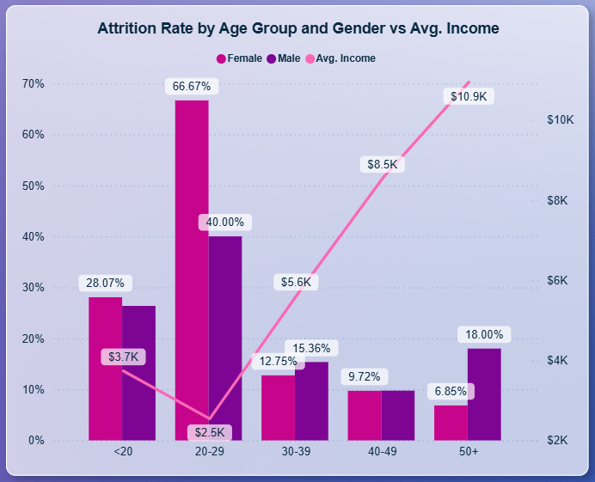
Attrition by Demographics
The highest employee turnover is seen in the 20-29 age group, with over half leaving the company. This group also has the lowest average salary.
Employees earning less are far more likely to leave than higher earners.
There is very little difference in attrition rates between male and female employees.

Slide 9
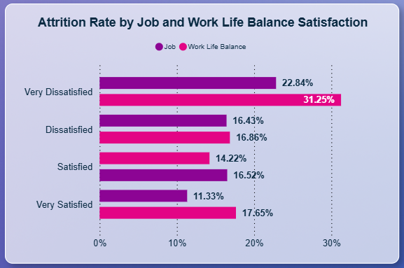
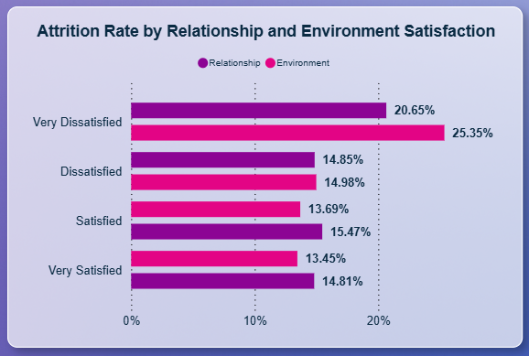
Satisfaction & Attrition
Very dissatisfied groups show the highest turnover: Work‑life 31.25%, Job 22.84%, Environment 25.35%, Relationship 20.65%.
Improving satisfaction should materially reduce attrition in at‑risk teams.
And average satisfaction scores are modest: Job 2.73, Environment 2.72, Work‑life 2.76, Relationship 2.71, signaling room for improvement across the board.

Slide 10
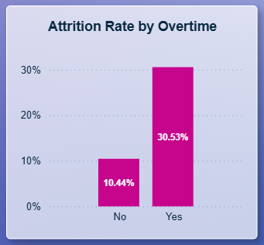

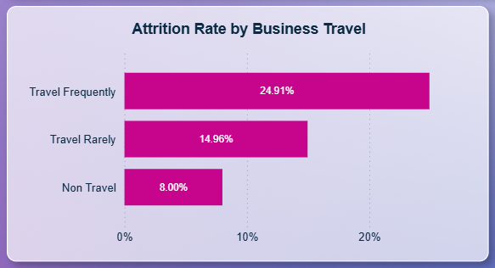
Insights summary
Employees: 20-29 age group shows 54.55% attrition and earns lowest average income of $2.5K
Department & Job Role: Sales Representatives lead at 39.76% and Lab Technicians at 23.94%. Sales department shows 20.63% overall attrition rate
Overtime turnover: Workers with overtime show 30.53% vs. 10.44% without overtime.
Business travel : Frequent travelers quit at 24.91% vs. 8% for non-travelers.
Work-life satisfaction : Very dissatisfied workers show 31.25% vs. 17.65% for very satisfied.
Low Income: $1-3K income group shows 28.61% attrition rate.
Marital Status: 25.53% attrition vs. 12.48% for married workers.

Slide 11

BUSINESS Recommendations
Focus first on the 20–29 age group with tailored onboarding, mentorship, and clear growth paths, as this group has the highest attrition rate.
Redesign high‑turnover roles, especially Sales Representatives (39.76%) and Lab Technicians (23.94%), with workload fixes, clearer career steps, and targeted recognition.
Reduce required overtime and offer flexible scheduling in teams with 30.53% attrition among overtime employees.
Support frequent travelers with schedule flexibility or travel relief where 24.91% attrition rate.
Review entry‑level pay for employees in the $1–3K income group where attrition is 28.61%,
Prioritize work‑life balance actions for teams scoring “Very Dissatisfied” where attrition reaches 31.25%.

Slide 12

Q&A

Slide 13
Thank you
Omar Adel

