Slide 1

Car accident severity

Slide 2
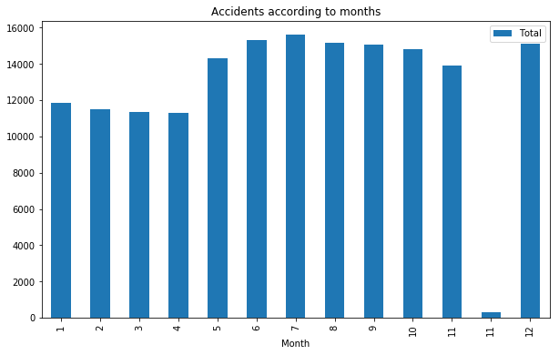
Number of accidents every Month

Slide 3
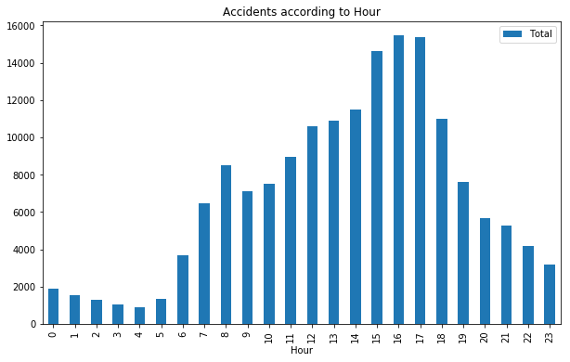
Number of accidents every hour

Slide 4
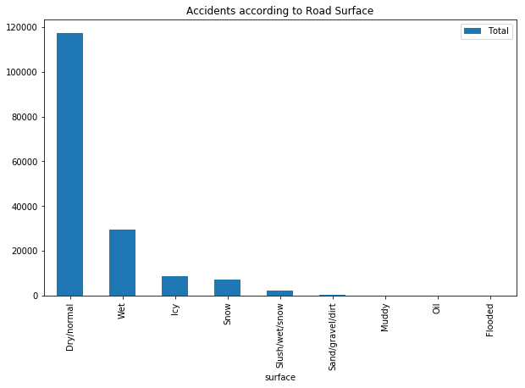
Relationship between Road Surface and accidents

Slide 5
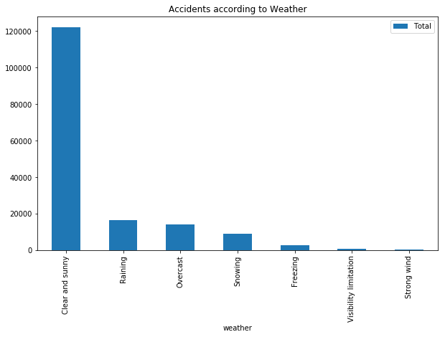
Relationship between weather and accidents

Slide 6
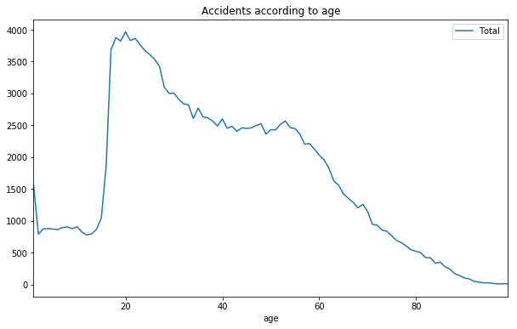
Relationship between age and accidents

Slide 7
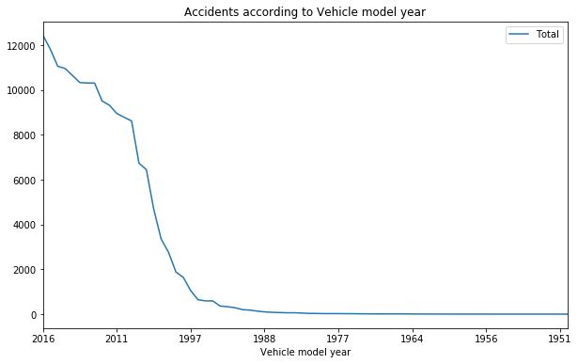
Relationship between Vehicle model year and accidents:

Slide 8
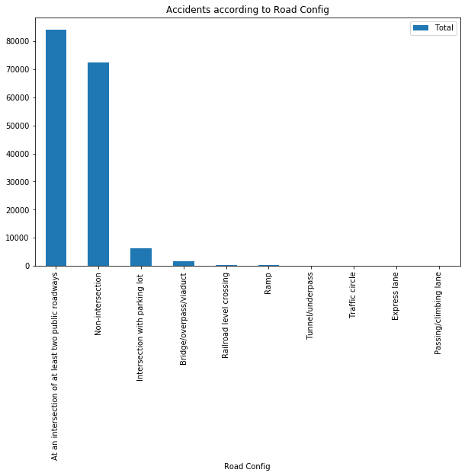
Relationship between Road Config and accidents:

