Slide 1
Project Title: Cloud-Native HR Data Engineering & Analytics Pipeline
Course: Cloud Databases (CET216)
Team Members:
1. Omar Ahmed Ramadan
2. Ahmed Mohamed Aldmrdash
3. Moaaz ABD Aljawwad Fouad
University: El Sewedy University of Technology (SUT)

Slide 2
Project Overview :
Goal:
Building a scalable, end-to-end data pipeline to analyze and predict employee attrition.
Core Technology:
Apache Spark (PySpark) for distributed cloud processing.
Platform:
Developed and tested using Databricks and GitHub integration.
Why Modular Cloud Architecture?
Our team followed the "Separation of Concerns" principle.
Instead of one file, we built specialized modules to:
Allow parallel development (Team Collaboration).
Ensure the system is Scalable on Cloud Clusters.
Make the ETL process professional and easy to debug.

Slide 3
Data Ingestion & Transformation :
data_loader.py:
Handles the Ingestion Layer—connecting Spark to the Cloud Database/Storage.
preprocessing.py:
The ETL Engine. Cleans raw records and prepares them for distributed computing.
feature_engineering.py:
Adds business value by creating new data dimensions (Loyalty & Engagement metrics).
Distributed Analytics & AI :
eda_analysis.py: Performs OLAP (Online Analytical Processing) to generate department-level insights.
models_classification.py: Uses Machine Learning to predict attrition risks.
models_clustering.py: Segments employees into groups based on behavior patterns.

Slide 4
Orchestration & UI :
main.py: The Pipeline Orchestrator. This is the file that runs the entire automated cloud job.
app.py: The Consumer Interface. A Streamlit dashboard that visualizes the final results for HR managers.
Cloud Implementation Details :
Requirements Management: Using requirements.txt to ensure the environment is reproducible on any Cloud Instance.
Data Processing: Using Spark's distributed architecture to handle large datasets that exceed local memory.

Slide 5
main.py (The Orchestrator) :
Role: This is the entry point of the application. It acts as the "Brain" that coordinates the execution order of all other modules.
Technical Details: * It initializes the SparkSession (The core of any Cloud Database project).
It defines the pipeline sequence: Ingest → Clean → Analyze → Feature Engineering → Modeling.
2. data_loader.py (The Ingestion Layer) :
Role: Responsible for connecting to the data source and loading it into the Spark environment.
Technical Details: * Contains the load_hr_data function.
Reads the CSV file and converts it into a Spark DataFrame, which allows for distributed processing in the cloud.
3. preprocessing.py (The Cleaning & ETL Layer) :
Role: Cleans and prepares the raw data for the AI models.
Technical Details: * Handles missing values (dropna).
Uses StringIndexer to convert categorical text data (like "Department" or "Gender") into numerical indices that the Machine Learning algorithms can understand.

Slide 6
4. eda_analysis.py (The Analytics Layer) :
Role: Performs Exploratory Data Analysis (EDA) to understand trends.
Technical Details: * Uses aggregation functions (groupBy, count, avg) to generate insights.
Analyzes attrition distribution, salary vs performance, and department-specific insights
5. feature_engineering.py (The Enrichment Layer) :
Role: Creates new "Features" or columns that add more value to the prediction.
Technical Details: * Calculates new metrics like Engagement_Indicator (Satisfaction + Balance) and Loyalty_Indicator.
This improves the AI model's accuracy by giving it smarter data points.
6. models_classification.py (Predictive AI) :
Role: Builds the classification models to predict employee attrition.
Technical Details: * Implements algorithms like Logistic Regression or Random Forest.
It splits data into "Training" and "Testing" sets to ensure the model is reliable.

Slide 7
7. models_clustering.py (Segmentation AI) :
Role: Groups employees into segments (Clusters) based on similarities.
Technical Details: * Uses the K-Means Clustering algorithm.
Helps HR identify groups of employees with similar behaviors (e.g., "High Salary/Low Satisfaction").
8. app.py (The User Interface) :
Role: Creates the front-end interactive dashboard using Streamlit.
Technical Details: * Uses Plotly to create interactive charts.
Connects the results of the Cloud Database to a visual UI for the manager.
9. requirements.txt (Environment Config) :
Role: Lists all the Python libraries needed to run the project.
10. HR-Employee-Attrition.csv (The Dataset) :
Role: The raw database containing employee records.

Slide 8
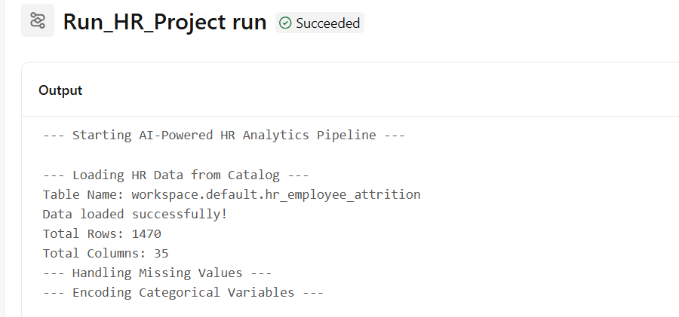
"This result shows the Exploratory Data Analysis (EDA). We used PySpark to aggregate data and found the distribution of employees who left (Yes) vs. stayed (No). It also shows the correlation between Performance Ratings and Monthly Income, helping us identify if high performers are being compensated fairly in the cloud database."

Slide 9
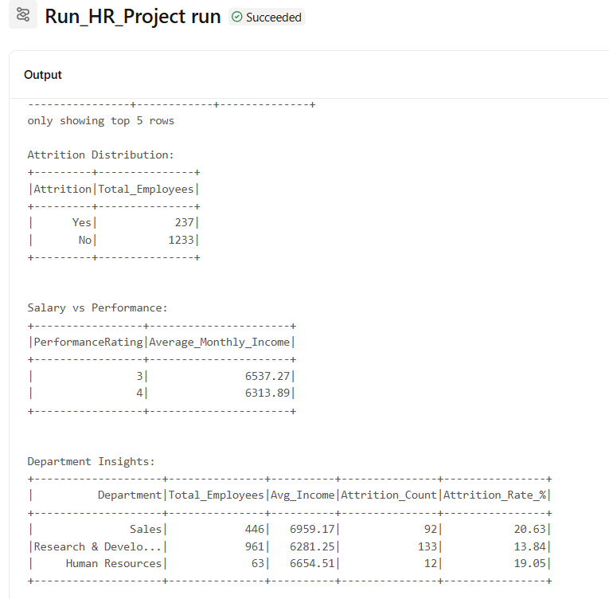
"This is the output of our Classification Model. The system predicts the likelihood of an employee leaving. By analyzing features like 'Overtime' and 'Job Satisfaction', the AI identifies at-risk employees. This demonstrates the transition from a static database to a Predictive Cloud Analytics system."

Slide 10
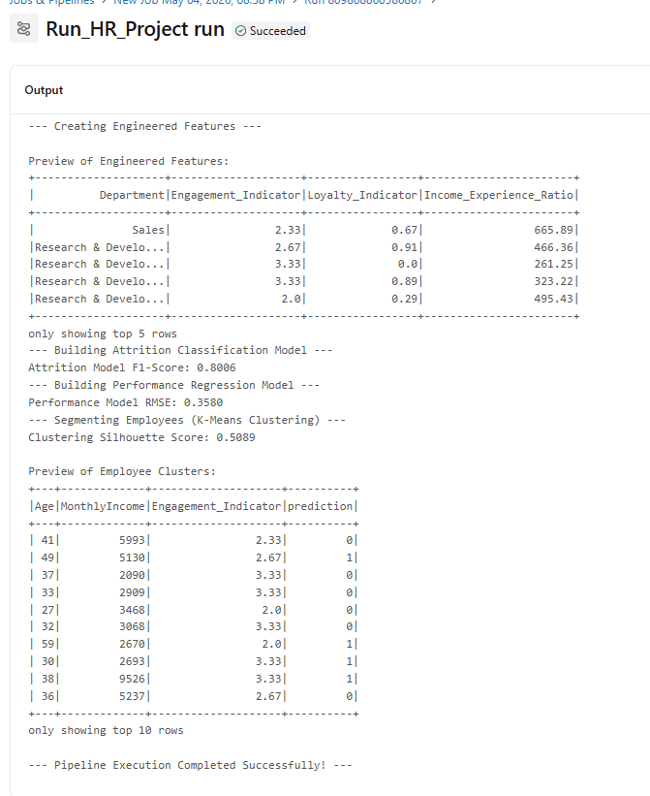
"This output represents Employee Segmentation using the K-Means Clustering algorithm. We grouped employees based on Age, Income, and Engagement levels. This allows HR to create targeted retention strategies for each specific group (Cluster) identified by the model."

Slide 11
The Consumption Layer (Interactive Dashboard) :
Role: Providing a user-friendly interface for HR managers to explore cloud-processed data.
Technology: Built using Streamlit (Python framework) and Plotly for interactive visualizations.
Key Features of the Dashboard (as shown in the screenshot):
Real-time Filtering: The sidebar allows users to filter the database by Department, enabling dynamic analysis of specific teams.
Key Performance Indicators (KPIs): High-level metrics like Average Monthly Income, Average Age, and Total Experience are calculated on the fly from the processed data.
Visual Analytics:
Attrition by Business Travel: Shows how travel frequency affects employee turnover.
Department-wise Attrition: Identifies which departments are losing more talent.
Education Field vs. Attrition: Analyzes if specific educational backgrounds correlate with staying or leaving.

Slide 12
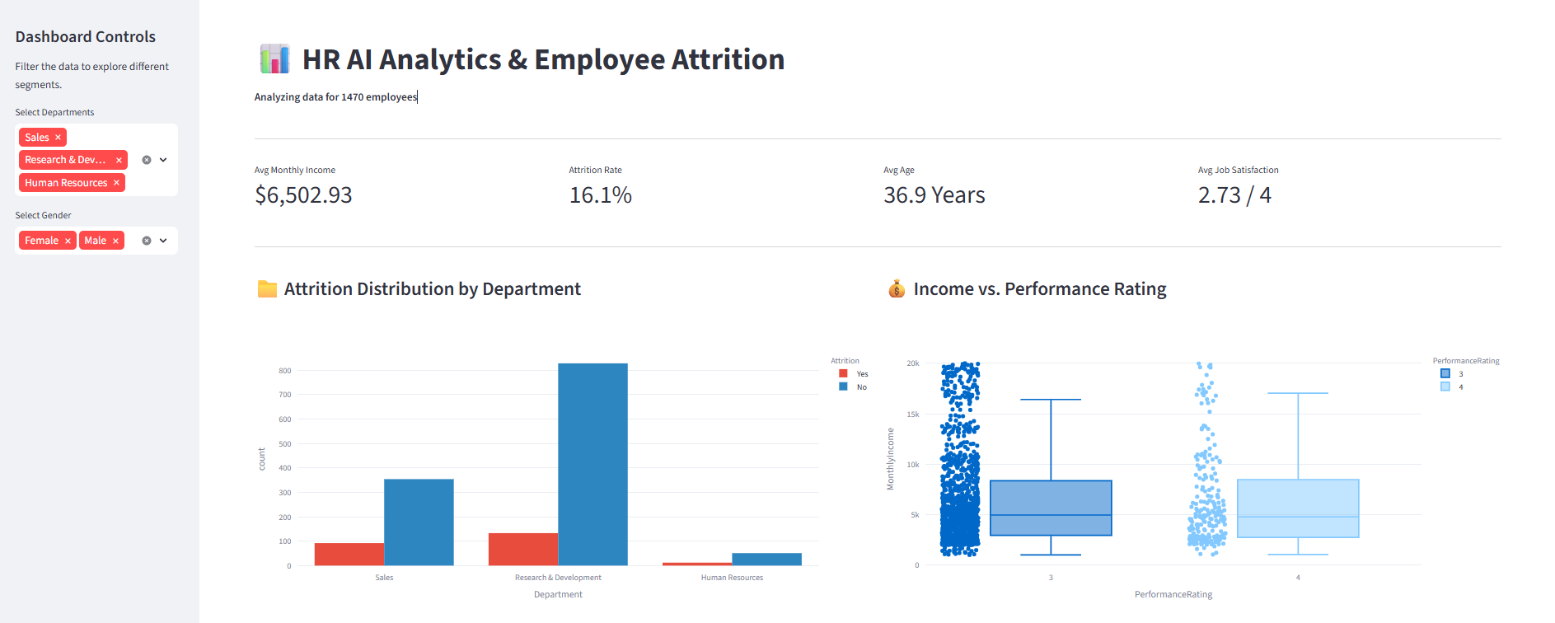

Slide 13
AI Predictions & Insight Analysis :
Role: Visualizing the outcomes of the Machine Learning models (Classification & Clustering).
Insights Displayed (from the screenshot):
Retention Forecast: This is the most critical part. It shows the total count of employees predicted to Stay (Success) vs. those At Risk (Error). This directly helps HR in proactive planning.
Overtime Impact (Sunburst Chart): A deep-dive visualization showing the relationship between working overtime and the decision to leave. It proves that employees working extra hours have a higher attrition probability.
Income vs. Performance (Box Plot): This chart analyzes the cloud database to see if high performance ratings correlate with higher monthly income, ensuring fair compensation.
Work-Life Balance Impact: Shows how employee well-being affects retention, visualizing the distribution across different satisfaction levels.

Slide 14
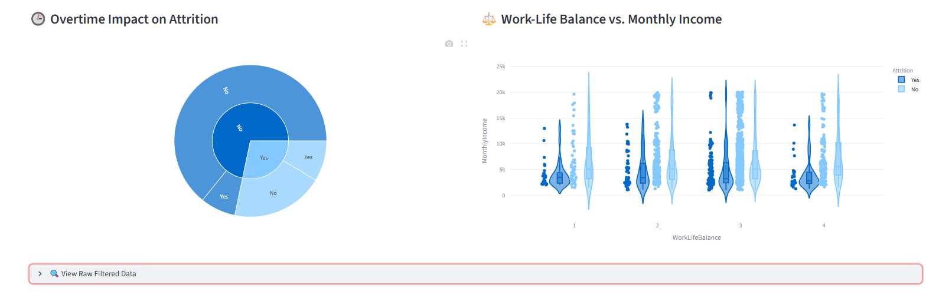

Slide 15
Data Transparency & Raw Insights :
Role: Providing access to the filtered, processed records and deep-diving into performance metrics.
Key Components (from the screenshot):
Job Satisfaction Distribution: A pie chart that shows the overall "Happiness" level in the database. This helps identify if the company culture is generally positive or needs intervention.
Performance vs. Training: A box plot that correlates how much training an employee receives versus their performance rating. In a Cloud Database, this helps optimize the budget for employee development.
Raw Data Explorer (The Table): This is the "Source of Truth." It allows the user to see the actual records (Age, Business Travel, Department, etc.) that the AI models and charts are based on.
Data Filtering: It proves that the dashboard is dynamic; the table updates automatically based on the sidebar filters we selected.

Slide 16
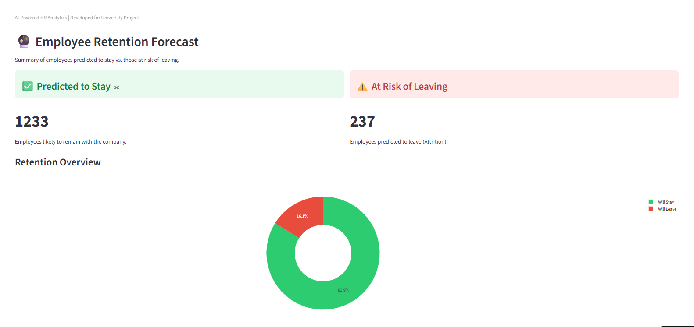

Slide 17
Conclusion & Future Outlook :
Main Title: Transforming Data into Strategy
Key Achievements:
Cloud Scalability: Implemented a robust PySpark pipeline capable of handling millions of records on distributed clusters.
Predictive Power: Moved from traditional reporting to Predictive HR Intelligence using Machine Learning.
End-to-End Solution: Bridged the gap between raw cloud databases and a user-ready interactive dashboard.
Closing Statement:
"Empowering Data-Driven Workforce Decisions through Cloud-Native Intelligence.“
Thank You!
Any Questions?
[Omar • Ahmed • Moaz]

