Slide 1
Project Title: NYC Real Estate Market Optimization: An AI-Driven Analytical Approach
Course: Data Analysis Final Project
Institution: El Sewedy University of Technology (EUT)
Team Members: Omar Ahmed Ramadan & Ahmed Mohamed
Project Abstract :
This project aims to optimize short-term rental revenues in the highly competitive New York City market. By analyzing a comprehensive dataset of over 45,000 listings, we developed a data-driven pipeline utilizing Python for data processing and algorithmic recommendations, coupled with Power BI for advanced visual analytics. The objective is to transition real estate hosts from traditional "guesswork" pricing to prescriptive, data-backed strategies that maximize occupancy and profitability.

Slide 2
The Project Problem & Motivation :
1. The Core Problem: Despite the massive demand for short-term rentals in NYC, many property hosts suffer from revenue leakage and low occupancy rates. Our preliminary analysis revealed that this is primarily caused by two critical factors:
Misaligned Pricing: Hosts often set static prices that do not reflect the dynamic averages of their specific hyperlocal neighborhoods (Boroughs).
Rigid Booking Policies: Excessive "minimum nights" requirements alienate a massive segment of short-stay tourists, leading to unbooked calendars.
2. Why It Matters (The Importance): In a market saturated with over 44,000 options, visibility and competitive positioning are critical. Solving this problem empowers investors to maximize their Return on Investment (ROI) and provides a scalable framework that can be applied to any global real estate market.

Slide 3

Python Data Engineering & Exploratory Analysis :
Data Extraction & Cleaning Pipeline :
To ensure high data integrity for our analysis, we utilized Pandas and NumPy to process the raw dataset of 45,840 records. The following preprocessing steps were applied:
Text Normalization: Standardized string columns (name, host_name, neighbourhood) to lowercase to ensure consistency during grouping and filtering.
Handling Missing Values: Handled null values strategically. We filled missing reviews_per_month with 0 (assuming no reviews yet) and dropped records with missing essential identifiers (like host names).
Logical Constraints: Filtered out unrealistic data points, such as prices equal to $0 or properties requiring a minimum stay of > 365 days.
Outlier Removal (IQR Method): To prevent extreme, ultra-luxury prices from skewing the market averages, we applied the Interquartile Range (IQR) statistical method on the price column to establish lower and upper bounds, successfully filtering out extreme outliers.

Slide 4
2. Exploratory Data Analysis (EDA) & Visualizations :
Using Seaborn and Matplotlib, we conducted a visual analysis to understand the relationships between different market drivers.
Correlation Matrix (Heatmap): We generated a heatmap to identify correlations between numerical variables such as price, minimum nights, and availability.
Borough-Level Valuation: We created comparative bar charts to analyze the "Average Property Value" versus "Average Engagement" across the 5 NYC boroughs. This revealed crucial insights, such as Manhattan having the highest prices, while other boroughs had different engagement levels.

Slide 5
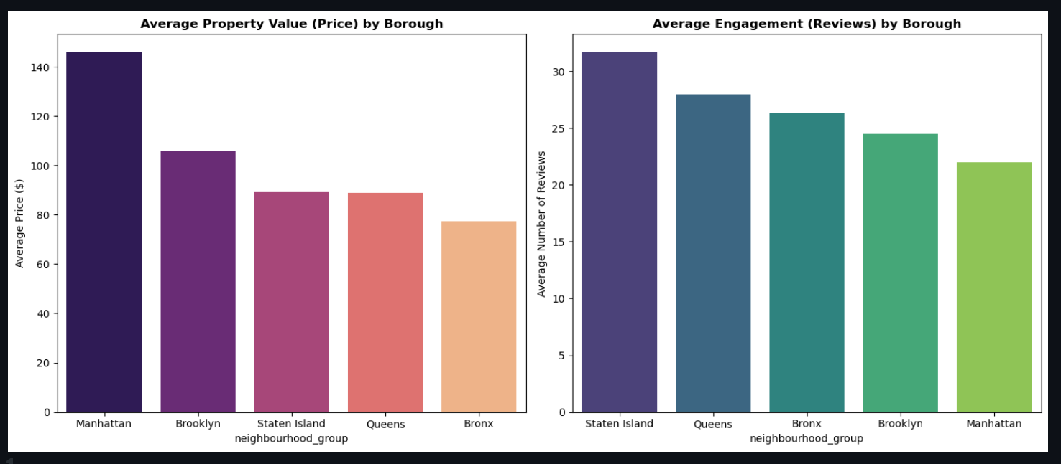
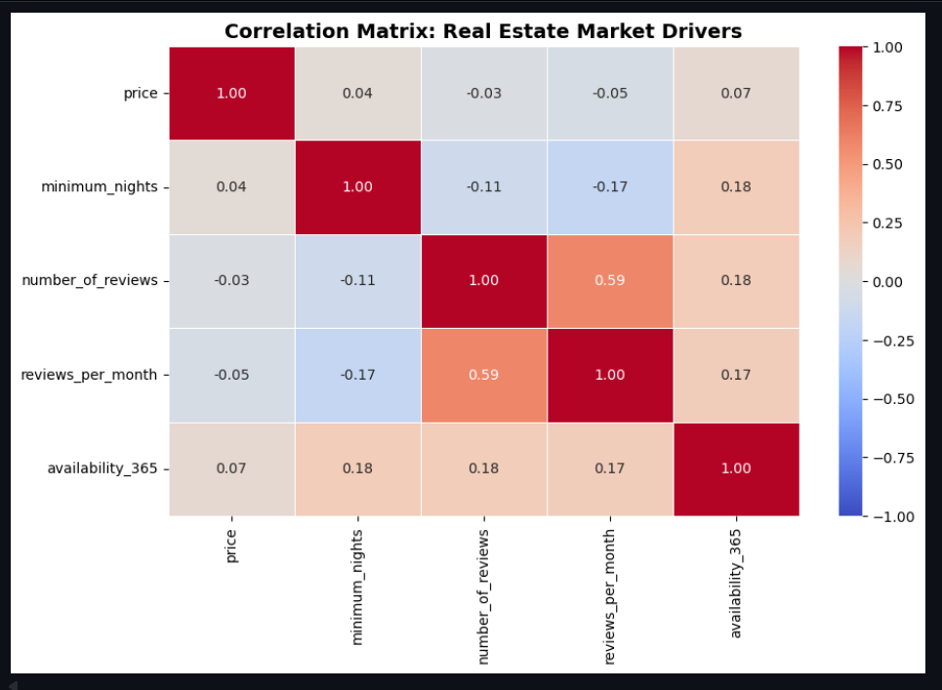
Bar Charts:
Manhattan is the most expensive, but Brooklyn and Queens lead in popularity (Review Density).
Heatmap:
Negative correlation (-0.17) proves that strict booking rules reduce listing engagement.

Slide 6
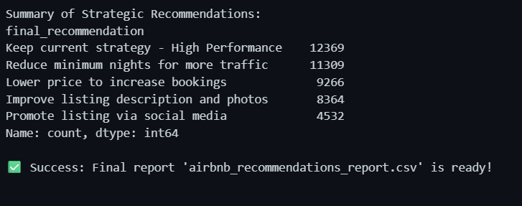
3. Feature Engineering & Prescriptive Logic :
Instead of just descriptive analytics, we transformed the data to provide actionable advice for real estate hosts.
KPI Creation: Calculated a new metric, occupancy_score, based on the availability_365 column, giving a clear percentage of a property's performance.
Context-Aware Benchmarks: Instead of comparing a property to the entire NYC average, we calculated neighborhood_avg to compare each property strictly to its local competitors.
Rule-Based AI Recommendation Engine: We developed a custom Python function get_recommendation(row) that evaluates each property and assigns one of 5 strategic actions:
Lower price to increase bookings (For overpriced, low-engagement listings).
Reduce minimum nights for more traffic (For listings with high entry barriers).
Improve listing description and photos (For well-priced but ignored listings).
Keep current strategy - High Performance (For highly successful listings).
Promote listing via social media (Default action for average performers).

Slide 7
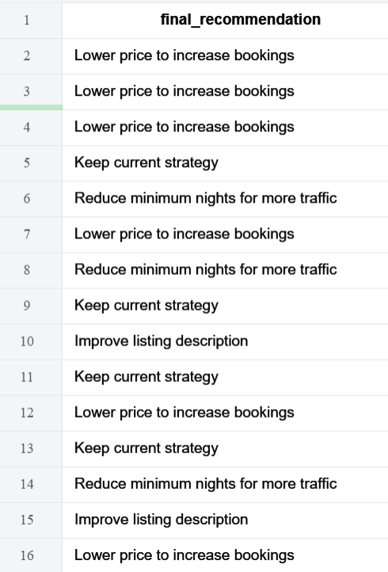
5. Implementation & Automated Advisory:
We successfully processed all 45,840 listings through a custom-built diagnostic script.
A new feature column, "Final Recommendation," was integrated into the master dataset.
Each host now has a personalized strategy (e.g., "Lower price" or "Reduce nights") mapped directly to their specific listing performance.

Slide 8
Interactive AI Advisor & Web Deployment (Streamlit) :
Transitioning to a Data Product :
To make our Python logic accessible to non-technical users (real estate owners), we developed and deployed a web-based application using Streamlit. The app serves as a real-time "AI Listing Advisor" and is hosted live on the cloud.
2. Key Features of the App:
Real-time Market KPIs: Displays dynamic metrics such as Market Average Price, Occupancy Scores, and Listing Volumes across NYC.
Interactive Data Exploration: Allows users to filter the 45,000+ listings by Borough, Room Type, and Price Range using a sidebar controller.
AI Listing Advisor (Simulator): This is the core innovation. A user can input their property's details (Name, Borough, Price, Minimum Nights). The app then runs our Prescriptive Logic in the background to provide an instant diagnosis and a specific "Action Plan" to ensure the new listing is competitive.
3. Visualizations & Technologies:
We used Plotly Express to create interactive charts (Pie charts for strategy distribution and Box plots for borough price ranges) that allow users to hover and explore data points individually.

Slide 9
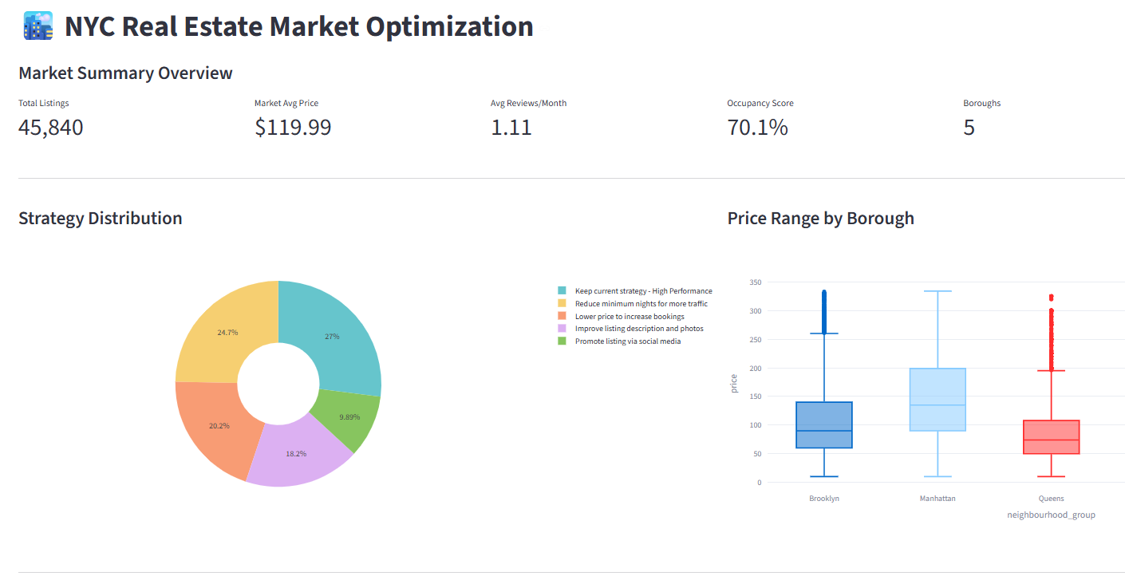
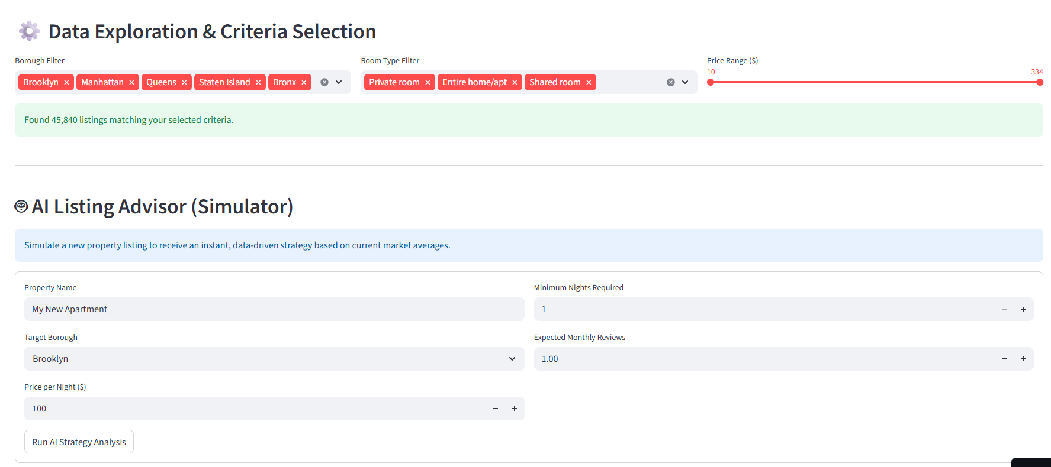

Slide 10
Interactive Power BI Dashboard Analysis :
The dashboard is designed to display market data from a macro perspective (the entire city) down to the granular details (micro-neighborhoods and host names). Below is a breakdown of each component:
Executive KPIs
What We Did: In this section, we designed a set of Key Performance Indicator (KPI) cards to summarize the entire market status at a glance. Through these, investors can see that the total number of active listings is approximately 44.47K, with an average nightly price of $119.99, and an average occupancy score of 70.06. We also highlighted a critical market issue: the average "Minimum Nights" requirement is exceptionally high at 6.58 days, which significantly reduces the chances of securing short-term bookings.

Slide 11
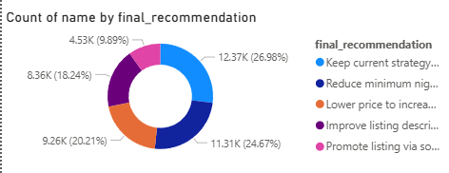
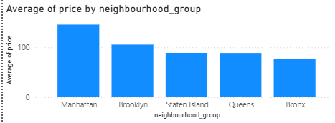
2. Market Strategy Distribution
What We Did:
We utilized a Donut Chart to visualize the distribution of the recommendations generated by our AI algorithm. This chart provides an actual diagnosis of the market's health, revealing that about 26.9% of properties need to reduce their minimum nights to increase traffic, while 20.2% need to lower their prices to remain competitive. This visual transforms raw data into a clear "roadmap" for improving host performance.
3. Geographic Pricing Discrepancy
What We Did:
To understand the purchasing power differences across NYC's five boroughs, we built a clustered bar chart comparing average prices. The analysis clearly shows that Manhattan leads the market as the most premium borough, followed by Brooklyn. This guides new investors in setting their budgets based on their target geographic location.

Slide 12
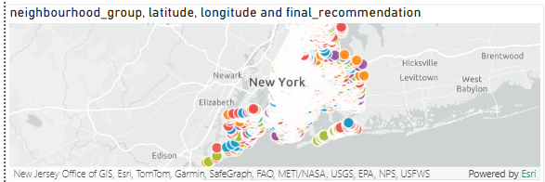
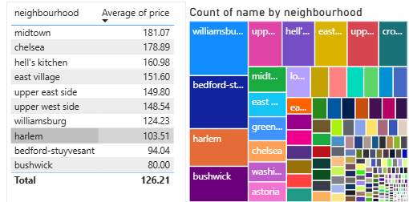
4. Geospatial Analysis
What We Did:
Using Latitude and Longitude coordinates, we activated a Map Visual that plots each property as a point on the actual map of New York City. These points are color-coded based on the "Final Recommendation", allowing investors to geographically spot clusters of overpriced properties (hotspots) and identify areas with better investment opportunities.
5. Micro-Neighborhood Analysis
What We Did:
To dive deeper into the details, we created a Table filtered to display only the Top 10 most expensive micro-neighborhoods in NYC (e.g., Midtown, Chelsea). Alongside it, we used a Treemap to illustrate the "listing density" in each area; larger blocks (like Williamsburg) represent neighborhoods with the highest concentration of properties and the most intense competition.

Slide 13
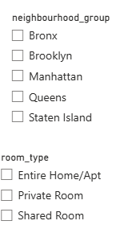
Interactive Data Controls: The Navigation Slicers
What We Did :
In this section, we integrated Interactive Slicers for neighbourhood_group and room_type. These are not just static lists; they serve as the primary "Remote Control" for the entire dashboard. By selecting any specific borough or accommodation type, the user triggers an immediate recalculation across all other visuals.
Key Features & Insights:
Dynamic Cross-Filtering:
Selecting a specific segment (e.g., "Brooklyn" + "Private Room") instantly updates the KPIs, the Map, and the Strategic Recommendations to reflect only that specific market niche.
Hyperlocal Investigation:
This allows investors to drill down from the city-wide perspective to a granular level. For example, they can isolate Manhattan to see which specific neighborhoods are overpriced.
User-Centric Experience (UX):
We designed these slicers to ensure that the 45,000+ data points are manageable and that stakeholders can find relevant insights within seconds by toggling different market parameters.

Slide 14
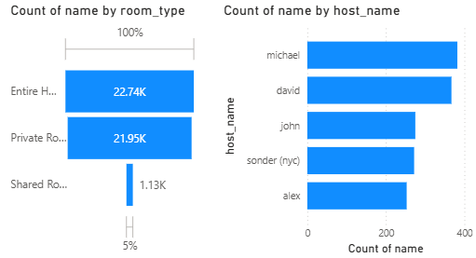
Interactive Market Navigation (The Control Center) :
What We Did:
Integrated dynamic cross-filtering slicers for neighbourhood_group and room_type to allow real-time data exploration.
Strategic Value:
Customized Insights: Investors don't have to analyze 45,000 listings at once. They can isolate specific markets (e.g., Manhattan + Entire Home) to get a targeted action plan.
Decision Support: This transforms the dashboard from a static report into an interactive "Decision Support System" where KPIs update instantly based on user selection.

Slide 15
Market Composition & Key Players Analysis :
What We Did:
Developed a Funnel Chart to analyze accommodation trends and a Bar Chart to identify the Top 5 market leaders.
Strategic Insights:
Consumer Preference (Room Types): The market is heavily dominated by "Entire Home/Apt" (22.74K) and "Private Rooms" (21.95K). "Shared Rooms" make up a negligible fraction (1.13K), indicating a strong consumer demand for privacy.
The "Whales" of the Market (Top Hosts): By analyzing the host names, we identified major corporate players like Sonder (NYC) alongside top individual hosts. This tells new investors who their biggest competitors are and shows the level of corporate consolidation in the NYC market.

Slide 16
Final Conclusion & Strategic Recommendations :
Project Summary:
This project successfully transformed a massive, static dataset of 45,000+ NYC real estate listings into a dynamic, multi-layered decision-support system. By integrating Python's computational power, Streamlit’s real-time accessibility, and Power BI’s high-level visual storytelling, we have bridged the gap between raw data and actionable business intelligence.
Key Findings:
The Policy Friction: Our analysis identified a major revenue leak in the NYC market: the high average of "Minimum Nights" (6.58 days). This acts as a significant barrier to entry, excluding a large segment of short-term travelers.
Pricing Discrepancies: While Manhattan remains the premium benchmark for price, boroughs like Staten Island and the Bronx show higher relative engagement (review density), suggesting untapped potential for value-tier investments.
The AI Impact: Through our engineered "Final Recommendation" logic, we found that nearly 47% of the market requires immediate adjustments (either in pricing or booking policy) to remain competitive.

Slide 17
Final Strategic Advice:
For real estate hosts to maximize ROI in a saturated market, they must move away from static, emotional pricing toward dynamic, data-backed strategies. The tools developed in this project—specifically the AI Listing Simulator—provide the necessary framework for hosts to audit their performance against hyperlocal benchmarks in real-time.
Closing Statement:
In conclusion, data-driven optimization is no longer a luxury but a necessity in the NYC short-term rental market. This project demonstrates that with the right analytical pipeline, any property owner can transition from "guesswork" to a "data-first" approach, ensuring long-term profitability and market leadership.

