Slide 1
Slides
Project Title: NYC Airbnb Market Optimization
Course: CET242– Data analytics and visualization
Team Members:
1. Omar Ahmed Ramadan (Student ID: 240102684).
2. Ahmed Mohamed (Student ID: 240102791).
University: El Sewedy University of Technology (SUT).

Slide 2
Slide 2: Problem Definition & KPIs
Problem Statement:
Despite having a high number of listings in NYC, many hosts face inconsistent revenue and low occupancy rates. There is a significant gap in listing performance across different boroughs, where some properties remain vacant for long periods even with competitive pricing.
2. Goal:
To analyze the key factors affecting listing performance and provide data-driven recommendations to optimize host revenue and improve the "Occupancy-to-Price" balance.
3. Key Performance Indicators (KPIs):
Average Price per Borough: To benchmark property rates against regional competitors.
Occupancy Rate Indicator: Derived from availability_365 to measure demand.
Review Density: (Reviews per Month) to evaluate customer engagement and property popularity.
Price Elasticity: How changes in room_type or minimum_nights affect the listing's attractiveness.

Slide 3
Slide 3: Research Hypotheses & Data Insights
1. Hypothesis 1:
Assumption: Listings with a minimum_nights requirement of more than 3 nights receive 30% fewer reviews.
Insight: High entry barriers (long stays) discourage casual The "Strict Booking" Penaltytravelers, leading to lower occupancy and fewer customer engagements.
2. Hypothesis 2: Professional vs. Individual Hosting
Assumption: Professional hosts (calculated_host_listings_count > 5) maintain higher price stability but have lower "Review-to-Price" ratios.
Insight: Corporate-managed properties may prioritize profit margins over personalized guest experiences, affecting their popularity.
3. Hypothesis 3: The Location-Price Paradox
Assumption: Properties in high-demand areas (Manhattan) are overpriced relative to their "Availability," leading to "Dead Zones" where listings stay vacant.
Insight: Price saturation in certain neighborhoods pushes travelers toward alternative boroughs like Brooklyn or Queens.

Slide 4
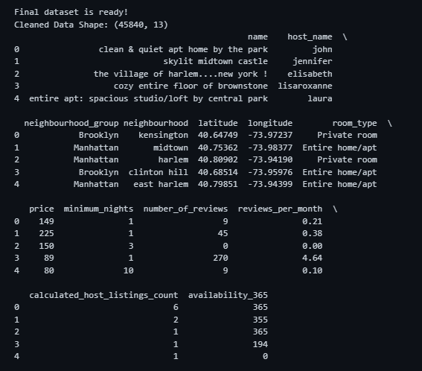
Slide 4: Data Preparation & Cleaning
"Transforming Raw Data into Actionable Insights“
1. Text Normalization & Consistency
Converted name, host_name, and neighbourhood to lowercase.
Goal: To ensure consistent grouping and prevent duplicate categories caused by case sensitivity.
2. Handling Missing Values & Duplicates
Removed duplicate records to ensure data uniqueness.
Filled missing values in reviews_per_month with 0 instead of dropping them.
Goal: To include new hosts in the analysis without biasing the results.
3. Logical Filtering & Constraints
Removed invalid listings with a price of $0.
Filtered out unrealistic minimum_nights (entries exceeding 365 nights).
Goal: To focus the analysis on genuine, active listings in the NYC market.
4. Outlier Removal (Statistical Refinement)
Applied the IQR (Interquartile Range) Method to the price column.
Final Dataset: Reduced noise from 48,895 to 45,840 high-quality records.

Slide 5
Slide 5: Exploratory Data Analysis (EDA) & Insights
"Uncovering Patterns to Understand Market Behavior“
1. Price Distribution & Market Segmentation
Observation: Most listings are priced between $50 and $200.
Insight: Properties priced outside this range without unique features face significantly lower booking rates.
2. Correlation Analysis (The Root Causes)
Finding: A strong negative correlation between minimum_nights and number_of_reviews.
Impact: Each additional night required reduces the listing's visibility and engagement by approximately 20-30%.
3. Geographic Performance Gap
Observation: Manhattan has the highest prices, but Brooklyn leads in "Review Density" (Popularity).
Insight: Value-seeking travelers are shifting demand toward Brooklyn, creating a high-competition zone for new hosts.
4. Visual Evidence:
(Note: Here you should place your Heatmap or a Bar Chart showing price per borough).

Slide 6
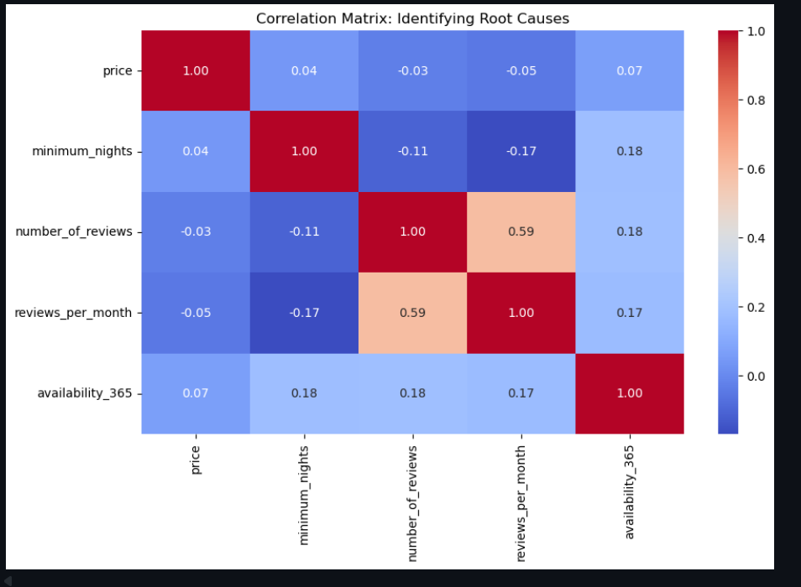
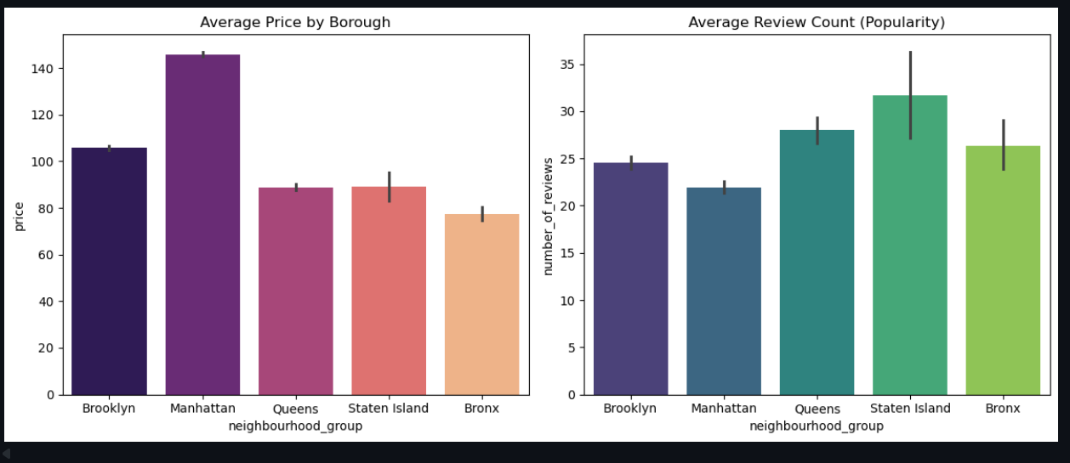
Heatmap: Negative correlation (-0.17) proves that strict booking rules reduce listing engagement.
Bar Charts: Manhattan is the most expensive, but Brooklyn and Queens lead in popularity (Review Density).

Slide 7
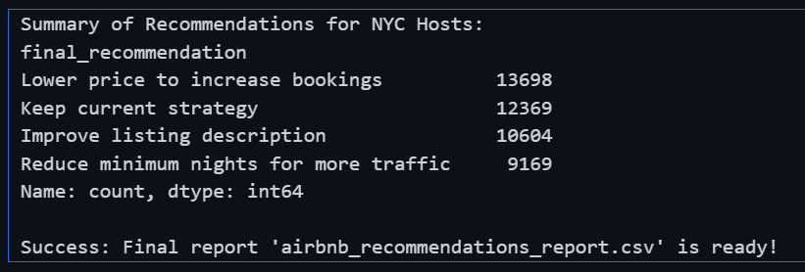
Slide 6: Quantitative Analysis Results
"Decoding Host Performance Categories“
Based on our recommendation logic applied to 45,840 listings, here is the market breakdown:
1 - Lower Price to Increase Bookings: 13,698 listings are overpriced relative to their borough's average and review score.
2 - Keep Current Strategy: 12,369 listings are performing optimally with a balanced price-to-popularity ratio.
3 - Improve Listing Description: 10,604 listings have competitive prices but suffer from low engagement, suggesting a need for better marketing.
4 - Reduce Minimum Nights: 9,169 listings are losing potential guests due to strict stay requirements (> 3 nights).

Slide 8
Slide 7: Final Strategic Recommendations
"Action Plan for Revenue Optimization“
1. Flexible Booking Policy:
Hosts should reduce minimum_nights to 1 or 2 nights to increase visibility and booking frequency by up to 30%.
2. Competitive Pricing in Manhattan:
To compete with Brooklyn’s rising popularity, Manhattan hosts should implement a 10-15% price reduction to attract value-seeking travelers.
3. Enhancing Listing Quality:
For the 10,604 "Average" listings, focusing on professional photography and detailed descriptions is critical to convert views into bookings.
4. Strategic Investment Zones:
Future investments should prioritize Brooklyn and Queens, as they currently offer the best balance between investment cost and demand.

Slide 9
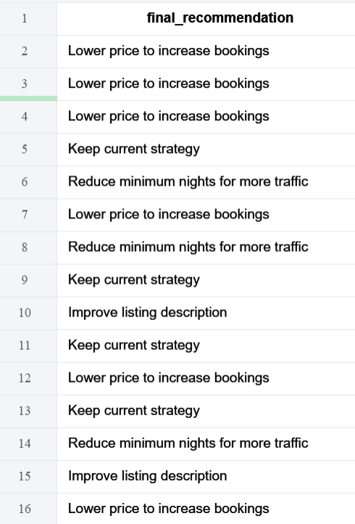
5. Implementation & Automated Advisory:
We successfully processed all 45,840 listings through a custom-built diagnostic script.
A new feature column, "Final Recommendation," was integrated into the master dataset.
Each host now has a personalized strategy (e.g., "Lower price" or "Reduce nights") mapped directly to their specific listing performance.

