Slide 1
Network Programming
Java Review

Slide 2
Content
Loops
Methods
Arrays
Objects and Classes
Exceptions
Text I/O
Binary I/O
Multithreading

Slide 3
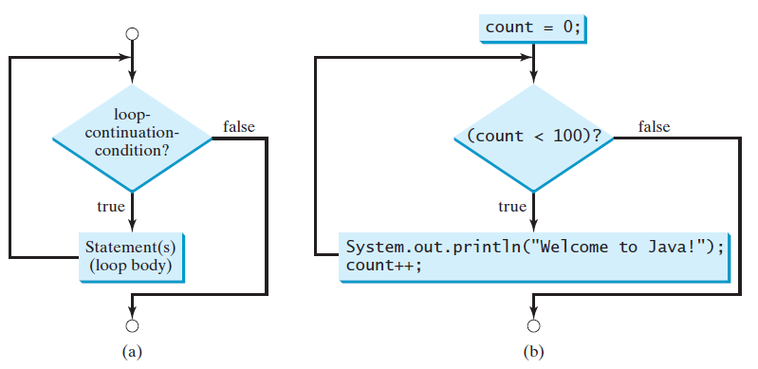
Loops
While
do …while
for
while (loop-continuation-condition) {
// Loop body
Statement(s);
}

Slide 4
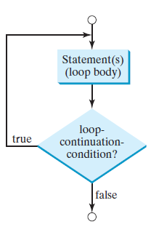
Loops
While
do …while
for
do {
// Loop body;
Statement(s);
} while (loop-continuation-condition);

Slide 5
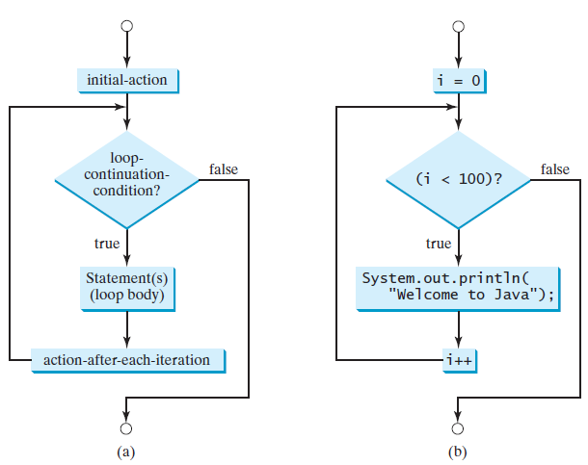
Loops
While
do …while
for
for (initial-action; loop-condition; action-after-each-iteration) {
// Loop body;
Statement(s);
}

Slide 6
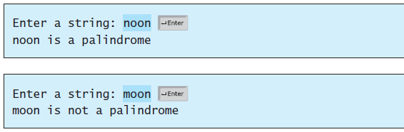




Loops
Case Study: Checking Palindromes

Slide 7
Content
Loops
Methods
Arrays
Objects and Classes
Exceptions
Text I/O
Binary I/O
Multithreading

Slide 8
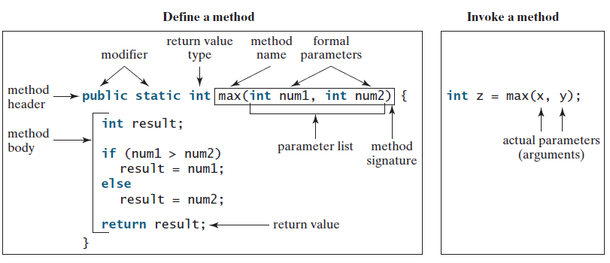
Methods
To define a method:
modifier returnValueType methodName(list of parameters) {
// Method body;
}

Slide 9
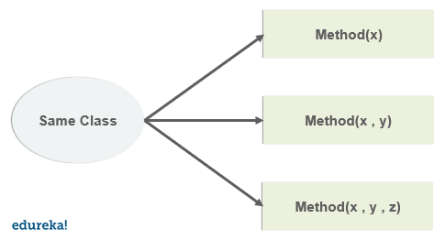
Methods
Overloading methods enables you to define the methods with the same name as long as their signatures are different.

Slide 10
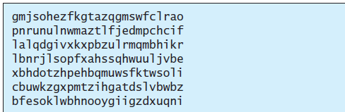
Methods
Case Study: Generating Random Characters

Slide 11
Content
Loops
Methods
Arrays
Objects and Classes
Exceptions
Text I/O
Binary I/O
Multithreading

Slide 12
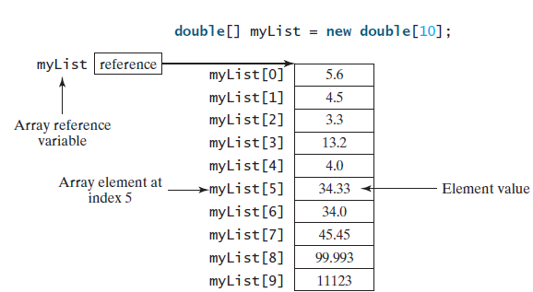
Arrays
A single array variable can reference a large collection of data.
Once an array is created, its size is fixed.
An array reference variable is used to access the elements in an array using an index.
for (elementType element: arrayRefVar) {
// Process the element
}

Slide 13
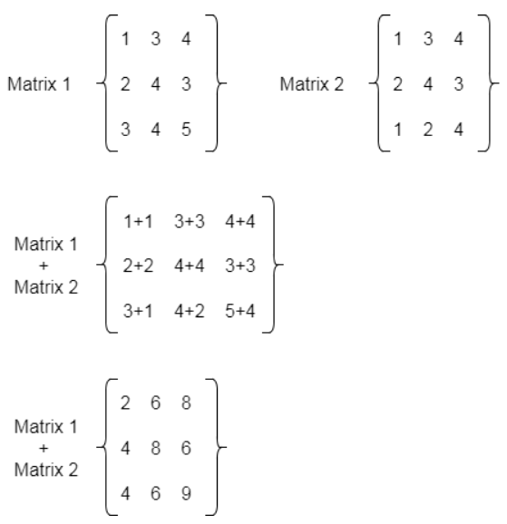
Arrays
Case Study: Addition of 2D Matrices

Slide 14
Content
Loops
Methods
Arrays
Objects and Classes
Exceptions
Text I/O
Binary I/O
Multithreading

Slide 15
Objects and Classes
OOP Concepts
Object
An entity that has attributes and methods
Class
The blueprint that describes objects
Encapsulation
When an object exposes the selected information only
Inheritance
Abstraction
Polymorphism
Objects can inherit other attributes and behaviors from other objects
Hide complex details to reduce complexity
Objects can have more than one form

Slide 16
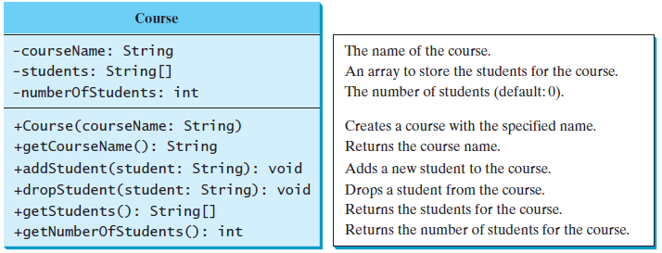
Objects and Classes
Case Study: Designing the Course Class

Slide 17
Content
Loops
Methods
Arrays
Objects and Classes
Exceptions
Text I/O
Binary I/O
Multithreading

Slide 18
Exceptions
Exceptions are error messages thrown from a method.
The caller of the method can catch and handle the exception.
Different ways for handling runtime errors: Quotient.java

Slide 19
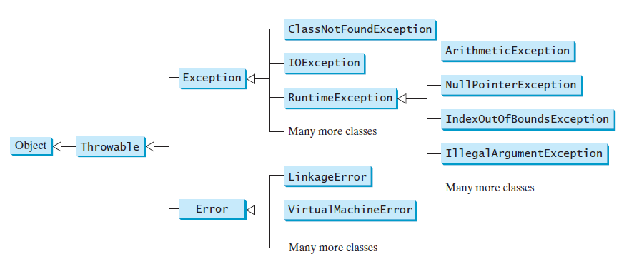
Exceptions
try {
Code to run;
A statement or a method that may throw an exception;
}
catch (type ex) {
Code to process the exception;
}

Slide 20
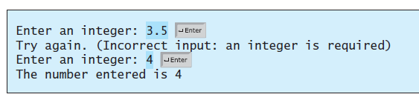
Exceptions
InputMismatchExceptionDemo

Slide 21
Checkpoints
What is the advantage of using exception handling?
Which of the following statements will throw an exception?
Point out the problem in the following code. Does the code throw any exceptions?
System.out.println(1 / 0);
System.out.println(1.0 / 0);
long value = Long.MAX_VALUE + 1;
System.out.println(value);

Slide 22
Checkpoints
What is the advantage of using exception handling?
It enables a method to throw an exception to its caller. The caller can handle this exception. Without this capability, the called method itself must handle the exception or terminate the program. Often the called method does not know how to handle the exception. So it needs to pass the exception to its caller for handling.
Which of the following statements will throw an exception?
Point out the problem in the following code. Does the code throw any exceptions?
System.out.println(1 / 0);
System.out.println(1.0 / 0);
// Throws an exception
// will not throws an exception
long value = Long.MAX_VALUE + 1;
System.out.println(value);
Adding 1 to Long.MAX_VALUE exceeds the maximum value allowed by a long value. Some versions do not report this as an exception

Slide 23
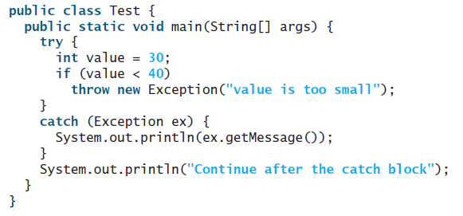
Checkpoints
What does the JVM do when an exception occurs? How do you catch an exception?
What is the output of the following code?

Slide 24
Checkpoints
What does the JVM do when an exception occurs? How do you catch an exception?
What is the output of the following code?
When an excepion occurs, Java searches for a handler in the catch clause. So, to catch an exception in your program
value is too small
Continue after the catch block

Slide 25
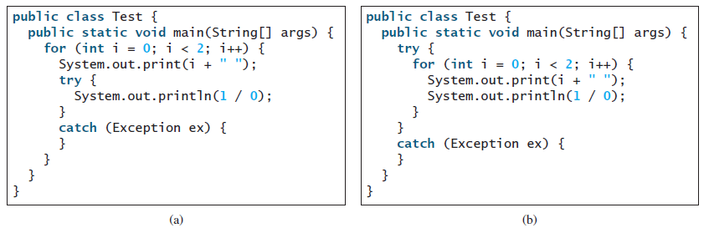
Checkpoints
Show the output of the following code.

Slide 26
Checkpoints
Show the output of the following code.
0 1
0

Slide 27
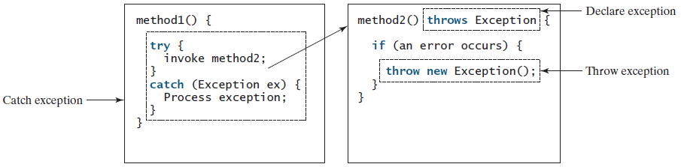
Exceptions
Java’s exception-handling model is based on three operations:
declaring an exception,
throwing an exception,
catching an exception

Slide 28

Exceptions
Declaring exceptions for methods uses $throws$ keyword with method’s header
public void myMethod() throws IOException
public void myMethod()
throws Exception1, Exception2, ..., ExceptionN

Slide 29

Exceptions
Throwing exceptions uses $throw$ keyword in the method’s body
IllegalArgumentException ex =
new IllegalArgumentException("Wrong Argument");
throw ex;
throw new IllegalArgumentException("Wrong Argument");

Slide 30
Exceptions
Catching exceptions
try {
statements; // Statements that may throw exceptions
}
catch (Exception1 exVar1) {
handler for exception1;
}
catch (Exception2 exVar2) {
handler for exception2;
}
...
catch (ExceptionN exVarN) {
handler for exceptionN;
}

Slide 31
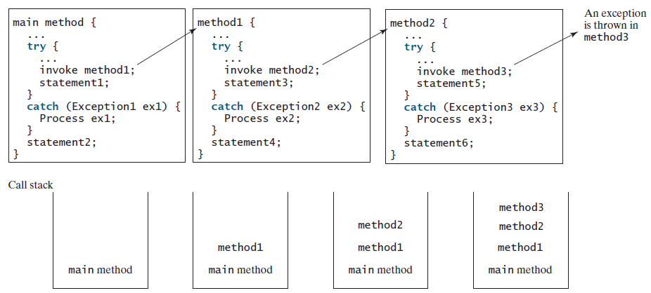
Exceptions
If an exception is not caught in the current method, it is passed to its caller. The process is repeated until the exception is caught or passed to the main method.

Slide 32
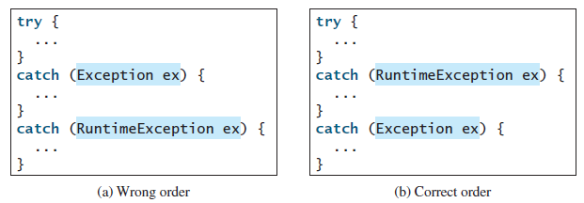
Exceptions
The order in which exceptions are specified in catch blocks is important.
A compile error will result if a catch block for a superclass type appears before a catch block for a subclass type.

Slide 33
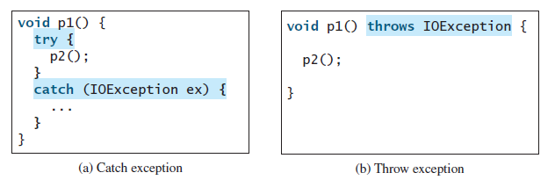

Exceptions
Java forces you to deal with checked exceptions.
checked exception is an exception other than $Error$ or $RuntimeException$
If a method declares a checked exception, you must invoke it in a try-catch block or declare to throw the exception in the calling method.

Slide 34
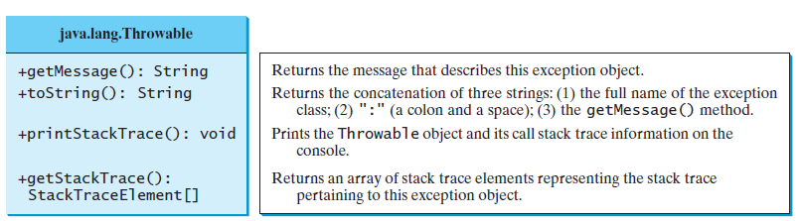
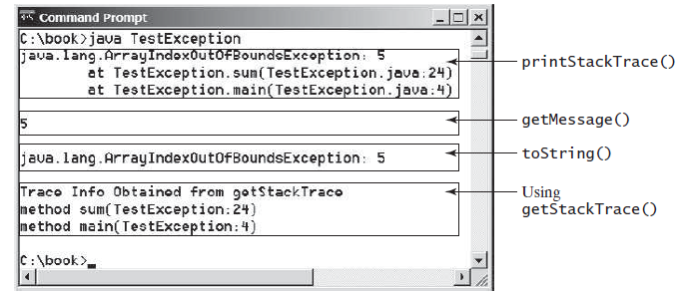
Exceptions
Getting Information from Exceptions

Slide 35

Exceptions
Example: Declaring, Throwing, and Catching Exceptions
CircleWithException

Slide 36

Checkpoints
What is a checked exception, and what is an unchecked exception?
Suppose that $statement2$ causes an exception in the following try-catch block: Answer the following questions:
Will $statement3$ be executed?
If the exception is not caught, will $statement4$ be executed?
If the exception is caught in the catch block, will $statement4$ be executed?
try {
statement1;
statement2;
statement3;
}
catch (Exception1 ex1) {
}
catch (Exception2 ex2) {
}
statement4;

Slide 37

Checkpoints
What is a checked exception, and what is an unchecked exception?
A checked exception must be explicitly declared in the method declaration, if a method throws it. A checked exception must be caught in a try-catch block. An unchecked exception does not need to be declared and does not need to be caught. In Java, the only unchecked exceptions are RuntimeException and Error and their subclasses.
Suppose that $statement2$ causes an exception in the following try-catch block: Answer the following questions:
Will $statement3$ be executed? No
If the exception is not caught, will $statement4$ be executed? No
If the exception is caught in the catch block, will $statement4$ be executed? Yes
try {
statement1;
statement2;
statement3;
}
catch (Exception1 ex1) {
}
catch (Exception2 ex2) {
}
statement4;

Slide 38
Checkpoints
Correct a compile error in the following code:
public void m(int value) {
if (value < 40)
throw new Exception("value is too small");
}

Slide 39
Checkpoints
Correct a compile error in the following code:
public void m(int value) {
if (value < 40)
throw new Exception("value is too small");
}
The method throws a checked exception. It must be caught or thrown. You may fix it as follows:
public void m(int value) throws Exception {
if (value < 40)
throw new Exception("value is too small");
}

Slide 40

Exceptions
The $finally$ clause is always executed regardless whether an exception occurred or not.
try {
statements;
}
catch (TheException ex) {
handling ex;
}
finally {
finalStatements;
}

Slide 41
Content
Loops
Methods
Arrays
Objects and Classes
Exceptions
Text I/O
Binary I/O
Multithreading

Slide 42
Text I/O
Files can be classified as either text or binary.
A file that can be processed (read, created, or modified) using a text editor such as Notepad is called a text file.
All the other files are called binary files.
You cannot read binary files using a text editor—they are designed to be read by programs.
Java source programs are text files and can be read by a text editor,
but Java class files are binary files and are read by the JVM.

Slide 43
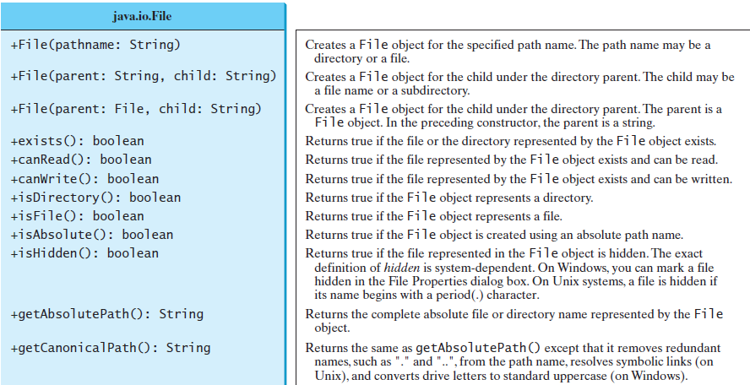

Text I/O
The $File$ class contains the methods for obtaining the properties of a file/directory and for renaming and deleting a file/directory.

Slide 44
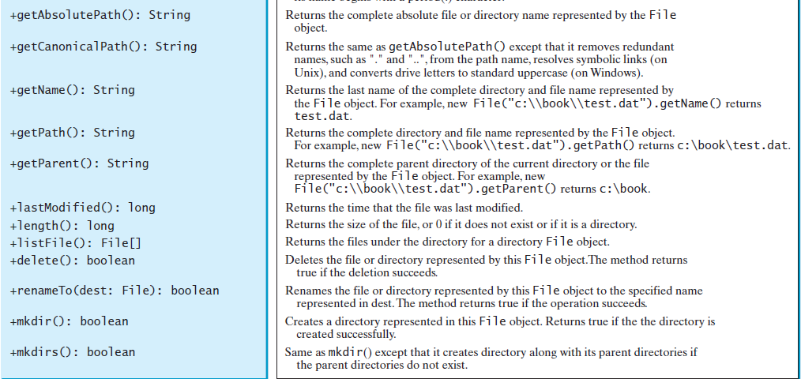
Text I/O

Slide 45
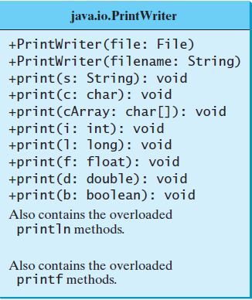

Text I/O
Text data are read using the $Scanner$ class.
Text data written using the $PrintWriter$ class.
PrintWriter output = new PrintWriter("temp.txt");
output.print("Java 101");
output.close();
Scanner input = new Scanner(new File("temp.txt"));
System.out.println(input.nextLine());

Slide 46
Content
Loops
Methods
Arrays
Objects and Classes
Exceptions
Text I/O
Binary I/O
Multithreading

Slide 47
Binary I/O
Files can be classified as either text or binary.
A file that can be processed (read, created, or modified) using a text editor such as Notepad is called a text file.
All the other files are called binary files.
You cannot read binary files using a text editor—they are designed to be read by programs.
Java source programs are text files and can be read by a text editor,
but Java class files are binary files and are read by the JVM.

Slide 48
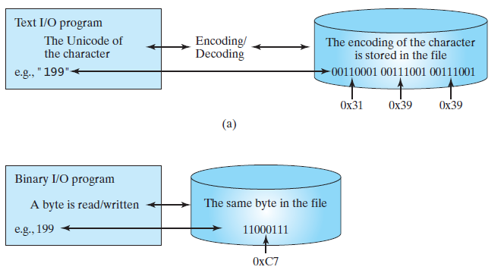
Binary I/O
Binary I/O does not involve encoding or decoding.
Computers do not differentiate between binary files and text files.
All files are stored in binary format, and thus all files are essentially binary files.
Text I/O is built upon binary I/O to provide a level of abstraction for character encoding and decoding

Slide 49
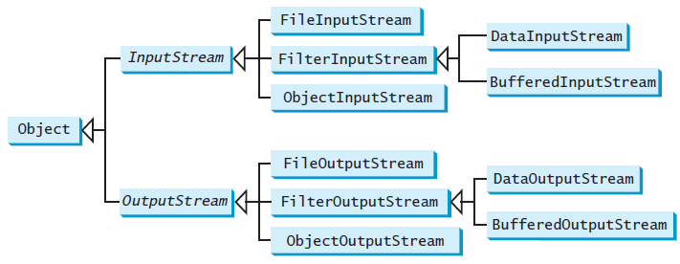

Binary I/O
The abstract $InputStream$ is the root class for reading binary data.
The abstract $OutputStream$ is the root class for writing binary data.
An input object reads a stream of data from a file.
Also called an input stream.
An output object writes a stream of data to a file.
Also called an output stream.

Slide 50
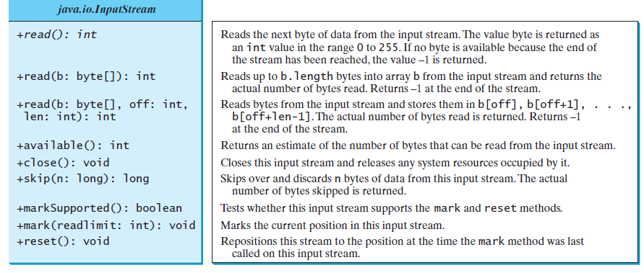
Binary I/O

Slide 51
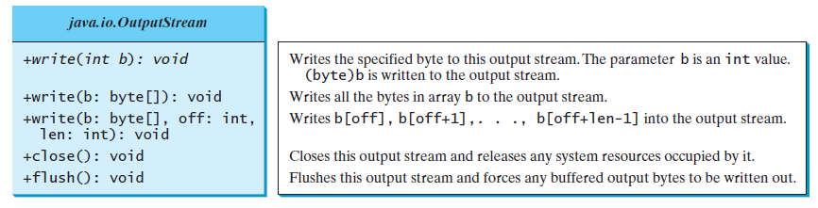
Binary I/O

Slide 52


Binary I/O
Example: uses binary I/O to write ten byte values from 1 to 10 to a file named $temp.dat$ and reads them back from the file.
FileStream.java

Slide 53
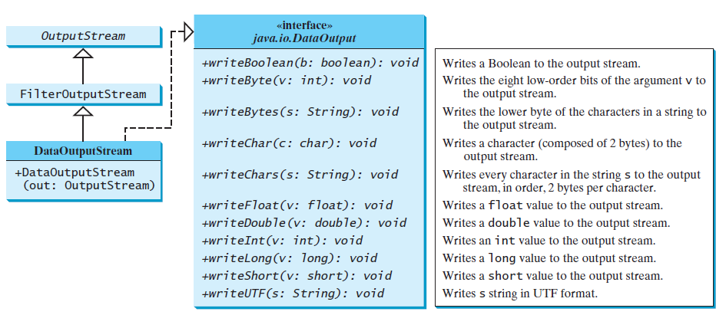

Binary I/O
$DataInputStream$ reads bytes from the stream and converts them into appropriate primitive-type values or strings.
$DataOutputStream$ converts primitive-type values or strings into bytes and outputs the bytes to the stream.
Example: Write students data (DataFileStream)

Slide 54
Content
Loops
Methods
Arrays
Objects and Classes
Exceptions
Text I/O
Binary I/O
Multithreading

Slide 55
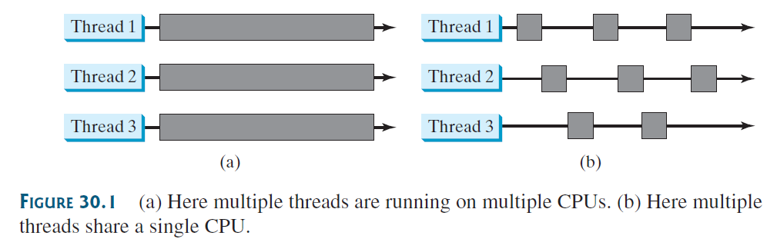
Multithreading
Multithreading enables multiple tasks in a program to be executed concurrently.
A thread provides the mechanism for running a task.
You can launch multiple threads from a program concurrently.
These threads can be executed simultaneously in multiprocessor systems.

Slide 56
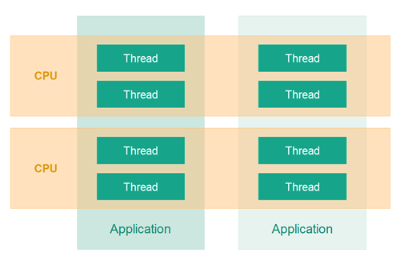

Multithreading
In Java, each task is an instance of the $Runnable$ interface.
Also called a $runnable object$.
A $thread$ is an object that facilitates the execution of a task.

Slide 57
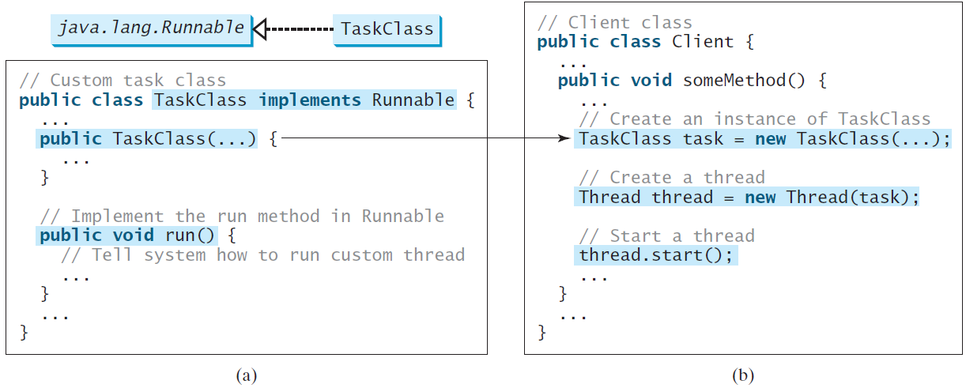

Multithreading
To create tasks, you must first define a class for tasks, which implements the $Runnable$ interface.

Slide 58
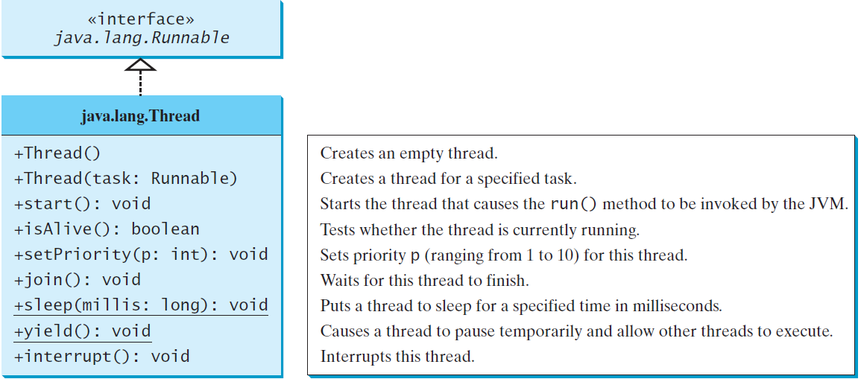

Multithreading
The $Thread$ class contains the constructors for creating threads for tasks and the methods for controlling threads.

Slide 59
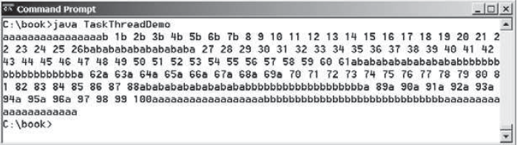
Multithreading
Example: TaskThreadDemo.java

Slide 60

Multithreading
The $run()$ method in a task specifies how to perform the task.
This method is automatically invoked by the JVM. You should not invoke it.
Invoking $run()$ directly merely executes this method in the same thread; no new thread is started.

Slide 61
Checkpoint
What is wrong in the following two programs? Correct the errors.
public class Test implements Runnable {
public static void main(String[] args) {
new Test();
}
public Test() {
Thread t = new Thread(this);
t.start();
t.start();
}
public void run() {
System.out.println("test");
}
}
public class Test implements Runnable {
public static void main(String[] args) {
new Test();
}
public Test() {
Test task = new Test();
new Thread(task).start();
}
public void run() {
System.out.println("test");
}
}

Slide 62
Checkpoint
What is wrong in the following two programs? Correct the errors.
new Test() is recursively called inside the constructor.
public class Test implements Runnable {
public static void main(String[] args) {
new Test();
}
public Test() {
Thread t = new Thread(this);
t.start();
t.start();
}
public void run() {
System.out.println("test");
}
}
public class Test implements Runnable {
public static void main(String[] args) {
new Test();
}
public Test() {
Test task = new Test();
new Thread(task).start();
}
public void run() {
System.out.println("test");
}
}
An illegal java.lang.IllegalThreadStateException may be thrown because you just started thread and thread might have not yet finished before you start it again.

Slide 63

Multithreading
You can use the $yield()$ method to temporarily release time for other threads.
Every time a number is printed, the thread of the task is yielded to other threads.
public void run() {
for (int i = 1; i <= lastNum; i++) {
System.out.print(" " + i);
Thread.yield();
}
}

Slide 64

Multithreading
The $sleep\left(long millis\right)$ method puts the thread to sleep for a specified time in milliseconds to allow other threads to execute.
Every time a number (>= 50) is printed, the thread of the task is put to sleep for 1 millisecond.
The sleep method may throw an $InterruptedException$, which is a checked exception.
public void run() {
try {
for (int i = 1; i <= lastNum; i++) {
System.out.print(" " + i);
if (i >= 50) Thread.sleep(1);
}
}catch (InterruptedException ex) {
}
}

Slide 65
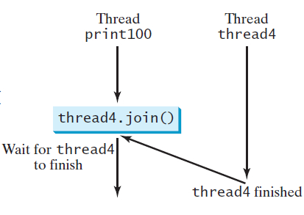

Multithreading
The $join()$ method to force one thread to wait for another thread to finish.
A new $thread4$ is created and it prints character c 40 times. The numbers from 50 to 100 are printed after thread thread4 is finished.
public void run() {
Thread thread4 = new Thread( new PrintChar('c', 40));
thread4.start();
try {
for (int i = 1; i <= lastNum; i++) {
System.out.print (" " + i);
if (i == 50) thread4.join();
}
} catch (InterruptedException ex) {
}
}

Slide 66
Summary
We reviewed the following
Loops
Methods
Arrays
Objects and Classes
Exceptions
Text I/O
Binary I/O
Multithreading

