Slide 1
Bank Churning Prediction Model
Omar J. Alnimasi

Slide 2
Outline
We will be going down the data science pipeline to explain the work done in this project:
Problem Identification
Data Wrangling
Exploratory Data Analysis
Pre-Processing
Modeling
Conclusion

Slide 3
Problem Identification
I am working on a dataset from a bank about their users.
This dataset will be used to predict churning customers as request by the banking institute manager.

Slide 4
Problem Identification
The goal here is to predict if a customer is going to remain or not so the manager could act accordingly and attempt to keep them as customers so the main metric is going to be recall to assess our models.
There are issues with the dataset, mainly some of the categorical columns have many ‘Unknown’ entries.

Slide 5
Problem Identification
The dataset we are using is from kaggle, an online community platform for data scientists and machine learning enthusiasts, and it can be found in the following link.
https://www.kaggle.com/datasets/sakshigoyal7/credit-card-customers

Slide 6
Data Wrangling
We need to prepare our dataset for the Exploratory Data Analysis step, and for that, we need to clean it up.

Slide 7
Data Wrangling
As mentioned earlier, we have a few columns with “Unknown” values, namely, Education_Level, Marital_Status, and Income_Category.
As we do not have any information about these entries, we will have to leave them as is

Slide 8
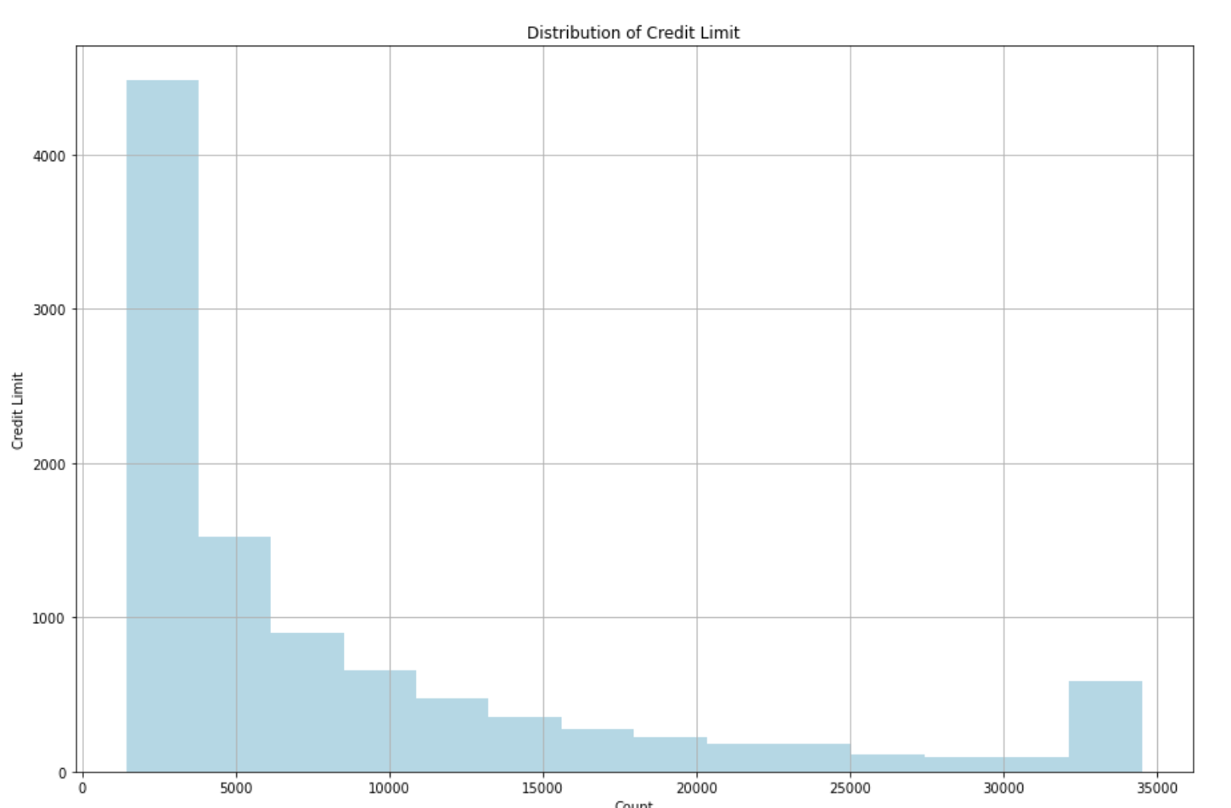
Data Wrangling
Furthermore, There is an usual behavior in the distribution of Credit_Limit, as shown in the following figure:

Slide 9
Data Wrangling
After investing the Credit_Limit column, I noticed that most values have occurrences less than 20 times, however the maximum value and the minimum value have over 500 occurrences.
This led me to believe that they are the maximum and minimum possible values. Which could explain why they are overcrowded.
Checking for duplicate observations resulted in the fact that there aren’t any, which eliminate the possibility that they are simply duplicate values.

Slide 10
Data Wrangling
Finally, I converted the attrition flag column to attired_customer, and changed the values to 1, and 0 accordingly to have a numerical target column.

Slide 11
Exploratory Data Analysis
Now that the dataset is clean we can start to explore it.
This will give us insights and a better understanding of the dataset we are working with

Slide 12
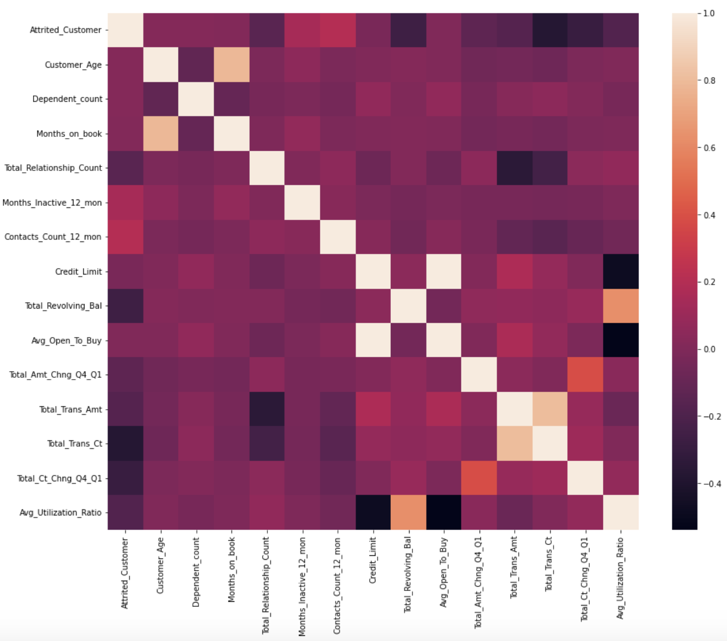
Exploratory Data Analysis
The first thing that was done here is creating a heatmap.
The heatmap shows relations between features, and between the features and the target

Slide 13
Exploratory Data Analysis
From the heatmap, we can see that the highest correlation with our target is with Months_Inactive_12_mon and Contacts_Count_12_mon.
We can also notice a high correlation between some of our features Credit_Limit and Avg_Open_To_Buy.

Slide 14
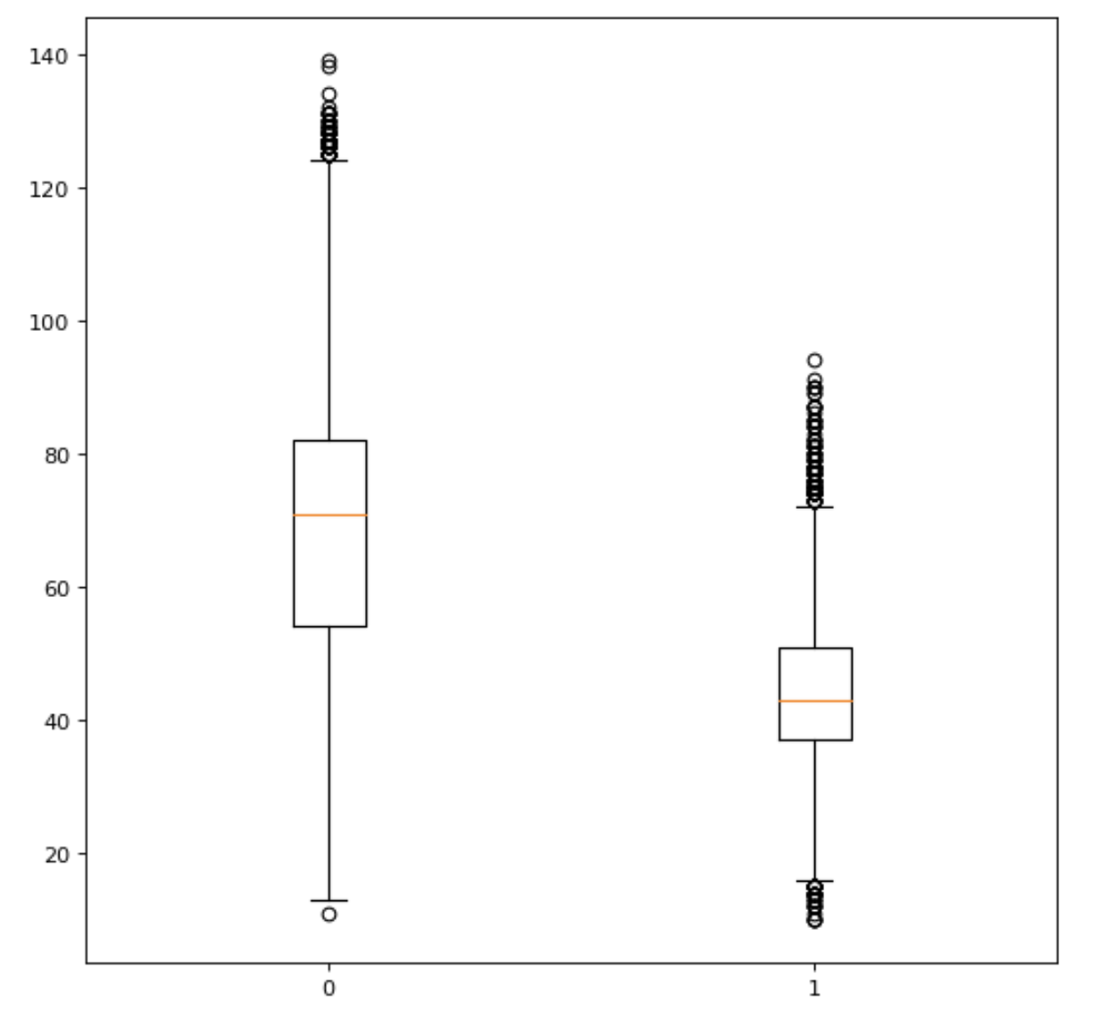
Exploratory Data Analysis
The distribution of Total_Trans_Ct is shown here in boxplots for both attired and existing customers.

Slide 15
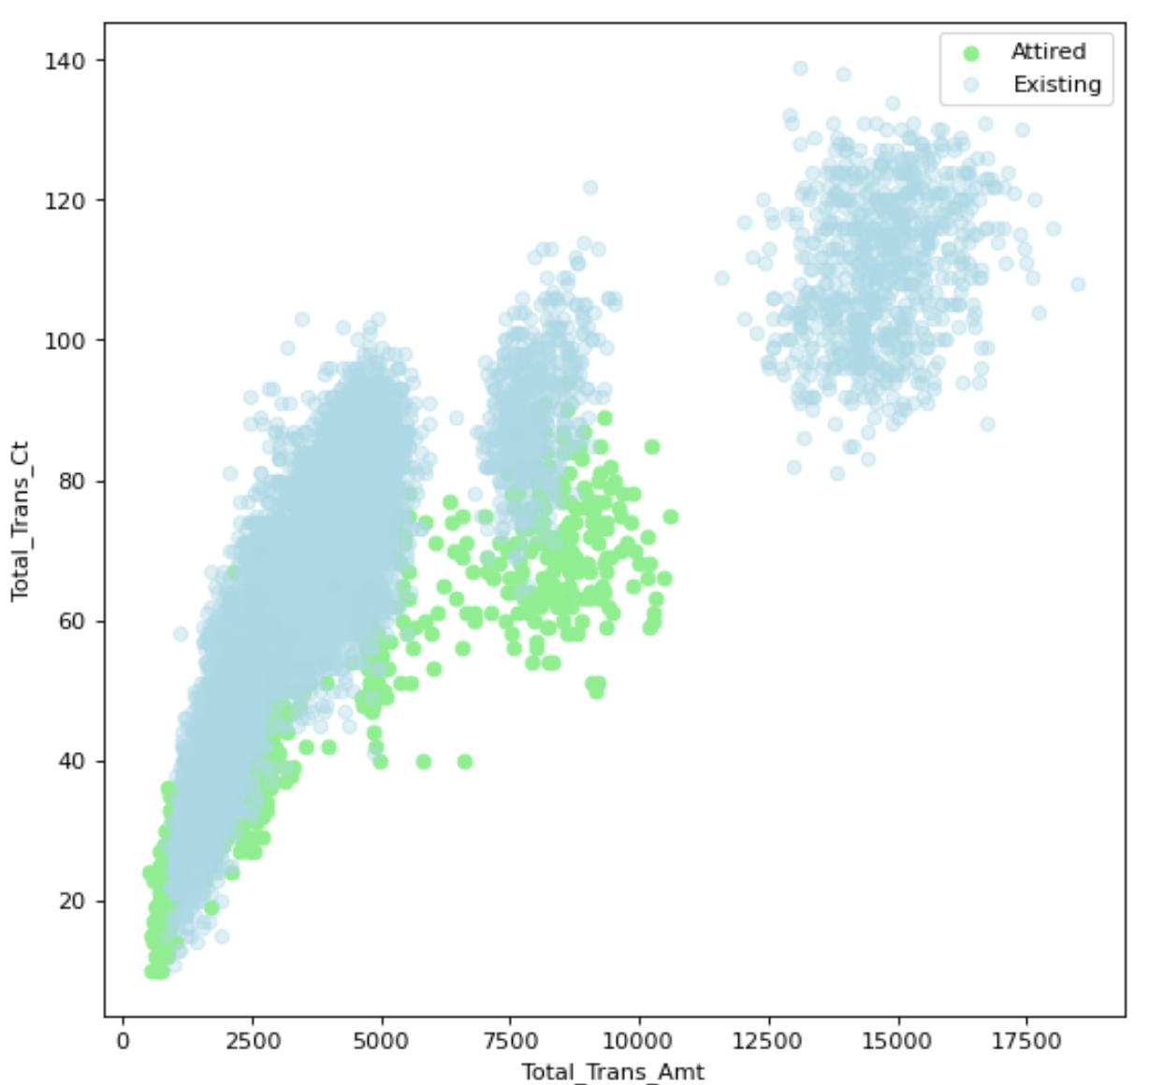
Exploratory Data Analysis
And here we can see the correlation between Total_Trans_Ct, and Total_Trans_Amt, as well as seeing the distribution of different values of the target column as shown in different colors.

Slide 16
Pre-Processing
After cleaning up the data, and exploring the relation between features. We are now ready to pre-process the data before modeling.
The first thing we need to do here is to break down categorical data using get dummy, which turns categorical data to tables of ones and zeros for each category.

Slide 17
Pre-Processing
For the numerical features, we used the standard scaler and we scaled all of our data using it to make sure that no column would dominate simply for having high values whenever we are building our model.

Slide 18
Pre-Processing
Now that our data is completely numerical we can start by splitting the data into train and test. Here, we went for a 30% test set after shuffling to make sure we have a random 30% of the data in the test set.

Slide 19
Modeling
In the Modeling step, I attempted both machine learning models and deep learning models.
The goal here is to reach a model with the highest recall

Slide 20
Modeling
I started with machine learning models.
The first one was a support vector machine model which resulted in a 67.5% recall.
After optimizing the hyperparameter optimization, the recall is 75%

Slide 21
Modeling
The next model testes is decision trees, which resulted in 78% recall, both with and without hyperparameter optimization.

Slide 22
Modeling
Then I attempted a random forest tree, this got me a 75% recall.
However, hyperparameter optimization got the model to 78.5% recall.

Slide 23
Modeling
The final machine learning model was a Gaussian naive bayes, this was the worst model resulting in 57% recall.
Optimizing hyperparameters of the model got us a recall of 52%.

Slide 24
Modeling
As the best model was the optimized random forest tree, I attempted to test for different number of features.
The best resulting number of features was with 16 features, and that resulted in a 84% recall

Slide 25
Modeling
In the deep learning stage, I used a sequential model.
A different number of hidden layers, and hidden nodes were used to check for the best performance.
As well as checking for different optimizers and activation functions

Slide 26
Modeling
The best model achieved in the deep learning models was a model achieving 88.6% recall, which is a better model than everything done in the machine learning stage.
Next I will show a brief table with the different models and their recall and accuracy.

Slide 27
Modeling
Model | Recall | Accuracy
Support Vector Machine | 75.4% | 93.4%
Decision Tree | 78.2% | 93.8%
Random Forest Classifier | 78.8% | 95.7%
Naive Bayes | 57.7% | 86.2%
RFC ( with 16 features ) | 84.3% | 96.4%
Deep Learning | 88.6% | 89%

Slide 28
Conclusion
I worked with a dataset of credit card customers.
I started with cleaning and exploring the data to prepare it for the modeling and understand the dataset better.
Then I moved on to the preprocessing step to have the dataset completely numerical and split it into training and testing sets.
Finally, after attempting multiple machine learning and deep learning models. I achieved a model with 88.6% recall.
Although there are other models with better accuracy, the main metric here is recall

