Slide 1

Design and Implementation of the DCSK MODEM on the Cyclone V FPGA
Omar Tarek Amer
Moustafa Darwish
Yahia Hatem
Mennatullah Ahmed

Slide 2
Agenda
Introduction to DCSK.
Proposed Architecture.
Testing Environment.
Synthesis Results.

Slide 3
Introduction
What is Chaos ?
Differential Chaos Shift-Keying.

Slide 4

What is Chaos?
Cambridge: “A state of total confusion with no order.”
A system where a small difference in initial conditions yields widely diverging outcomes.
Example: Logistic Map: $x_{i+1}=x_{i}×r(1−x_{i})$

Slide 5
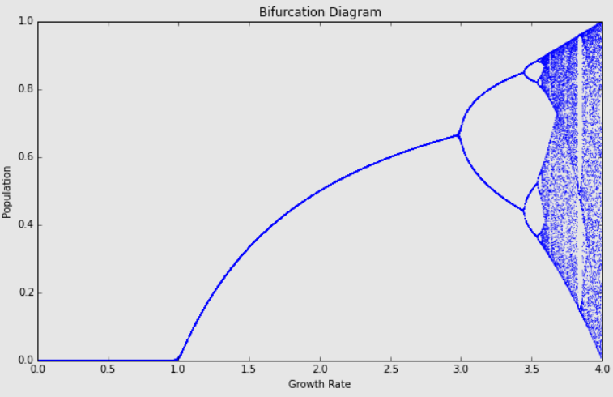
Example: Logistic Map

Slide 6
Differential Chaos Shift-Keying
Differential Chaos Shift-Keying.
An innovative modulation scheme.
One bit of the message is spread across several bits.
Less susceptible to multi-path fading.
An extra layer of security.
Frame 1 |  | Frame 2 |  | Frame 3
Chaos Bits | Modulated Chaos | Chaos Bits | Modulated Chaos | Chaos Bits | Modulated Chaos
Bit 0
Bit 1
Bit 2

Slide 7
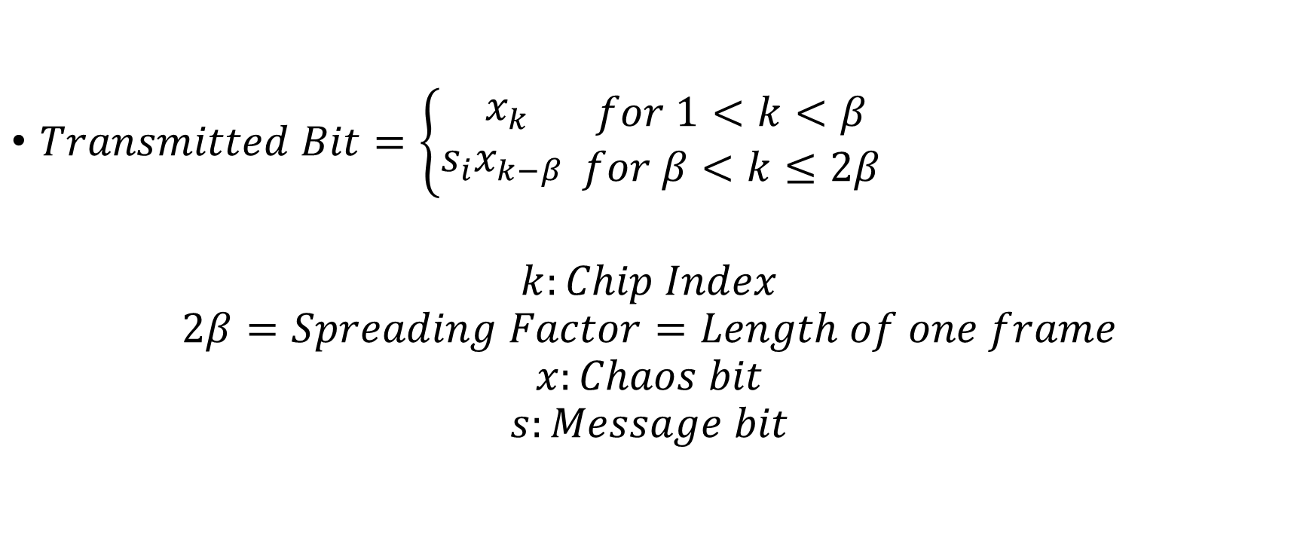
Differential Chaos Shift-Keying
$Transmitted Bit=\left\{\begin{aligned}x_{k} \\ s_{i}x_{k−β} \end{aligned}\right.\begin{matrix}for 1<k<β \\ for β<k≤2β\end{matrix}$
$$k:Chip Index$$
$$2β=Spreading Factor=Length of one frame$$
$$x:Chaos bit$$
$$s:Message bit$$

Slide 8
Proposed Architecture

Slide 9
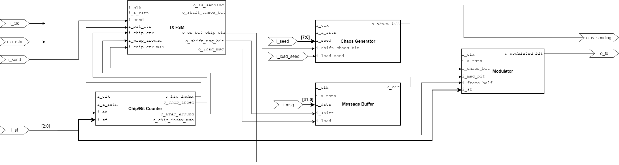
TX Architecture

Slide 10
Features
32-Bit Message
Modem supports four spreading factors:
SF4
SF8
SF16
SF32
Modem supports variable spreading factor per message.

Slide 11
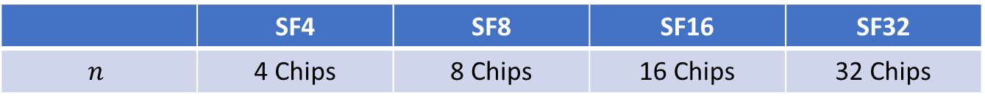
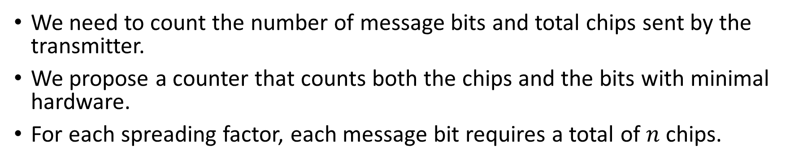
Chip/Bit Counter
We need to count the number of message bits and total chips sent by the transmitter.
We propose a counter that counts both the chips and the bits with minimal hardware.
For each spreading factor, each message bit requires a total of $n$chips.
 | SF4 | SF8 | SF16 | SF32
$$n$$ | 4 Chips | 8 Chips | 16 Chips | 32 Chips

Slide 12
Chip/Bit Counter
The message is 32-bits wide.
The maximum number of chips is 32 chips per bit.
This means that 1Kbit of data will be sent for an SF32 Message.
Use a 10-bit counter.
Using a second 5-bit counter would be a waste of hardware.
Since both counters have the same increment condition, We can use a slice of the 10-bit counter as the 5-bit counter.

Slide 13
Chip/Bit Counter
logic [9:0] o_bit_index
o_bit_index[1:0]
SF4
SF8
SF16
SF32
o_bit_index[2:0]
o_chip_index[4:0]
o_bit_index[3:0]
o_bit_index[4:0]
i_sf[1:0]

Slide 14
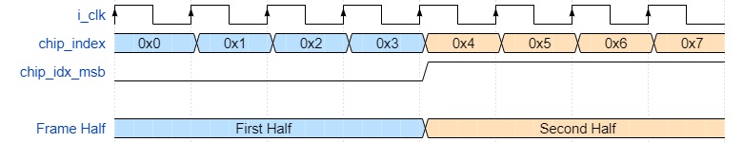
Message Buffer
The 32-bit message is stored in a parallel-in serial-out shift register.
When a negative edge is detected in the MSB of the chip index:
A bit from the message buffer is shifted into the modulator.
Use the MSB of the chip index to detect the current half of the frame.
That way we don’t have to use extra hardware for comparison.

Slide 15
Modulator
Based on the DCSK equation, the modulator outputs either:
The chaos bits.
The message bits, modulated by a delayed version of the chaos.
The modulation is as follows:
If a message bit is one, output the chaos bits unchanged.
If a message bit is zero, output the one’s complement of the chaos bits.

Slide 16
Modulator
Based on the spreading factor, the delay amount of the chaos bits varies.
We have a maximum delay of 16 clock cycles (for SF32).
Use a shift register with taps at locations 2, 4, 8, and 16
Multiplex on the required delay value based on the spreading factor of the current message.
Modulation:
Output chaos in the first half of the frame.
Output the modulated signal in the second half of the frame.

Slide 17
Chaos Generator
This module generates the required chaos bits for modulation.
It consists of three main parts:
16-bit chaotic sequence generator.
16-bit to 256-bit chaos expander.
Chaos PISO.

Slide 18
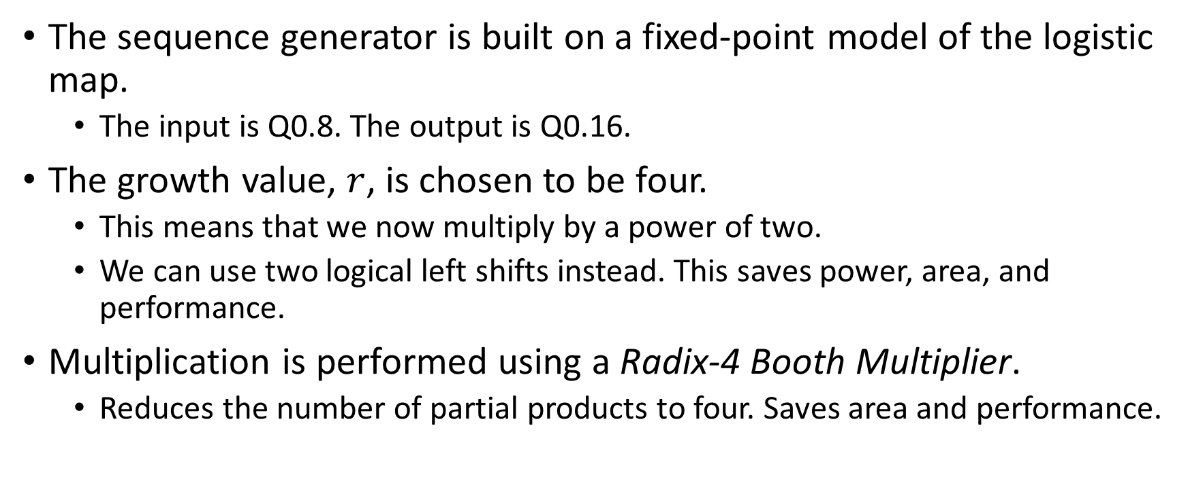
Sequence Generator
The sequence generator is built on a fixed-point model of the logistic map.
The input is Q0.8. The output is Q0.16.
The growth value, $r$, is chosen to be four.
This means that we now multiply by a power of two.
We can use two logical left shifts instead. This saves power, area, and performance.
Multiplication is performed using a Radix-4 Booth Multiplier.
Reduces the number of partial products to four. Saves area and performance.

Slide 19
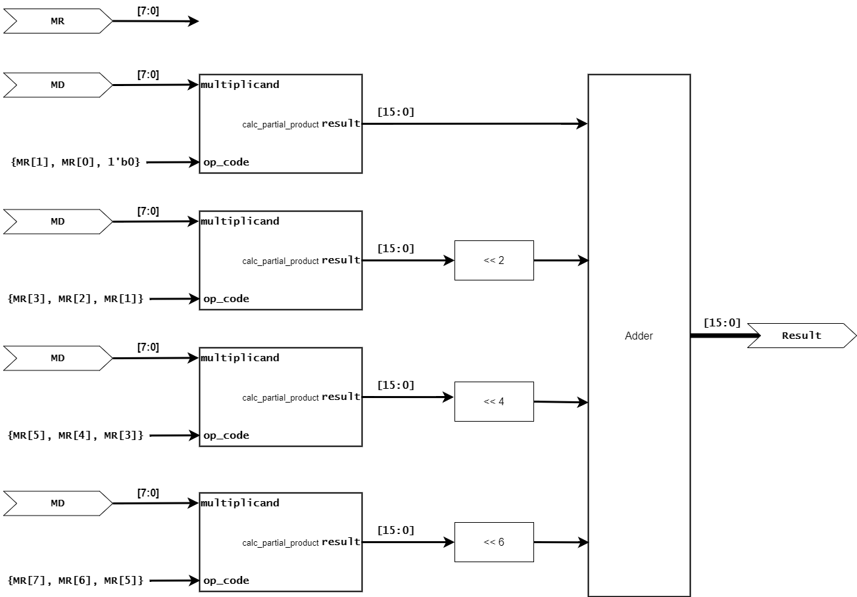
Radix-4 Booth Multiplier

Slide 20
Chaos Expander
For an SF32 message, we need 32 chips for each bit.
A total of 1 Kbit.
Half of which are chaos bits.
Using the sequence generator to generate the whole 512 bits is not area or power efficient.
Solution, generate 16 bits of chaos, then expand them into 256 bits.
We propose a simple algorithm that uses only multiplexers and inverters.
More performance-friendly than generating 256 bits of chaos.
Saves power (generate chaos bits less frequently).

Slide 21
Chaos Expander
The algorithm is inspired by the DCSK, with an added shuffling stage.
For each bit of the input chaos sequence:
If the bit is “1” copy the chaotic sequence unchanged.
If the bit is “0” copy the one’s complement of the chaotic sequence.
To remove correlation between the expanded bits and the input sequence:
We shuffle the output wires of the module.
256 random number were generated using randperm from MATLAB.
Reorder the expanded bits based on the random MATLAB-obtained locations.

Slide 22
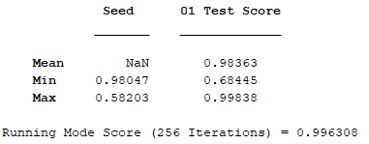
Chaos Expander
We need to make sure the expanded sequence is still chaotic.
Run the 0-1 Test.
This test takes a bit sequence as input, then performs mathematic operations, and outputs a value.
Values close to zero are not chaotic.
Values close to one however, are.

Slide 23
FSM
Single FF FSM.
Two states: IDLE, and SEND.
Controls when to load the message/chaos into their respective buffers.
Enables/disables the Chip/Bit Counter.
Outputs chaos/message bits from their respective buffers

Slide 24
Modulator
Variable Delay Shift Register
Chaos Bit
SF
Delayed Chaos Bit
First Half
TX
Modulate
Modulated Bit
Message Bit
Second Half
Frame Half

Slide 25

Demodulator
The Demodulator objective is to reconstruct the transmitted message (data bits) from the received modulated bits
The Demodulator uses a correlation technique to decide if the transmitted bit was one or zero and this is essential according to the channel non-idealities
The Demodulator has the capability to switch between different spreading factors thus according to the channel quality we can control the transmission rate by choosing a suitable spreading factor with reasonable SNR
Frame
In_Serial
DCSK_Demod
32
Demod_Data
Valid
SPF_Sel
2
Valid_Data
Chaos_Bits
Mod_Bit

Slide 26
Demodulator FSM
Valid == 1
Idle
Receiving_data
Valid == 0
Valid == 0
Chaos_received
Valid == 1
Store&out
correlation
Correlation_finished

Slide 27

Demodulator Architecture
State:
Clk
Rst
0
input
0
1
1
0
Demodulated_word
1
Receiving_data
Store&out
Idle
correlation
Addr
Re
load
0
0
1
0
1
1
0
0
1
0
0
1
0
0
1
0
1
1
0
1
0
1
1
0
1
0
1
1
0
1
0
0
1
Demod_Bit
FSM
Corr_Bit
load
Chaos_Sel
2
Re
Valid
Addr
Example of data sent
1001_0110
0001_0001
…..
Assuming spreading factor = 8
Valid_Data
Clk
Rst
Clk
Rst
0
32
Out_Demod_Data

Slide 28
Testing

Slide 29
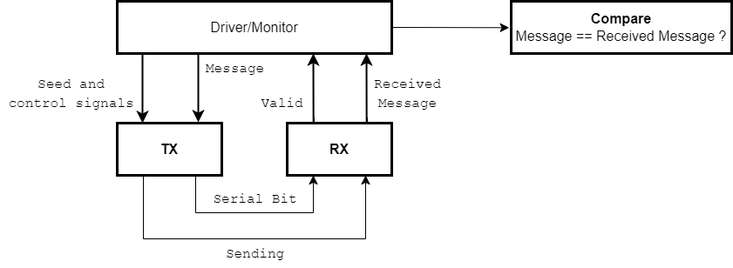
Testing
End to End testing.
Parametrized testbench.
Self-checking.

Slide 30
Testing
The workings of the test environment can be summarized as follows:
Randomize a message.
Randomize spreading factor.
Push the message to the TX queue. Drive the TX module to send the message.
Iterate over the last three steps for a random amount.
Wait a random amount of clock cycles.
Monitor the Valid_Data output. On rising edge, pop the TX queue and compare the popped word with the demodulated word.
A match means that the system is operational.

Slide 31
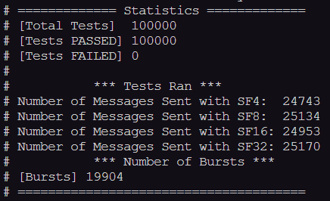
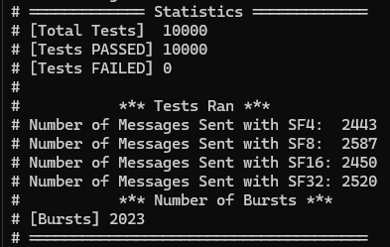
Testing

Slide 32
Synthesis Results
Timing Analysis
Resource Usage
Power Dissipation

Slide 33
Synthesis
Synthesis was performed on the Cyclone V FPGA (Chameleon96 Board).
Target Frequency :50 MHz.
Software: Quartus Prime Lite Edition.

Slide 34
Timing Analysis
MCMM was run on the following corners:
Slow 1100mV 100C
Slow 1100mV -40C
Fast 1100mV 100C
Fast 1100mV -40C

Slide 35
Timing Analysis
 | Metric | Value
RX | Setup Slack | 2.025 ns
 | Hold Slack | 0.165 ns
 | Maximum Frequency | 55.63 MHz
TX | Setup Slack | 1.26 ns
 | Hold Slack | 0.171 ns
 | Maximum Frequency | 53.37 MHz

Slide 36
Resource Usage
 | Resource | Amount
RX | Registers | 69
 | ALMs | 89
TX | Registers | 242
 | ALMs | 244
Total | Registers | 311
 | ALMs | 333

Slide 37
Power Dissipation
 | Power | Amount
RX | Total Thermal Power | 421mW
TX | Total Thermal Power | 533mW
Total |  | 954mW

Slide 38
Resource Usage
Important note:
The design does not use any DSP block, PLL, DLL, memory blocks, or any other type of FPGA-specific hardware.
The design is fully independent on any softcore IPs.
This means that the design is target-agnostic (can be implemented on any technology node).

Slide 39
Discussion

Slide 40
Thank You.

