Slide 1

Design and Implementation of the DCSK MODEM on the Cyclone V FPGA
Omar Tarek Amer
Moustafa Darwish
Yahia Hatem
Mennatullah Ahmed

Slide 2
Agenda
Introduction to DCSK.
Proposed Architecture.
Testing Environment.
Synthesis Results.

Slide 3
Introduction
What is Chaos ?
Differential Chaos Shift-Keying.

Slide 4

What is Chaos?
Cambridge: “A state of total confusion with no order.”
A system where a small difference in initial conditions yields widely diverging outcomes.
Example: Logistic Map: $x_{i+1}=x_{i}×r(1−x_{i})$

Slide 5
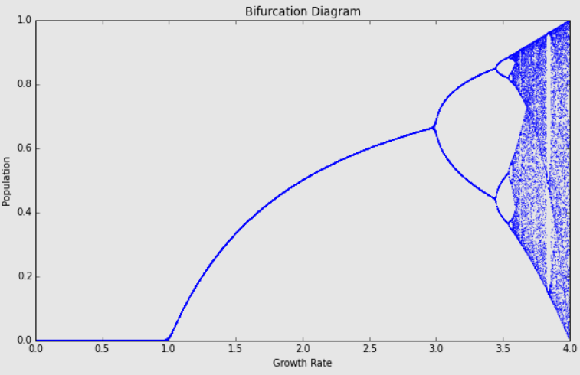
Example: Logistic Map

Slide 6
Differential Chaos Shift-Keying
Differential Chaos Shift-Keying.
An innovative modulation scheme.
One bit of the message is spread across several bits.
Less susceptible to multi-path fading.
An extra layer of security.
Frame 1 |  | Frame 2 |  | Frame 3
Chaos Bits | Modulated Chaos | Chaos Bits | Modulated Chaos | Chaos Bits | Modulated Chaos
Bit 0
Bit 1
Bit 2

Slide 7
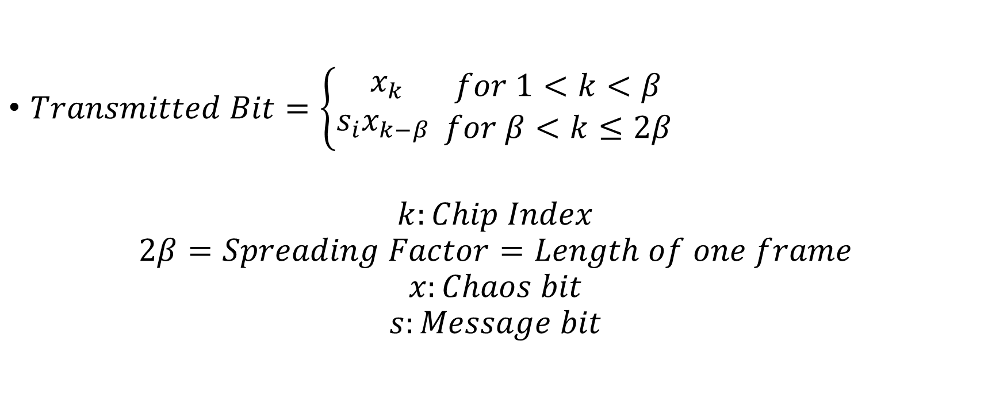
Differential Chaos Shift-Keying
$Transmitted Bit=\left\{\begin{aligned}x_{k} \\ s_{i}x_{k−β} \end{aligned}\right.\begin{matrix}for 1<k<β \\ for β<k≤2β\end{matrix}$
$$k:Chip Index$$
$$2β=Spreading Factor=Length of one frame$$
$$x:Chaos bit$$
$$s:Message bit$$

Slide 8
Proposed Architecture

Slide 9
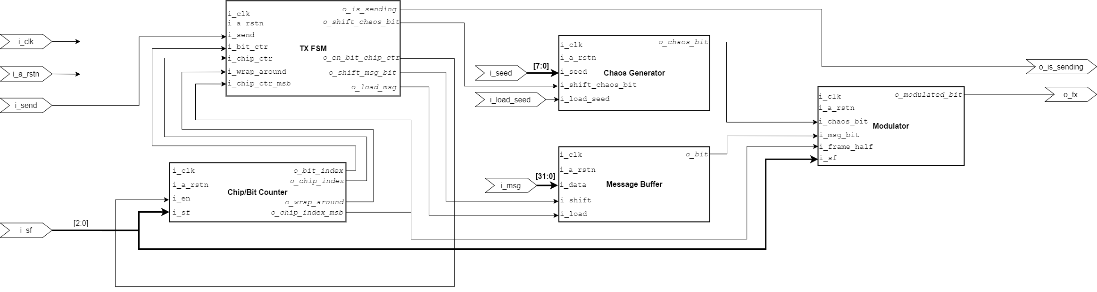
TX Architecture

Slide 10
Features
Modem supports four spreading factors:
SF4
SF8
SF16
SF32
Modem supports variable spreading factor per message.

Slide 11
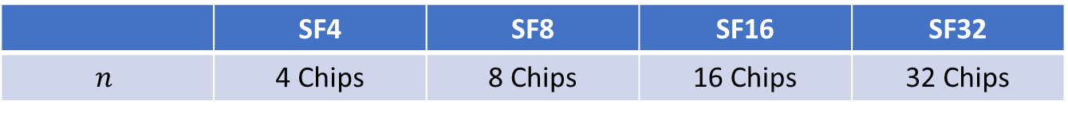
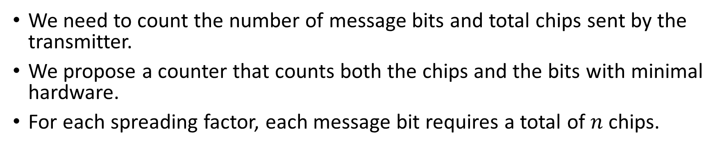
Chip/Bit Counter
We need to count the number of message bits and total chips sent by the transmitter.
We propose a counter that counts both the chips and the bits with minimal hardware.
For each spreading factor, each message bit requires a total of $n$chips.
 | SF4 | SF8 | SF16 | SF32
$$n$$ | 4 Chips | 8 Chips | 16 Chips | 32 Chips

Slide 12
Chip/Bit Counter
The message is 32-bits wide.
The maximum number of chips is 32 chips per bit.
This means that 1KB of data will be sent for an SF32 Message.
Use a 10-bit counter.
Using a second 5-bit counter would be a waste of hardware.
Since both counters have the same increment condition, We can use a slice of the 10-bit counter as the 5-bit counter.

Slide 13
Chip/Bit Counter
logic [9:0] o_bit_index
o_bit_index[1:0]
SF4
SF8
SF16
SF32
o_bit_index[2:0]
o_chip_index[4:0]
o_bit_index[3:0]
o_bit_index[4:0]
i_sf[1:0]

Slide 14
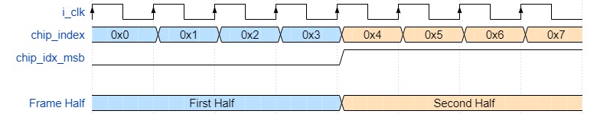
Message Buffer
The 32-bit message is stored in a parallel-in serial-out shift register.
When a negative edge is detected in the MSB of the chip index:
A bit from the message buffer is shifted into the modulator.
Use the MSB of the bit index to detect the current half of the frame.
That way we don’t have to use extra hardware for comparison.

Slide 15
Modulator
Based on the DCSK equation, the modulator outputs either:
The chaos bits.
The message bits, modulated by a delayed version of the chaos.
The modulation is as follows:
If a message bit is one, output the chaos bits unchanged.
If a message bit is zero, output the one’s complement of the chaos bits.

Slide 16
Modulator
Based on the spreading factor, the delay amount of the chaos bits varies.
We have a maximum delay of 16 clock cycles (for SF32).
Use a shift register with taps at locations 2, 4, 8, and 16
Multiplex on the required delay value based on the spreading factor of the current message.
Modulation:
Output chaos in the first half of the frame.
Output the modulated signal in the second half of the frame.

Slide 17
Modulator
Variable Delay Shift Register
Chaos Bit
SF
Delayed Chaos Bit
First Half
TX
Modulate
Modulated Bit
Message Bit
Second Half
Frame Half

Slide 18
Chaos Generator
This module generates the required chaos bits for modulation.
It consists of three main parts:
16-bit chaotic sequence generator.
16-bit to 256-bit chaos expander.
Chaos PISO.

Slide 19
Sequence Generator
TODO

Slide 20
Chaos Expander
For an SF32 message, we need 32 chips for each bit.
A total of 1 Kbit.
Half of which are chaos bits.
Using the sequence generator to generate the whole 512 bits is not area or power efficient.
Solution, generate 16 bits of chaos, then expand them into 256 bits.
We propose a simple algorithm that uses only multiplexers and inverters.
More performance-friendly than generating 256 bits of chaos.
Saves power (generate chaos bits less frequently).

Slide 21
Chaos Expander
The algorithm is inspired by the DCSK, with an added shuffling stage.
For each bit of the input chaos sequence:
If the bit is “1” copy the chaotic sequence unchanged.
If the bit is “0” copy the one’s complement of the chaotic sequence.
To remove correlation between the expanded bits and the input sequence:
We shuffle the output wires of the module.
256 random number were generated using randperm from MATLAB.
Reorder the expanded bits based on the random MATLAB-obtained locations.

Slide 22
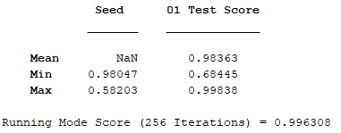
Chaos Expander
We need to make sure the expanded sequence is still chaotic.
Run the 0-1 Test.
This test takes a bit sequence as input, then performs mathematic operations, and outputs a value.
Values close to zero are not chaotic.
Values close to one however, are.

Slide 23
Demodulator

Slide 24
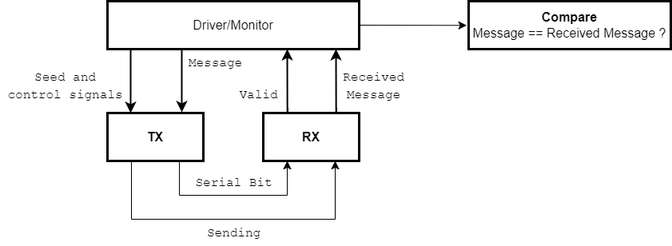
Testing
End to End testing.
Parametrized testbench.
Self-checking.

Slide 25
Testing
The workings of the test environment can be summarized as follows:
Randomize a message.
Randomize spreading factor.
Push the message to the TX queue. Drive the TX module to send the message.
Iterate over the last three steps for a random amount.
Wait a random amount of clock cycles.
Monitor the Valid_Data output. On rising edge, pop the TX queue and compare the popped word with the demodulated word.
A match means that the system is operational.

Slide 26
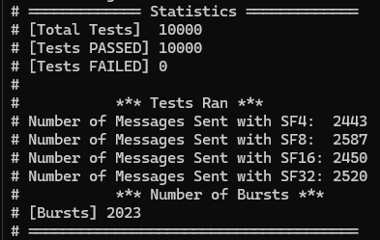
Testing

