Slide 1
ELC681 Final Project
By Omar T. Amer
ID 202410224
Notes:
Agenda:

Slide 2
The Plan

Slide 3
START
Generate Traffic Pattern
Start Network
Constant
AR1
Send
Collect Metrics
Plot
Test

Slide 4
Phase 1: Best Effort

Slide 5
Phase 1: Best Effort
Prerequisites
✅ | Topology
Test
PASS | Contention implies that the bandwidths of Gold and Bronze are nearly equal

Slide 6
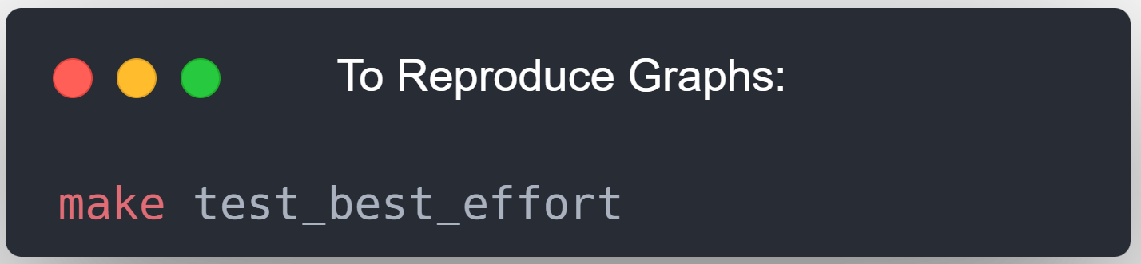

Slide 8
Phase 2: Hardcoded Rules

Slide 9
Phase 2: Hardcoded Rules
Prerequisites
✅ | Topology
✅ | Hardcode Rules
Test
PASS | Contention implies that the bandwidths of Gold and Bronze are split 70/30, respectively

Slide 10
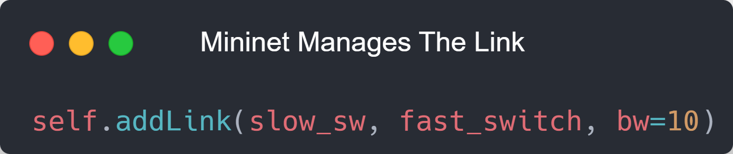
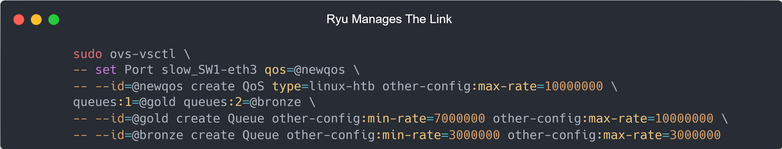
Topology: Who manages the link?

Slide 11
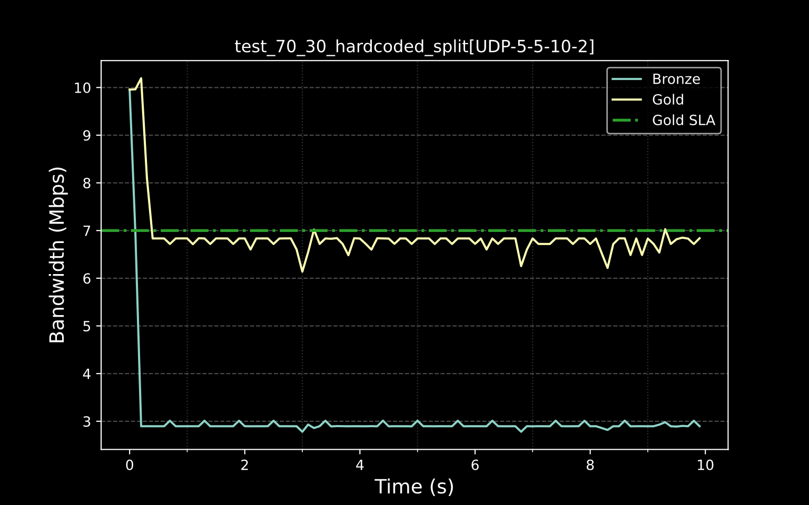
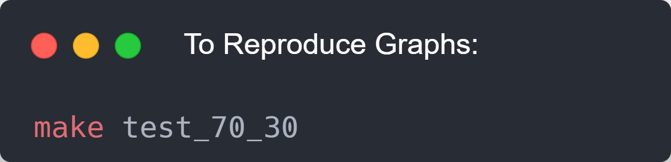

Slide 12
Phase 3: ML-Enforced QoS

Slide 13
Phase 3: ML-Enforced QoS
Prerequisites
✅ | Dataset
✅ | System Design
Tests
Flaky! | Gold drops below its SLA only if it wishes to
PASS | Bronze is observed to spend time above 3 Mbps

Slide 14
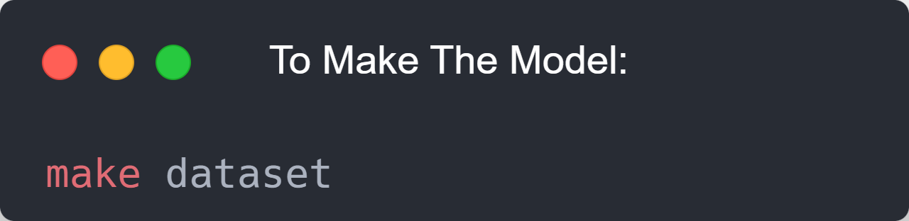
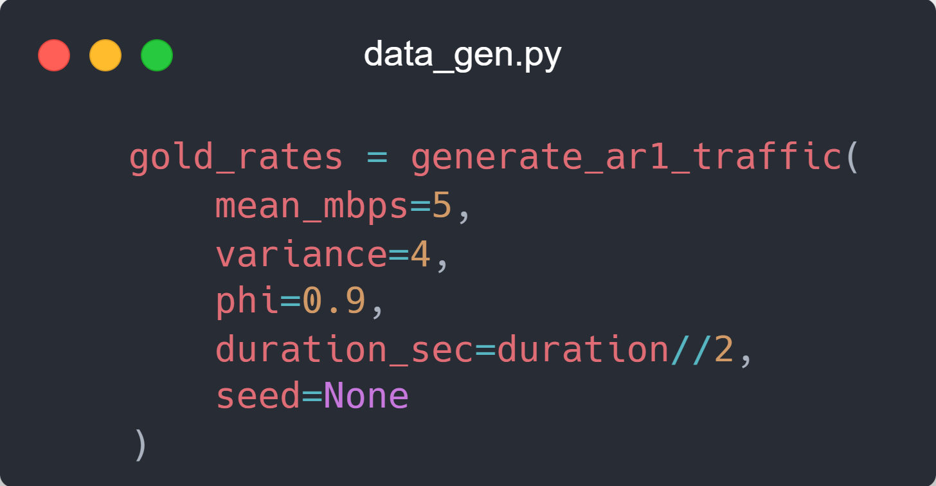
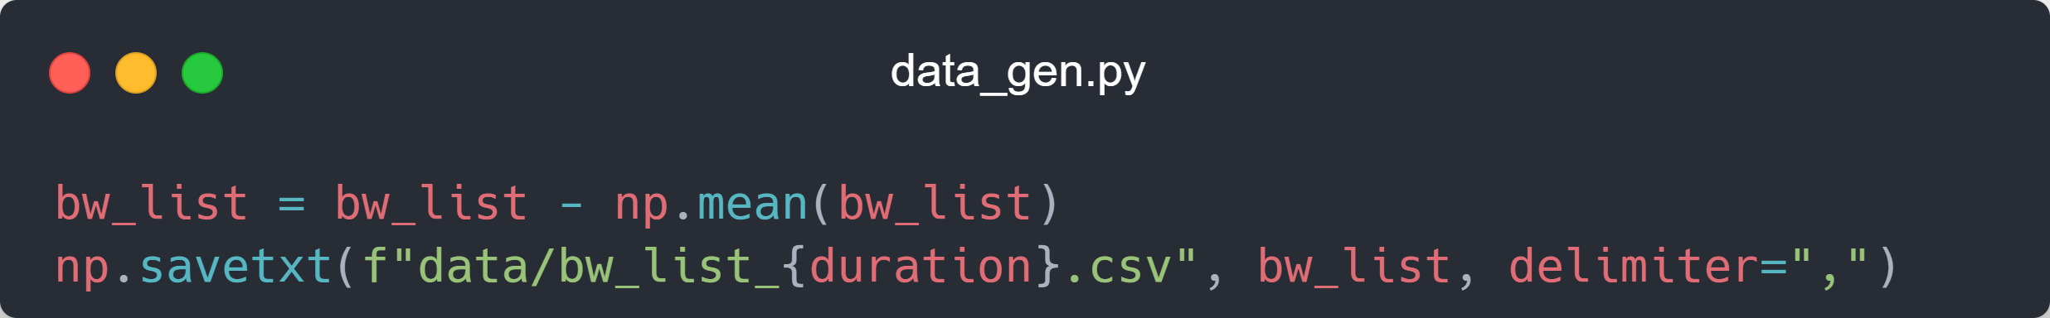

Slide 15
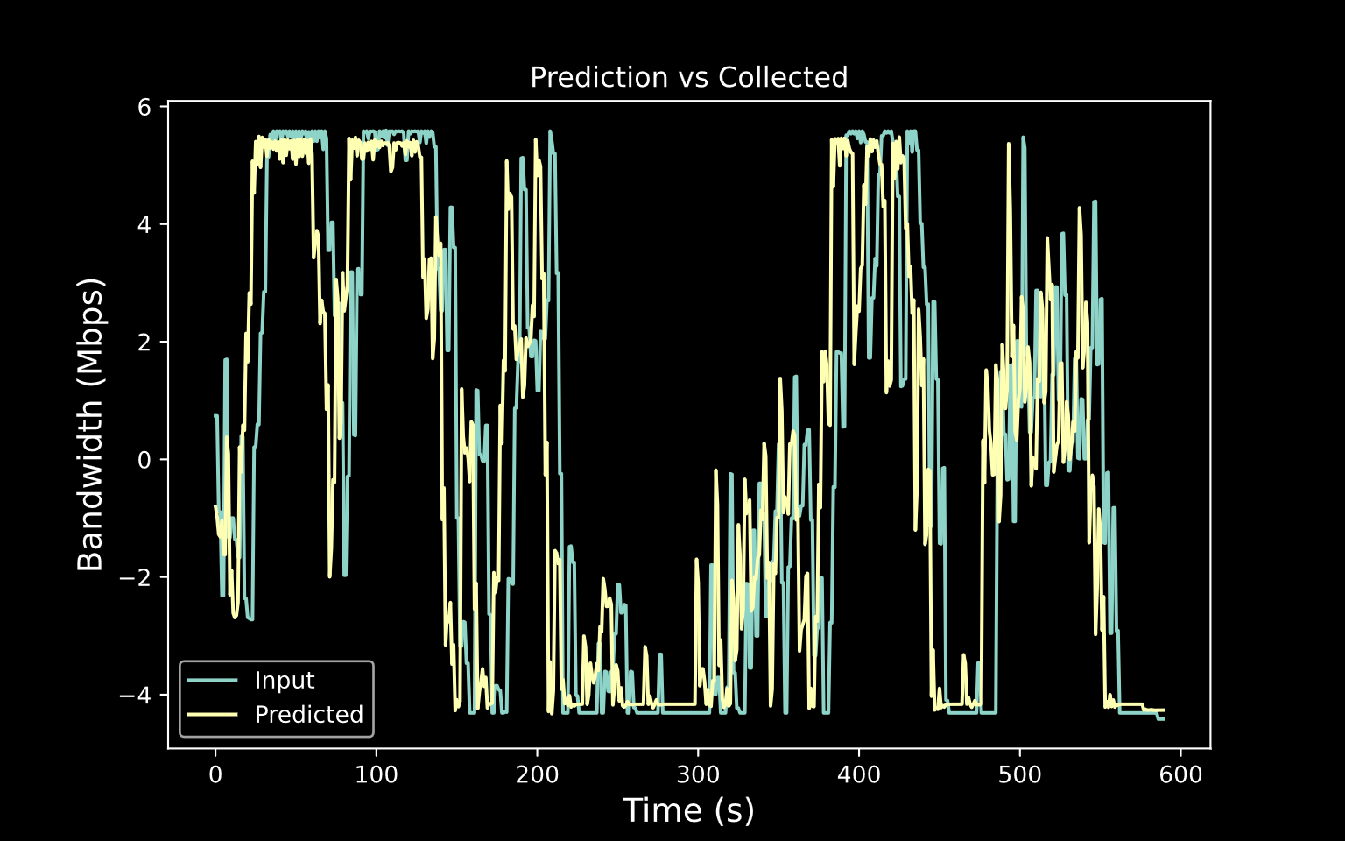
MAE: 1.883
MSE: 7.261

Slide 16
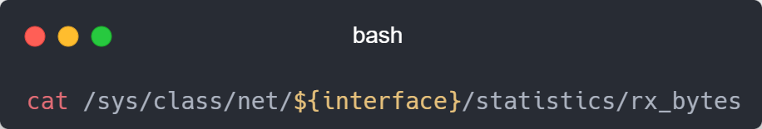
How do we get the Bandwidth?

Slide 17
Analysis of Requirements
“Replace static rules with an ML Agent. The agent predicts if the Gold user is about to go "quiet" and temporarily gives that bandwidth to the Bronze user”

Slide 18
Analysis of Requirements
“Replace static rules with an ML Agent. The agent predicts if the Gold user is about to go "quiet" and temporarily gives that bandwidth to the Bronze user”

Slide 19
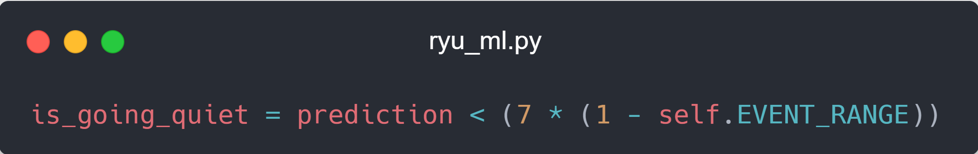
“Quiet?”
Take the maximum of the last 4 predictions
Set to 0.1

Slide 20
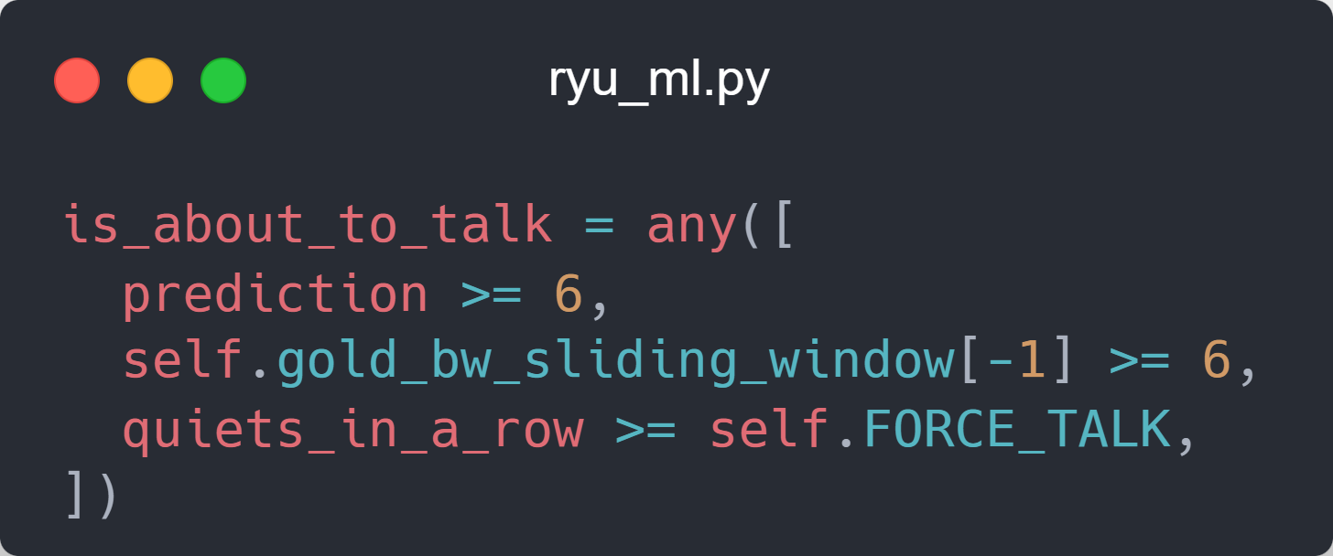
“Temporarily” ?
Set to 3

Slide 21
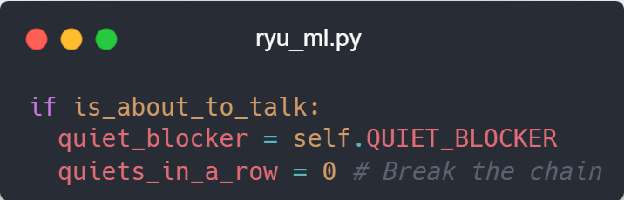
“Temporarily” ?
Set to 2

Slide 22
“That Bandwidth” ?
If Gold is about to talk, it takes its 7 Mbps

Slide 23
“That Bandwidth” ?
If Gold is about to go quiet, it takes prediction Mbps
Bronze takes
10 – prediction Mbps

Slide 24
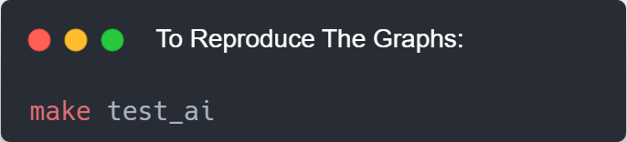

Slide 27
Thank You!

