Slide 1

Schematic to GDS SAR Digital Logic CND211 Final Project

Slide 2
Agenda
This presentation shows our final project submission for
CND211

Slide 3
Agenda
SAR ADC Logic: From schematic, to GDS.

Slide 4
SAR ADC
Finds the digital value by binary searching every possible value.

Slide 5
SAR ADC
Successively approximates the result, bit by bit.

Slide 6
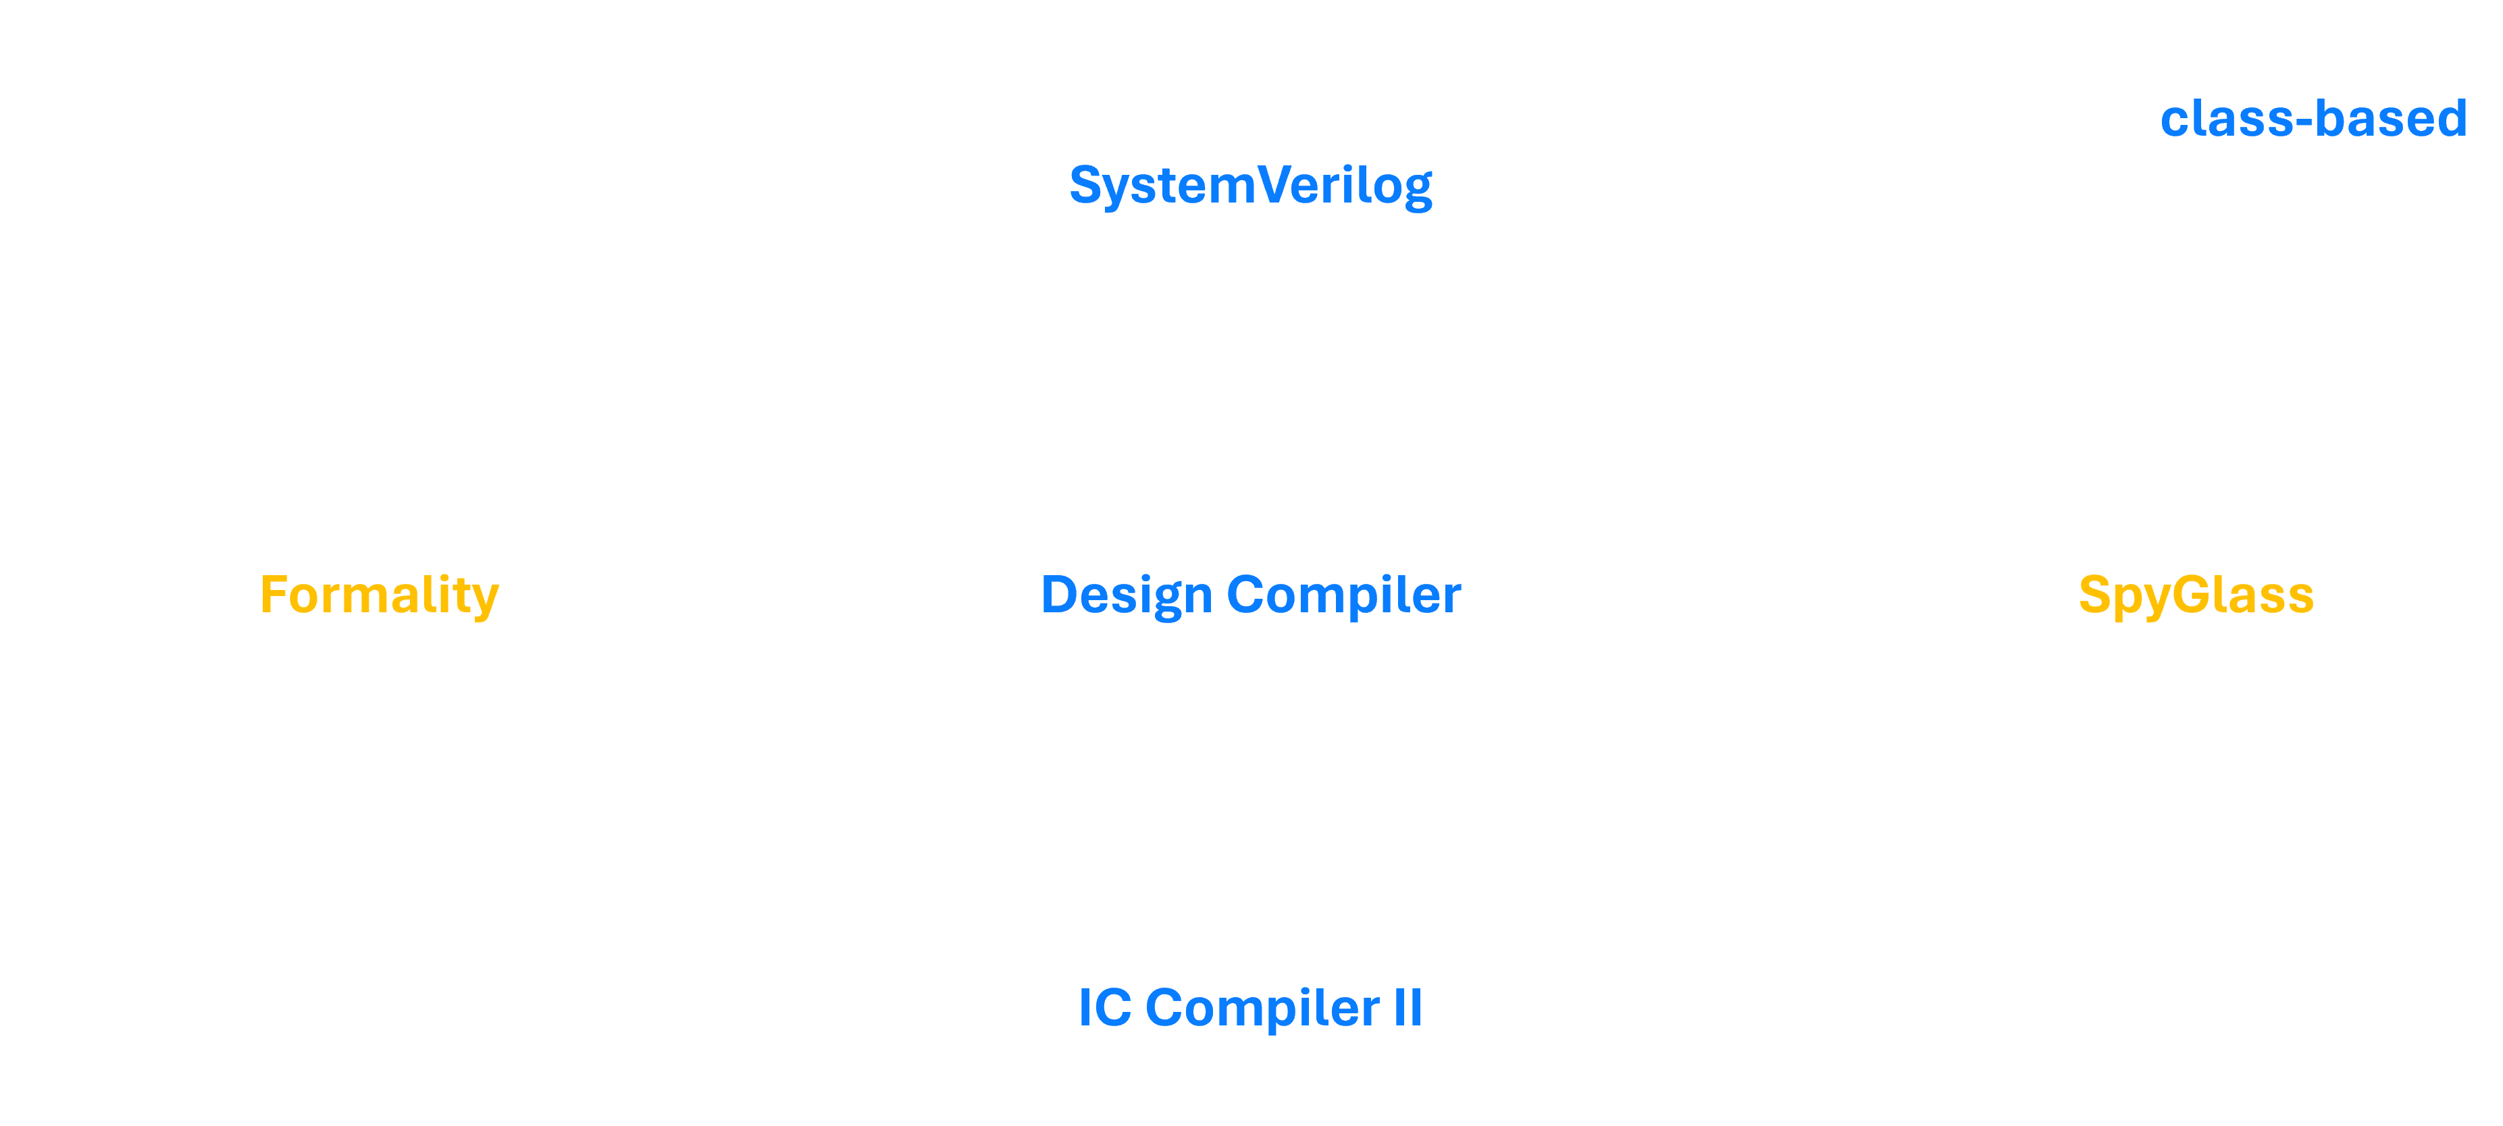
Our Work

Slide 10
Our Work

Slide 11
Our Work

Slide 12
Our Work

Slide 13
Our Work

Slide 14
Our Work
Understanding The Design
Writing the RTL in
SystemVerilog
Making a class-based testing environment.
Formal Verification using Formality
Synthesis using Design Compiler
Linting using SpyGlass
ASIC Flow using
IC Compiler II

Slide 15
Our Work
Understanding The Design
Writing the RTL in
SystemVerilog
Making a class-based testing environment.
Formal Verification using Formality
Synthesis using Design Compiler
Linting using SpyGlass
ASIC Flow using
IC Compiler II

Slide 16
Understanding The Design

Slide 17
Understanding The Design
Scott, M. D., Boser, B. E., & Pister, K.
An ultra-low energy ADC for Smart Dust.

Slide 18
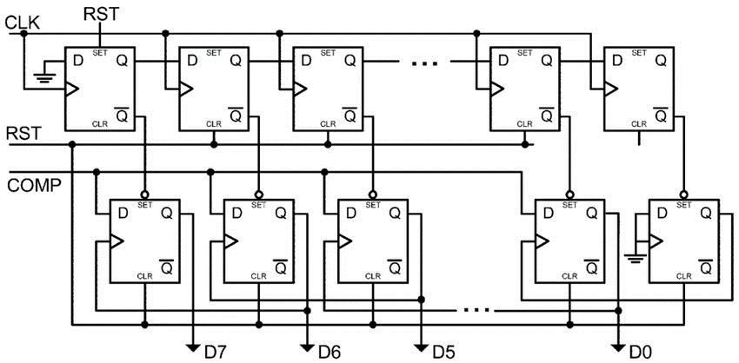
Scott, M. D., Boser, B. E., & Pister, K.
An ultra-low energy ADC for Smart Dust.

Slide 19
Scott, M. D., Boser, B. E., & Pister, K.
An ultra-low energy ADC for Smart Dust.

Slide 20
Scott, M. D., Boser, B. E., & Pister, K.
An ultra-low energy ADC for Smart Dust.

Slide 21
Our Work
Understanding The Design
Writing the RTL in
SystemVerilog
Making a class-based testing environment.
Formal Verification using Formality
Synthesis using Design Compiler
Linting using SpyGlass
ASIC Flow using
IC Compiler II

Slide 22
Writing the RTL in SystemVerilog

Slide 23
Writing the RTL in SystemVerilog
Two modules were implemented:

Slide 24
Writing the RTL in SystemVerilog
Two modules were implemented:
Set Propagator
SAR Custom Register

Slide 25
Writing the RTL in SystemVerilog
Design is generic. The resolution, 10 bits, is a parameter.

Slide 26
Our Work
Understanding The Design
Writing the RTL in
SystemVerilog
Making a class-based Testing Environment
Formal Verification using Formality
Synthesis using Design Compiler
Linting using SpyGlass
ASIC Flow using
IC Compiler II

Slide 27
Making a class-based Testing Environment

Slide 28
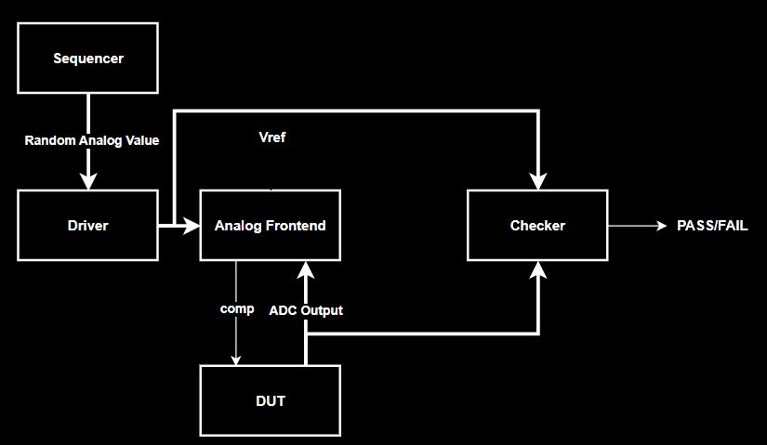
Testing Environment

Slide 29
Testing Environment
Generate a random analog value.

Slide 30
Testing Environment
Send the analog value to the analog frontend

Slide 31
Testing Environment
Compare the DUT output with the ADC output.

Slide 32
Testing Environment

Slide 33
Testing Environment
Compare the DUT output with the expected output.

Slide 34
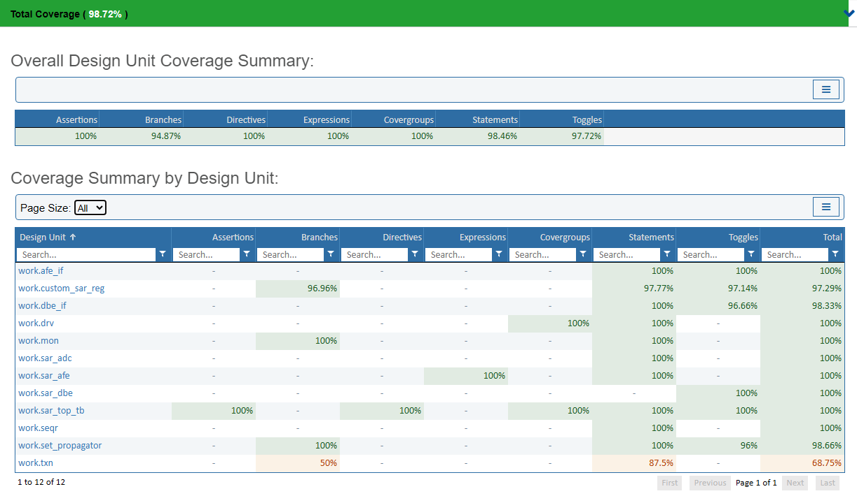
Coverage

Slide 35
Coverage
The verbose print setting in the transaction class was turned off in the simulation. The code is something like this: if not verbose then return.
Thus the 50% branch coverage .

Slide 36
Coverage
Same reason for statement coverage (87.5%)

Slide 37
Coverage
Other than that, everything is at an acceptable percentage.

Slide 38
Our Work
Understanding The Design
Writing the RTL in
SystemVerilog
Making a class-based testing environment
Formal Verification using Formality
Synthesis using Design Compiler
Linting using SpyGlass
ASIC Flow using
IC Compiler II

Slide 39
Linting using SpyGlass

Slide 40
Linting using SpyGlass
The paper contains many un-orthodox techniques.

Slide 41
SpyGlass was annoyed at the core principles of the design.

Slide 43
Clock connected to zero : Linting Error

Slide 44
Flipflop clocks are outputs of other flipflops: Linting Error

Slide 45
Async set pins of flipflops are outputs of other flipflops: Linting Error

Slide 46
All these errors can be waived
These are core design principles of the SAR ADC.

Slide 47
Our Work
Understanding The Design
Writing the RTL in
SystemVerilog
Making a class-based testing environment.
Formal Verification using Formality
Synthesis using Design Compiler
Linting using SpyGlass
ASIC Flow using
IC Compiler II

Slide 48
Synthesis using Design Compiler

Slide 49

Synthesis
Requirements
10 Bit SAR ADC.
100 MS/s $→$1.1 GHz
Using SAED90nm

Slide 50
Synthesis
Use LVT cells for performance (Sacrifice Power).

Slide 51
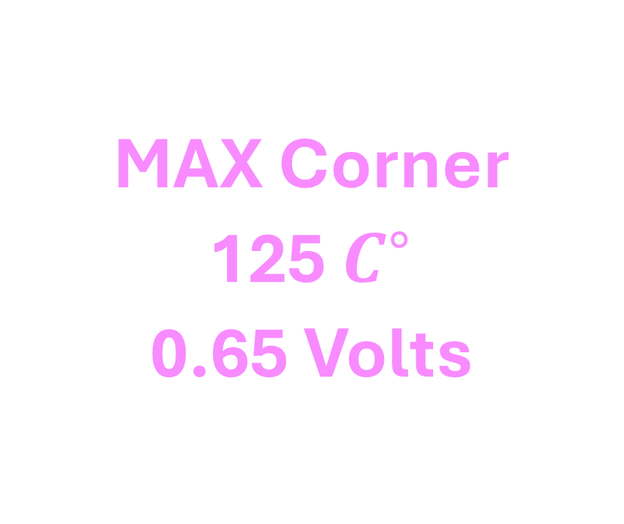
Corners
MAX Corner
125 $C^{∘}$
0.65 Volts

Slide 52
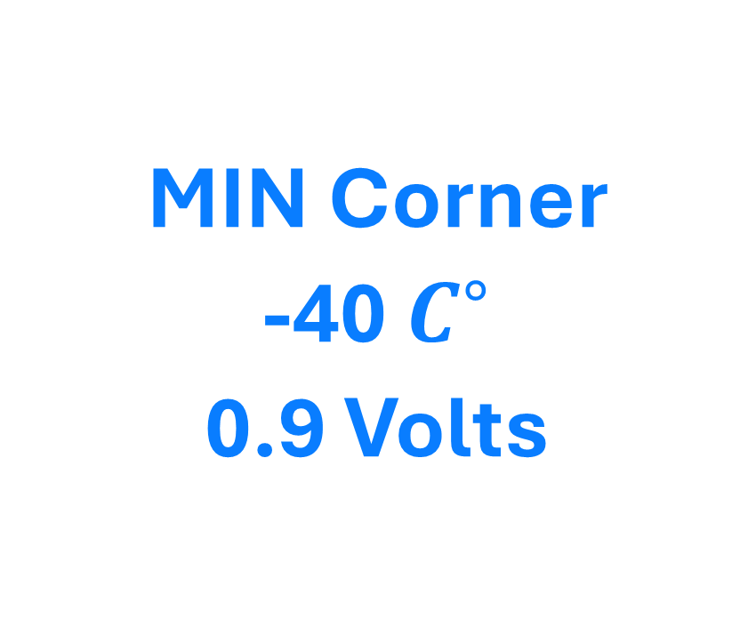
Corners
MAX Corner
125 $C^{∘}$
0.65 Volts
MIN Corner
-40 $C^{∘}$
0.9 Volts

Slide 53
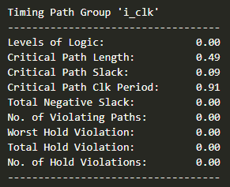
Timing Report

Slide 54
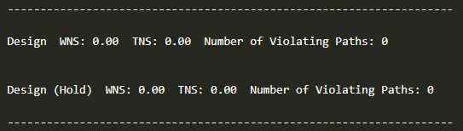
Timing Report

Slide 55
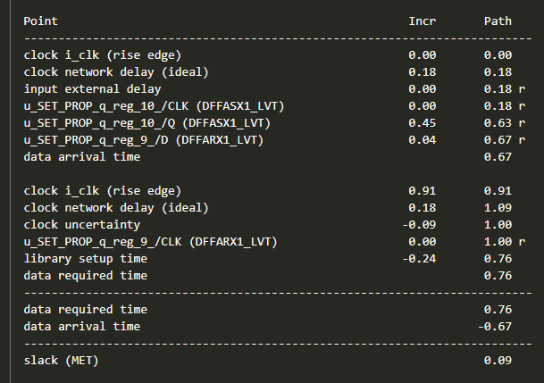
Critical Path Report

Slide 56
Although small, more performance can be “squeezed” from the design.

Slide 57
Our Work
Understanding The Design
Writing the RTL in
SystemVerilog
Making a class-based testing environment.
Formal Verification using Formality
Synthesis using Design Compiler
Linting using SpyGlass
ASIC Flow using
IC Compiler II

Slide 58
Formal Verification using Formality

Slide 59
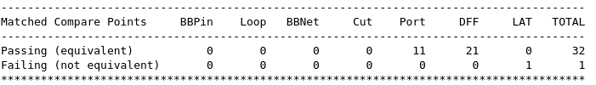
Formal Verification

Slide 60
Formal Verification

Slide 61
A Latch?
The design contains no latches.
Design compiler did not warn about unintentional latches being inferred.
The generated netlist does not contain any latch cell.

Slide 62
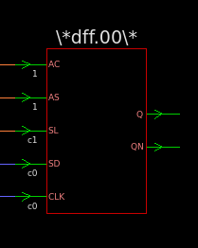
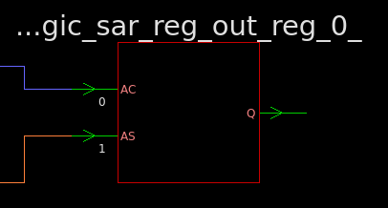
A Latch?
Reference
Implementation

Slide 63
A Latch?
No clock in reference!
Reference
Implementation

Slide 64
A Latch?
Implementation has a clock pin, is a normal DFF.
Reference
Implementation

Slide 65
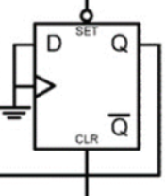
The code in question
always_ff @(posedge dummy_ground, negedge i_rstn, negedge i_setn[0]) begin
if (~i_setn[0]) sar_reg_out[0] <= 1'b1;
else if (~i_rstn) sar_reg_out[0] <= 1'b0;
else sar_reg_out[0] <= 1'b0;
end

Slide 66
Explanation
A DFF with asynchronous set / reset

Slide 67
Explanation
With the clock and D connected to zero…

Slide 68
Explanation
Behaves like an SR latch.

Slide 69
Explanation
DC recognized the always_ff and did not infer a latch.

Slide 70
Explanation
Formality, however, inferred a latch.

Slide 71
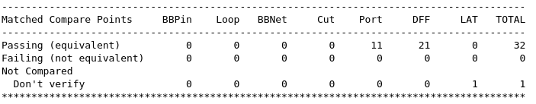
Explanation

Slide 72
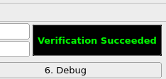
Explanation

Slide 73
Our Work
Understanding The Design
Writing the RTL in
SystemVerilog
Making a class-based testing environment.
Formal Verification using Formality
Synthesis using Design Compiler
Linting using SpyGlass
ASIC Flow using
IC Compiler II

Slide 74
ASIC Flow using IC Compiler II
Understanding The Design
Writing the RTL in
SystemVerilog
Making a class-based testing environment.
Formal Verification using Formality
Synthesis using Design Compiler
Linting using SpyGlass

Slide 75
Preparing the NDM
Was smooth sailing, except…

Slide 76
Preparing the NDM
Two cells in the .lef file had incorrect dimensions.

Slide 77
Preparing the NDM
The heights were not multiples of the sole site definition in the technology data.

Slide 78
The Offending Cells
LSDNENCLX4_LVT
LSDNENCLX8_LVT

Slide 79
The Offending Cells
High to low level shifters with high active enables clamp low.

Slide 80
The Offending Cells
We are not using any level shifters in the design.

Slide 81
The Offending Cells
Solution: Remove the level shifters from the lef file.

Slide 82
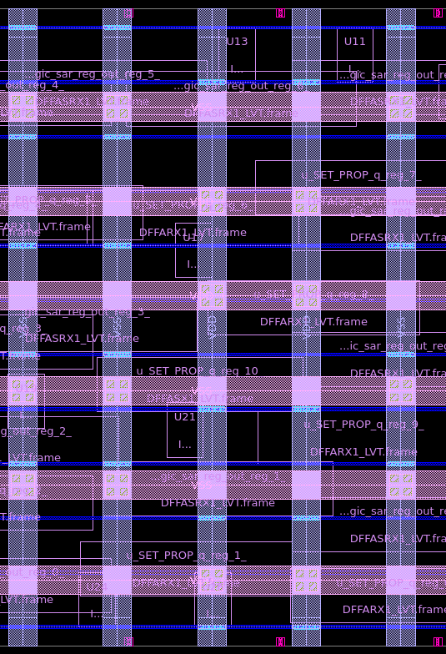
Floor And Power Planning
No power ring, as this design will be part of a larger design (in the same chip with the analog front end)

Slide 83
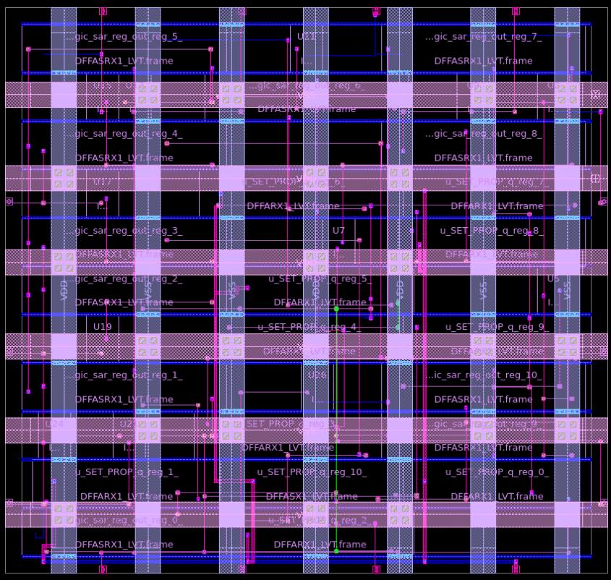
Placement And CTS
After placement and CTS, the critical path slack has improved by 44%

Slide 84
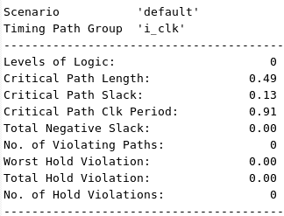
After Placement And CTS

Slide 85
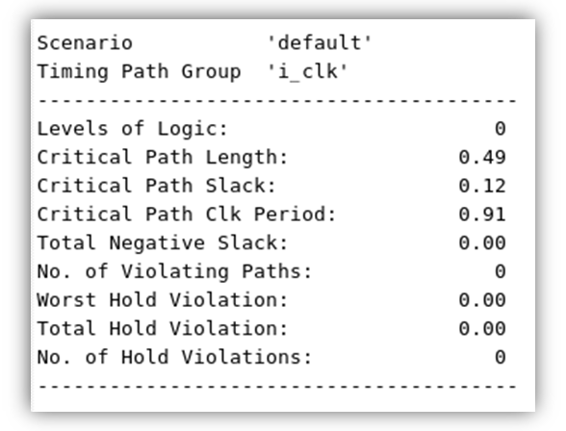
After Routing + Filler Cell Insertion

Slide 86
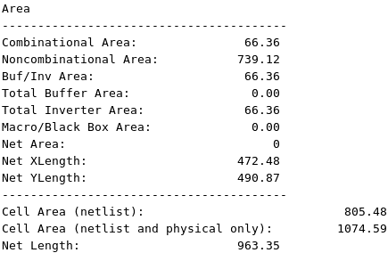
After Routing + Filler Cell Insertion

Slide 87
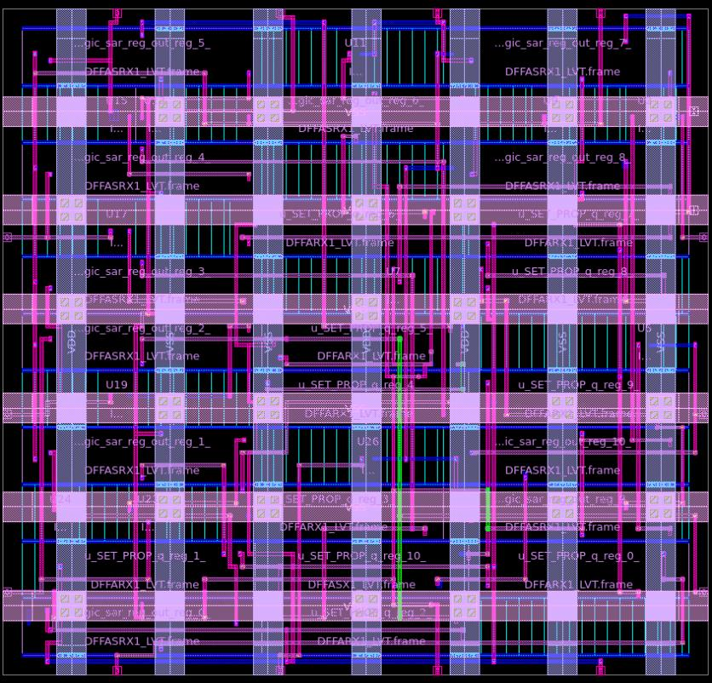
Final IC

Slide 88
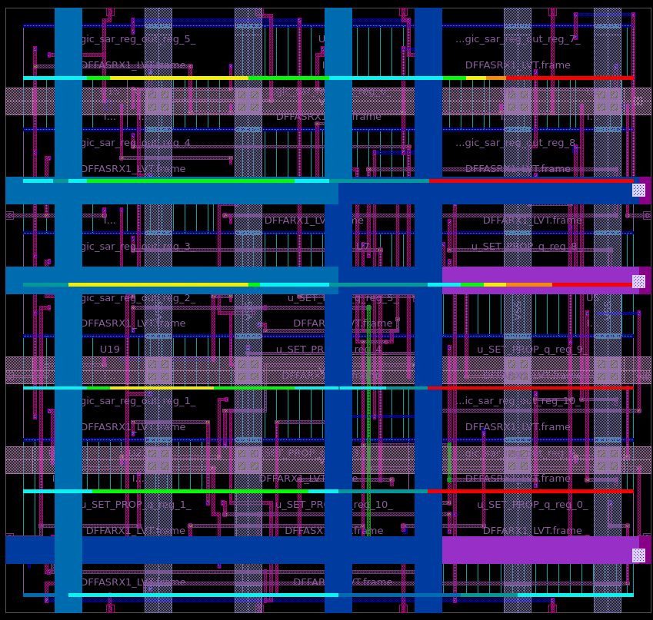
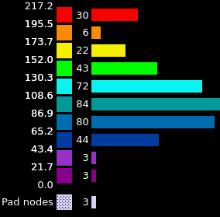
IR Drop

Slide 89
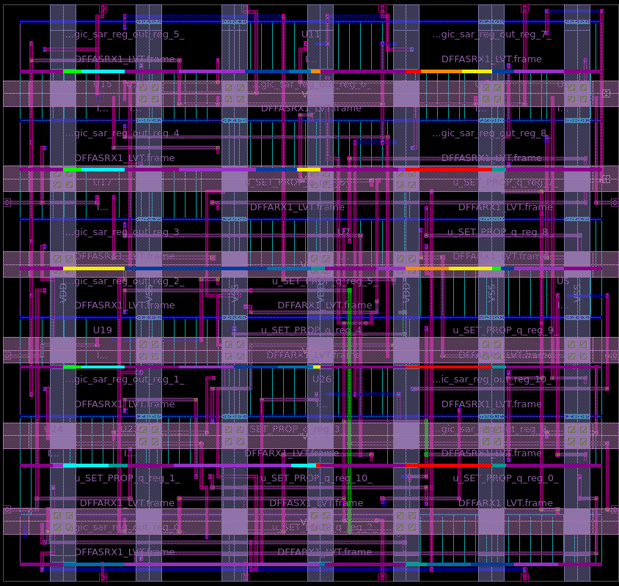
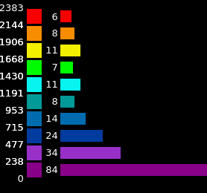
Electromigration

Slide 90
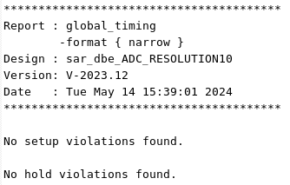
Final Timing (Using PrimeTime)

