Slide 1

UVM Verification of OpenCores 8051 ALU CND212 Final Project Submission
Omar T. Amer | Hussein Shedeed | Nermeen Alaa
Hisham Tarek | Lobna Ahmed | Mennatullah Mohamed

Slide 2
Introduction
OpenCores 8051 ALU

Slide 3
Introduction
OpenCores 8051 ALU

Slide 4
Introduction
OpenCores 8051 ALU

Slide 5
Introduction
OpenCores 8051 ALU

Slide 6
OpenCores 8051 ALU
Operations
ADD | INC
SUB | NOP
MUL | XCH
DIV | DA
AND | RR
OR | RRC
NOT | RL
XOR | RLC

Slide 7
OpenCores 8051 ALU
Operations
ADD | INC
SUB | NOP
MUL | XCH
DIV | DA
AND | RR
OR | RRC
NOT | RL
XOR | RLC

Slide 8
Arithmetic Operations
ADD | INC
SUB | NOP
MUL | XCH
DIV | DA
AND | RR
OR | RRC
NOT | RL
XOR | RLC

Slide 9
Arithmetic Operations
ADD | INC
SUB | NOP
MUL | XCH
DIV | DA
AND | RR
OR | RRC
NOT | RL
XOR | RLC
Multiplication, and division require 4 cycles.

Slide 10
ADD | INC
SUB | NOP
MUL | XCH
DIV | DA
AND | RR
OR | RRC
NOT | RL
XOR | RLC
Logic Operations

Slide 11
ADD | INC
SUB | NOP
MUL | XCH
DIV | DA
AND | RR
OR | RRC
NOT | RL
XOR | RLC
Rotation Operations

Slide 12
Miscellaneous Operations
ADD | INC
SUB | NOP
MUL | XCH
DIV | DA
AND | RR
OR | RRC
NOT | RL
XOR | RLC

Slide 13
16 Operations
ADD | INC
SUB | NOP
MUL | XCH
DIV | DA
AND | RR
OR | RRC
NOT | RL
XOR | RLC

Slide 14
Verification Plan
Every operation is independent on the one before.
ADD | INC
SUB | NOP
MUL | XCH
DIV | DA
AND | RR
OR | RRC
NOT | RL
XOR | RLC

Slide 15
Verification Plan
Send randomized transactions to the ALU.

Slide 16
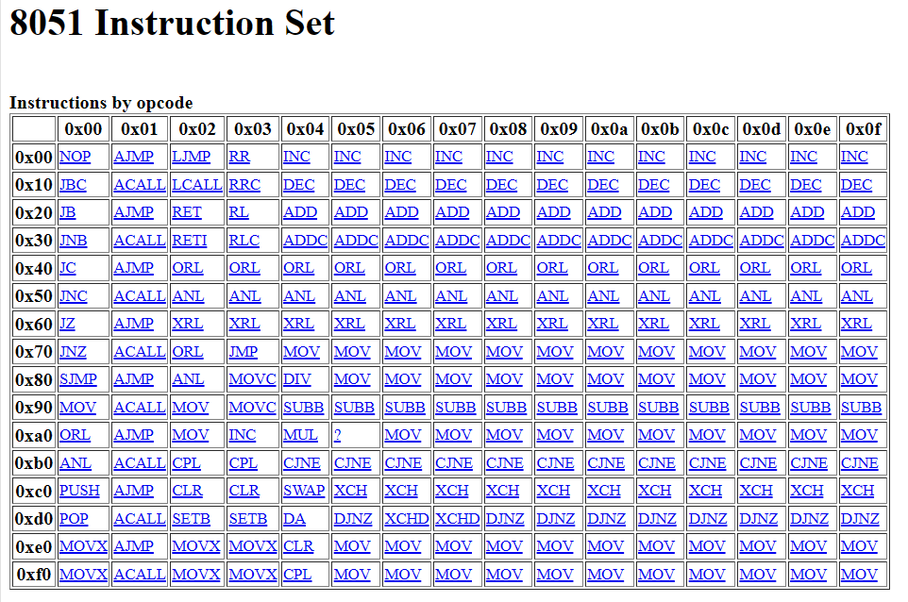
Verification Plan
With what do we compare the output?

Slide 17
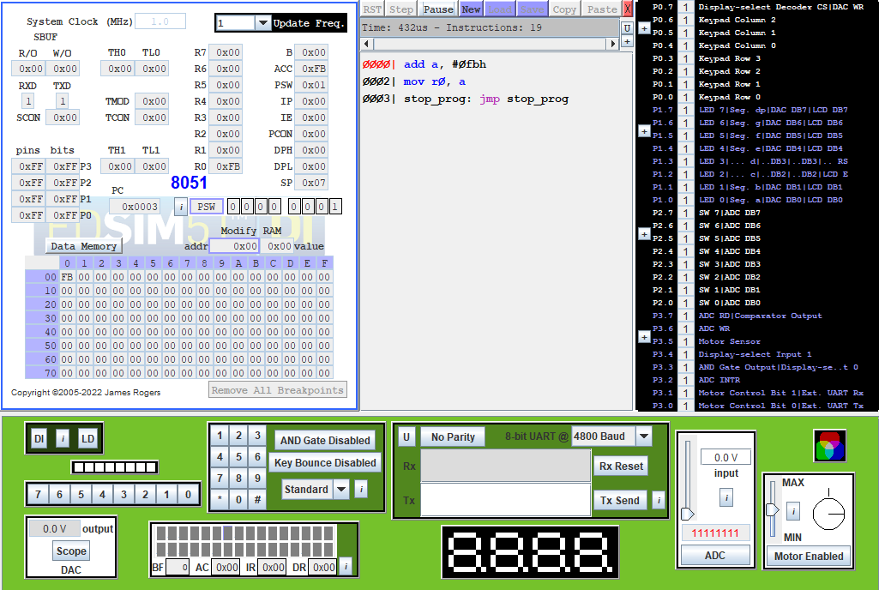
With what do we compare the output?

Slide 18
4-Bit Opcode
Interface Specification
3 Operation modifiers
3 8-bit Operands
4 8-bit Results
3 Output flags

Slide 19
Clocking Blocks
Two clocking blocks, one for Driving

Slide 20
Clocking Blocks
The other for Monitoring.

Slide 21











UVM Testbench

Slide 22
UVM Testbench

Slide 26
Sequences
One Sequence for each operation

Slide 28
Sequences
One Sequence for each operation

Slide 29
One Sequence for each operation
Would be too much overhead, if it weren’t for…

Slide 30
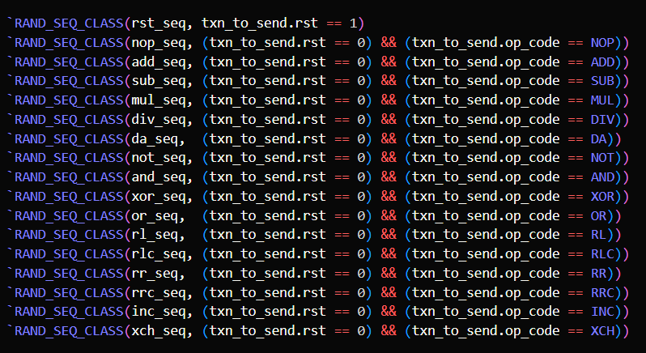
One Sequence for each operation
Macros!

Slide 31
One Sequence for each operation

Slide 32
Randomization Constraints

Slide 33
ENUMs

Slide 34
Sequence Library
Arbitrate sequences to the sequencer.
Random amounts of random transactions.

Slide 35
Driver
Convert Sequences to pin wiggles at the interface.

Slide 36
Monitor
Read transactions from the DUT.
Send them to the Scoreboard for checking.
Send them to the Subscriber for coverage collection.

Slide 37
Scoreboard
Receives a transaction from the analysis port.

Slide 38
Scoreboard
Checks the type, and
runs the appropriate checking function.

Slide 39
Scoreboard
All checking functions are neatly grouped in a package.

Slide 40
Subscriber
The subscriber also has an analysis port.

Slide 41
Subscriber
Has all the Covergroups of the design.

Slide 42
Functional Coverage
We need to make sure of a few things
before calling the testbench a success.

Slide 43
Functional Coverage
Are we trying all operations?

Slide 44
Functional Coverage
Are we trying all combinations of operations and operation modifiers?

Slide 45
Functional Coverage
This is the responsibility of the operations Covergroup.

Slide 46
Functional Coverage
Are we getting all combinations of operations and flags?

Slide 47
Functional Coverage
This is the responsibility of the outputs Covergroup.

Slide 48
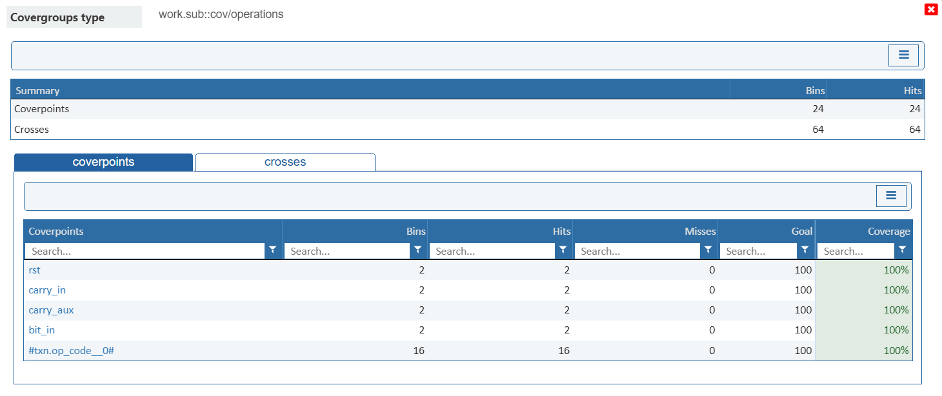
Functional Coverage
Multicycle operations: test two in a row.
Responsibility of multicycle_ops Covergroup.

Slide 49
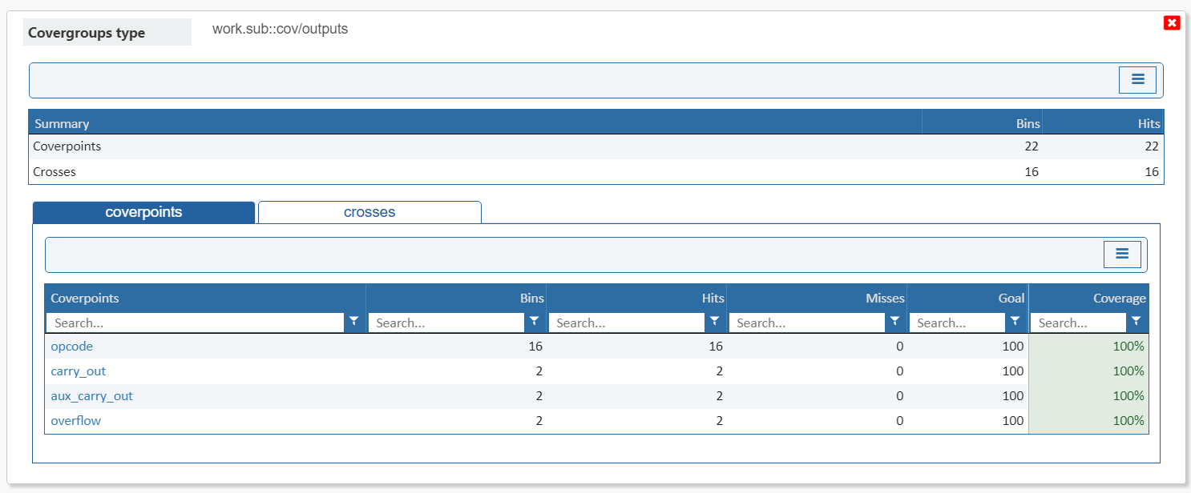
Functional Coverage Results
Multicycle operations: test two in a row.
Responsibility of multicycle_ops Covergroup.

Slide 50
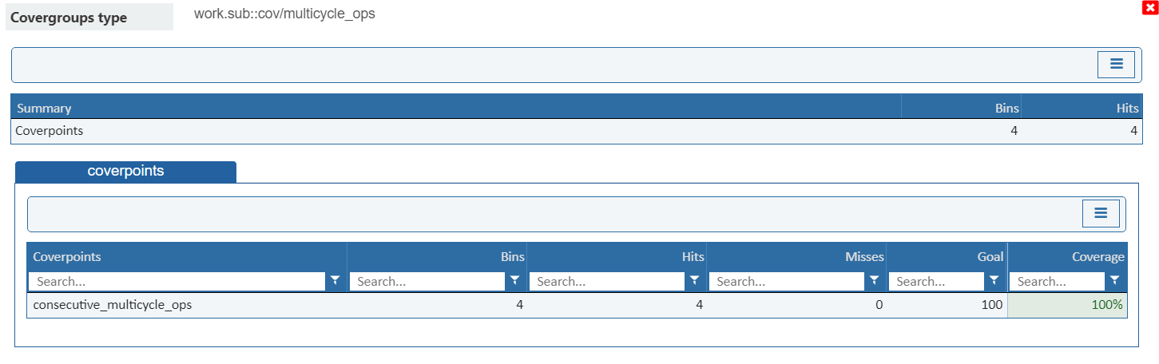
Functional Coverage Results

Slide 51
Functional Coverage Results

Slide 52
Functional Coverage Results
We are covering 100% of design functionalities.

Slide 53
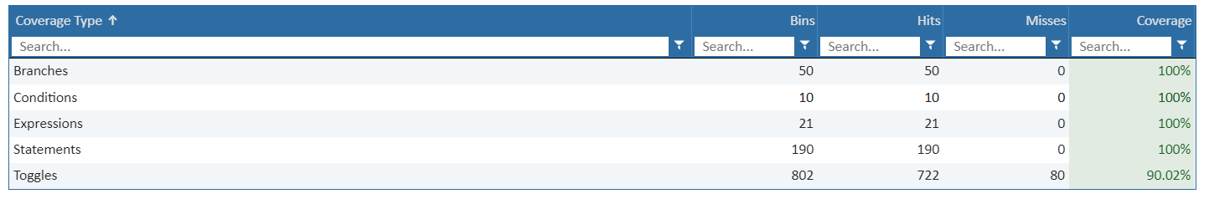
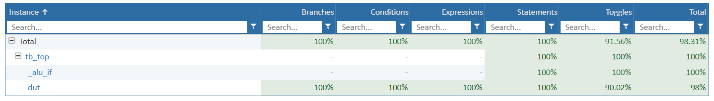
Code Coverage Results

Slide 54
Code Coverage Results

Slide 55
Simulation Results

Slide 56
A discrepancy ?

Slide 57
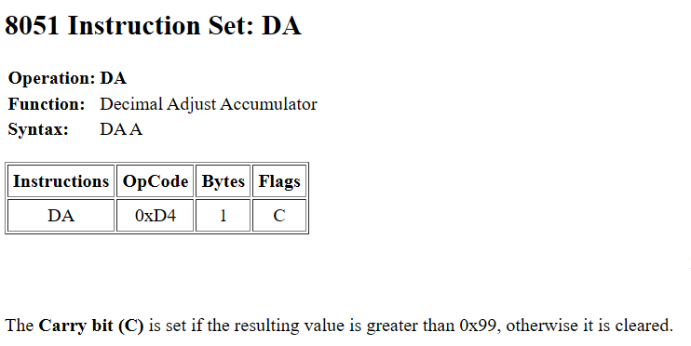
A discrepancy ?

Slide 58
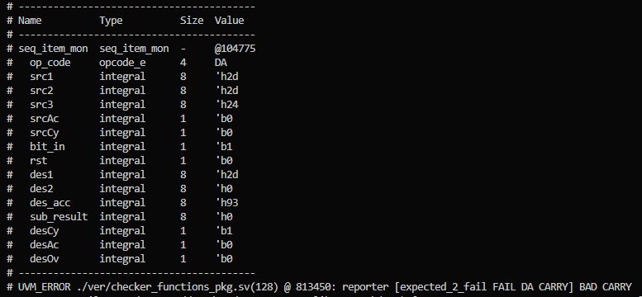
A discrepancy ?

Slide 59
A discrepancy ?

Slide 60
A discrepancy ?

Slide 61
A discrepancy ?

Slide 62
A discrepancy ?

