Slide 1






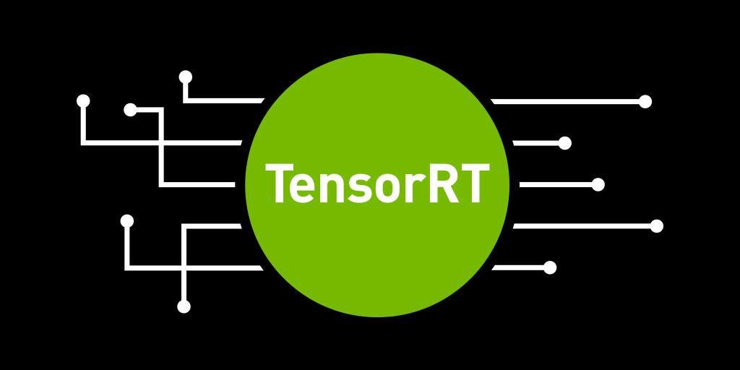
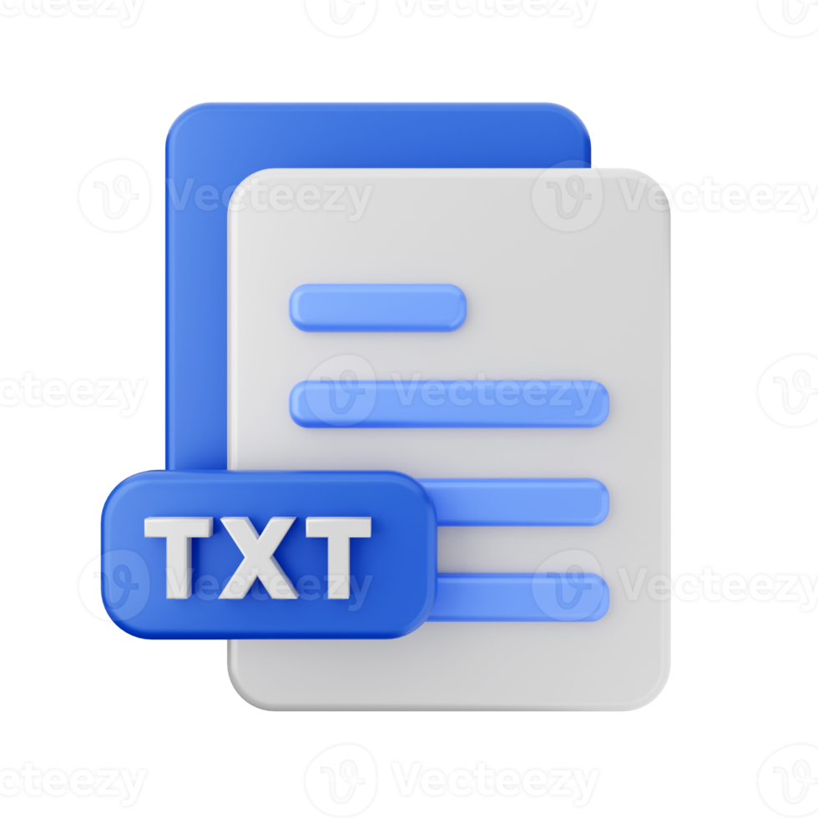


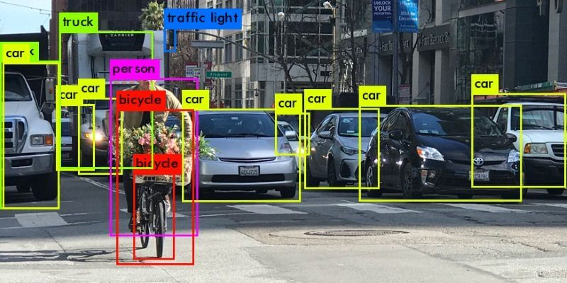
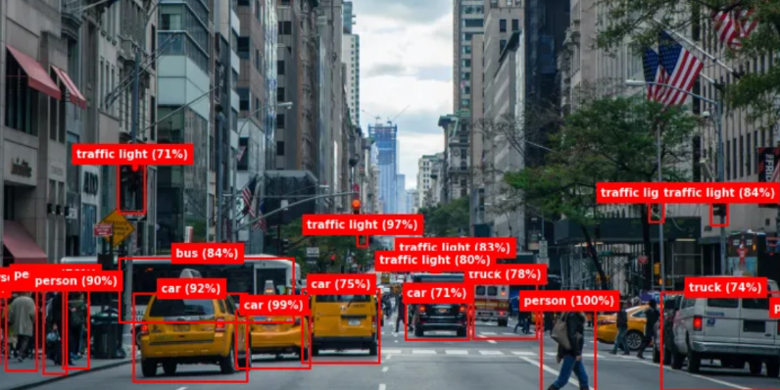
Video Images Inference Resnet model && Yolo 5
Text Inference distilbert-base-uncased-distilled-squad
Python for image inference
Video and images files
Image object inference detection
Generative IA chat Bot Question And Answer
Video object inference detection
Python for video inference
Windows folder where our python ia programs
will look for the inputs
Angular
Spring java
Request with a context and question
Python for text inference
PYTON SCRIPTS
Response from ia bot
Move to a txt file
RESULT IMAGES OR
RESULT VIDEOS
Windows Folder Detected videos Or Images
Angular folder

