Slide 1

A/B Test Design
OMAR ANSARI

Slide 2
Optimizing Payment Method Order for Increased Sales
Introduction
The right payment method enhances user convenience and satisfaction, leading to higher conversion rates and customer loyalty.
Optimized payment methods can reduce cart abandonment rates and encourage more users to complete transactions, ultimately increasing sales revenue.
Objective
The objective is to maximize total sales by optimizing the order of payment methods.
The goal is to gain insights that help optimize the payment method order, boosting user experience, conversion rates, and sales, thereby improving the e-commerce platform's performance.

Slide 3
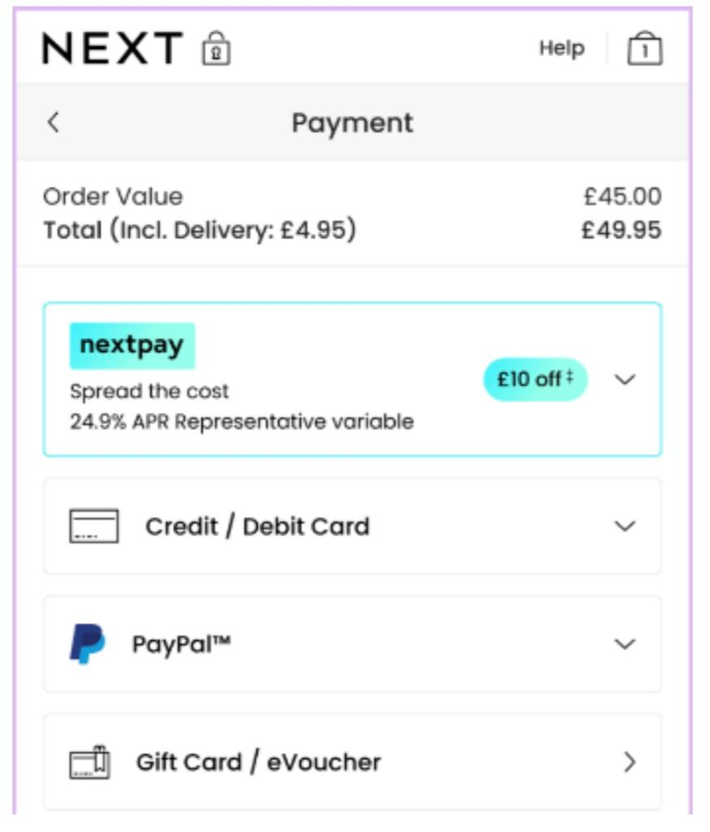
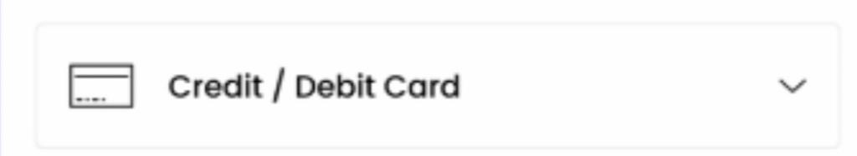
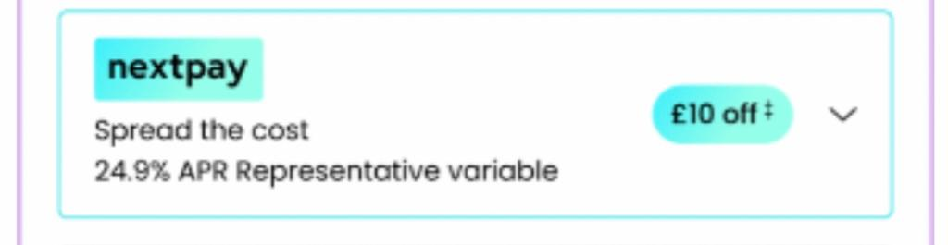
A/B Testing
Hypothesis Formulation:
Null Hypothesis (H0): Payment method order has no significant impact on total sales.
Alternative Hypothesis (H1): Changing the payment method order significantly affects total sales.
Identifying Variants: In A/B testing, we prioritize testing selected variants with high potential impact, saving time and resources, instead of testing all possible options.
Calculate Sample Size: Calculating required sample size per payment method variant considering factors like desired level of statistical significance and effect size.
Randomly assign users: Randomly assign users to different variations to eliminate bias and ensure that each variation has an equal chance of being shown to users.

Slide 4
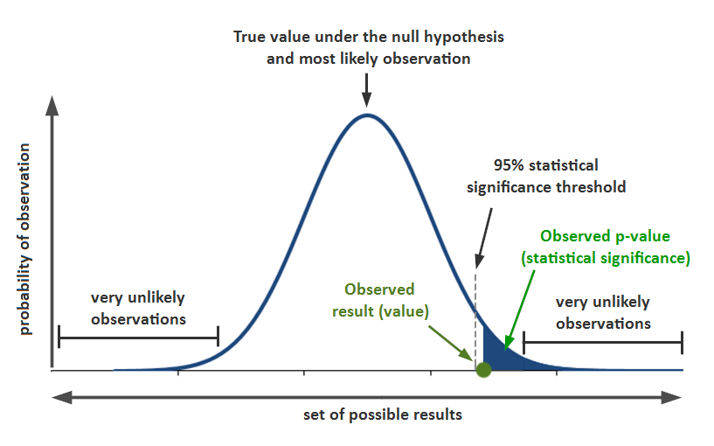
A/B Testing
Data Collection: Data Collection and Tracking is a crucial aspect of any A/B testing process. It involves gathering data on user interactions, behaviors, and outcomes during the experiment.
Test Duration: Estimating experiment duration based on website traffic and expected user interactions with the "Ways to pay" page.
Data Consistency: Ensuring that data collected across variants and the control group is consistent and follows the same format.
Statistical Analysis: Perform hypothesis test to check whether there is significant difference in total sales between the variants and the control group

Slide 5
Robust Methods
Compliance
Ensure that the objective of the test is well-defined and aligns with the business goal
Robust random assignment has been applied
Appropriate sample size is achieved to achieve statistical power
Ensure the accuracy and reliability of data. Inaccurate data can lead to incorrect results.
Consider a combination of metrics, not just total sales. Analyze conversion rates, AOV, and customer retention rate.
Have the test plan and methodology reviewed by peers.
PCI DSS Compliance: Follow PCI DSS for secure credit card processing.
Data Privacy (e.g., GDPR): Protect customer data as required by data privacy laws.
Third-Party Terms: Comply with payment provider terms.
Legal Expertise: Consult legal experts for compliance assurance.

Slide 6
Post-Campaign Analysis
Total Sales and Conversion Rates: Measure the effect on sales and conversion rates, aiming for a significant increase compared to the control group.
Explore User Behaviour: Analyse customer actions, like cart abandonment and payment method engagement, to streamline the checkout process.
Cost-Benefit Analysis: Evaluate the financial implications, considering development costs and revenue impact, to determine feasibility.
Customer Retention and Lifetime Value: Assess long-term effects on customer retention and value, striving for higher retention and value.
Customer Satisfaction: Collect user input on payment method order to enhance customer experience.

Slide 7
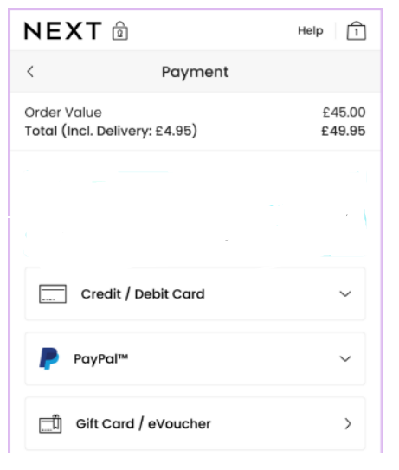
Removing Nextpay
Removing a credit option may limit accessibility for customers who rely on credit to make purchases.
Removing credit options may lead to lower conversion rates if potential customers abandon their carts due to a lack of credit availability.
Removing credit option could lead to dissatisfaction among customers who shop with us because of the availability of credit options.
Removing credit option may lead to a decrease in AOV.
The only risk we eliminate By remove the "NextPay" option, you may reduce the financial risk associated with offering credit.
Perform A/B test on users who use Nextpay.

Slide 8


Thank you!

