Slide 1
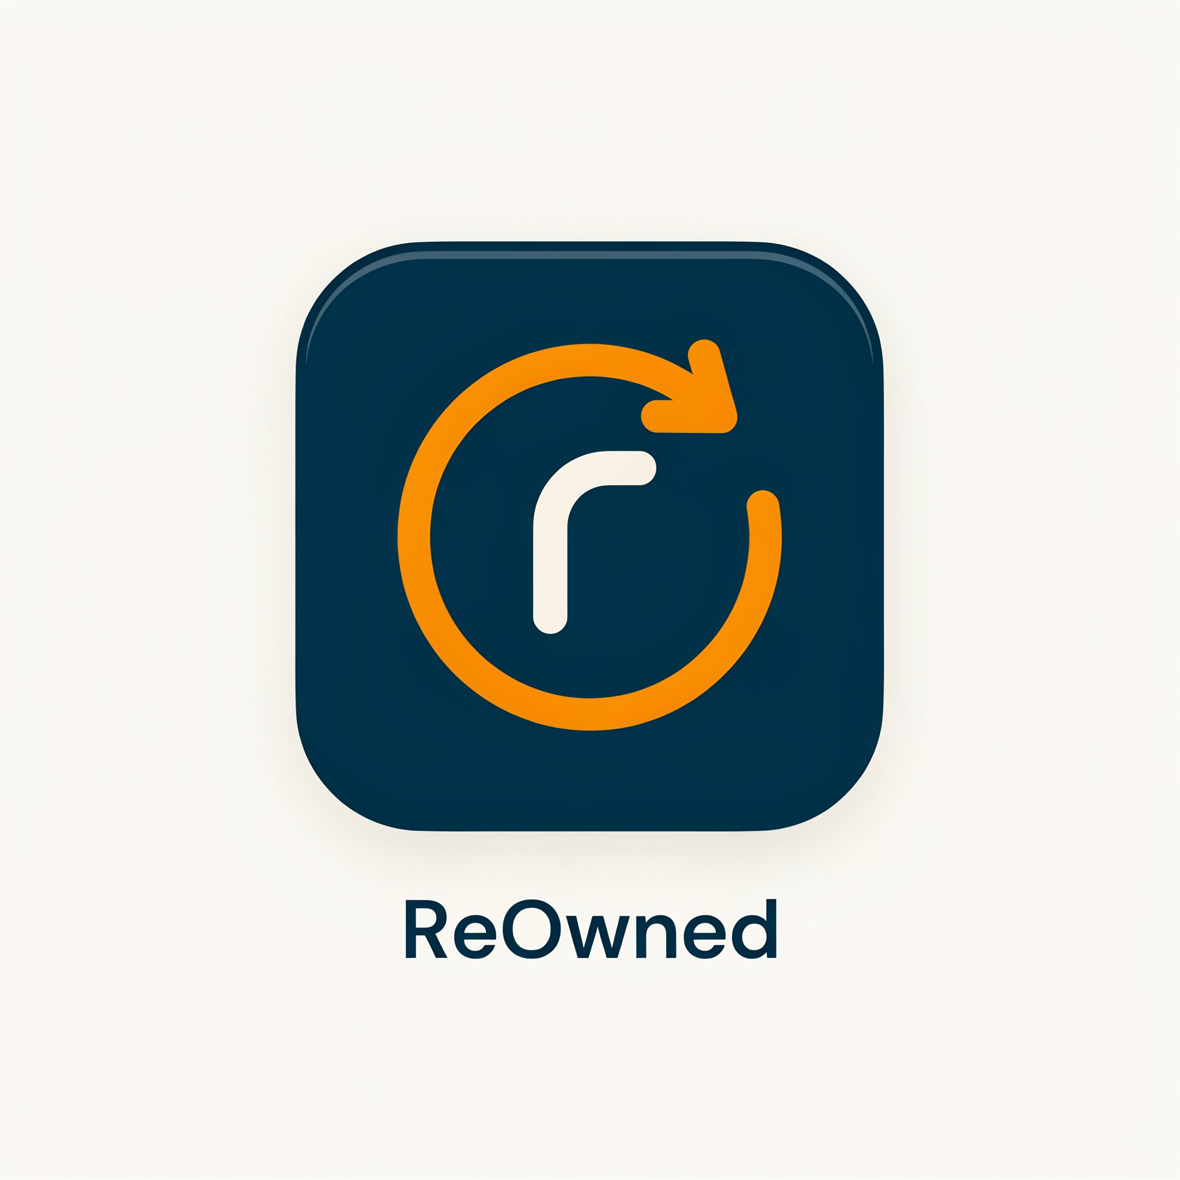
ReOwned
Egypt's Circular Marketplace for
Buying, Selling & Renting Pre-Owned Items
Buy
Sell
Rent
Lend
1

Slide 2
01
SECTION 03
Mission, Vision & Platform Concept
Project Overview
11

Slide 3
What is ReOwned?
A unified circular economy platform for Egypt & the Middle East
ReOwned connects people who want to monetize their used items with those looking for verified, affordable alternatives to buying new — all in one trusted platform.
🛒
🔑
🏷
🏠
Buy
Rent
Sell
Lend
Purchase verified pre-owned items from trusted, ID-checked sellers with buyer protection and COD support
Borrow items for any duration with digital contracts, escrow deposits and pre/post condition inspection
List items in minutes with a guided flow, smart pricing suggestions and full seller analytics dashboard
Turn idle assets into passive income — set your own terms, approve verified renters, get paid automatically
Trust
Transparency
Security
Sustainability
Verification, deposits, inspection
Condition grading, real reviews
Dispute resolution, escrow holds
Circular economy, reduce waste
12

Slide 4
Presentation Agenda
A structured walkthrough from research to final UI design
01
Survey & Stakeholder Research
06
Information Architecture & Flows
Quantitative survey questions, results & qualitative interviews
IA hierarchy and all 4 user flows from entry to complete
02
SWOT & Competitor Analysis
07
Wireframes
Strategic assessment and market positioning
Low-fidelity wireframes for all 19 mobile screens
03
Project Overview & Vision
08
Visual Identity & Design System
What ReOwned is, what it solves, and who it's for
Colors (60-30-10), typography, components and logo story
04
User Personas & Empathy Maps
09
High-Fidelity UI Screens
Four detailed personas, empathy quadrants and research insights
Final mobile UI designs across all key flows
05
User Journey Maps
End-to-end emotional journeys — Buyer/Renter & Seller/Lender
2

Slide 5
02
SECTION 01
Primary Research · Survey & Stakeholder Interviews
Understanding Our Users
3

Slide 6
Survey Questions — Quantitative
8 closed-ended questions distributed to target users across Egypt
Q1
How much do you trust online platforms for buying or renting second-hand devices?
Q5
How important is price and rental duration transparency in your decision?
Scale: Fully Trust → Neutral → Don't Trust at All
Scale: Not Important → Important
Q2
Have you ever faced problems when buying or renting second-hand devices?
Q6
How much do user reviews and ratings help you build trust in a platform?
Options: Yes · No
Options: Helpful · Moderately · Not at All
Q3
How important is it to have a pre/post inspection system to verify item condition?
Q7
After testing the platform, how likely are you to use ReOwned again?
Scale: Not Important → Important
Options: Likely · Maybe · Not Likely
Q4
If you have an unused device, how likely are you to rent it out instead of selling?
Q8
What would be your main reason for using the platform?
Options: Likely · Maybe · Never
Options: Affordable prices · Trust & verification · Ease of use · Reviews
4

Slide 7
Survey Key Findings
What the data revealed about user trust barriers and platform needs
78%
84%
3in4
71%
Don't Fully Trust
Need Inspection
Have Idle Items
Would Return
online second-hand platforms — trust is the #1 barrier to adoption
said pre/post inspection is important before any transaction
worth EGP 500+ sitting unused at home — huge supply potential
said they'd use ReOwned again after seeing the verified workflow
Main Reasons Users Would Choose ReOwned
5

Slide 8
Qualitative Research — Interview Questions
Open-ended questions that revealed deep user motivations, fears and needs
"What concerns you most when buying second-hand items?"
→ Users cited fear of hidden defects, no recourse after purchase, and being unable to verify item condition as their three biggest concerns.
"What would make you trust a rental platform?"
→ ID verification for all users, secure deposits, clear photos from multiple angles, verified badges, and a dispute resolution center.
"Why would you choose renting over buying?"
→ Cost savings for temporary needs, trying before buying, avoiding depreciation on expensive items, and not needing to store it after.
"What features would make you use ReOwned regularly?"
→ Pre-inspection workflow, standardized condition grading, COD payment option, in-app chat, and clear return / damage policies.
"What improvements would you suggest for second-hand platforms?"
→ More photo angles required, video demos, honest condition reports with grading standards, and better search filters by location.
6

Slide 9
Stakeholder Interview Questions
24 structured questions that defined the platform goals, constraints and features
Platform & Business
Users & Access
Content & Features
1. What is the main goal — selling only, or selling and renting?
1. Who is the primary target audience?
1. What types of items will be listed?
2. What problem does this solve that others don't?
2. What user types will the system have?
2. Are there conditions for accepting used items?
3. What makes ReOwned different from competitors?
3. What information is required during registration?
3. Will items be inspected before listing?
4. Will there be a commission from sales?
4. Will user identity verification be required?
4. Can users upload their own items for rent?
5. How will rental prices be determined?
5. Should there be a rating and review system?
5. What payment methods will be available?
6. Will there be a security deposit for renting?
6. Will there be a return or cancellation policy?
6. Should there be a chat system between users?
7. How will fraud or complaints be handled?
7. What usage rules should be applied?
7. Should there be order and rental tracking?
7

Slide 10
03
SECTION 02
Strategic Analysis
SWOT & Competitor Analysis
8

Slide 11
SWOT Analysis
Honest strategic assessment of ReOwned's market position in Egypt
STRENGTHS
WEAKNESSES
· Only platform combining Buy AND Rent in one experience
· New platform — cold-start: no users means no listings initially
· ID verification & escrow deposits build real trust infrastructure
· Complex dual-mode UX increases onboarding friction
· COD support — designed for Egypt's cash-first economy
· Requires significant trust investment before wide adoption
· Digital rental contracts — legal clarity for both parties
· ID verification adds steps compared to competitors
· Pre/post inspection workflow reduces disputes significantly
· Relies on user-generated content for quality signals
· 4 distinct role-based flows tailored to each user type
· No brand recognition vs. established OLX or Facebook
OPPORTUNITIES
THREATS
· EGP devaluation is driving demand for affordable alternatives
· OLX Egypt has massive existing user base and brand trust
· No dominant verified P2P rental platform in Egypt/MENA
· Facebook Marketplace is free and deeply embedded in Egypt
· Growing sustainability and circular economy awareness
· User skepticism about new platforms is very high (78% survey)
· University students are a huge underserved renter market
· Regulatory uncertainty around P2P digital contracts
· Rising gig economy — freelancers need a professional resale hub
· Payment infrastructure gaps — digital wallets not universal
· Middle East expansion — same trust gap exists region-wide
· Competitors could add rental features before ReOwned scales
9

Slide 12
Competitor Analysis
How ReOwned compares against existing platforms — and where the gap is
Feature | OLX Egypt | Facebook Marketplace | Dubizzle | ReOwned ✓
Buy & Rent in one platform | ✕ | ✕ | ✕ | ✓
ID Verification system | ✕ | ✕ | ✕ | ✓
Escrow deposit protection | ✕ | ✕ | ✕ | ✓
Pre/Post inspection workflow | ✕ | ✕ | ✕ | ✓
Digital rental contracts | ✕ | ✕ | ✕ | ✓
Built-in dispute resolution | Partial | ✕ | Partial | ✓
COD payment support | ✓ | ✓ | ✓ | ✓
Seller analytics dashboard | ✕ | ✕ | ✕ | ✓
Trust & verified badges | Partial | ✕ | Partial | ✓
Mobile-first design | ✓ | ✓ | ✓ | ✓
10

Slide 13
04
SECTION 04
Personas · Empathy Maps
User Research
13

Slide 14
User Personas — All Four Roles
Research-validated personas representing every side of the ReOwned marketplace
LH
KM
SE
AN
Layla Hassan
Karim Mansour
Sara El-Masry
Ahmed Nour
The Buyer
The Seller
The Renter
The Lender
27 · Cairo · Marketing Coordinator · EGP 8,000/mo
34 · Alexandria · Freelance Photographer · EGP 15,000/mo
22 · Giza · Architecture Student · EGP 2,500/mo
41 · New Cairo · Civil Engineer · EGP 25,000/mo
"I want good quality items without paying full price."
"ReOwned turns my unused gear into cash — fast."
"Why buy something I'll only use once?"
"My tools sit idle — why not earn from that?"
GOALS
GOALS
GOALS
GOALS
· Verified sellers with honest photos
· Fast listing with minimal effort
· Short-term affordable access
· Passive income from idle assets
· COD payment, flexible refunds
· Serious buyers only
· Clear deposit & rental terms
· ID-verified renters only
· Authentic brands at lower prices
· Transparent commission rates
· Digital contract for security
· Damage protection & auto-payment
PAIN POINTS
PAIN POINTS
PAIN POINTS
PAIN POINTS
· Fear of hidden defects
· No-show buyers
· Hidden fees
· Worry about item damage
· Fake listings / profiles
· Lowball offers
· Unreasonably high deposits
· Late returns disrupting schedule
· Shipping delays
· Complex listing processes
· No dispute mediator
· Non-tech-friendly interfaces
14

Slide 15
Empathy Maps — Both User Groups
Says · Thinks · Does · Feels — mapped for each side of the marketplace
Buyer & Renter
Seller & Lender
SAYS
THINKS
SAYS
THINKS
· "How can I be sure the condition is exactly as described?"
· Second-hand can save money, but it might be risky
· "How much commission will the platform take?"
· Is it worth the effort to clean, photograph and ship?
· "Are there real reviews from previous users?"
· A verification system would make me trust this more
· "What if someone returns my item damaged?"
· I hope my personal details stay private
· "Is the payment process safe? Can I pay cash?"
· Clear photos and detailed descriptions are essential
· "Is the listing process quick? I'm not technical."
· I want a hassle-free way to sell without drama
DOES
FEELS
DOES
FEELS
· Compares prices between new and second-hand options
· 😟 Concern about scams or wrong condition
· Cleans and prepares items to look as new as possible
· 😰 Anxiety about shipping high-value items
· Reads reviews and ratings before every purchase
· 😌 Relief when sellers are verified
· Researches similar listings to set a competitive price
· 😒 Annoyance at lowball offers
· Asks sellers questions about condition and usage
· 😄 Excitement when finding a great deal
· Packages items carefully to avoid shipping damage
· 😊 Satisfaction turning clutter into income
· 😤 Frustration when product info is unclear
· 🤞 Hopeful items find a good second home
15

Slide 16
05
SECTION 05
Journey Maps · Information Architecture · User Flows
UX Architecture
16

Slide 17
User Journey Map — Buyer / Renter
5-phase emotional journey from first awareness to transaction complete
1. Awareness
2. View & Check
3. Contact & Pay
4. Receive & Use
5. Return & Review
ACTION
User finds ReOwned, searches for items to buy or rent
Opens item details, reviews photos, price, deposit and terms
Messages seller, confirms, completes payment
Item delivered; buyer receives or renter uses it
Buyer reviews; renter returns item and gets deposit back
PAIN POINTS
Unsure about platform trust; unclear item condition
Incomplete info, confusing rental terms
Delayed replies; worries about payment security
Delivery delays, damage during transit
Complicated return; unclear deposit refund process
FEELING
😐 Uncertain
🤔 Cautious
😬 Tense
😄 Excited
😌 Relieved
IMPROVEMENT
Trust badges, item verification, clear condition labels
Multi-angle photos, clear pricing, rental calendar
Chat notifications, secure gateways, confirmation emails
Tracking, pre/post delivery verification, support
Simplified return, auto deposit refund, review incentives
17

Slide 18
User Journey Map — Seller / Lender
5-phase journey from platform awareness to payment received
1. Awareness
2. Set Price
3. Communicate
4. Ship / Pickup
5. Complete & Pay
ACTION
Seller registers and creates a listing for their device
Sets rental price, sale price, duration and deposit requirements
Responds to inquiries and answers questions about the device
Arranges delivery or approves local pickup; confirms condition
Device returned or sale completed; seller receives payment
PAIN POINTS
Uncertainty about platform trust; unclear listing process
Confused about competitive pricing and rental policies
Slow responses; worries about disputes or scams
Shipping delays; damage during transport; unclear verification
Payment delays; disputes over condition; rating uncertainty
FEELING
😕 Hesitant
😟 Anxious
😤 Alert
😌 Attentive
😊 Satisfied
IMPROVEMENT
Step-by-step guide, verified seller badge, intuitive UI
Suggested pricing guide, clear commission breakdown
In-app chat notifications, dispute support, Q&A templates
Integrated tracking, pre-shipment checklist, condition photos
Auto payment release, rating system, instant deposit transfer
18

Slide 19
User Flow — All 4 Paths
One shared entry point · Four parallel journeys · One converged outcome
Visit App
Sign Up / Login
Dashboard
Choose Action
🛒 BUYER
🔑 RENTER
🏷 SELLER
🏠 LENDER
1 Browse / Search Items
1 Browse Rentals
1 Create Listing
1 List Item for Rent
2 View Product Detail
2 Check Terms + Deposit
2 Upload Photos (3+ angles)
2 Set Terms + Duration
3 Contact Seller (Chat)
3 ID Verification Upload
3 Set Price (Guide Shown)
3 Add Insurance Option
4 Confirm Purchase
4 Contact Owner + Confirm
4 Publish & Go Live
4 Publish Listing
5 Payment — COD / Card
5 Pay Fee + Deposit
5 Receive Inquiries
5 Review Renter ID
6 Track Delivery
6 Receive (Condition Check)
6 Confirm Buyer
6 Approve Request
7 Receive & Inspect
7 Use for Rental Period
7 Ship / Handover Item
7 Hand Over Item
8 Rate & Review Seller
8 Return → Deposit Refund
8 Receive Payment → Rate
8 Inspect Return + Release
⬦ Issue? → Dispute / Refund
⬦ Damage? → Deduct Deposit
⬦ Offer → Accept / Decline
⬦ Damage? → Deduct / Release
🎉 Transaction Complete — All Flows Converge
19

Slide 20
User Flow — Walkthrough
Step-by-step explanation of each user journey through the ReOwned platform
BUYER
Buyer Flow
RENTER
Renter Flow
SELLER
Seller Flow
LENDER
Lender Flow
20
Browse & Search
Users discover items through filters, categories, and keyword search across the entire marketplace.
20
Browse Rentals
Dedicated rental section with availability calendars, pricing tiers, and duration options.
20
Create Listing
Guided listing flow with smart suggestions for pricing based on category and market data.
20
List for Rent
Create a rental listing with terms, availability calendar, and optional insurance.
20
View Product Detail
High-resolution photos, condition reports, seller ratings, and pricing help buyers evaluate items.
20
Check Terms & Deposit
Transparent rental conditions including deposit amount, duration limits, and insurance.
20
Upload Photos
Minimum 3-angle photo requirement ensures quality listings with built-in camera integration.
20
Set Terms
Define rental duration, rates, deposit requirements, and condition documentation rules.
20
Contact Seller
In-app messaging enables negotiation and clarification without sharing personal contact info.
20
ID Verification
Mandatory identity verification protects owners — renters upload a valid ID before approval.
20
Set Price
AI-assisted pricing guide shows market averages and suggested ranges for competitive pricing.
20
Review Renter
Access renter profiles with verification status, rental history, and community ratings.
20
Confirm & Pay
Secure checkout supports COD and card payments — COD is preferred by Egyptian users.
20
Confirm & Pay
Rental fee plus refundable deposit collected upfront with clear deposit return conditions.
20
Publish & Respond
Listing goes live instantly; real-time notifications for inquiries and offers.
20
Approve Request
Full discretion to accept or decline rental requests — lenders maintain complete control.
20
Track & Receive
Real-time order tracking with status updates, plus an inspection window upon receipt.
20
Receive & Use
Condition check at pickup confirmed digitally; rental period tracked with return reminders.
20
Confirm Buyer
Seller reviews buyer profile, ratings, and offer details before accepting.
20
Hand Over Item
Digital condition report signed by both parties protects against false damage claims.
20
Rate & Review
Post-transaction feedback builds trust and helps future buyers make informed decisions.
20
Return & Refund
Item inspected on return — deposit released if condition matches; damage results in fair deduction.
20
Ship & Get Paid
Flexible handover options; payment released after buyer confirms receipt.
20
Inspect Return
Structured return inspection with photo evidence; deposit handled per agreement.

Slide 21
Information Architecture
Hierarchical map of all platform sections and user-type flows
ReOwned App · Web & Mobile
Onboarding
Dashboard
Browse
Notifications
Support
Splash · Sign Up
Home Feed
Search Results
Orders · Rentals
Help Centre
Log In · Verify
Search & Filters
Filter Panel
Chat Messages
Dispute Center
Role Select
Featured Items
For Sale / Rent
Payment Alerts
Report System
Profile Setup
Notifications
Map View
System Updates
Refund Requests
USER-TYPE FLOWS
🛒 Buyer Flow
🔑 Renter Flow
🏷 Seller Flow
🏠 Owner/Lender
Product Detail
Rental Detail
New Listing
Rental Listing
In-App Chat
ID Verification
Photo Upload
Set Terms
Make Offer
Rental Request
Pricing Screen
Availability Cal
Checkout
Pay + Deposit
Publish Listing
Review Renter
Payment
Active Rental
Inquiries Inbox
Approve Request
Order Tracking
Return Item
Ship/Handover
Active Tracker
Rate & Review
Deposit Refund
Rate Buyer
Inspect Return
21

Slide 22
Information Architecture — Walkthrough
Platform structure explained — every section, its purpose, and how users navigate through it
Main Platform Sections
User-Type Flows
Onboarding
Splash & Sign Up · Log In & Verify · Role Selection · Profile Setup
Buyer Flow
First-time experience designed to build trust. Users sign up, verify identity, select their role, and complete profile setup. Verification establishes the trust foundation that differentiates ReOwned.
End-to-end purchasing journey from discovery to review. Detailed product pages, verified seller profiles, in-app chat, and secure payment with COD support ensure buyers feel protected.
Product Detail → Chat → Offer → Checkout → Payment → Tracking → Review
Dashboard
Home Feed · Search & Filters · Featured Items · Notifications
Central hub after login — personalized by role. Buyers see recommendations and orders; sellers see listing performance and inquiries. Unified notification center keeps users informed.
Renter Flow
Rental journey with built-in safeguards. ID verification, transparent deposit terms, digital condition reports at handover and return, and automatic return reminders create a secure experience.
Browse
Search Results · Filter Panel · For Sale / Rent · Map View
Rental Detail → ID Verify → Request → Pay + Deposit → Active Rental → Return → Refund
Discovery engine with advanced filtering by category, condition, price, location, and listing type. Map view enables location-based browsing for local transactions.
Seller Flow
Streamlined listing and selling with AI-assisted pricing. Photo requirements, market-based suggestions, and structured inquiry inbox help sellers create quality listings quickly.
Notifications
Orders & Rentals · Chat Messages · Payment Alerts · System Updates
Real-time alerts organized by type — order updates, rental reminders, chat messages, payment confirmations. Badge counts and priority sorting ensure nothing is missed.
New Listing → Photos → Pricing → Publish → Inquiries → Ship/Handover → Rate Buyer
Lender Flow
Support
Help Centre · Dispute Center · Report System · Refund Requests
Comprehensive lending management with protection. Custom rental terms, renter profile reviews, digital condition documentation, insurance options, and fair deposit policies.
Comprehensive help and resolution system. Self-service Help Centre, Dispute Center for conflicts, Report System for violations, and Refund Request portal — all in-app.
Rental Listing → Terms → Calendar → Review Renter → Approve → Tracker → Inspect Return

Slide 23
06
SECTION 06
Low-Fidelity · 19 Mobile Screens
Wireframes
23

Slide 24
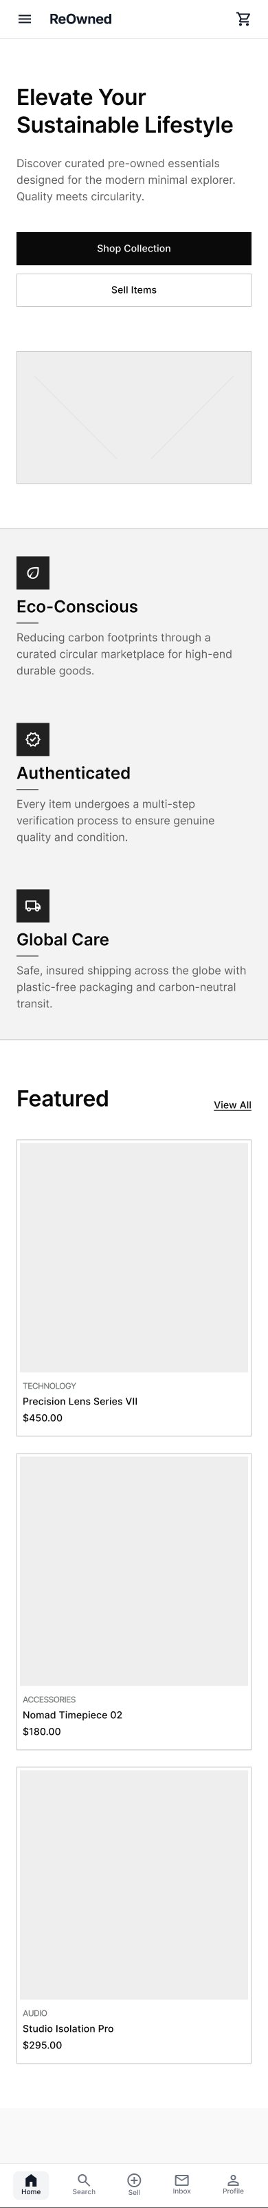
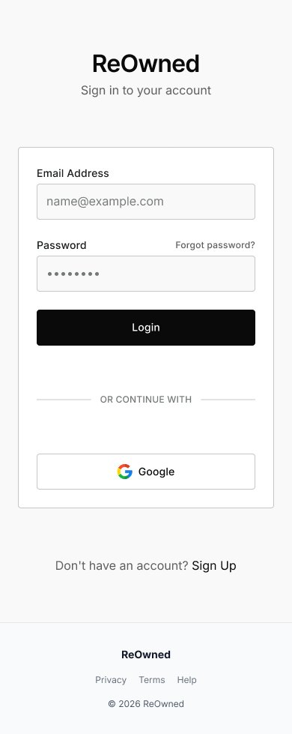
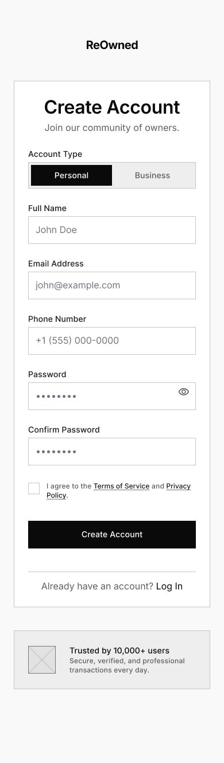
Low-Fidelity Wireframes — Onboarding
Screens 1–3: Landing, Login and Sign Up
Landing Page
Login
Sign Up

Slide 25
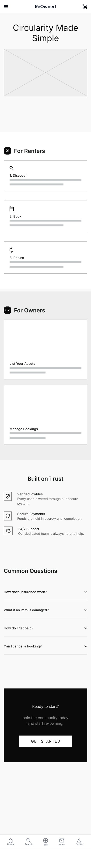
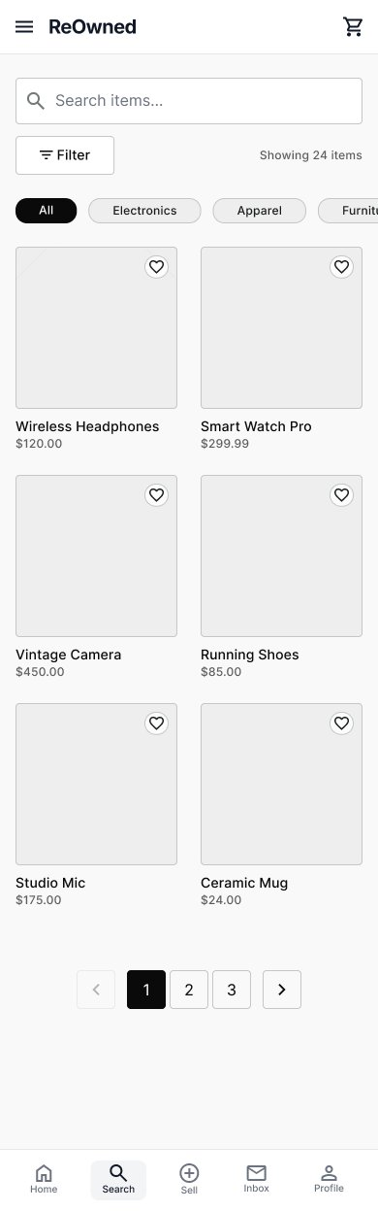
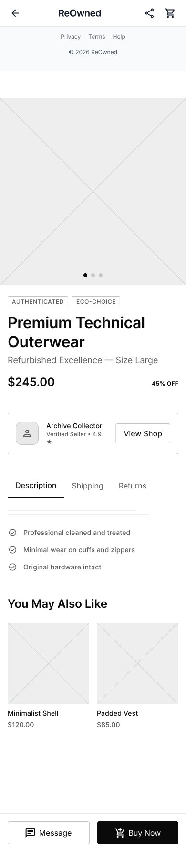
Low-Fidelity Wireframes — Discovery
Screens 4–6: How It Works, Browse and Item Detail
How It Works
Browse
Item Detail

Slide 26
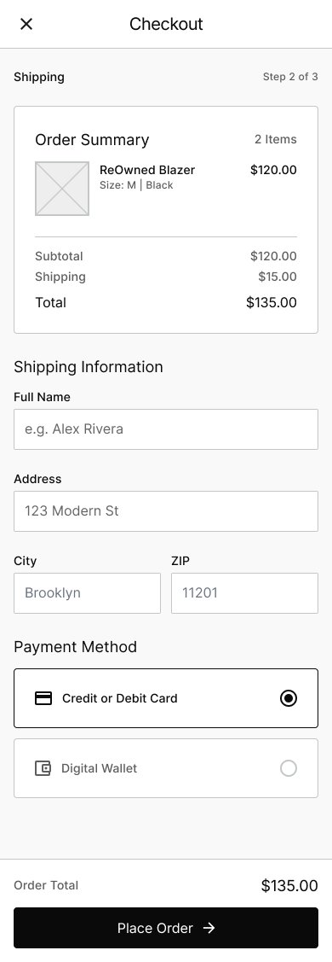
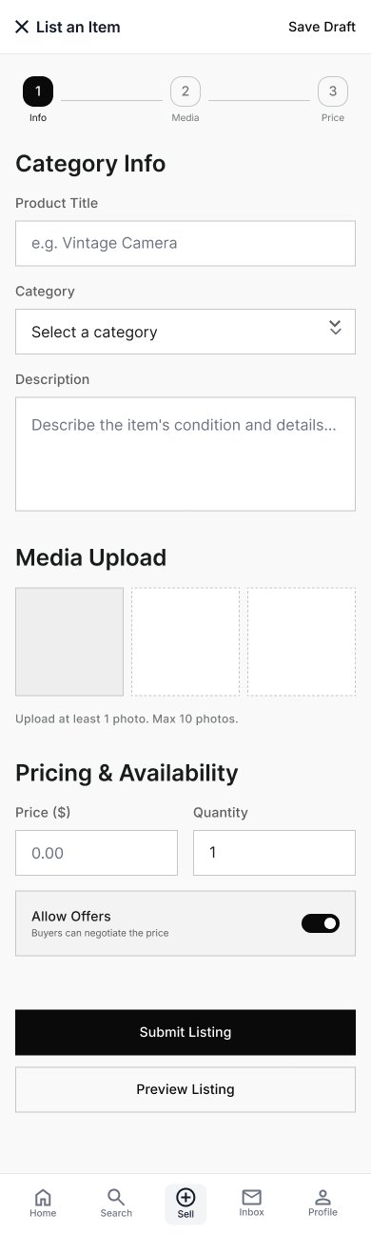
Low-Fidelity Wireframes — Transactions
Screens 7–9: Checkout, Post Listing and Create Sell
Checkout
Post Listing

Slide 27
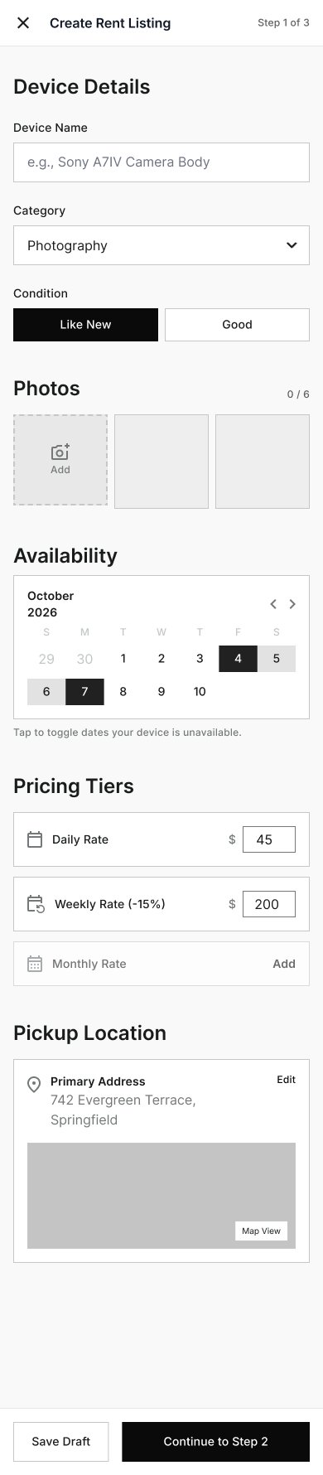
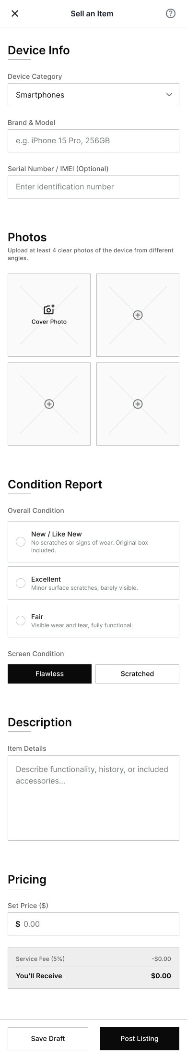
Low-Fidelity Wireframes — Listing
Screens 10–12: Create Rent, User and Admin Dashboard
Create Rent
Create Sell

Slide 28
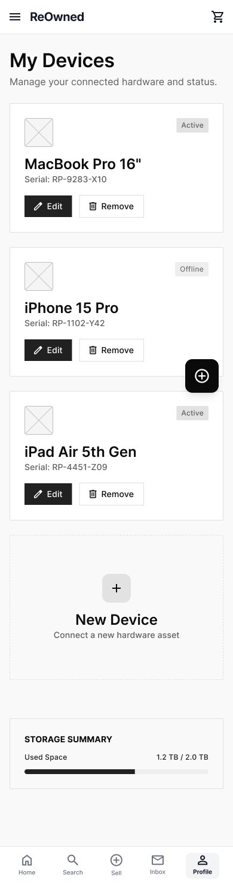
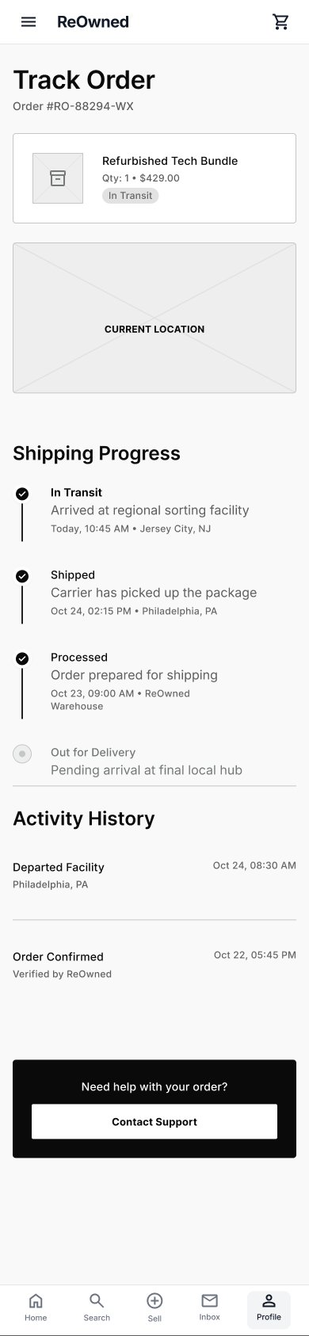
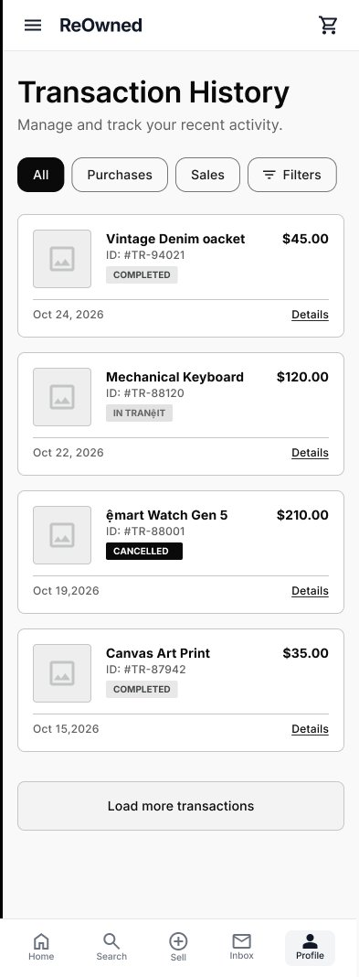
Low-Fidelity Wireframes — Account
Screens 13–15: My Devices, Order Tracking and Transactions
My Devices
Order Tracking
Transactions

Slide 29
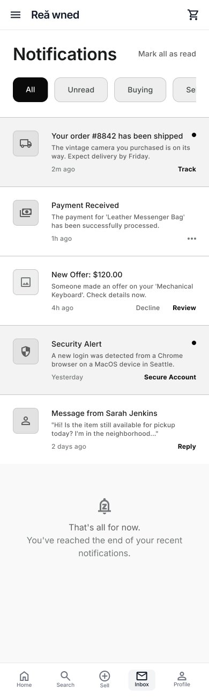
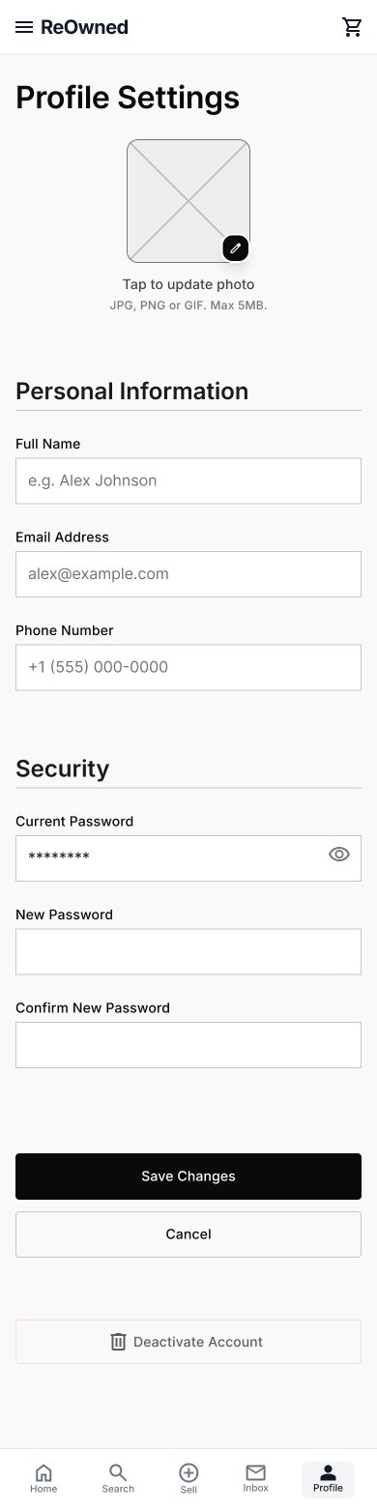
High-Fidelity Wireframes — Support
Screens 16–18: Notifications, Inspection and Settings
Notifications
Settings

Slide 30
07
SECTION 07
Brand Identity . Design System
Visual Identity
23

Slide 31
Visual Identity — Color Palette
60–30–10 rule: Off-White dominates · Navy supports · Orange accents
60%
#F7F5F0 · Soft Off-White · Base Background
The dominant surface — used for all slide backgrounds, page backgrounds, large panels and light containers
30%
10%
#003049 · Deep Navy · Structural Color
#F77F00
Navigation bars, headers, card backgrounds, section dividers, footer areas, buttons in secondary context
CTAs & highlights only
RULE: Orange (#F77F00) is NEVER used as a background for large areas. It appears ONLY on CTA buttons, key metrics, accent chips and important call-out elements — always in small doses.
32

Slide 32
Visual Identity — Typography
Montserrat for headings · Cairo for body — premium, bilingual pairing
MONTSERRAT
CAIRO
Heading Font
Body Font · Arabic & Latin
Aa Bb Cc
Aa أبت
ABCDEFGHIJKLMNOPQRSTUVWXYZ
ABCDEFabcdef 0–9 ١٢٣
abcdefghijklmnopqrstuvwxyz 0123456789
أ ب ت ث ج ح خ د ذ ر ز س ش ص ض ط ظ ع غ ف ق
Display — 40pt
Body Default — 14pt
H1 — Page Title, 28pt
Body Small — 12pt
H2 — Section, 22pt
Caption — 10pt
H3 — Card Title, 16pt
Labels — 9pt ALL CAPS
Use for: All headings, slide titles, navigation labels, stat numbers, CTA text
Use for: Paragraph text, descriptions, captions, form labels, all Arabic-language content
33

Slide 33
Visual Identity — Logo Story
The meaning behind the ReOwned mark — circularity, renewal and trust
The Circular Arrow
The orange arc with an arrowhead represents the circular economy — items moving from one owner to the next in a continuous loop. Every transaction gives something new life.
The Lowercase 'r'
Nestled inside the circular arc, the soft lowercase 'r' stands for ReOwned. Its rounded form signals approachability and trust — a community platform, not a cold corporation.
Navy Background
The deep navy (#003049) communicates authority and security — this is a platform you can trust with high-value items, verified identities and secure transactions.
Orange Accent
The vibrant orange (#F77F00) injects energy and warmth — signalling the excitement of finding (or selling) a great pre-owned item. Used sparingly to maintain impact.
The Wordmark
'ReOwned' set in a clean humanist sans-serif. The capital 'R' and lowercase 'e' create a deliberate visual break — emphasising RE as a prefix of renewal and second life.
34

Slide 34
08
SECTION 08
High-Fidelity Mobile Screens
UI Design
35

Slide 35
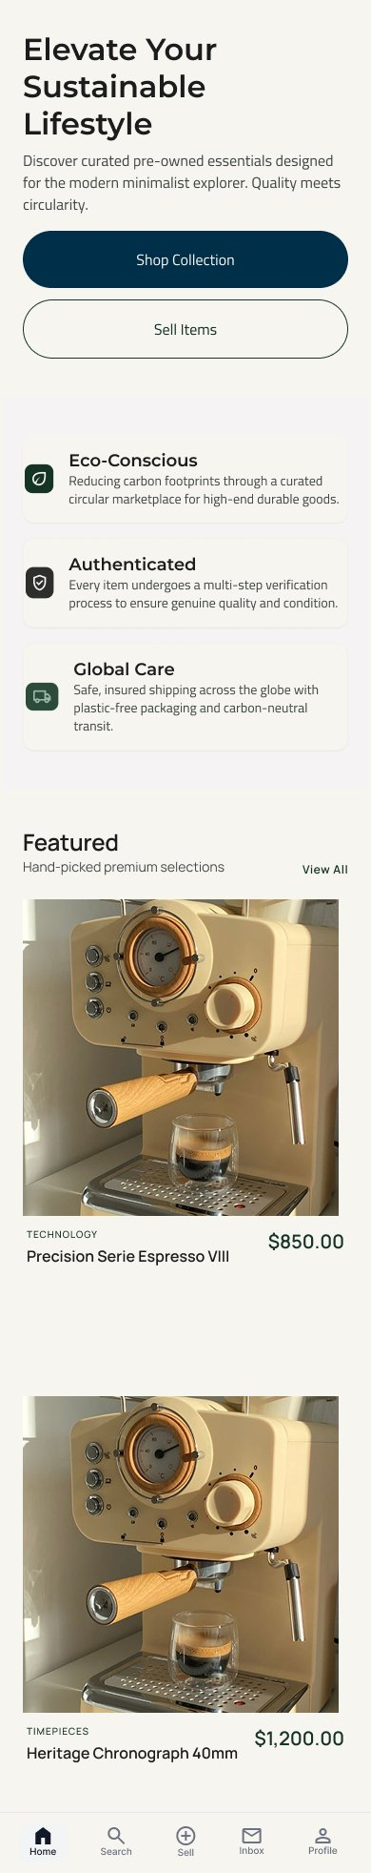
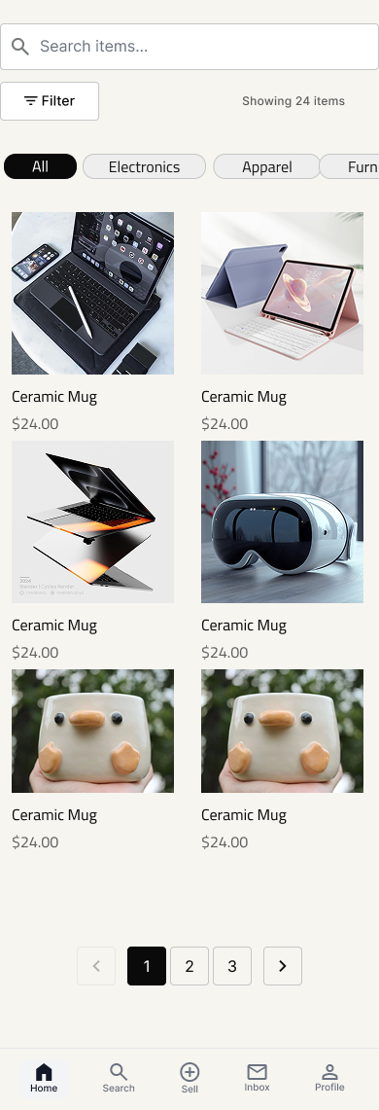
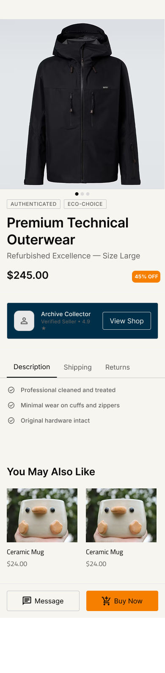
High-Fidelity UI — Discovery & Browsing
Landing, Browse, and Item Detail screens
Landing Page
Browse
Item Detail

Slide 36
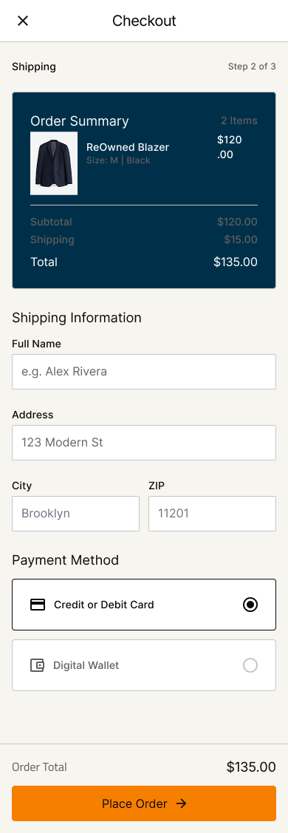
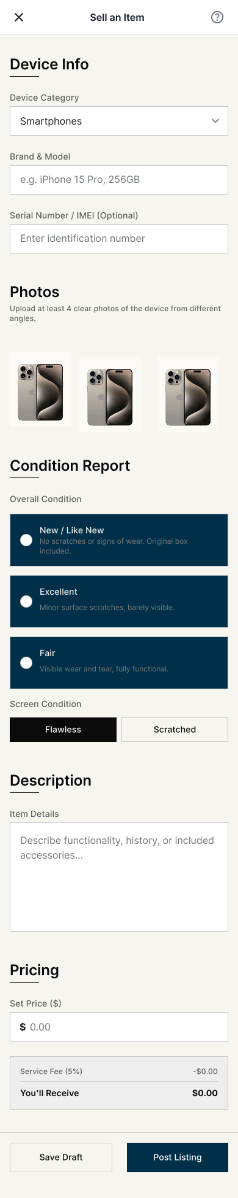
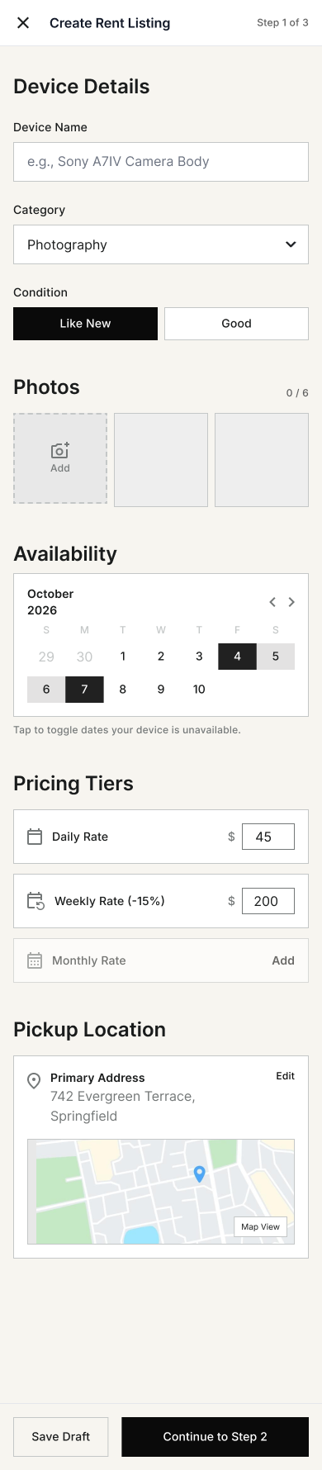
High-Fidelity UI — Transactions & Listing
Checkout, Create Sell, and Create Rent screens
Checkout
Create Sell
Create Rent

Slide 37
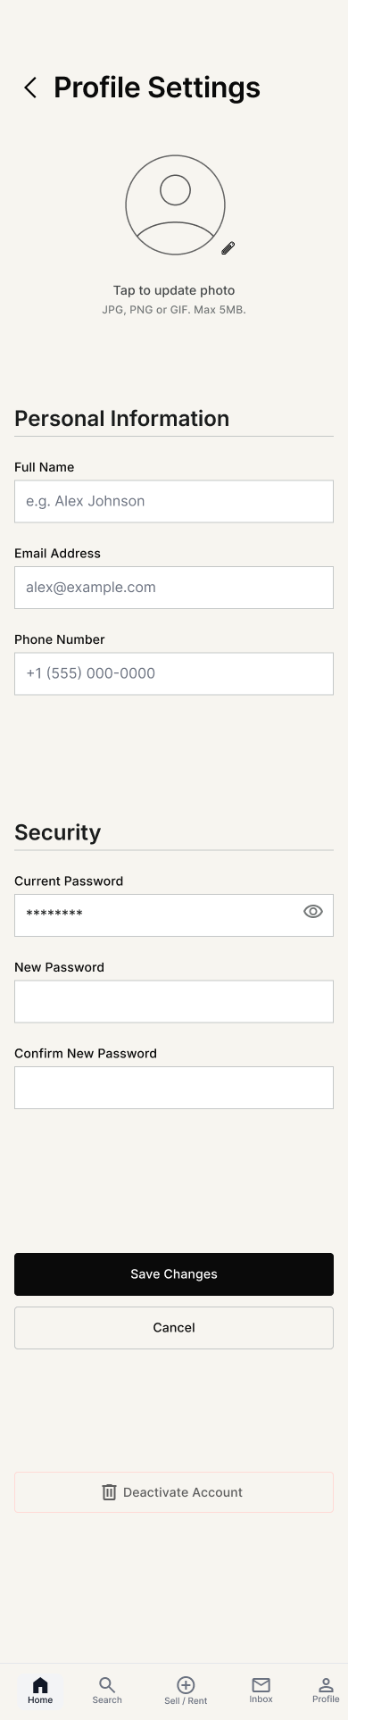
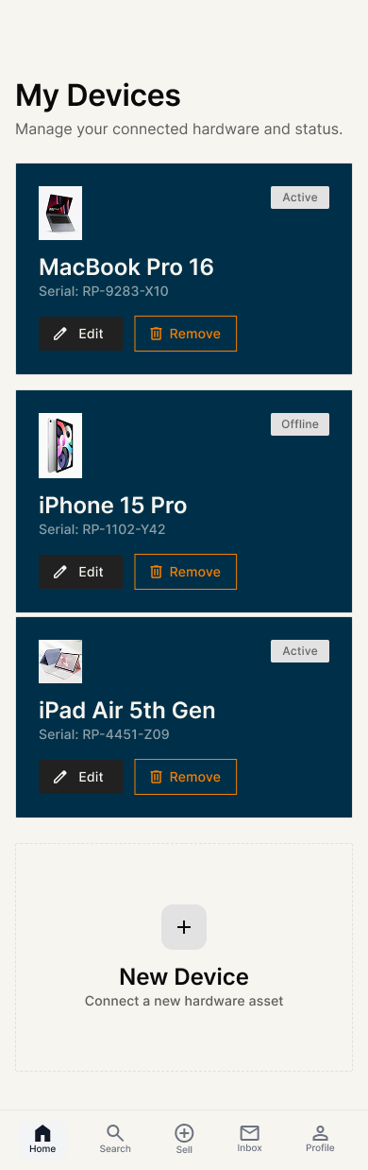
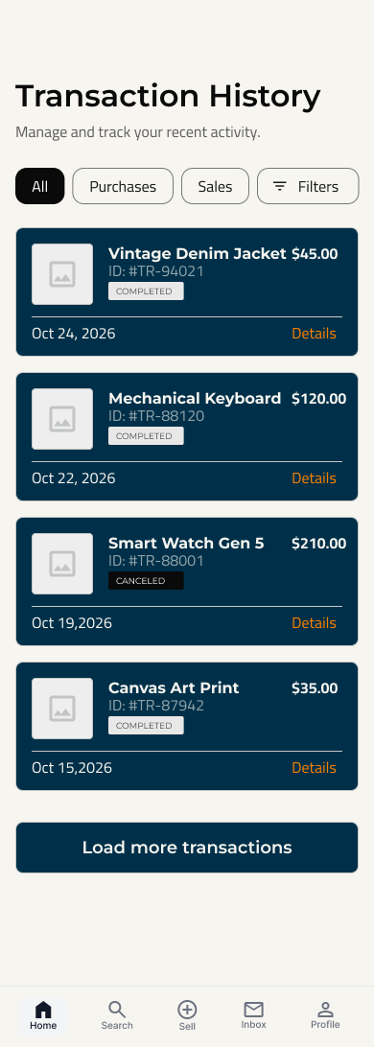
High-Fidelity UI — Management & Tracking
Dashboard, My Devices, and Transactions screens
setting
My Devices
Transactions

Slide 38
Key Takeaways & Lessons Learned
What this project taught us about designing for trust in emerging markets
01
Trust is the Product
78% of users didn't fully trust existing platforms. The most important UX work on ReOwned wasn't the visual layer — it was the trust infrastructure: ID verification, inspection, escrow deposits and dispute resolution.
02
Design for Real Behaviour
COD (Cash on Delivery) isn't a compromise — it's the preferred payment method for much of Egypt. Platforms that ignore local behaviour lose massive adoption. UX must follow real users, not idealized ones.
03
Four Mental Models, One Platform
Buyers, sellers, renters and owners have fundamentally different goals and fears. Serving all four requires careful IA to ensure each user type feels the platform was designed specifically for them.
04
Condition Transparency Drives Conversion
The single most requested feature across qualitative interviews was honest, detailed condition reporting. Our grading system — with photos, written descriptions and sub-ratings — converts trust into purchase confidence.
39

Slide 39
Project Team
ReOwned · 2024
OA
ZA
MT
Omar Ashraf Ezzat
Zeina Amr Nabil
Malak Tamer Abdelrazek
UI/UX Designer
UI/UX Designer
UI/UX Designer
Team Lead
AE
RE
Abadon Elwy Wadiaa
Rania Emam Ebrahim
UI/UX Designer
UI/UX Designer
YAT730B_GIZ4_DRT2_S1_DEPI4 · Team 1
41

Slide 40
09
SECTION 09
High-Fidelity Mobile Screens
USABILITY TEST
35

Slide 41
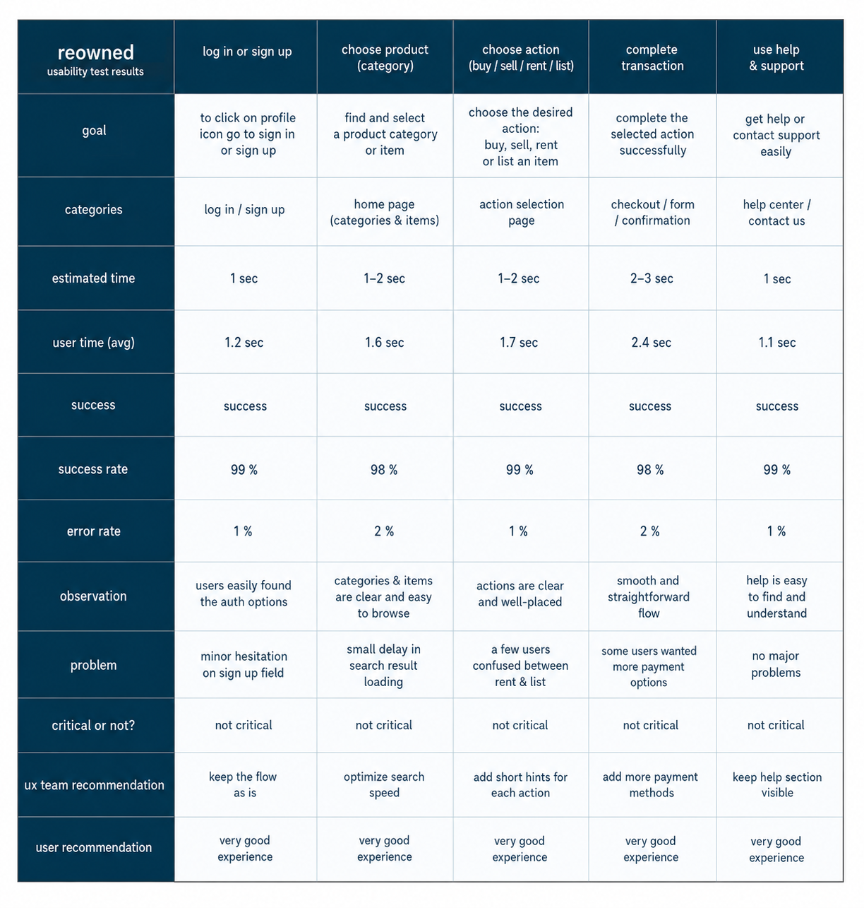
Usability Test
The usability test evaluated key user journeys within ReOwned.
• Overall success rate reached 98–99%.
• Error rates remained below 2% across tasks.
• Users completed tasks quickly and confidently.

Slide 42
Thank You
Questions & Discussion
ReOwned — Egypt's trusted circular marketplace
for buying, selling and renting pre-owned items.
Project
ReOwned
Team
YAT730B_GIZ4_DRT2_S1_DEPI4 · Team 1
42

