Slide 1
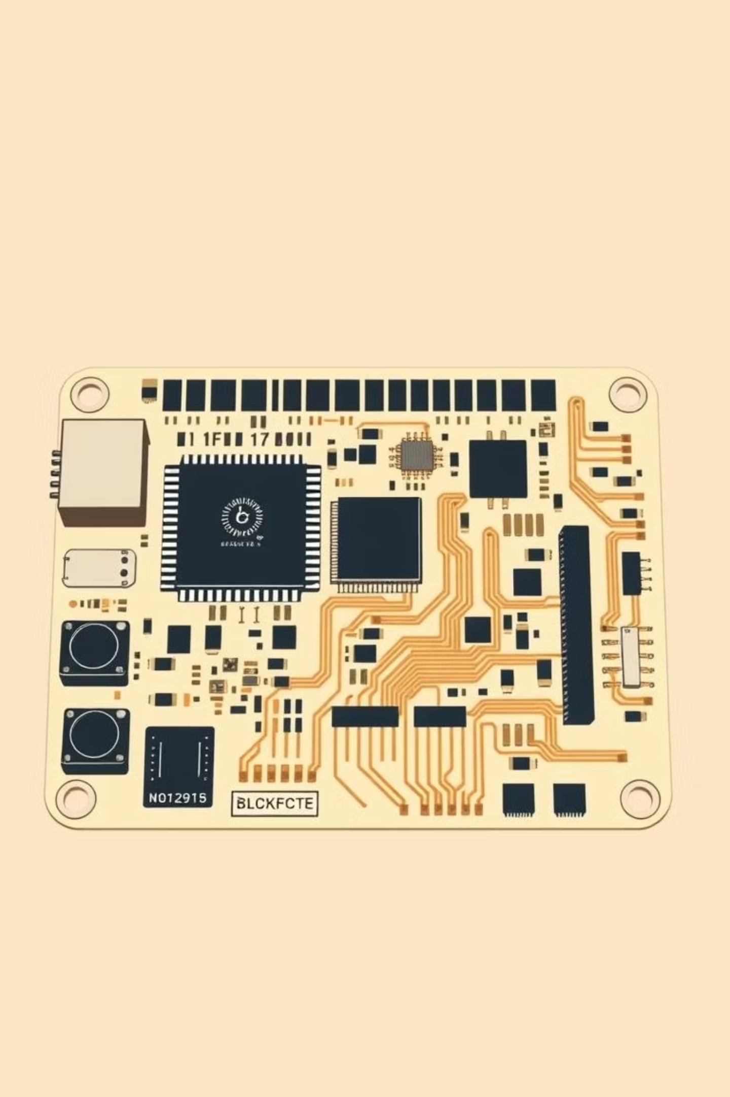
MCU Datalogger PCB Board: Graduation Project
Made By: Omar Atef
ID : 1472208251104

Slide 2
MCU Datalogger Board Main Function
This board works as a time-stamped data logger. The ATmega328P microcontroller collects data, then requests the current date and time from the RTC (DS1337) and finally stores the data in two EEPROM memory chips so the information remains saved even if power is removed.
Communication between the components is done using the I²C bus, which connects the MCU, RTC, and the two EEPROMs. The board also includes LED indicators to show power and activity, and header pins (UART/SPI/I²C) to allow programming, testing, and reading the stored data on a computer or another device.

Slide 3
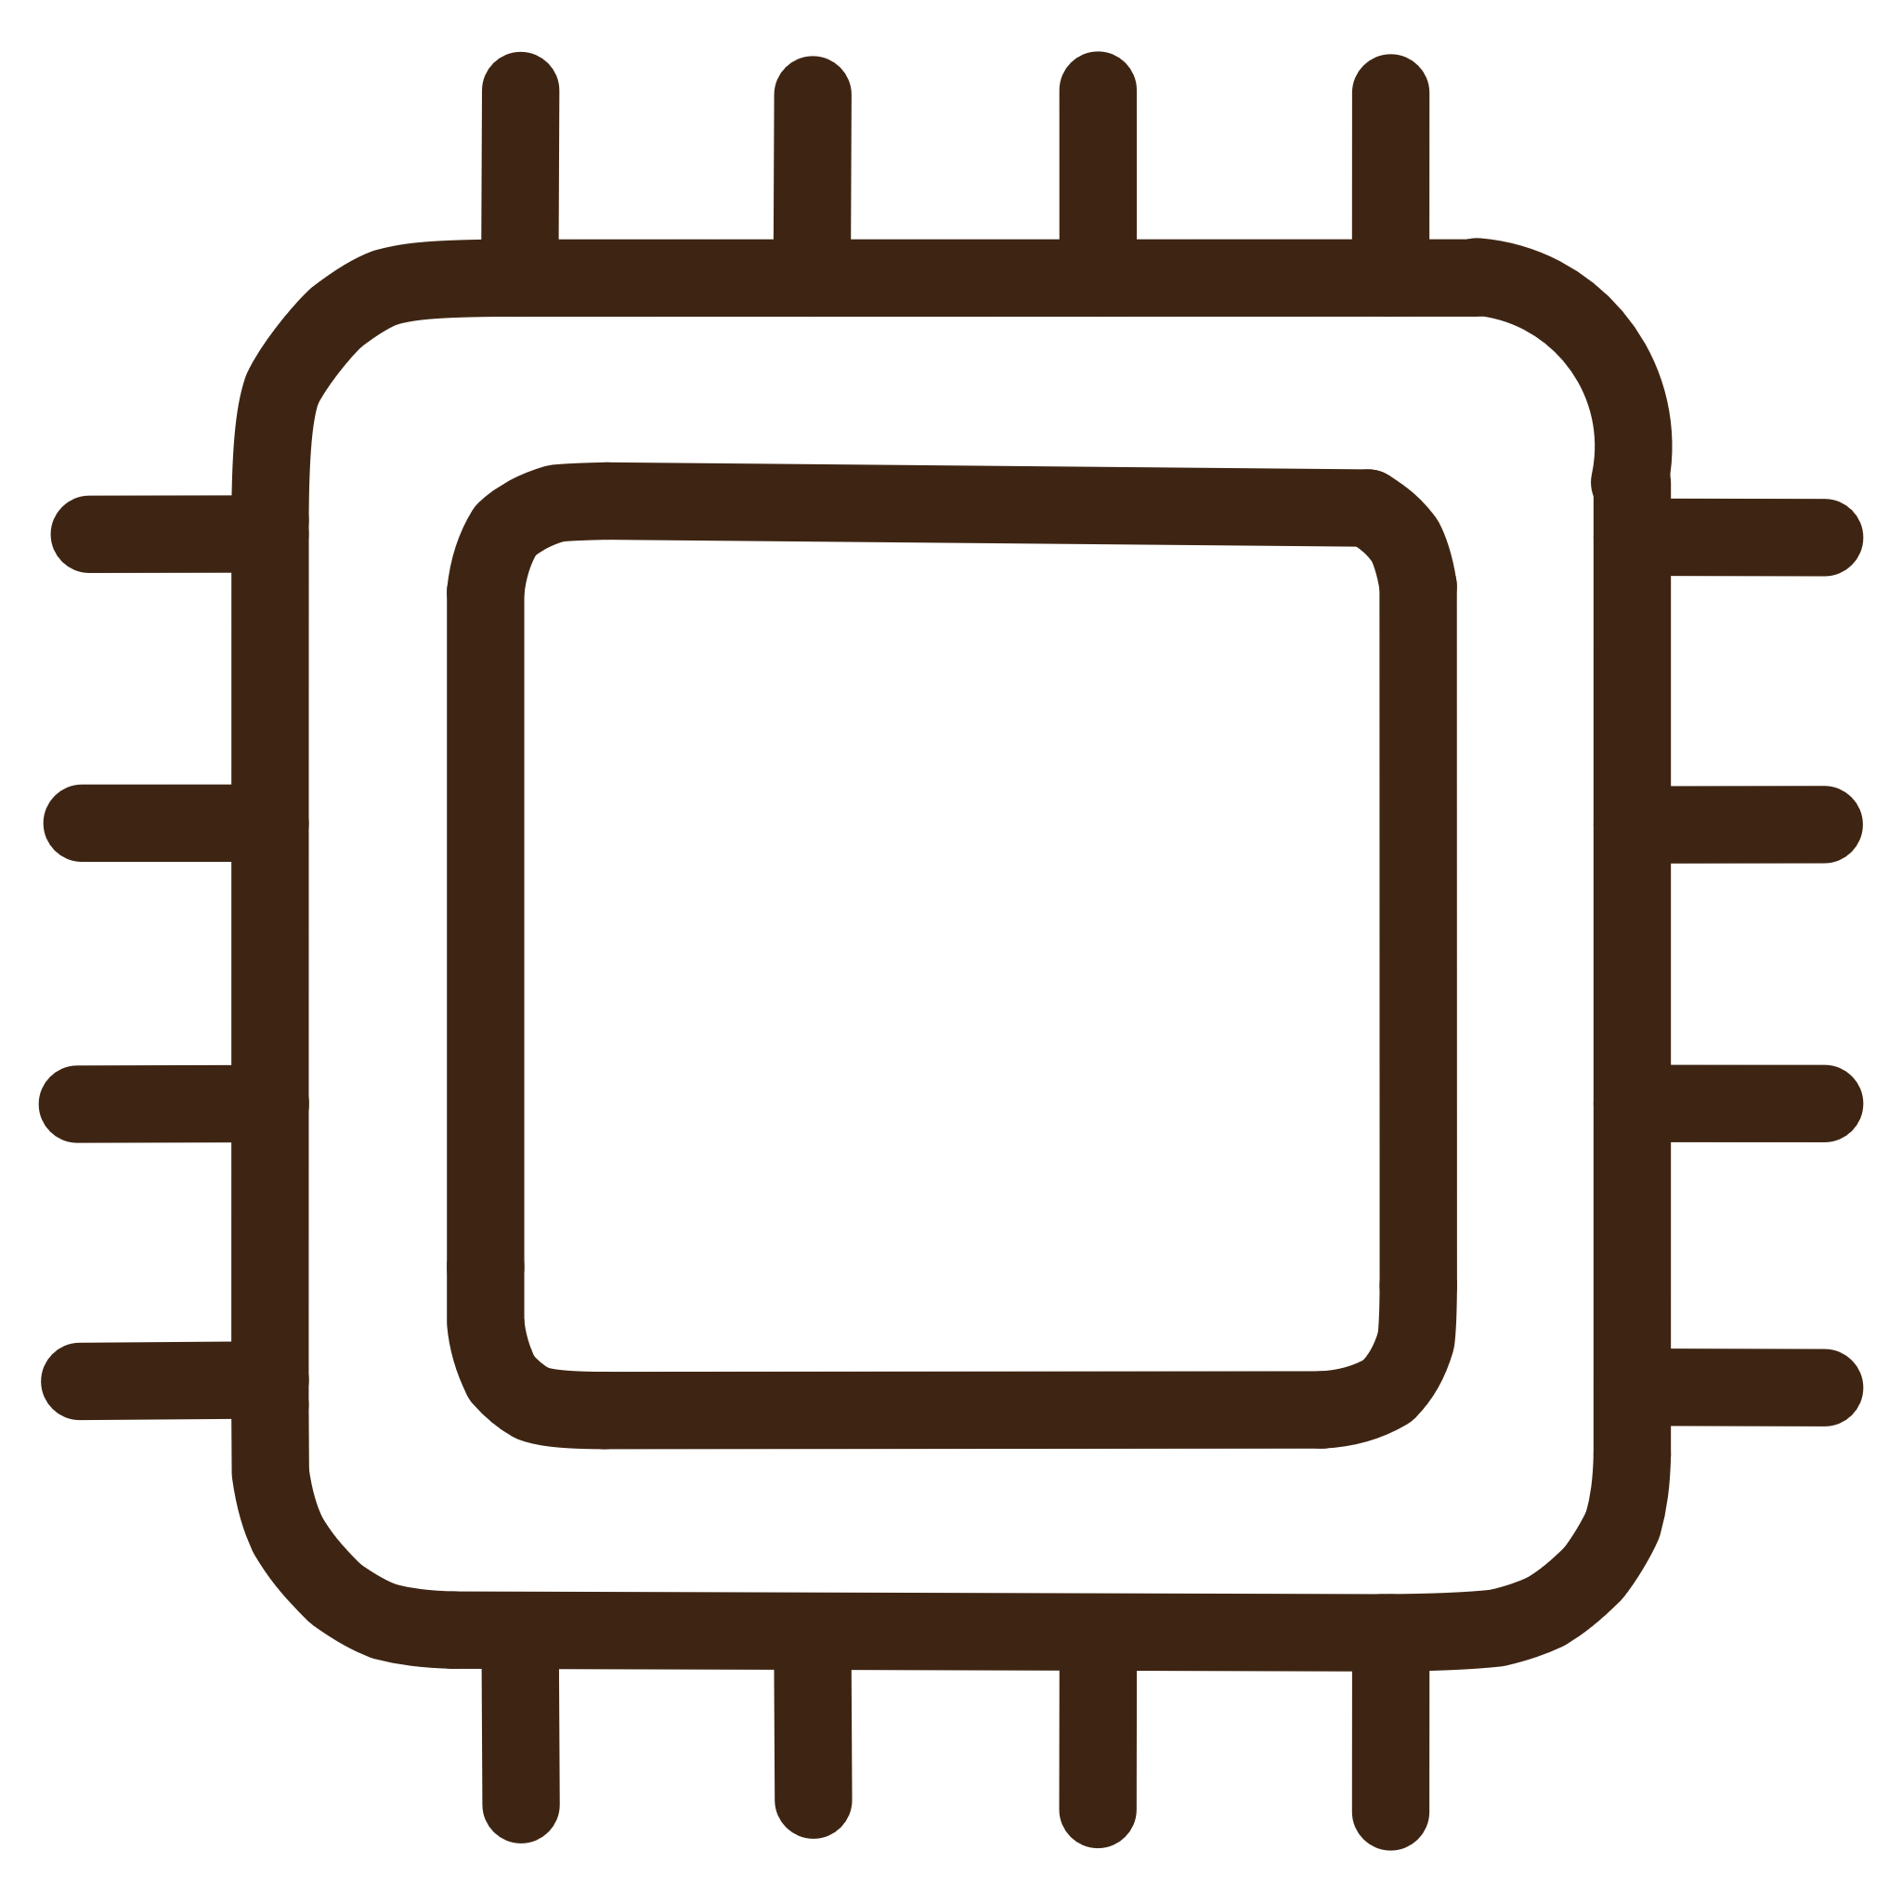



Key Components of the DataLogger Board
The board integrates several critical components to ensure reliable data logging and timekeeping.
ATmega328p-Au MC
2 EEPROM (24LC1025)
The central processing unit for all board operations.
Two external memory chips for high-capacity, non-volatile data storage.
RTC Chip (DS1337S)
Indicator LEDs
Real-Time Clock for accurate timestamping of logged data.
Visual feedback for power status and SPI clock signal activity.

Slide 4


Interfacing Capabilities
Connectors were designed to allow seamless communication with various external modules and peripherals.
UART Interface
SPI Interface
I2C Interface
Universal Asynchronous Receiver-Transmitter for serial data exchange.
Serial Peripheral Interface for high-speed synchronous communication.
Inter-Integrated Circuit bus for connecting low-speed peripherals.

Slide 5
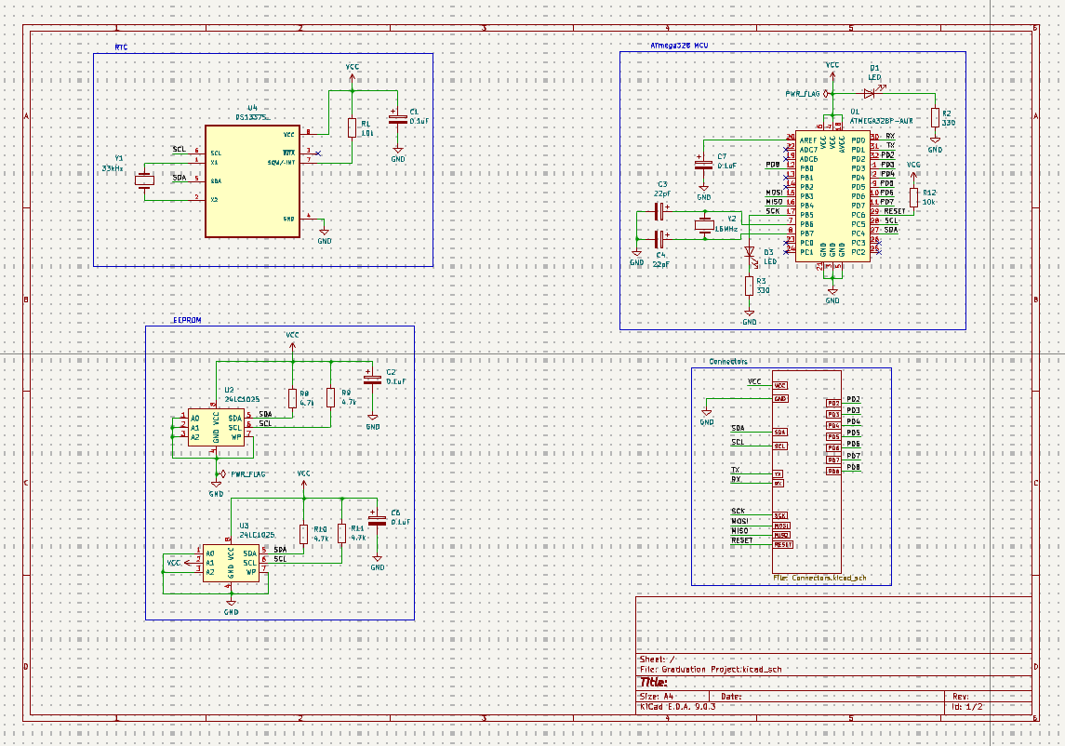

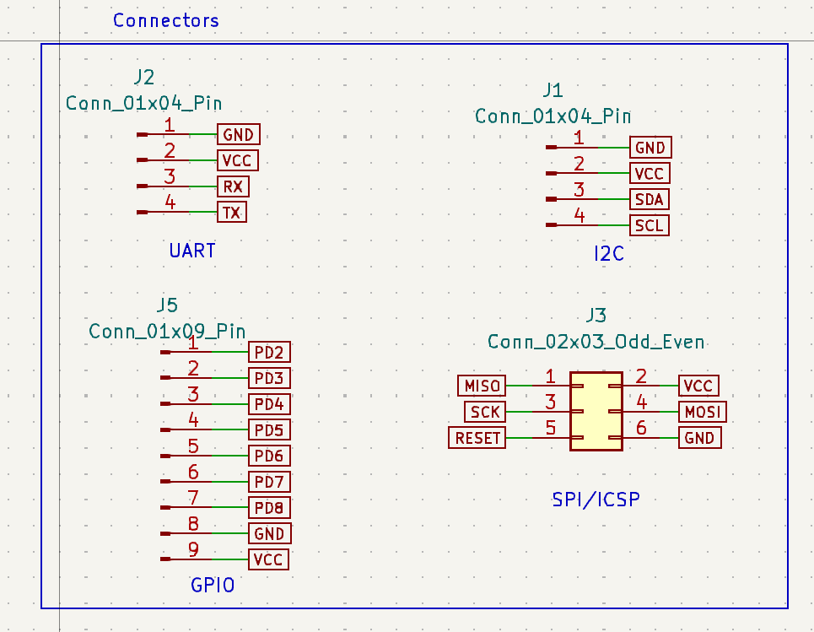
Project Objectives: Schematic Design
The schematic phase focused on defining the electrical connections and component placement logically.
Component Integration
Interfacing Connectors
Successfully connecting the MCU, EEPROMs, and RTC chip.
Creating dedicated connectors for UART, SPI, and I2C modules.

Slide 6
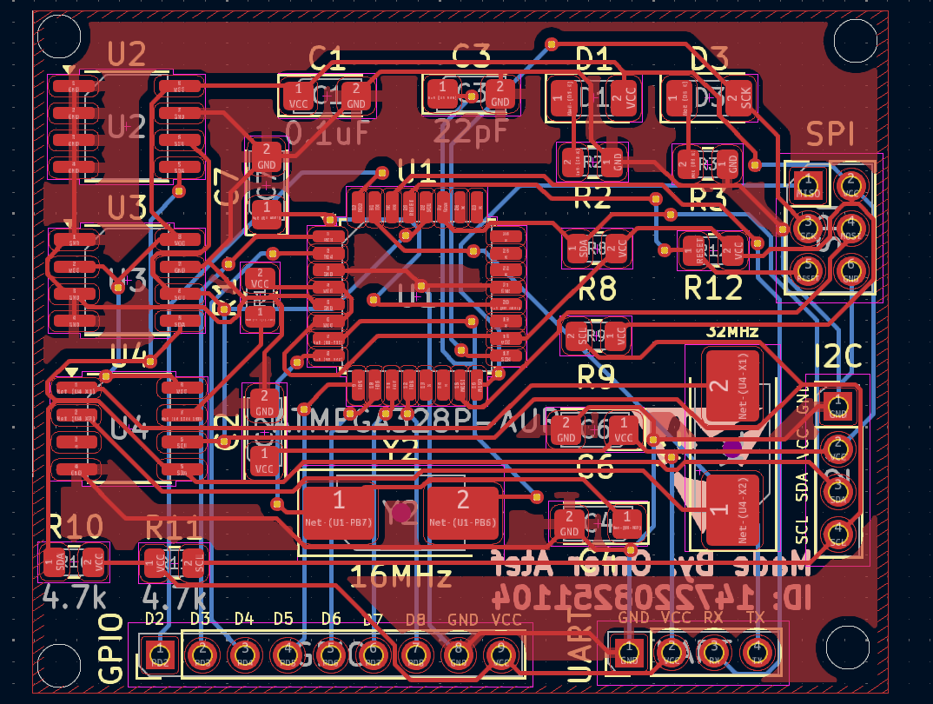
Layout Design: Physical Constraints and Aesthetics
The PCB layout required careful consideration of component placement, routing, and silkscreen details.

Slide 7
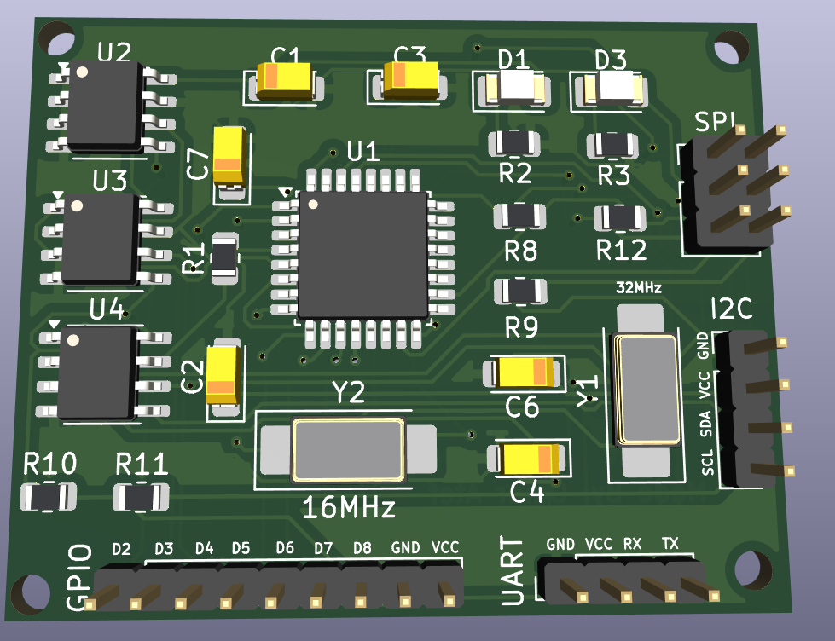
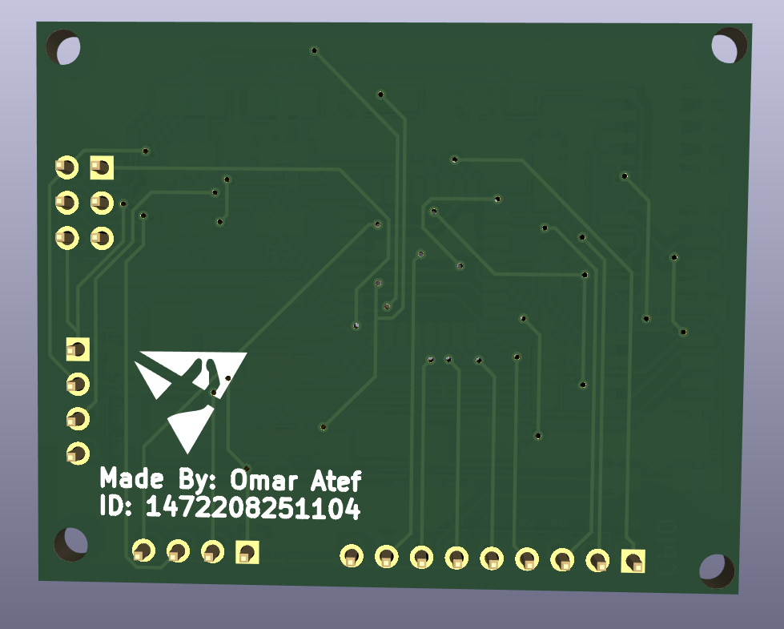
Visualizing the Final Board
A look at the completed design, ready for production and assembly.

Slide 8
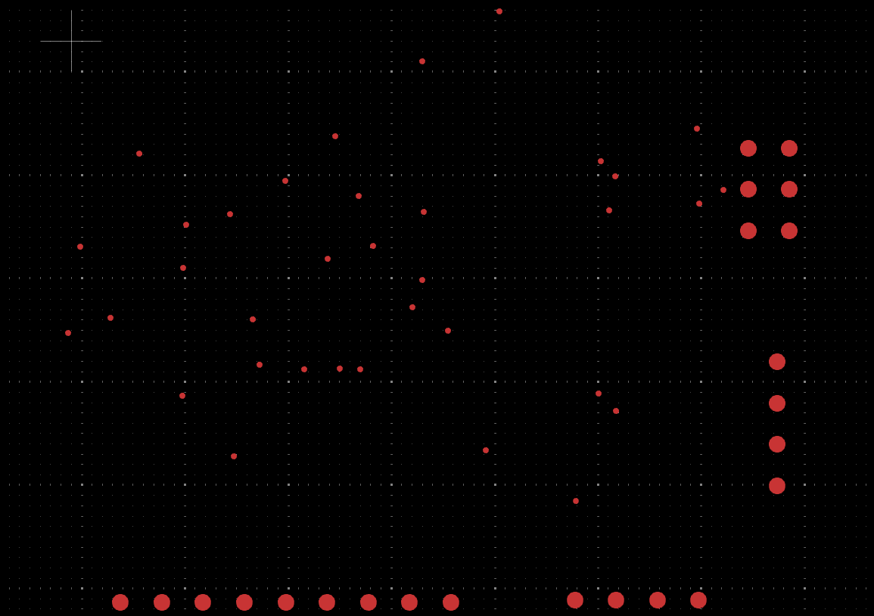
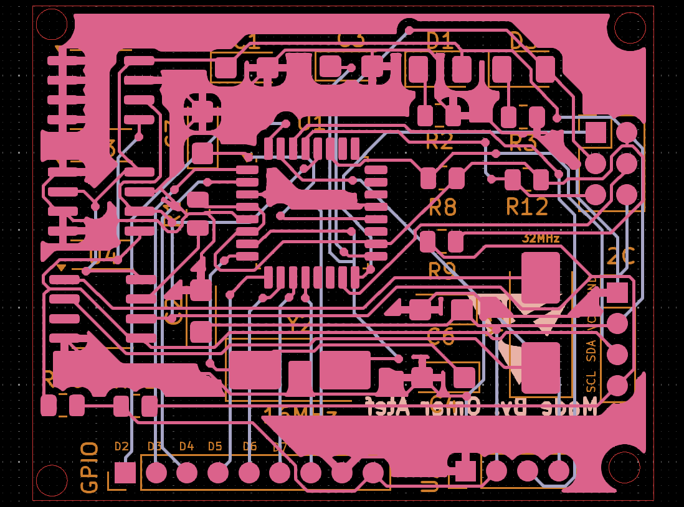
Manufacturing Preparation: Final Files
The final stage involved generating the necessary files for professional PCB manufacturing.
Drill Files
Gerber Files
Generating precise drill information for component holes and vias.
Outputting all layer data required for PCB fabrication.

Slide 9
Thank You For Listening!

