Slide 1
Agenda
1. Architecture
2. Admin Creation Flow
6. Auditing Service
3. Identity Provider Flow
7. Delegation
4. LDAP Provisioning Flow
8. Composite Roles
5. Signup Flow
9. User Blocking

Slide 2
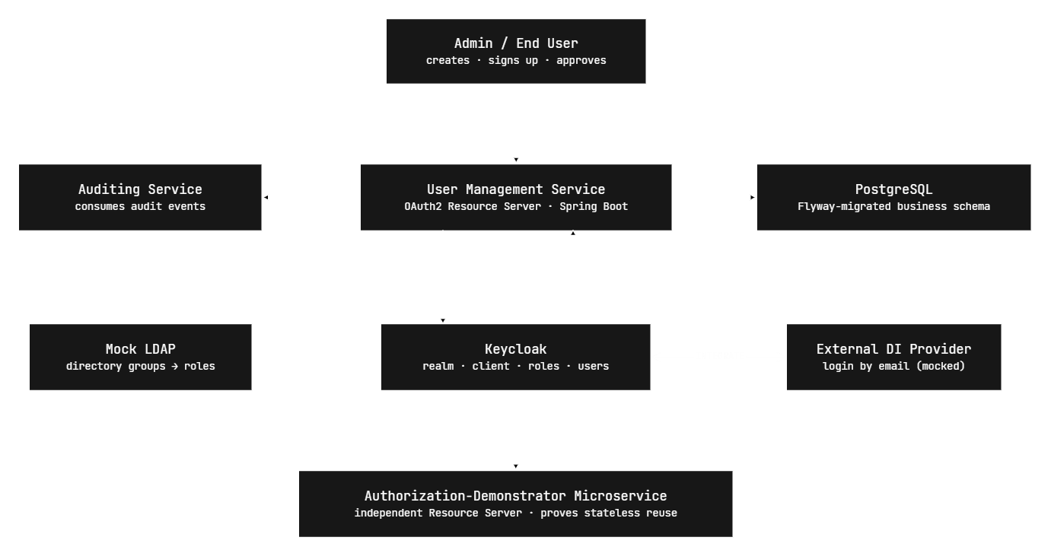
1. Architecture

Slide 3
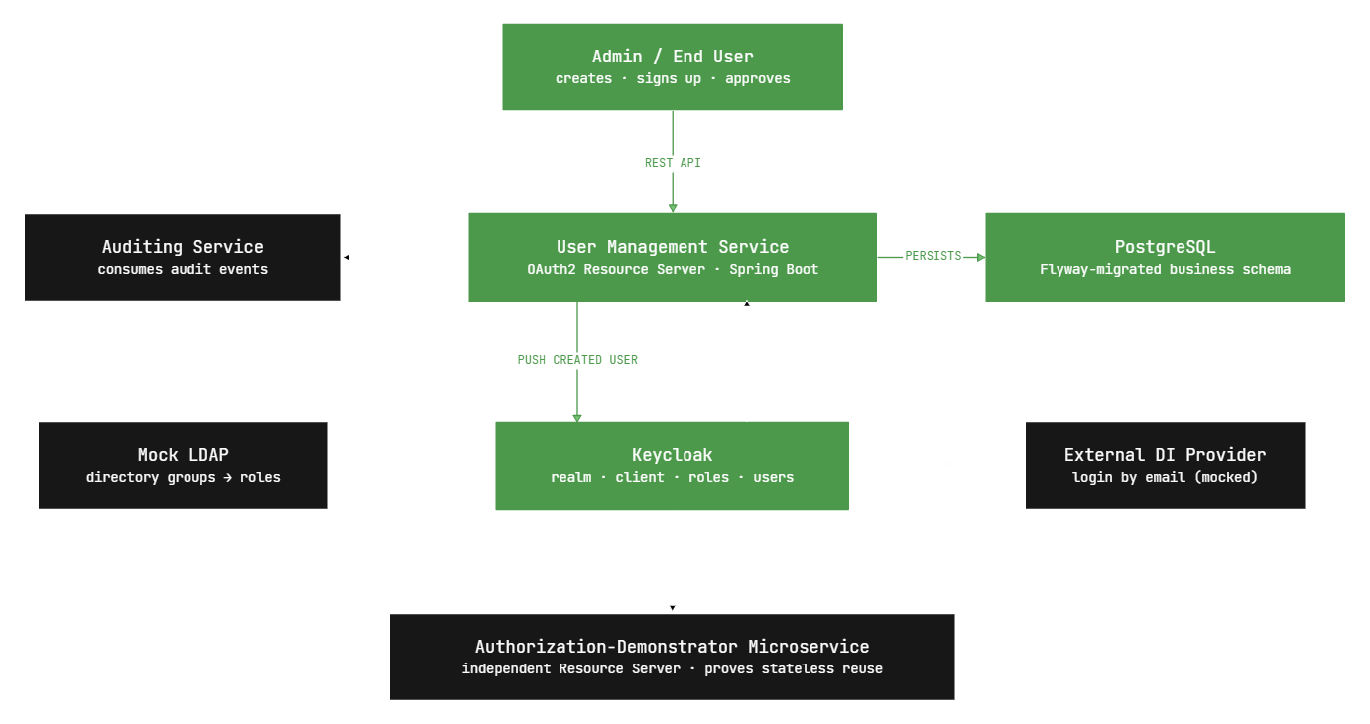
2. Admin Creation Flow

Slide 4
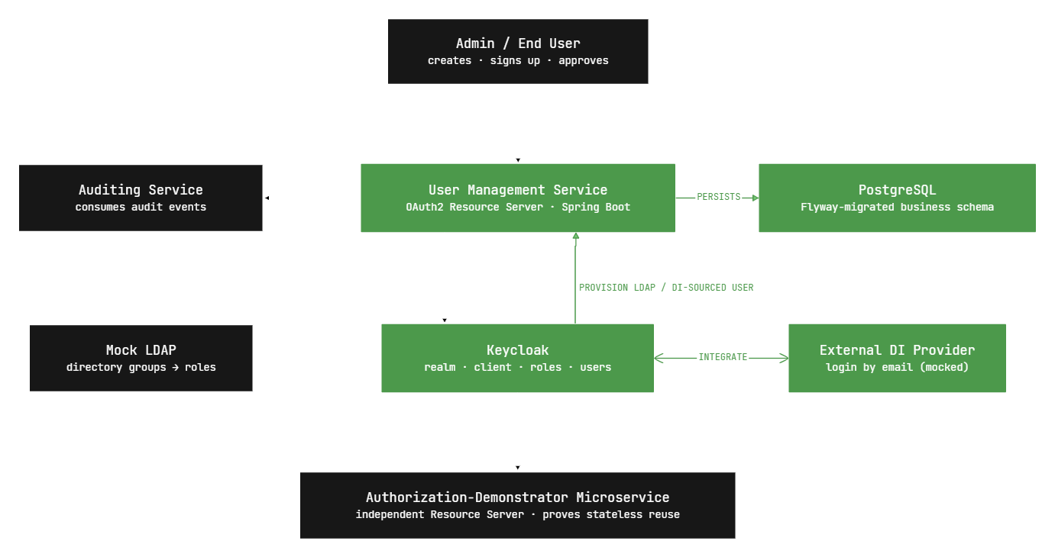
3. Identity Provider Flow

Slide 5
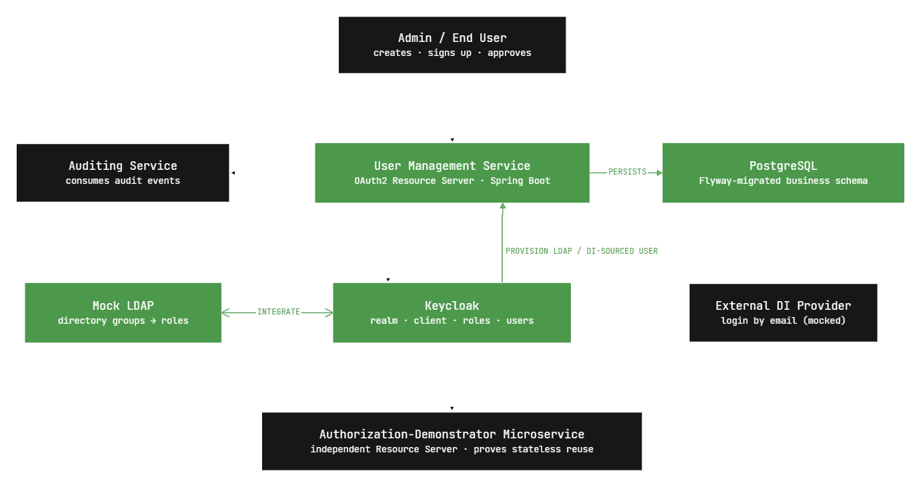
4. LDAP Provisioning Flow

Slide 6
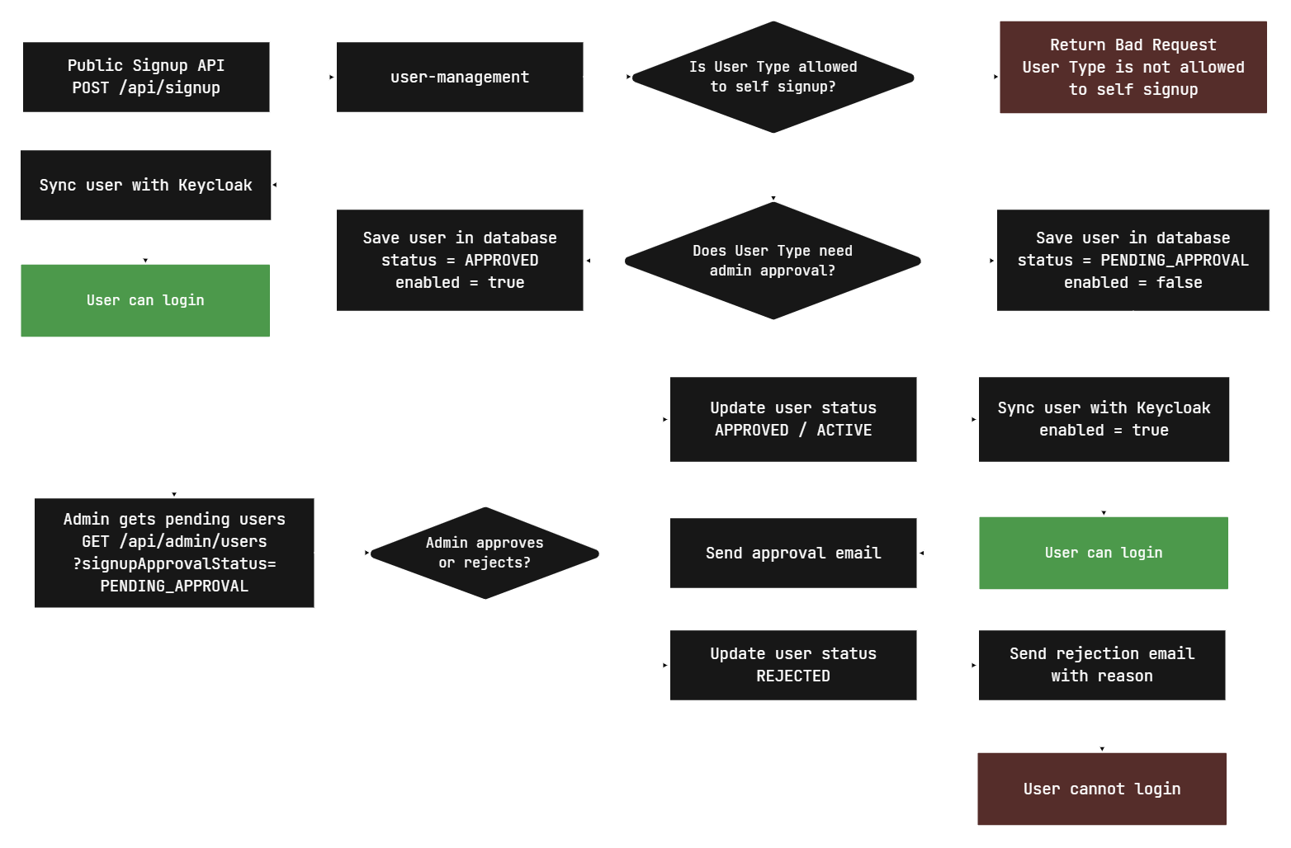
5. Signup Flow

Slide 7
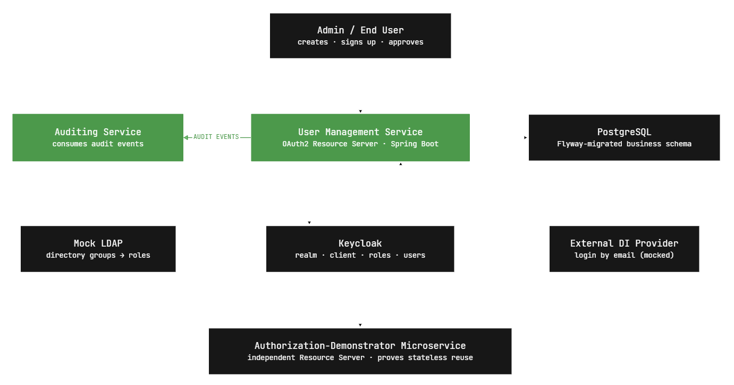
6. Auditing Service

Slide 8
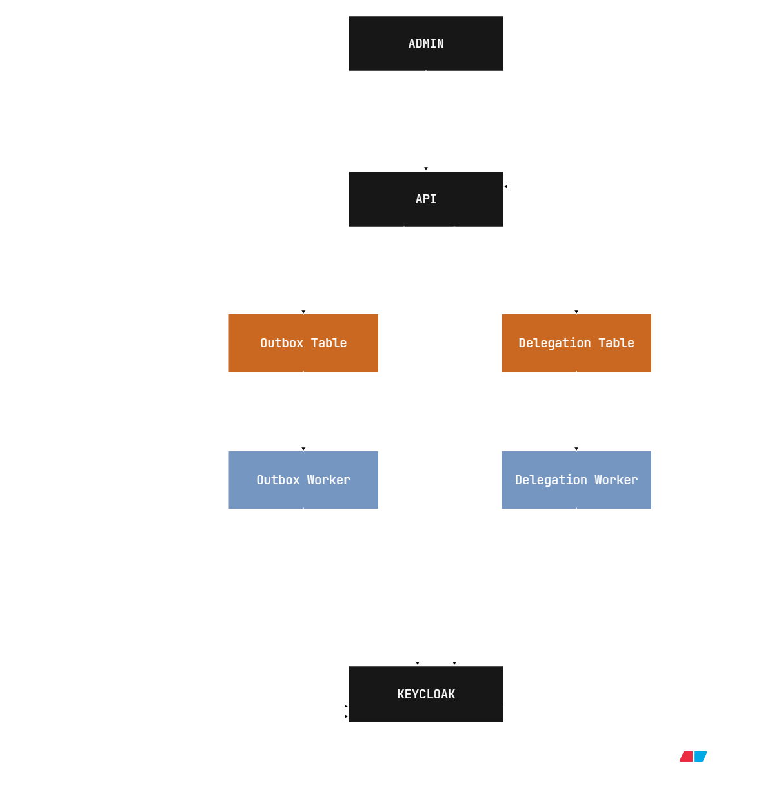
7. Delegation

Slide 9
8. Composite Roles
Flyway migration creates the role-sync tables.
Roles and permissions are initially marked as PENDING.
Role Sync Worker checks for pending records.
Pending roles and permissions are created in Keycloak.
Records are updated to SYNCED after successful migration.
Composite roles are created and linked automatically.
Enables dynamic synchronization without manual Keycloak configuration.

Slide 10
9. User Blocking
Keycloak tracks failed login attempts.
User is blocked after reaching the configured failed-attempt limit.
Keycloak publishes a USER_BLOCKED event through Kafka.
User Management verifies the user's status through the Keycloak Admin API.
The user is marked as disabled in the User Management database.
USER_UNBLOCKED events synchronize the user status again.
Keeps Keycloak and User Management user status synchronized.

Slide 11
THANK YOU!

