Slide 1









Complete Blood Count Using RAG
Omar Khadrawy

Slide 2

Presentation Objective
Extract CBC report data and identify important medical parameters
Store these key parameters in a structured, specialized medical database
Use patient-specific CBC values to search for relevant medical literature and clinical protocols
Literature and protocols are stored in the RAG pipeline’s vector database
Retrieve tailored recommendations to support doctor decision-making

Slide 3

Table of contents
01
04
CBC Report
Retrieval
02
05
RAG Pipeline
Generation
03
06
Conclusion
MultiVector Store

Slide 4

CBC Report
Stands for Complete Blood Count.
A common blood test that evaluates overall health.
Measures key blood components: Red Blood Cells (RBCs), White Blood Cells (WBCs), Hemoglobin, Hematocrit, and Platelets.

Slide 5
CBC Report
Importance of CBC Report
Anemia: Detects low red blood cells or hemoglobin.
Infections: Identifies high white blood cell counts.
Immune Disorders: Reveals abnormal immune cell patterns.
Blood Cancers: Flags unusual blood cell counts or types.

Slide 6
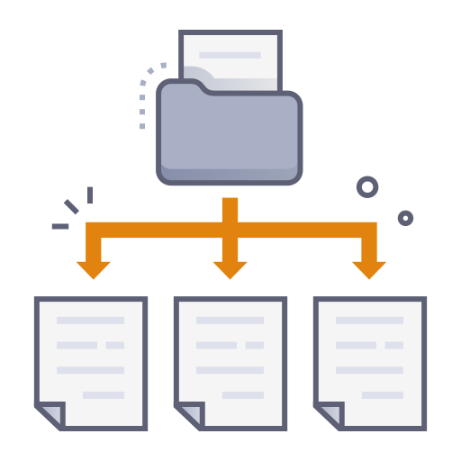
RAG pipeline
Data Collection & Chunking
Retrieved medical documents from trusted sources:
NCBI, WebMD, and Medicine.com
Focused on documents related to CBC and blood disorders
Split long documents into smaller, manageable chunks
Added overlapping between chunks to preserve context

Slide 7

RAG pipeline
Multi Index Vector
Summarized each document to create a precise, representative chunk
Stored these summaries in a multi-index vector store
Used similarity search to match the query with stored summaries
If semantic similarity is found, retrieved the original full document
RAG then generates an answer using the original document as context

Slide 8

RAG pipeline
Corrective RAG
Retrieved documents from the vector store using the query
Evaluated each document for relevance to the question
If relevant → Passed to the generation step directly
If not relevant:
Rewrote the summary to improve semantic matching
Used Tavily Web Search API to fetch external data
Retrieved new documents from the web
Final generation used the most relevant external content

Slide 9
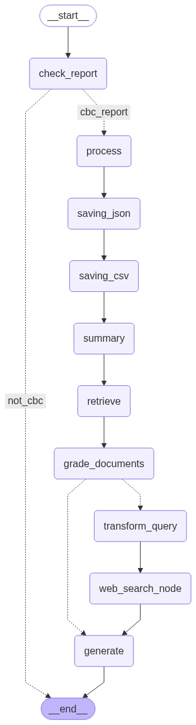
pipeline Implementation
Start: Entry point of the pipeline.
check_report: Validates the input file and checks if it contains a CBC report.
cbc_report: If a CBC report is found, it triggers the processing sequence.
process: Extracts and structures relevant medical data from the report.
saving_json: Saves the extracted data in a structured JSON format.
saving_csv: Converts and stores the data in CSV format for analysis.
summary: Generates a clean summary of the report contents.

Slide 10
pipeline Implementation
retrieve: Uses the summary to fetch relevant documents from the vector store
grade_documents: Evaluates the relevance of the retrieved documents to the query
transform_query (if needed): Reformulates the query if no relevant document is found
web_search_node: Triggers a fallback web search to find external information
generate: Produces a final response based on retrieved or searched content
end: Terminates the process after generation or if no data is found

Slide 11






Thanks!
Notes:
1.7.2013
‹#›

