Slide 1
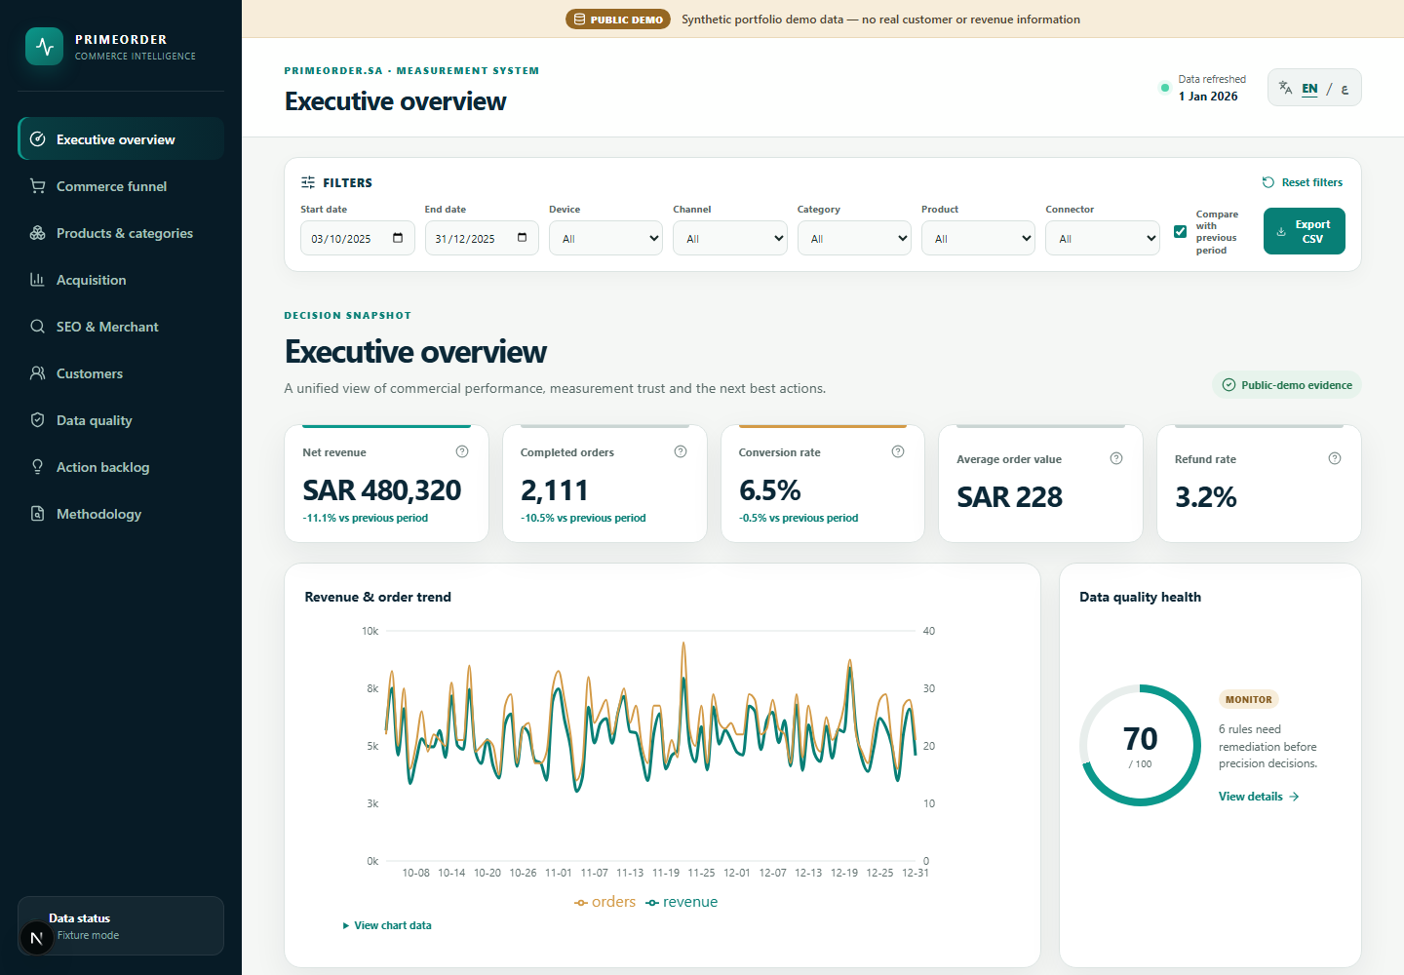
MEASUREMENT PORTFOLIO
Commerce intelligence
you can defend.
A privacy-separated, bilingual system for turning source-specific commerce signals into tested decisions.
9 DASHBOARD ROUTES
ENGLISH + AR/RTL
Omar Ba Jamel
PRIMEORDER COMMERCE INTELLIGENCE
OMAR BA JAMEL
01
Notes:
Portfolio narrative built from verified project evidence.
[Sources]
- assets/screenshots/01-executive-overview-desktop.png (synthetic public-demo evidence)
- docs/testing/TEST_REPORT.md
[/Sources]

Slide 2
01 | KPI AUTHORITY
Define ownership
before calculating.
COMMERCE
Completed orders, revenue, refunds and cost
GA4
Sessions, funnel behavior and tracked purchases
DIAGNOSTIC SOURCES
Ads, search, merchant health and Clarity
The dashboard shows variance and uncertainty - it does not hide them.
One business. Distinct measurement responsibilities.
PRIMEORDER COMMERCE INTELLIGENCE
OMAR BA JAMEL
02
Notes:
Portfolio narrative built from verified project evidence.
[Sources]
- assets/screenshots/01-executive-overview-desktop.png
- docs/architecture/KPI_DICTIONARY.md
- docs/architecture/SOURCE_AUTHORITY_MATRIX.md
[/Sources]

Slide 3
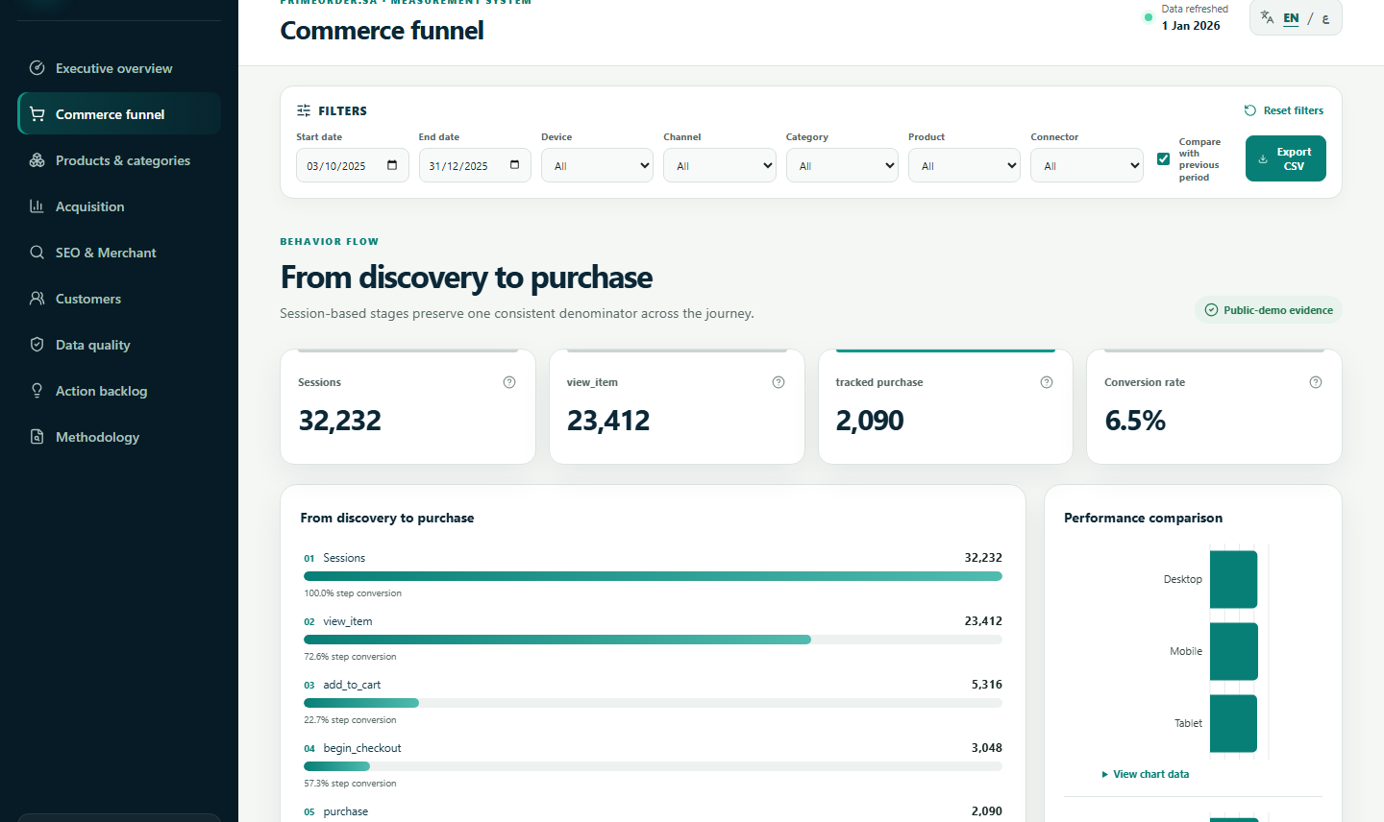
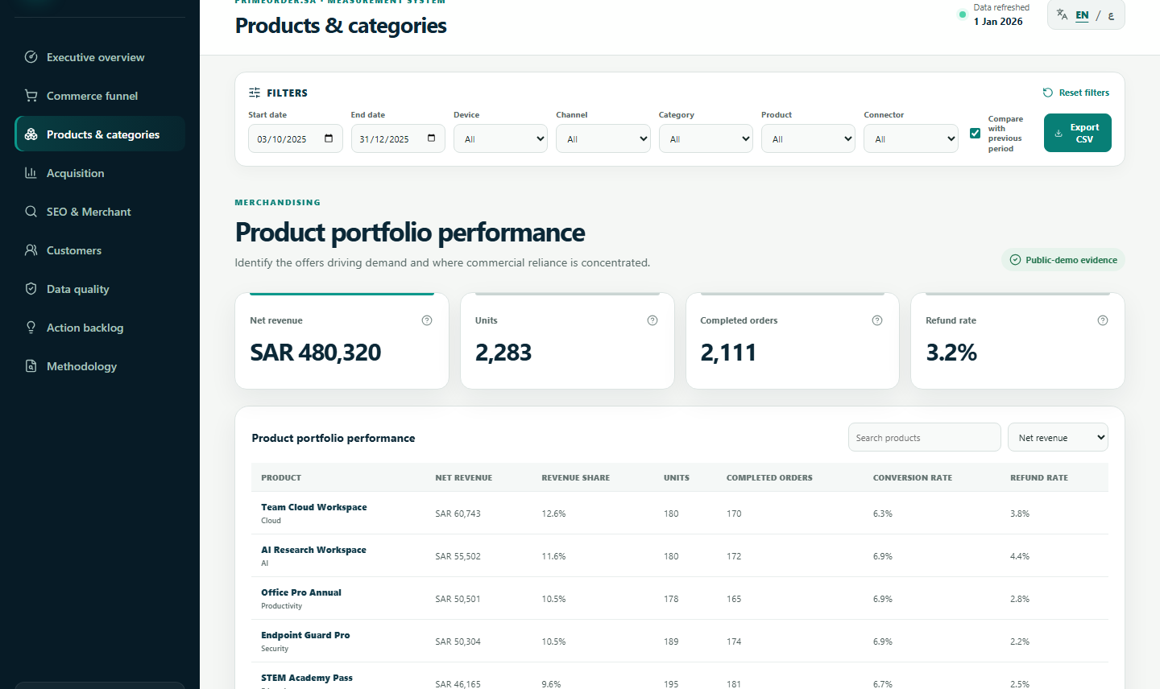
02 | BEHAVIOR TO PRODUCT
Connect event quality
to product decisions.
365
days of deterministic synthetic evidence
11
specified ecommerce events
12
products with category reconciliation
Reproducible by design
Fixed seed 20250301 keeps analysis, tests and screenshots aligned across the public release.
Funnel evidence only becomes useful when its tracking contract is testable.
PRIMEORDER COMMERCE INTELLIGENCE
OMAR BA JAMEL
03
Notes:
Portfolio narrative built from verified project evidence.
[Sources]
- assets/screenshots/02-funnel-analysis-desktop.png
- assets/screenshots/03-product-performance-desktop.png
- docs/measurement/GA4_MEASUREMENT_SPEC.md
- docs/testing/TEST_REPORT.md
[/Sources]

Slide 4
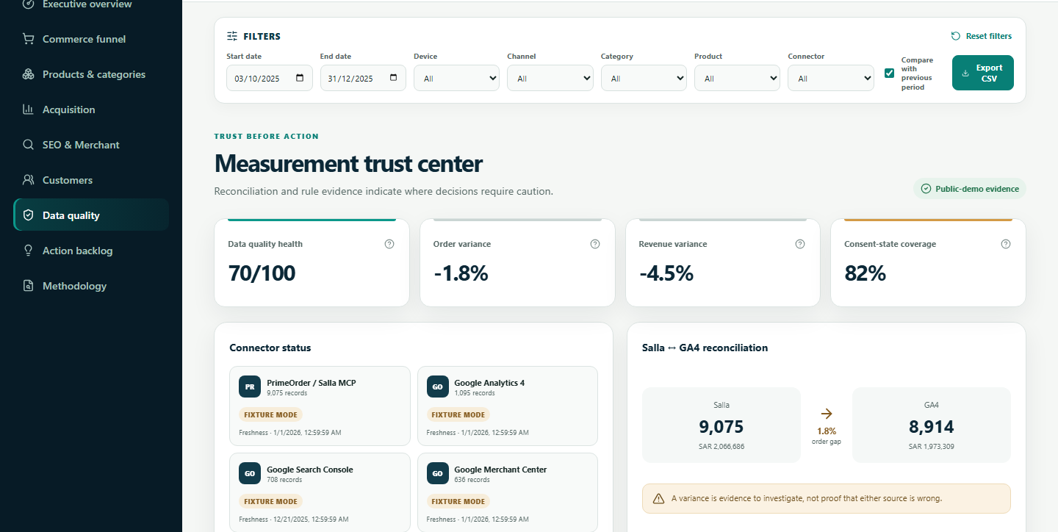
03 | QUALITY SYSTEM
Make uncertainty visible.
Quality, reconciliation and consent are part of the product - not appendix work.
6 READ-ONLY
CONNECTORS
DUCKDB + DBT
SEMANTICS
FASTAPI
READ-ONLY
STATIC
DASHBOARD
6
28
78
intentional anomaly classes
dbt models
data tests
PRIMEORDER COMMERCE INTELLIGENCE
OMAR BA JAMEL
04
Notes:
Portfolio narrative built from verified project evidence.
[Sources]
- assets/screenshots/04-data-quality-reconciliation-desktop.png
- docs/architecture/ARCHITECTURE.md
- docs/testing/TEST_REPORT.md
[/Sources]

Slide 5
04 | RELEASE EVIDENCE
Ship evidence,
not uplift claims.
Every headline below was executed against the release candidate.
117/117
26
dbt nodes
Python tests
10
17
frontend tests
browser + a11y
8
85
privacy-reviewed screens
desktop performance
Explore the public evidence
Live demo
omarbajamel.github.io/primeorder-commerce-intelligence/
GitHub
github.com/OmarBajamel/primeorder-commerce-intelligence
Synthetic public data only. No commercial uplift claimed.
PRIMEORDER COMMERCE INTELLIGENCE
OMAR BA JAMEL
05
Notes:
Portfolio narrative built from verified project evidence.
[Sources]
- docs/testing/TEST_REPORT.md
- artifacts/evidence/lighthouse-desktop.json
- artifacts/evidence/screenshot-manifest.json
- https://omarbajamel.github.io/primeorder-commerce-intelligence/
- https://github.com/OmarBajamel/primeorder-commerce-intelligence
[/Sources]

