Slide 1
Dilni For Governmental Services
Student Name | Student ID#
Omar Bani Kenana | 120172203002
Fu’ad Abu Awad | 120172201011
Saba Tarawneh | 120172203039
Diala Al-Huniti | 120172203054
Advisor Name Dr. Ahmad Al-Abadleh

Slide 2
Outline
Motivation and Problem.
Application Layouts.
Requirements Elicitation and Analysis .
Requirements Specifications .
Firebase Database.

Slide 3

Motivation and Problem

Slide 4

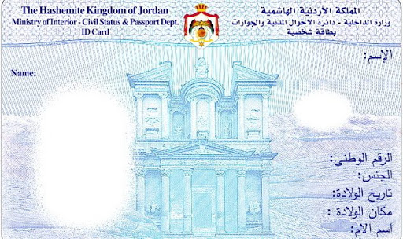

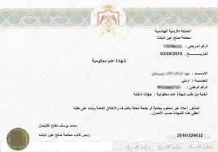
Motivation and Problem

Slide 5
Motivation and Problem
What are the locations of the government departments to perform the required transaction?
What are the documents that must be provided?
What are the procedures required to complete the transaction?
What is the cost required for transaction?
Can I get the transaction online?

Slide 6

Application Layout

Slide 7
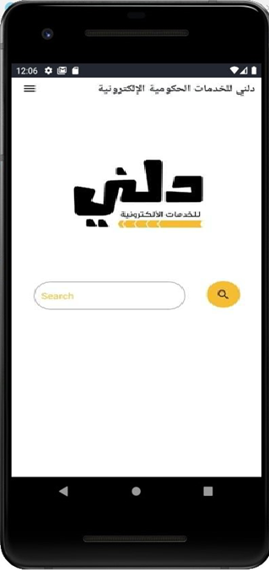
Application Layout

Slide 8
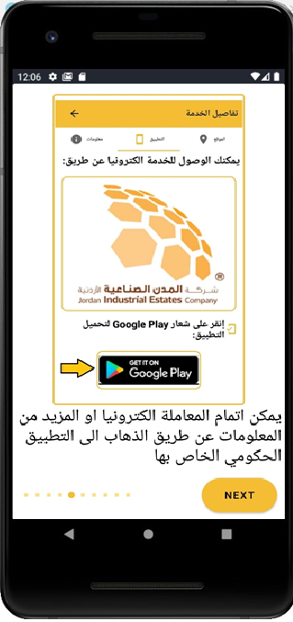
Application Layout

Slide 9
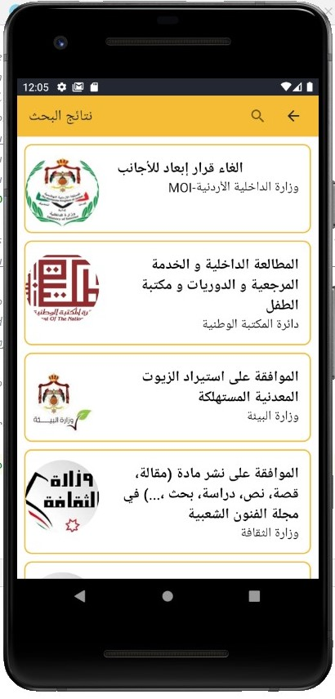
Application Layout

Slide 10
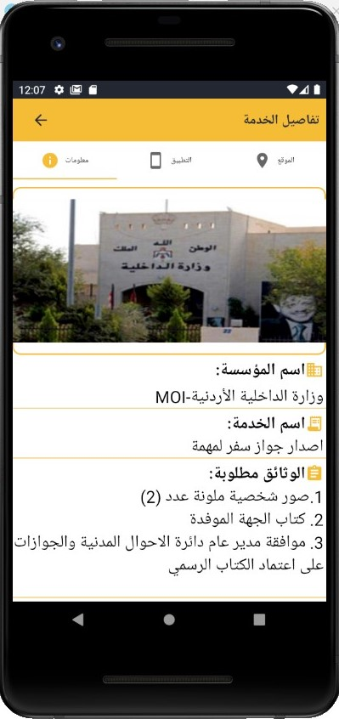
Application Layout

Slide 11
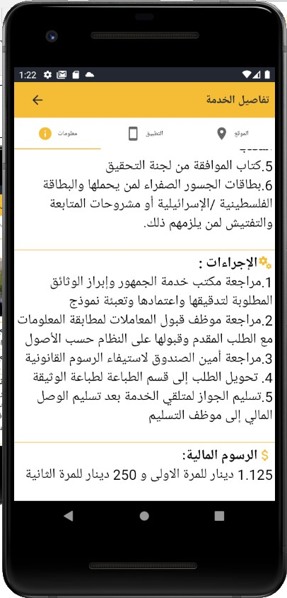
Application Layout

Slide 12
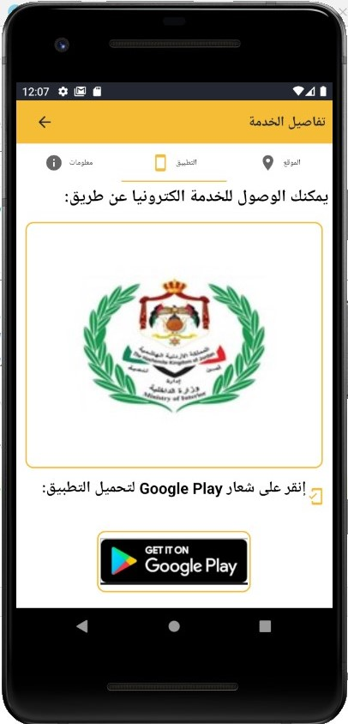
Application Layout

Slide 13
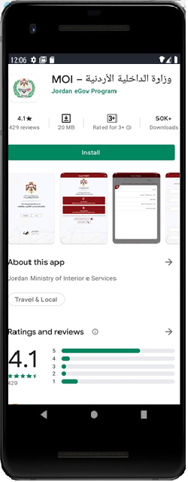
Application Layout

Slide 14
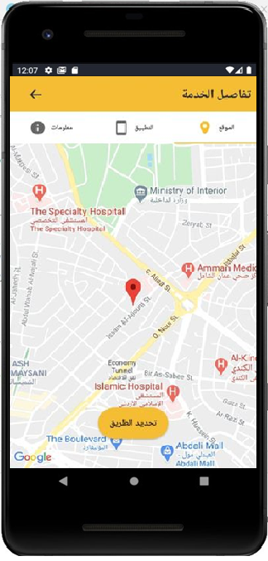
Application Layout

Slide 15
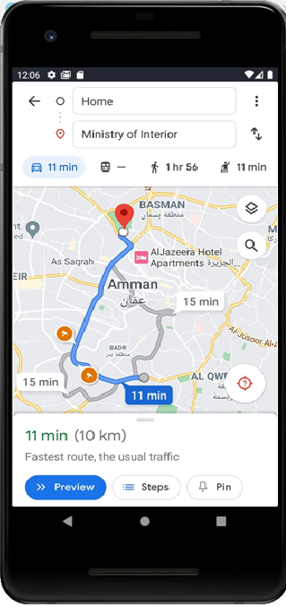
Application Layout

Slide 16
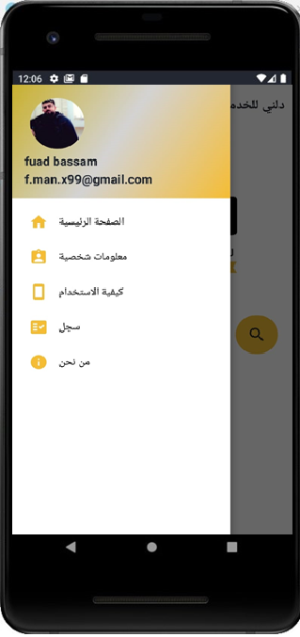
Application Layout

Slide 17
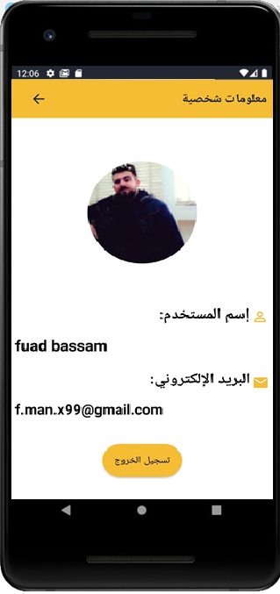
Application Layout

Slide 18
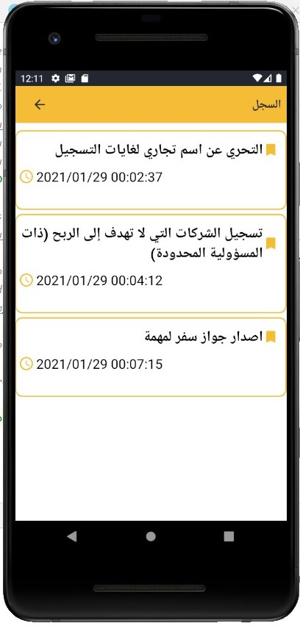
Application Layout

Slide 19
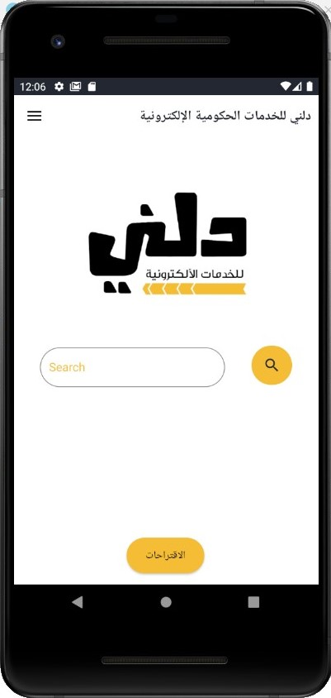
Application Layout

Slide 20
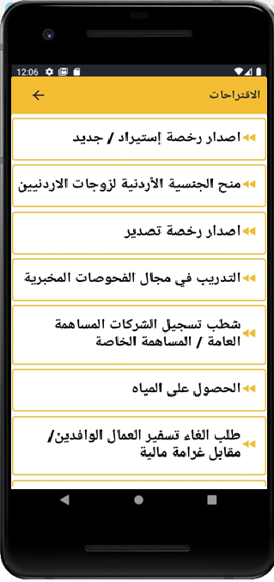
Application Layout

Slide 21
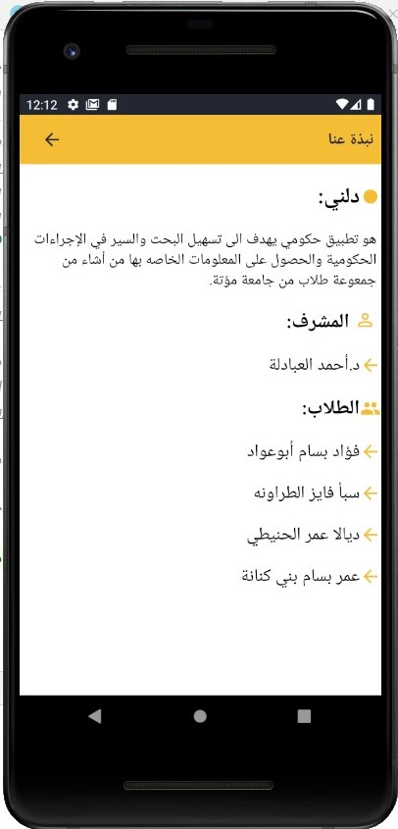
Application Layout

Slide 22
Requirements Elicitation and Analysis
Requirements Elicitation and Analysis: ​
Interviews​.
Observation.​
Internet.

Slide 23
Requirements Specifications
1.Functional requirements​.
2.non-Functional requirements.​
Security.​
Maintainability.​
Reliability​.
Availability.​
Usability​.
Portability.

Slide 24
Firebase Database
What is firebase ?
How it works?
Why do we need firebase in Android?

Slide 25
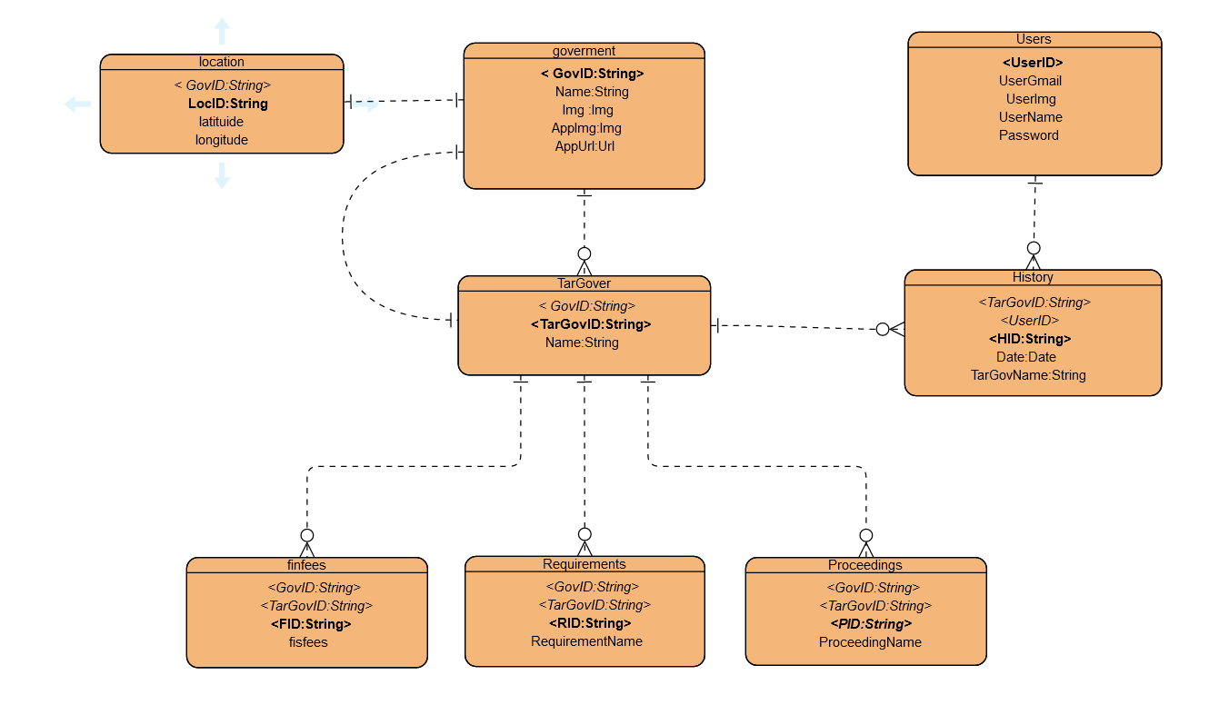
ER Diagrams

Slide 26
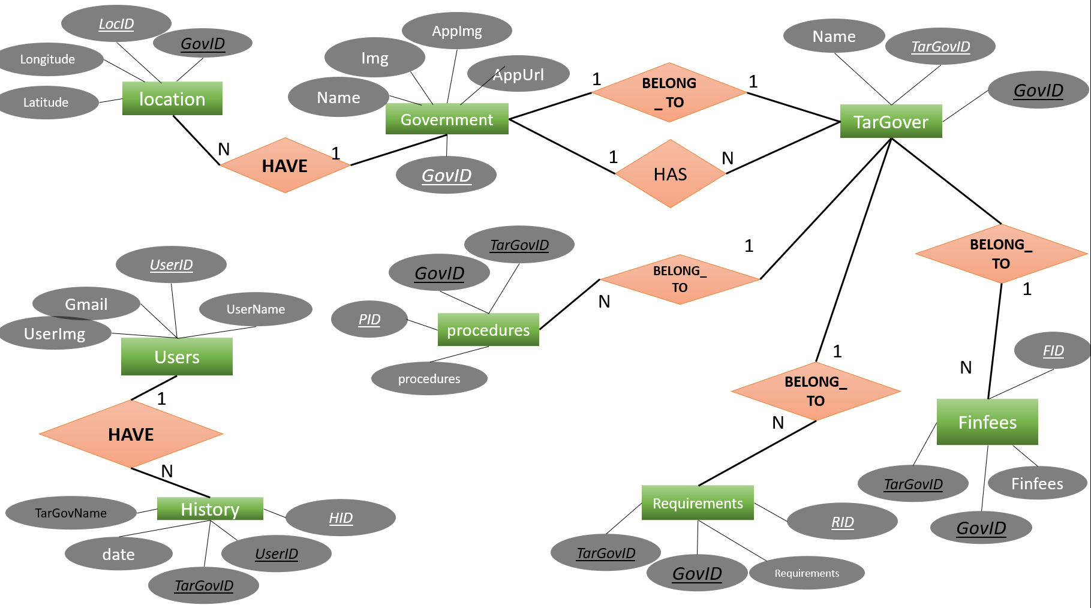

Slide 27
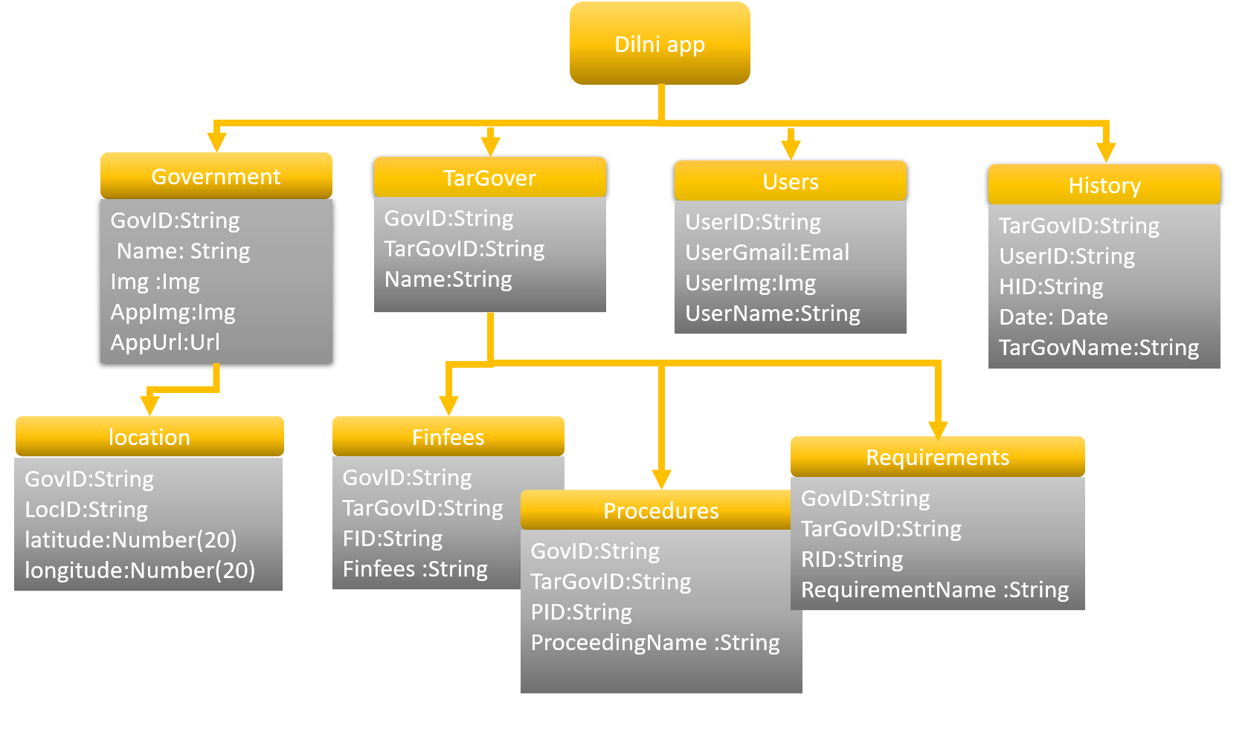

Slide 28
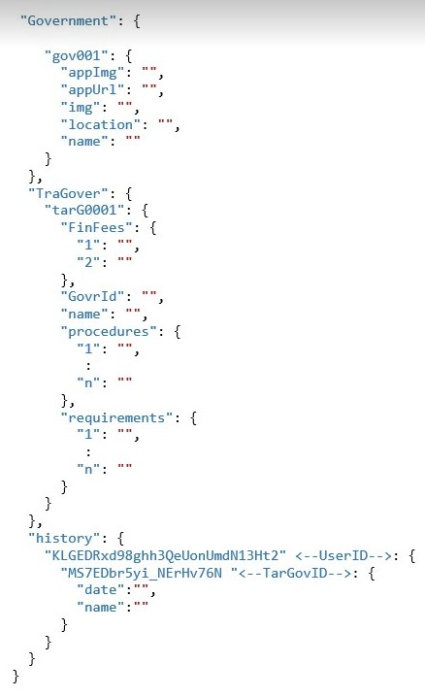

Slide 29
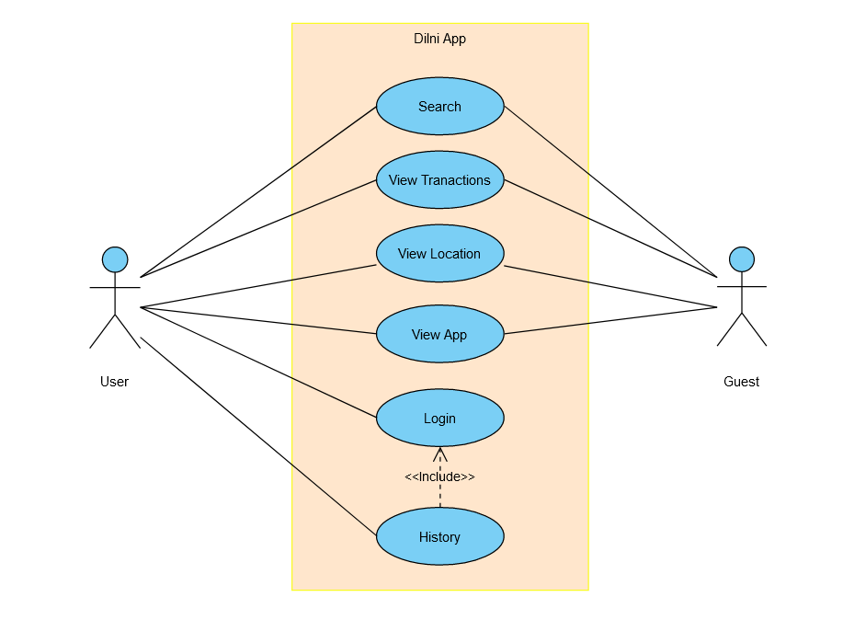
Use Case Diagram

Slide 30
Thank You
For
Your Attention

Slide 31
Questions
?

Slide 32
Dilni For Governmental Services
Student Name | Student ID#
Omar Bani Kenana | 120172203002
Fu’ad Abu Awad | 120172201011
Saba Tarawneh | 120172203039
Diala Al-Huniti | 120172203054
Advisor Name Dr. Ahmad Al-Abadleh

