Slide 1
Helicopter Model Summary

Slide 2
Nomenclature

Slide 3
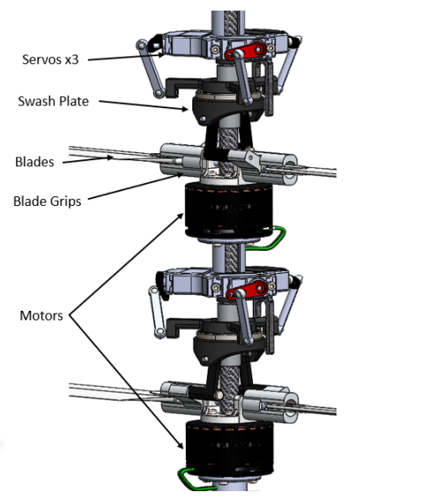
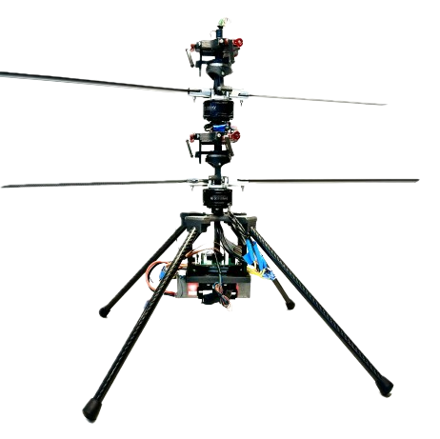










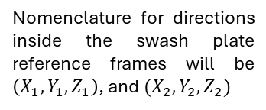












Diagram and Reference Frames 1
Frames of Reference
Nomenclature for directions inside the swash plate reference frames will be $\left(X_{1},Y_{1},Z_{1}\right)$, and $(X_{2},Y_{2},Z_{2})$
$$O_{3}$$
Heave Angle
$$O_{1}$$
$$p$$
$$u$$
$$v$$
$$x′$$
$$ω_{⊤}$$
$$q$$
Rotor Spacing
$$y′$$
$$w$$
$$\underline{r}$$
$$w$$
$$z′$$
$$O_{4}$$
Heave Angle
$$O_{0}$$
$$φ$$
$$x$$
$$ω_{⊥}$$
$$θ$$
$$y$$
$$ψ$$
$$z$$

Slide 4
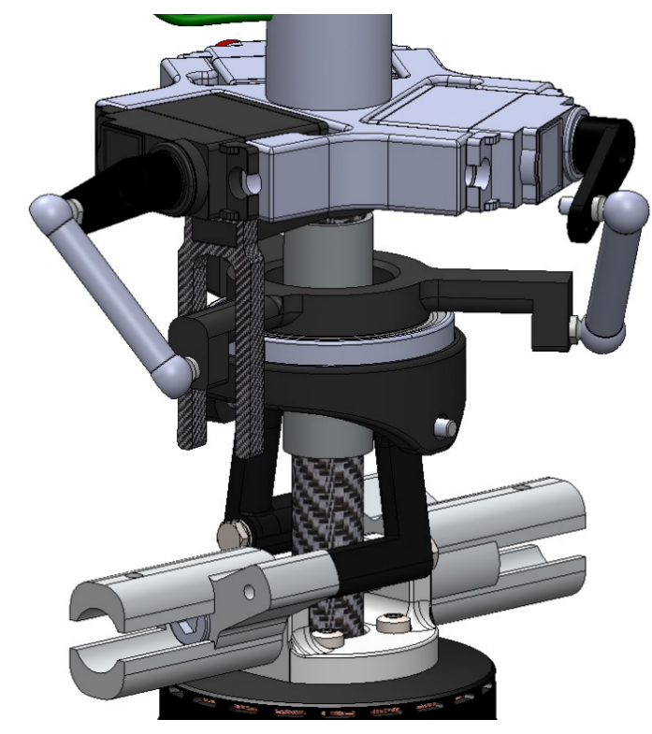
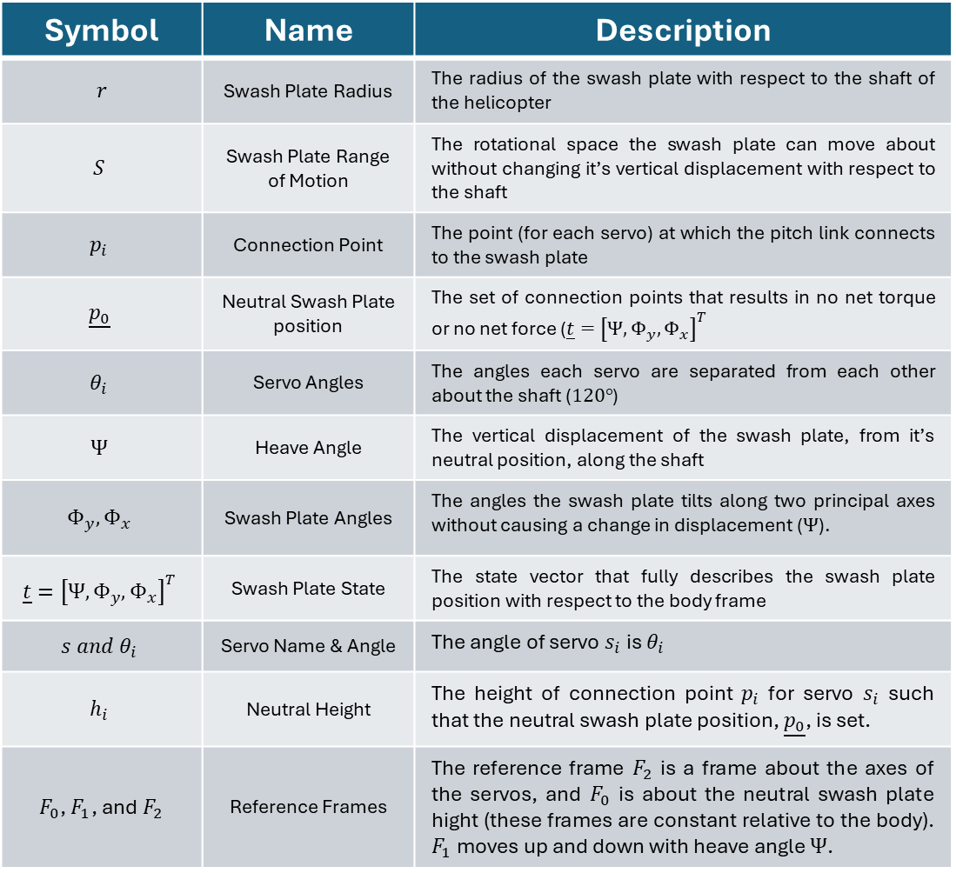
Diagram and Reference Frames 2
Nomenclature and Definitions
Symbol | Name | Description
$$r$$ | Swash Plate Radius | The radius of the swash plate with respect to the shaft of the helicopter
$$S$$ | Swash Plate Range of Motion | The rotational space the swash plate can move about without changing it’s vertical displacement with respect to the shaft
$$p_{i}$$ | Connection Point | The point (for each servo) at which the pitch link connects to the swash plate
$$\underline{p_{0}}$$ | Neutral Swash Plate position | The set of connection points that results in no net torque or no net force ($\underline{t}={\left[Ψ, Φ_{y},Φ_{x}\right]}^{T}$
$$θ_{i}$$ | Servo Angles | The angles each servo are separated from each other about the shaft ($120°$)
$$Ψ$$ | Heave Angle | The vertical displacement of the swash plate, from it’s neutral position, along the shaft
$$Φ_{y},Φ_{x}$$ | Swash Plate Angles | The angles the swash plate tilts along two principal axes without causing a change in displacement ($Ψ$).
$$\underline{t}={\left[Ψ,Φ_{y},Φ_{x}\right]}^{T}$$ | Swash Plate State | The state vector that fully describes the swash plate position with respect to the body frame
$$s{ and θ}_{i}$$ | Servo Name & Angle | The angle of servo $s_{i}$ is $θ_{i}$
$$h_{i}$$ | Neutral Height | The height of connection point $p_{i}$ for servo $s_{i}$ such that the neutral swash plate position, $\underline{p_{0}}$, is set.
$F_{0}$, $F_{1}$, and $F_{2}$ | Reference Frames | The reference frame $F_{2}$ is a frame about the axes of the servos, and $F_{0}$ is about the neutral swash plate hight (these frames are constant relative to the body). $F_{1}$ moves up and down with heave angle $Ψ$.
Servo
Rotation-Locking Fork
Servo Arm
Pitch Link
Connection Point
Swash Plate
shaft

Slide 5
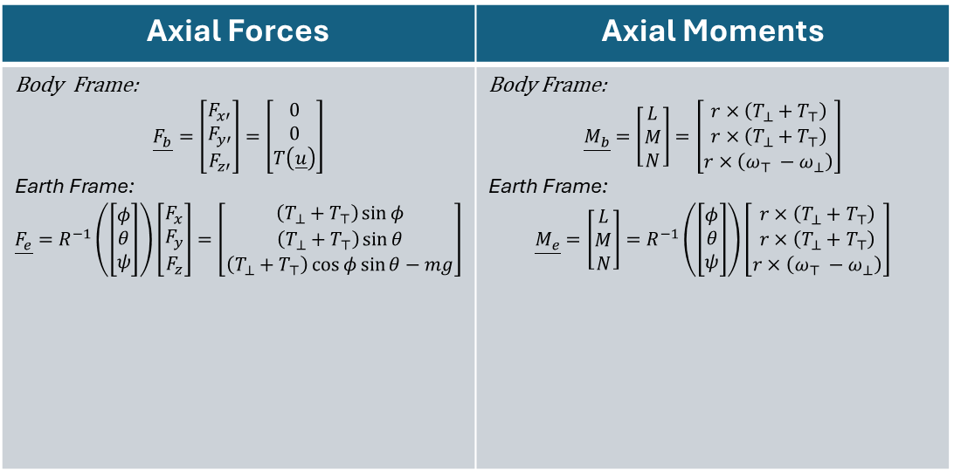
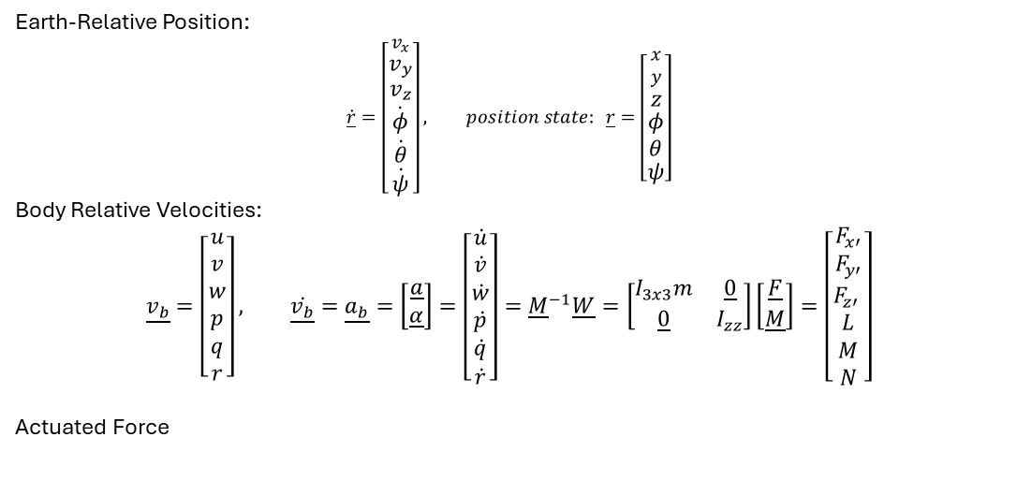
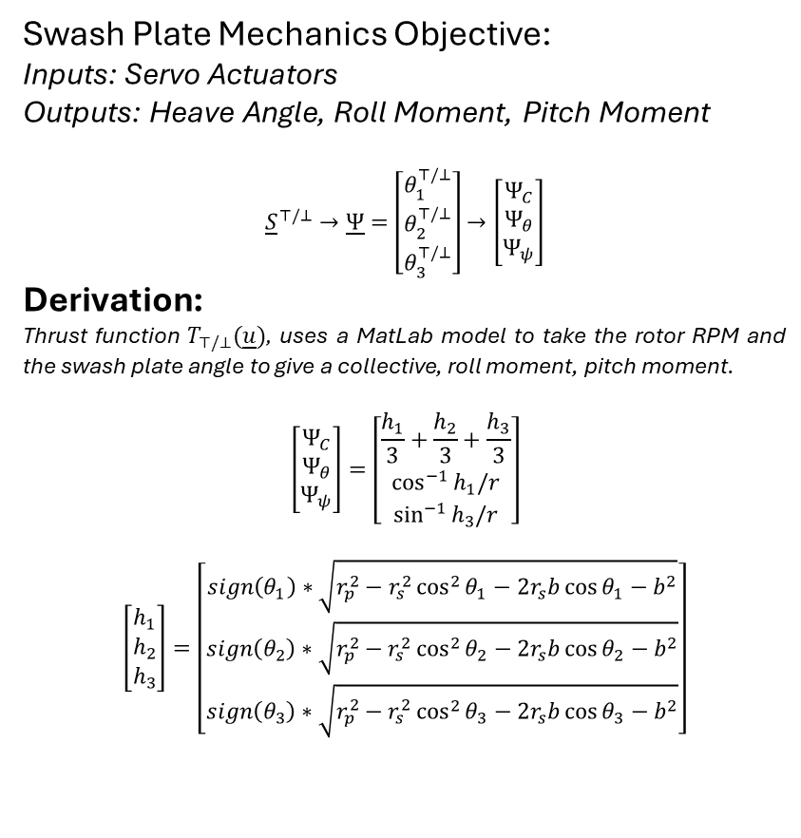
Helicopter Equations of Motion
Swash Plate
Earth-Relative Position:
$$\dot{\underline{r}}=\left[\begin{matrix}v_{x} \\ v_{y} \\ v_{z} \\ \dot{φ} \\ \dot{θ} \\ \dot{ψ}\end{matrix}\right], position state: \underline{r}=\left[\begin{matrix}x \\ y \\ z \\ φ \\ θ \\ ψ\end{matrix}\right]$$
Body Relative Velocities:
$$\underline{v_{b}}=\left[\begin{matrix}u \\ v \\ w \\ p \\ q \\ r\end{matrix}\right], \dot{\underline{v_{b}}}=\underline{a_{b}}=\left[\begin{matrix}\underline{a} \\ \underline{α}\end{matrix}\right]=\left[\begin{matrix}\dot{u} \\ \dot{v} \\ \dot{w} \\ \dot{p} \\ \dot{q} \\ \dot{r}\end{matrix}\right]={\underline{M}}^{−1}\underline{W}=\left[\begin{matrix}I_{3x3}m & \underline{0} \\ \underline{0} & I_{zz}\end{matrix}\right]\left[\begin{matrix}\underline{F} \\ \underline{M}\end{matrix}\right]=\left[\begin{matrix}F_{x′} \\ F_{y′} \\ F_{z′} \\ L \\ M \\ N\end{matrix}\right]$$
Actuated Force
Swash Plate Mechanics Objective:
Inputs: Servo Actuators
Outputs: Heave Angle, Roll Moment, Pitch Moment
$${\underline{S}}^{⊤/⊥}→\underline{Ψ}=\left[\begin{matrix}θ_{1}^{⊤/⊥} \\ θ_{2}^{⊤/⊥} \\ θ_{3}^{⊤/⊥}\end{matrix}\right]→\left[\begin{matrix}Ψ_{C} \\ Ψ_{θ} \\ Ψ_{ψ}\end{matrix}\right]$$
Derivation:
Thrust function $T_{⊤/⊥}(\underline{u})$, uses a MatLab model to take the rotor RPM and the swash plate angle to give a collective, roll moment, pitch moment.
$$\left[\begin{matrix}Ψ_{C} \\ Ψ_{θ} \\ Ψ_{ψ}\end{matrix}\right]=\left[\begin{matrix}\frac{h_{1}}{3}+\frac{h_{2}}{3}+\frac{h_{3}}{3} \\ \cos^{−1}{h_{1}/r} \\ \sin^{−1}{h_{3}/r}\end{matrix}\right]$$
$$\left[\begin{matrix}h_{1} \\ h_{2} \\ h_{3}\end{matrix}\right]=\left[\begin{matrix}sign\left(θ_{1}\right)∗\sqrt{r_{p}^{2}−r_{s}^{2}\cos^{2}{θ_{1}}−2r_{s}b\cos{θ_{1}−b^{2}}} \\ sign\left(θ_{2}\right)∗\sqrt{r_{p}^{2}−r_{s}^{2}\cos^{2}{θ_{2}}−2r_{s}b\cos{θ_{2}−b^{2}}} \\ sign\left(θ_{3}\right)∗\sqrt{r_{p}^{2}−r_{s}^{2}\cos^{2}{θ_{3}}−2r_{s}b\cos{θ_{3}−b^{2}}}\end{matrix}\right]$$
Axial Forces | Axial Moments
Body Frame: $$\underline{F_{b}}=\left[\begin{matrix}F_{x′} \\ F_{y′} \\ F_{z′}\end{matrix}\right]=\left[\begin{matrix}0 \\ 0 \\ T\left(\underline{u}\right)\end{matrix}\right]$$ Earth Frame: $$\underline{F_{e}}=R^{−1}\left(\left[\begin{matrix}φ \\ θ \\ ψ\end{matrix}\right]\right)\left[\begin{matrix}F_{x} \\ F_{y} \\ F_{z}\end{matrix}\right]=\left[\begin{matrix}\left(T_{⊥}+T_{⊤}\right)\sin{φ} \\ \left(T_{⊥}+T_{⊤}\right)\sin{θ} \\ \left(T_{⊥}+T_{⊤}\right)\cos{φ}sin{θ}−mg\end{matrix}\right]$$ | Body Frame: $$\underline{M_{b}}=\left[\begin{matrix}L \\ M \\ N\end{matrix}\right]=\left[\begin{matrix}r×\left(T_{⊥}+T_{⊤}\right) \\ r×\left(T_{⊥}+T_{⊤}\right) \\ r×\left(ω_{⊤} −ω_{⊥}\right)\end{matrix}\right]$$ Earth Frame: $$\underline{M_{e}}=\left[\begin{matrix}L \\ M \\ N\end{matrix}\right]=R^{−1}\left(\left[\begin{matrix}φ \\ θ \\ ψ\end{matrix}\right]\right)\left[\begin{matrix}r×\left(T_{⊥}+T_{⊤}\right) \\ r×\left(T_{⊥}+T_{⊤}\right) \\ r×\left(ω_{⊤} −ω_{⊥}\right)\end{matrix}\right]$$

Slide 6
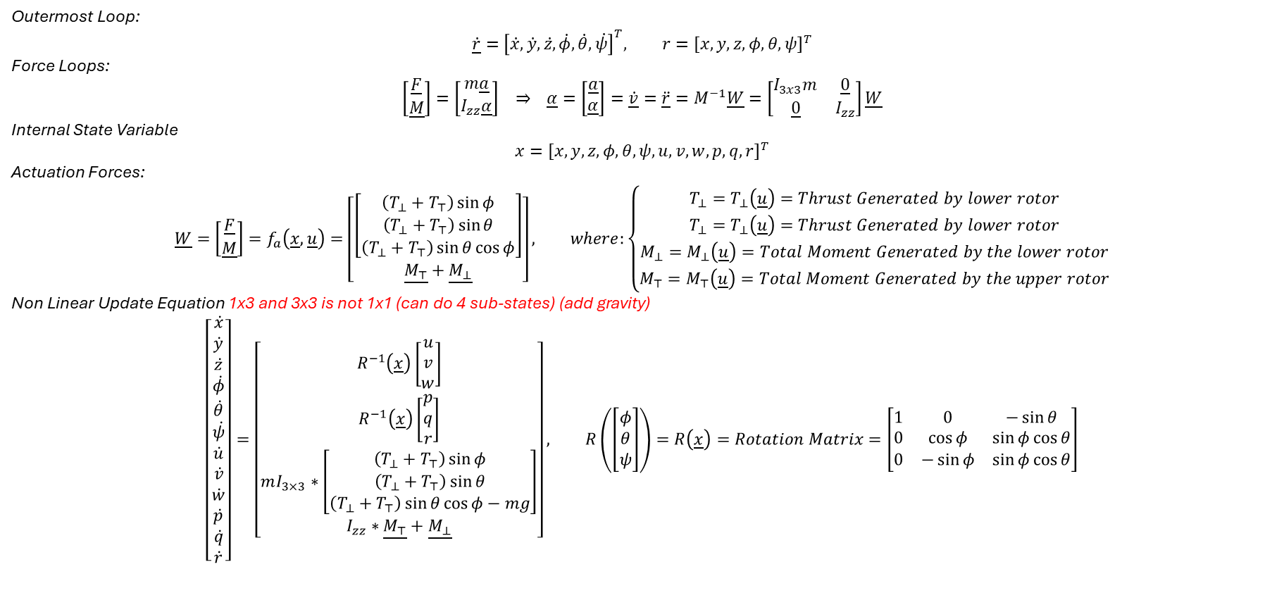
State Space Representation
Outermost Loop:
$$\dot{\underline{r}}={\left[\dot{x},\dot{y},\dot{z},\dot{φ},\dot{θ},\dot{ψ}\right]}^{T}, r={\left[x,y,z,φ,θ,ψ\right]}^{T}$$
Force Loops:
$$\left[\begin{matrix}\underline{F} \\ \underline{M}\end{matrix}\right]=\left[\begin{matrix}m\underline{a} \\ I_{zz}\underline{α}\end{matrix}\right] ⇒ \underline{α}=\left[\begin{matrix}\underline{a} \\ \underline{α}\end{matrix}\right]=\underline{\dot{v}}=\underline{\ddot{r}}=M^{−1}\underline{W}=\left[\begin{matrix}I_{3x3}m & \underline{0} \\ \underline{0} & I_{zz}\end{matrix}\right]\underline{W}$$
Internal State Variable
$$x={\left[x,y,z,φ,θ,ψ,u,v,w,p,q,r\right]}^{T}$$
Actuation Forces:
$$\underline{W}=\left[\begin{matrix}\underline{F} \\ \underline{M}\end{matrix}\right]=f_{a}\left(\underline{x},\underline{u}\right)=\left[\begin{matrix}\left[\begin{matrix}\left(T_{⊥}+T_{⊤}\right)\sin{φ} \\ \left(T_{⊥}+T_{⊤}\right)\sin{θ} \\ \left(T_{⊥}+T_{⊤}\right)\sin{θ\cos{φ}}\end{matrix}\right] \\ \underline{M_{⊤}}+\underline{M_{⊥}}\end{matrix}\right], where:\left\{\begin{aligned}T_{⊥}=T_{⊥}\left(\underline{u}\right)=Thrust Generated by lower rotor \\ T_{⊥}=T_{⊥}\left(\underline{u}\right)=Thrust Generated by lower rotor \\ M_{⊥}=M_{⊥}\left(\underline{u}\right)=Total Moment Generated by the lower rotor \\ M_{⊤}=M_{⊤}\left(\underline{u}\right)=Total Moment Generated by the upper rotor\end{aligned}\right.$$
Non Linear Update Equation 1x3 and 3x3 is not 1x1 (can do 4 sub-states) (add gravity)
$$\left[\begin{matrix}\dot{x} \\ \dot{y} \\ \dot{z} \\ \dot{φ} \\ \dot{θ} \\ \dot{ψ} \\ \dot{u} \\ \dot{v} \\ \dot{w} \\ \dot{p} \\ \dot{q} \\ \dot{r}\end{matrix}\right]=\left[\begin{matrix}R^{−1}\left(\underline{x}\right)\left[\begin{matrix}u \\ v \\ w\end{matrix}\right] \\ R^{−1}\left(\underline{x}\right)\left[\begin{matrix}p \\ q \\ r\end{matrix}\right] \\ mI_{3×3}∗\left[\begin{matrix}\left(T_{⊥}+T_{⊤}\right)\sin{φ} \\ \left(T_{⊥}+T_{⊤}\right)\sin{θ} \\ \left(T_{⊥}+T_{⊤}\right)\sin{θ\cos{φ}}−mg\end{matrix}\right] \\ I_{zz}∗\underline{M_{⊤}}+\underline{M_{⊥}}\end{matrix}\right], R\left(\left[\begin{matrix}φ \\ θ \\ ψ\end{matrix}\right]\right)=R\left(\underline{x}\right)=Rotation Matrix=\left[\begin{matrix}1 & 0 & −\sin{θ} \\ 0 & \cos{φ} & \sin{φ}\cos{θ} \\ 0 & −\sin{φ} & \sin{φ}\cos{θ}\end{matrix}\right]$$
Outermost Loop to Innermost Loop

Slide 7
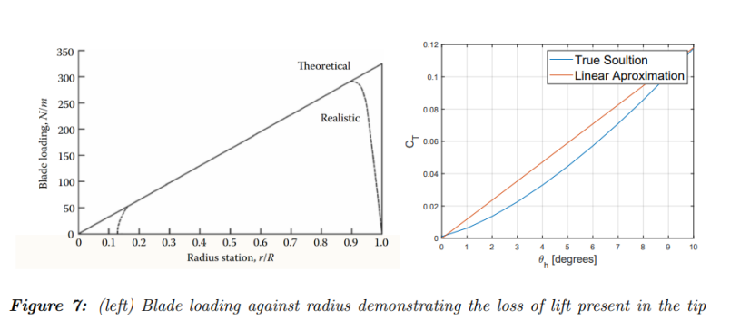
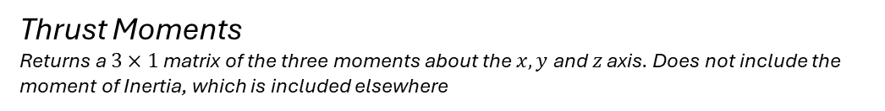
Non-Derived Functions
Axial Thrust
Using Equations as described by Papworth et al.
Thrust Moments
Returns a $3×1$ matrix of the three moments about the $x, y$ and $z$ axis. Does not include the moment of Inertia, which is included elsewhere
Note that the true solution will be used, not the linear approximation.
- https://repo.poltekbangsby.ac.id/id/eprint/83/1/Fundamentals%20of%20Helicopter%20Dynamics%20by%20Venkatesan%2C%20C%20%28z-lib.org%29.pdf
- https://www.mdpi.com/2073-8994/12/11/1834

Slide 8
