Slide 1




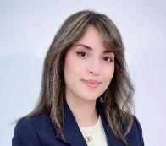
Mhamed Mehdi KALLALA
Second-year student in the computer science engineering program (fourth year of the ESPRIT program) passionate about data analysis and software development.
Introductory Internship
Compétences Principales
C • Java • Python • SQL • Spring Boot • JavaFX • Maven • Git • Glade • IntelliJ IDEA • SSIS • SSAS • Power BI • MySQL • Pandas • NumPy • Scikit-learn • Matplotlib • Seaborn
Verdanova Solutions (AgriTech) | Introductory Internship :
Development of a showcase website to promote mobile and web solutions dedicated to the agricultural sector.
Formation
Computer Engineering Program - Computer Engineering - ESPRIT Ariana (2024 – Present)
MP Preparatory Program - Mathematics and Physics - IPEIM Monastir (2022 – 2024)
High School Diploma in Mathematics - Mathematics - Monastir (2022)
Principales Réalisations & Références

Slide 2
Mhamed Mehdi KALLALA
Introductory Internship
Principales Réalisations & Références

